Slide 1


Slide 2

Radio 1’s Big Weekend is the stations’ flagship event each year Hull is the 16th Big Weekend, previous host cities include Glasgow, Derry Londonderry, Bangor, Norwich & Exeter Artists performing this year include Katy Parry, Little Mix, Kings of Leon and Stormzy Radio 1 reaches 42% of all 15-24 year olds in the UK Radio 1’s Big Weekend Hull will be a major part of Hull UK City of Culture 2017 The event is covered on BBC Radio 1, BBC Radio 1 Extra, BBC iPlayer and BBC Red Button.

Slide 3
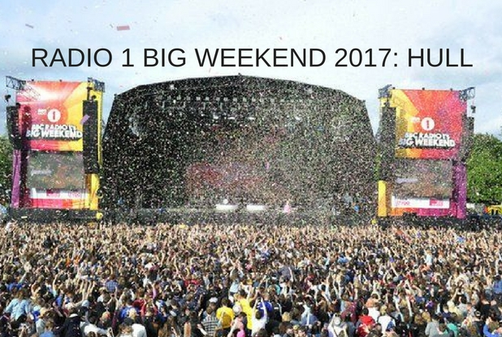
ECONOMIC BENEFITS Radio 1 Big Weekend brought over £3.5m to the local economy in Exeter and Teignbridge An average spend of £58 per person (off site) Exeter recorded 100% hotel occupancy across Big Weekend Glasgow estimated a Press and Marketing value of £10.2m

Slide 4
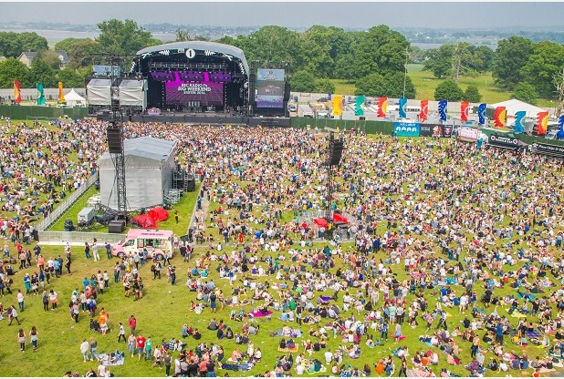
Exeter & Teignbridge “That was outstanding – the experience of a lifetime for me and much of Devon. Thanks from the bottom of my heart” – Earl of Devon “It’s been a memorable weekend for the people of Teignbridge and one which has truly put our wonderful region on the the national and world stage. In years to come, this will still be the talk of Teignbridge and it’s a proud chapter in our local history. Such a huge event would not have been possible without the support of our residents” – Cllr Jeremy Christophers, Leader, Teignbrdige Council.

