Slide 1

WELCOME
THE MERCURE HOTEL
MONDAY 21ST NOVEMBER 2016
WOW Thinkin

Slide 2

HENRIETTA DUCKWORTH
Executive Producer
Hull UK City of Culture 2017
WOW Thinkin

Slide 3
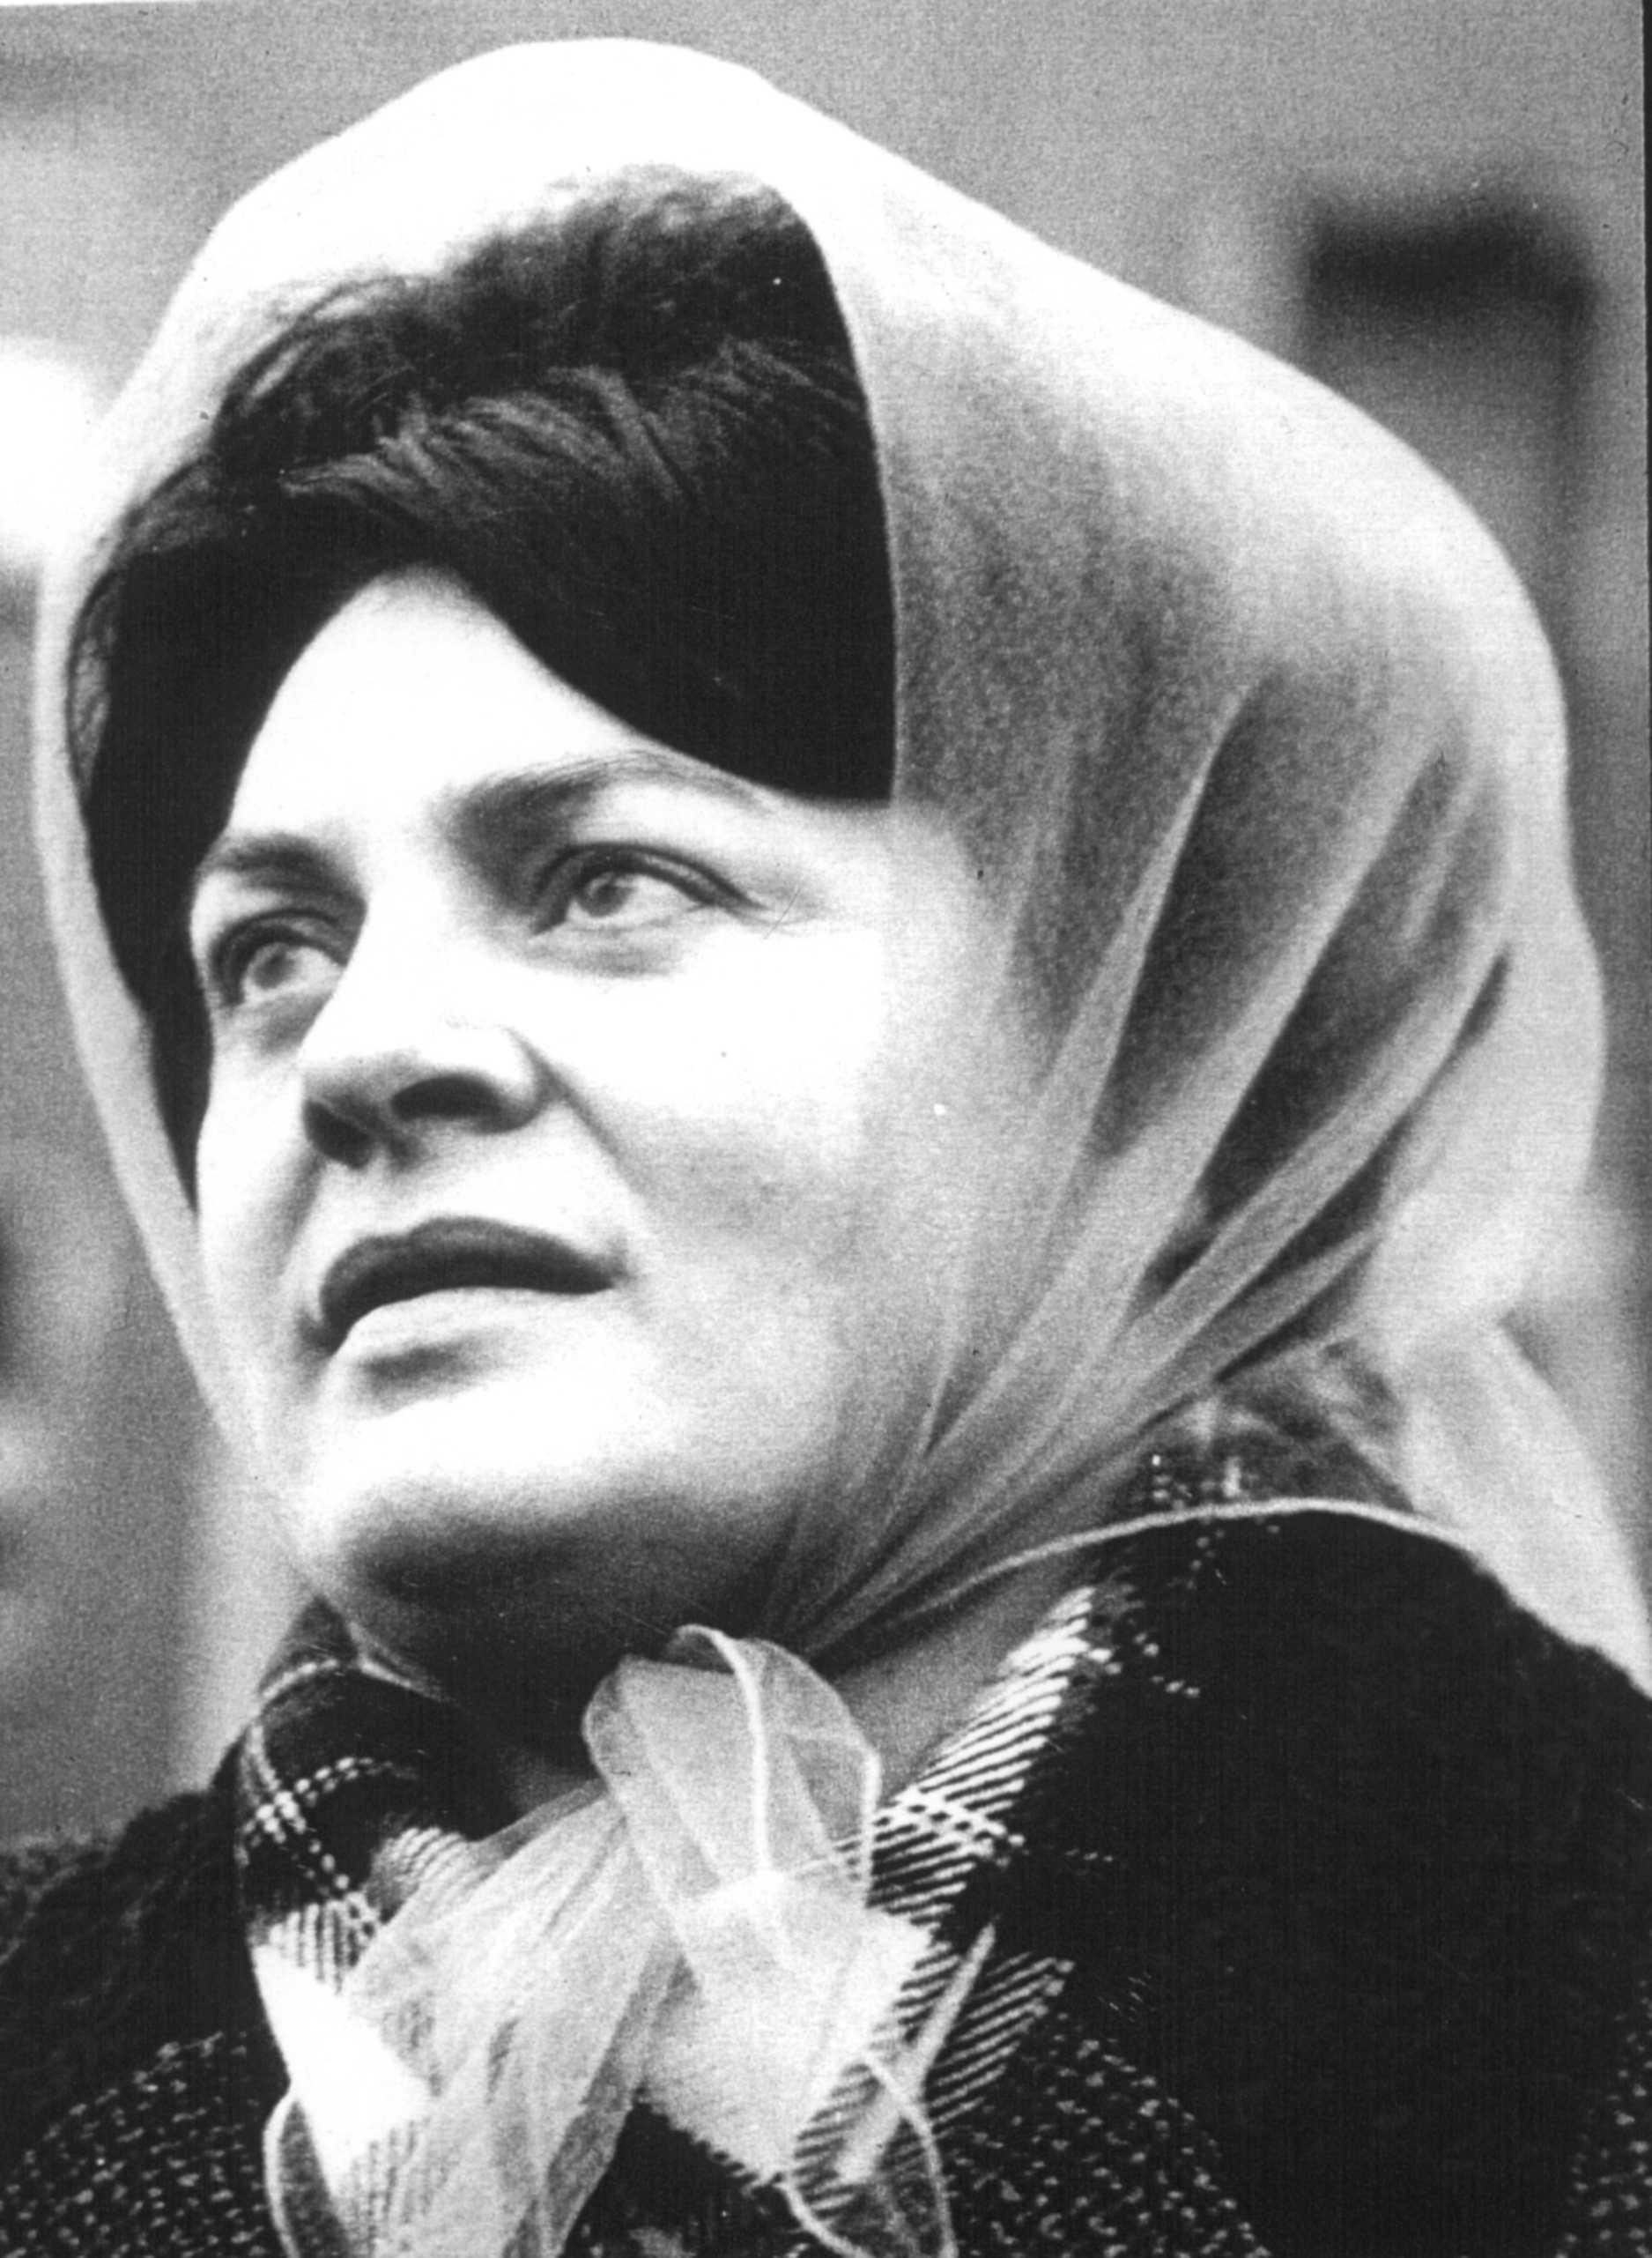
WOW HULL
10 – 12 MARCH 2017
#WOWHULL
HULL2017.CO.UK/WOWHULL
@2017HULL
WOW Thinkin
Lillian Bilocca
Trawler Safety Campaigner
Photo: © Hull Daily Mail

Slide 4
KATE FOX
Poet
WOW Thinkin

Slide 5
ROSIE MILLARD
Chair
Hull UK City of Culture 2017
WOW Thinkin

Slide 6
JUDE KELLY CBE
WOW Founder
Artistic Director
Southbank Centre London
WOW Thinkin

Slide 7
WOW PANEL
David ‘Burnsy’ Burns
Bea Campbell
Suzanne Clisby
Melanie Eusebe
Tish Lamb
WOW Thinkin

Slide 8
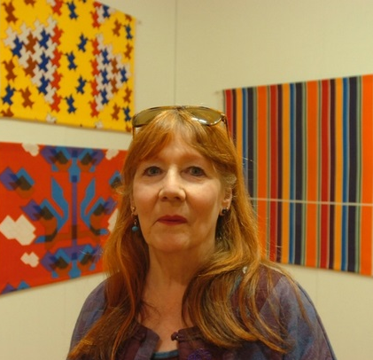
REVOLUTIONARY
MAKERS
IAN READ
Head of Learning & Participation
Hull UK City of Culture 2017
Shirley Craven
Textile Designer
Photo: © Hull Daily Mail

Slide 9
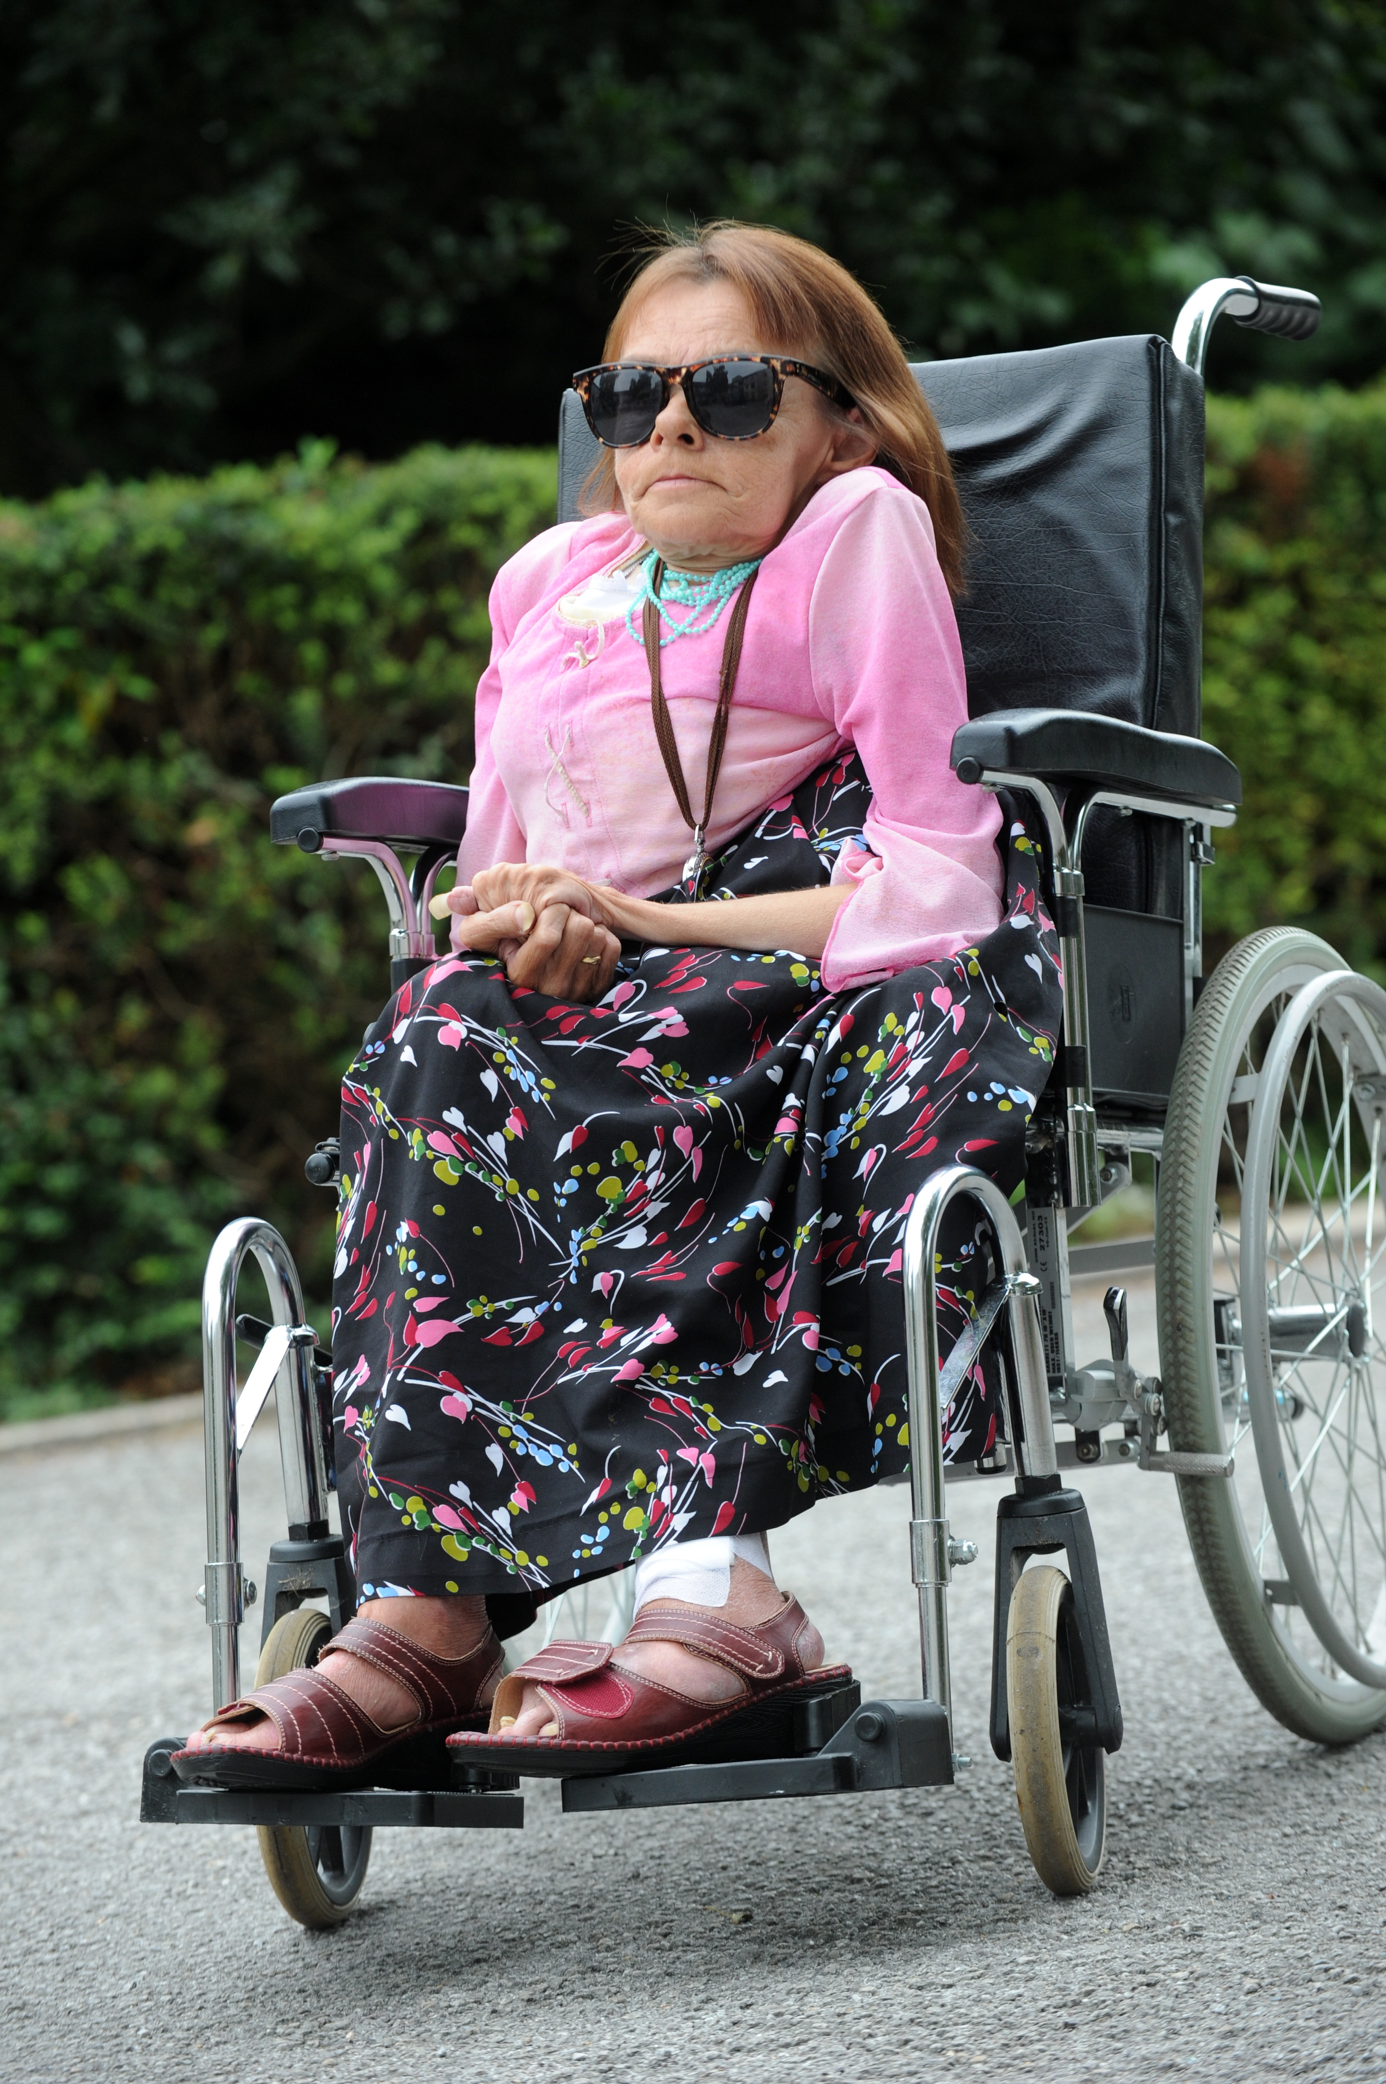
WOW HULL THINKIN
WOW Thinkin
Susie Meakin Clarke
Activist
Photo: © Hull Daily Mail

Slide 10
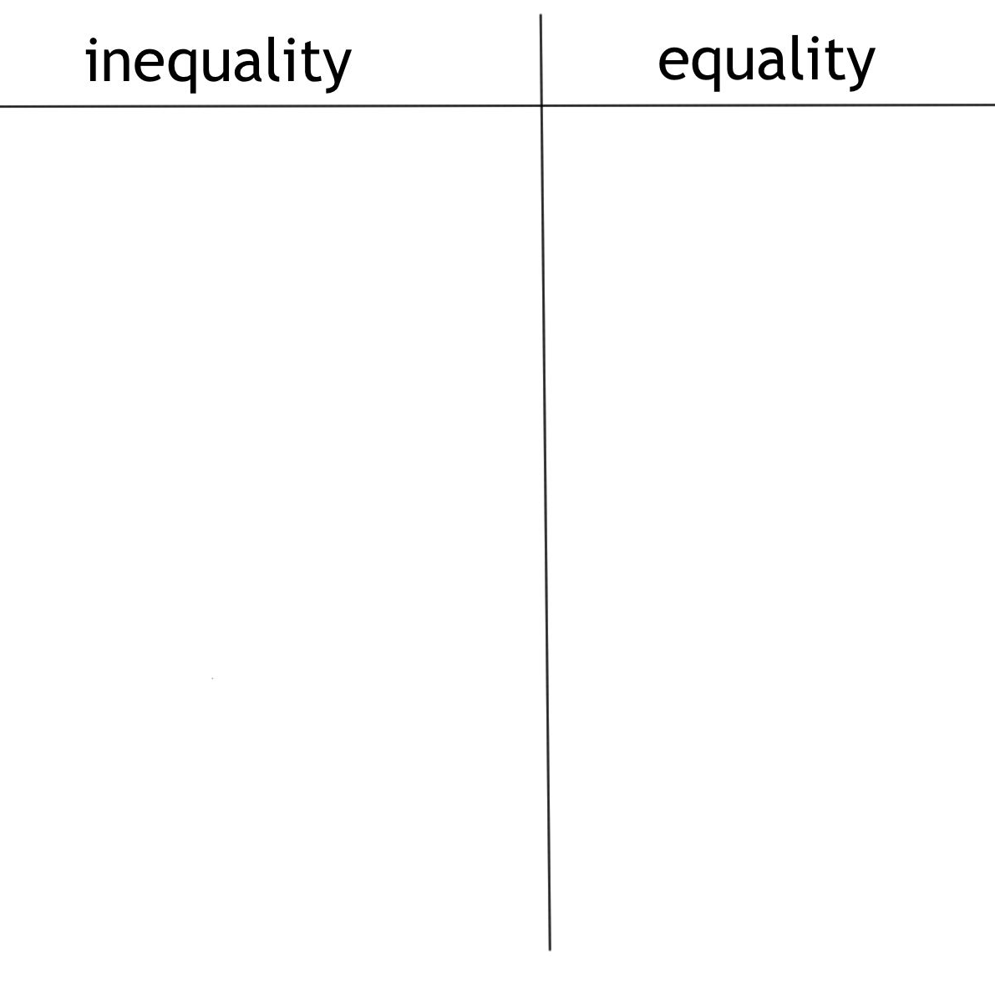
When have you experienced or witnessed gender inequality?
When have you experienced or witnessed gender equality?
WOW Thinkin

Slide 11
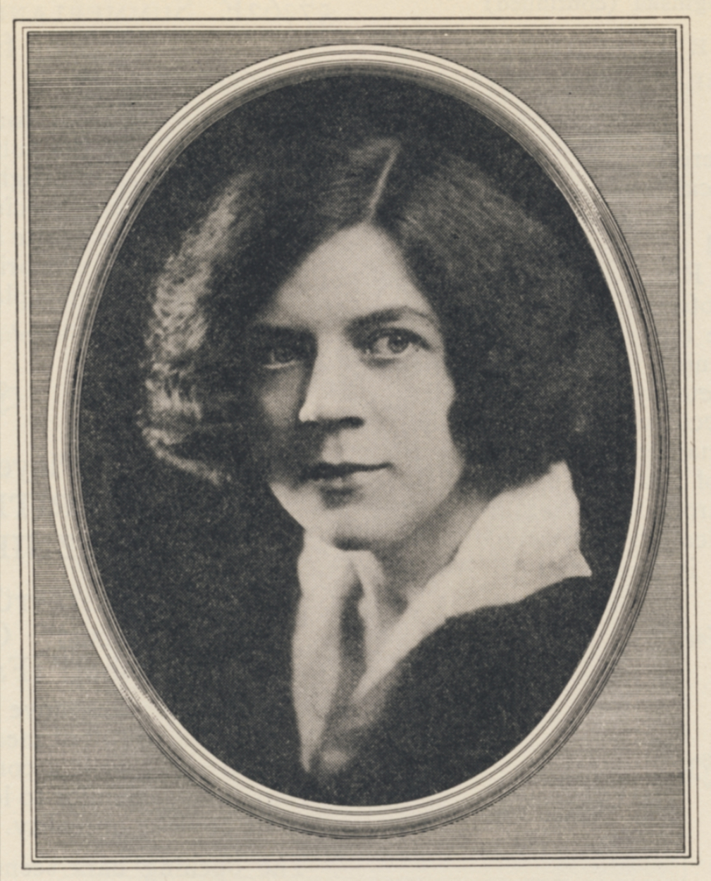
WOW HULL MANIFESTO
WHAT SHALL WE CHANGE?
PLEDGES
ACTIONS
WOW Thinkin
Ethel Leginska
Composer & Conductor

Slide 12
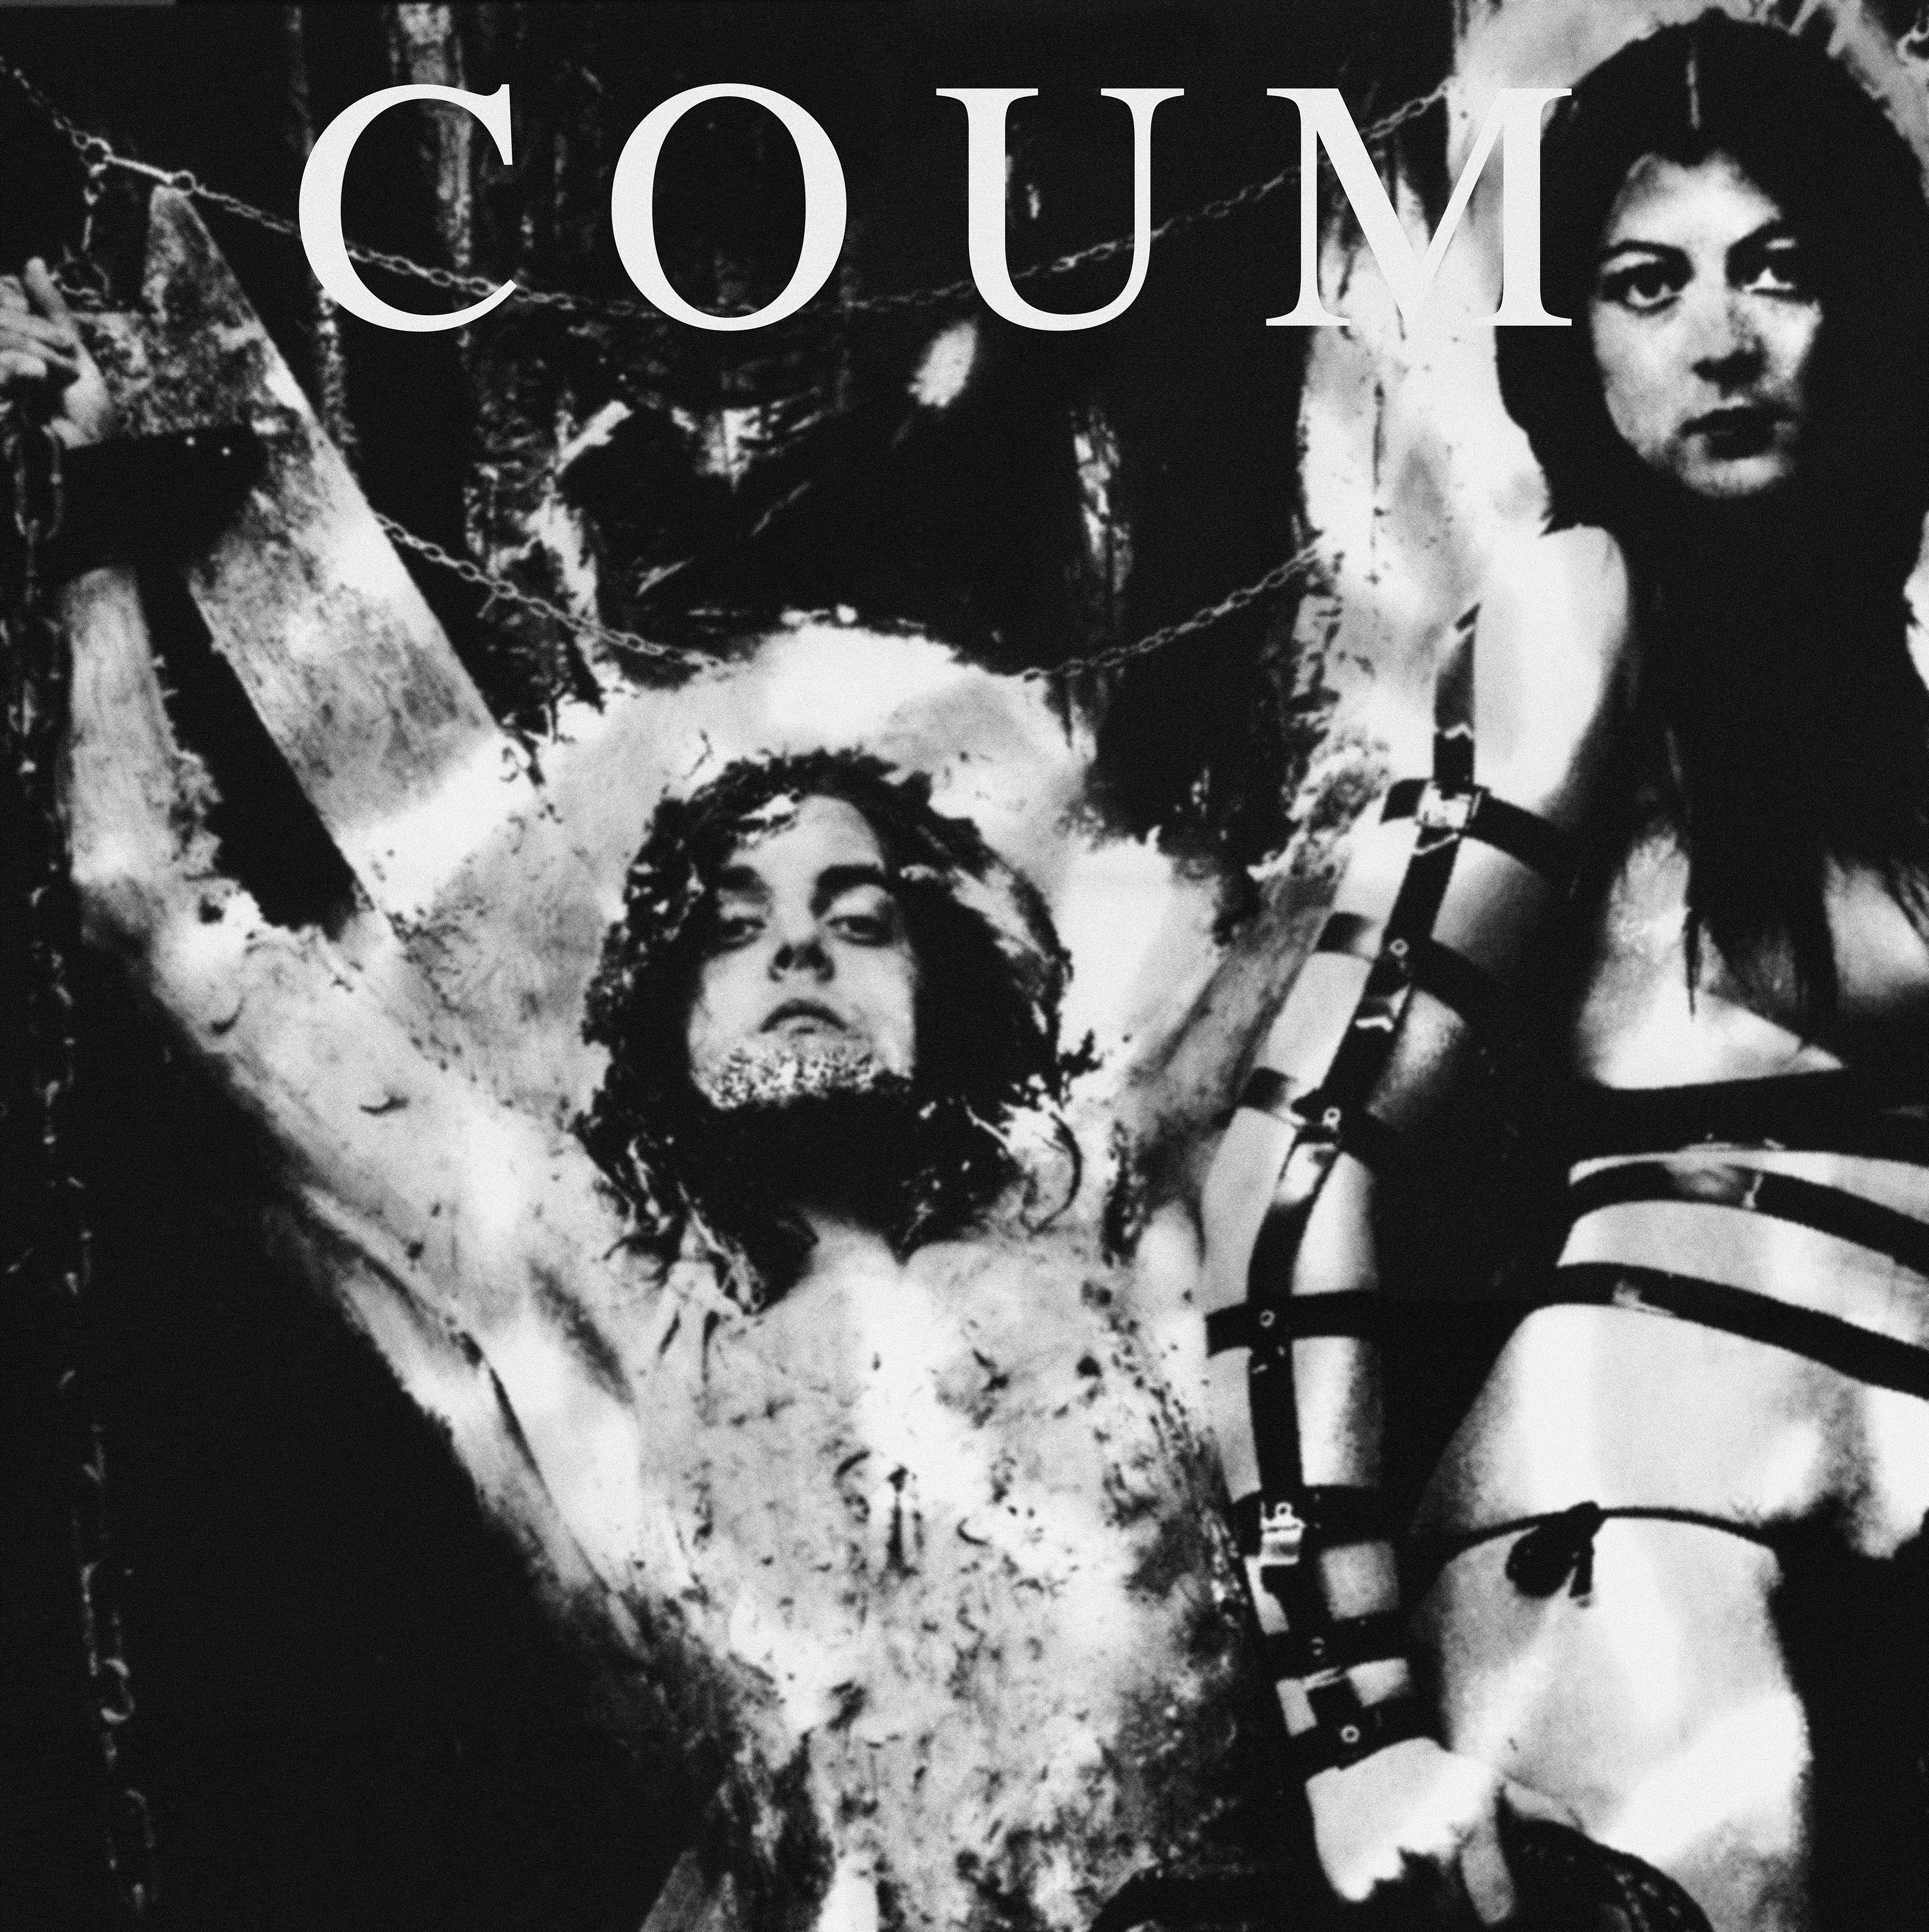
EXAMPLES OF PLEDGES
Equal representation in local politics
Equal broadcasting of men and women’s football in Hull
Empower everyone to challenge everyday sexism
Cosey Fanni Tutti
COUM Transmissions
Artist
Photo: © Coum Transmissions

Slide 13
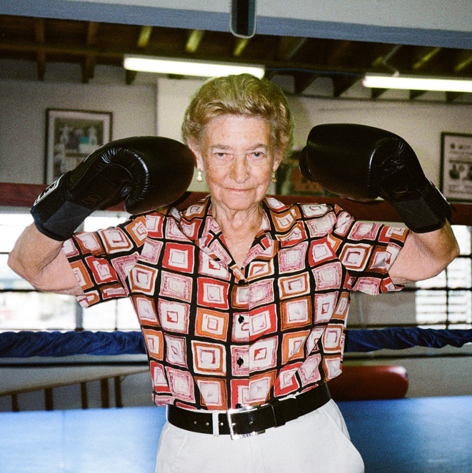
PLEDGES
1:
2:
3:
4:
5:
WOW Thinkin
Barbara Buttrick
Boxer
Photo: © Dana Goldstein

Slide 14
PLEDGES
6:
7:
8:
9:
10:
WOW Thinkin
Barbara Buttrick
Boxer
Photo: © Dana Goldstein

Slide 15
KATE FOX
Poet
WOW Thinkin

Slide 16
THANK YOU
WOW Thinkin

Slide 17
WOW HULL
10 – 12 March 2017
#WOWHULL
HULL2017.CO.UK/WOWHULL
@2017HULL
WOW Thinkin

Slide 18


