Slide 1

CREATIVE COMMUNITIES PROGRAMME
HENRIETTA DUCKWORTH
Executive Producer

Slide 2
CREATIVE COMMUNITIES PROGRAMME
ESSENTIAL CRITERIA

Slide 3

1 CELEBRATE ARTS & CULTURE
We’re looking for projects that:
Bring together community groups and artists to collaborate on a truly creative project
Use any form of arts or cultural activity in your project

Slide 4

2 OPEN TO ALL
We’re looking for projects that are inclusive and celebrate people of all backgrounds.
Projects must take place in a space or venue that can be accessed by everyone, whatever the size of the event or activity.
Applicants must work with and engage people in Hull to celebrate the city and challenge perceptions.
We would like to know what positive steps you intend to take to make sure your project embraces inclusivity across performers, participants and audience.

Slide 5

3 ENGAGE PEOPLE & COMMUNITIES IN HULL
We’re looking for projects that connect communities across the city and inspire engagement, such as:
Events that bring people together and create opportunities to participate.
Projects that involve and embody the spirit of local people and the area where they live.

Slide 6

4 BE MORE THAN THE EVERYDAY
UK City of Culture will only happen once in Hull. This is Hull’s chance to show what the city is really about.
We want people to create projects that do something extra, something special, something different to make Hull 2017 unique.
Go above and beyond your normal activities.
Be original, ambitious, radical and iconic.
Build a project that transforms Hull.
Give people the opportunity to see something new, unusual or exciting.

Slide 7
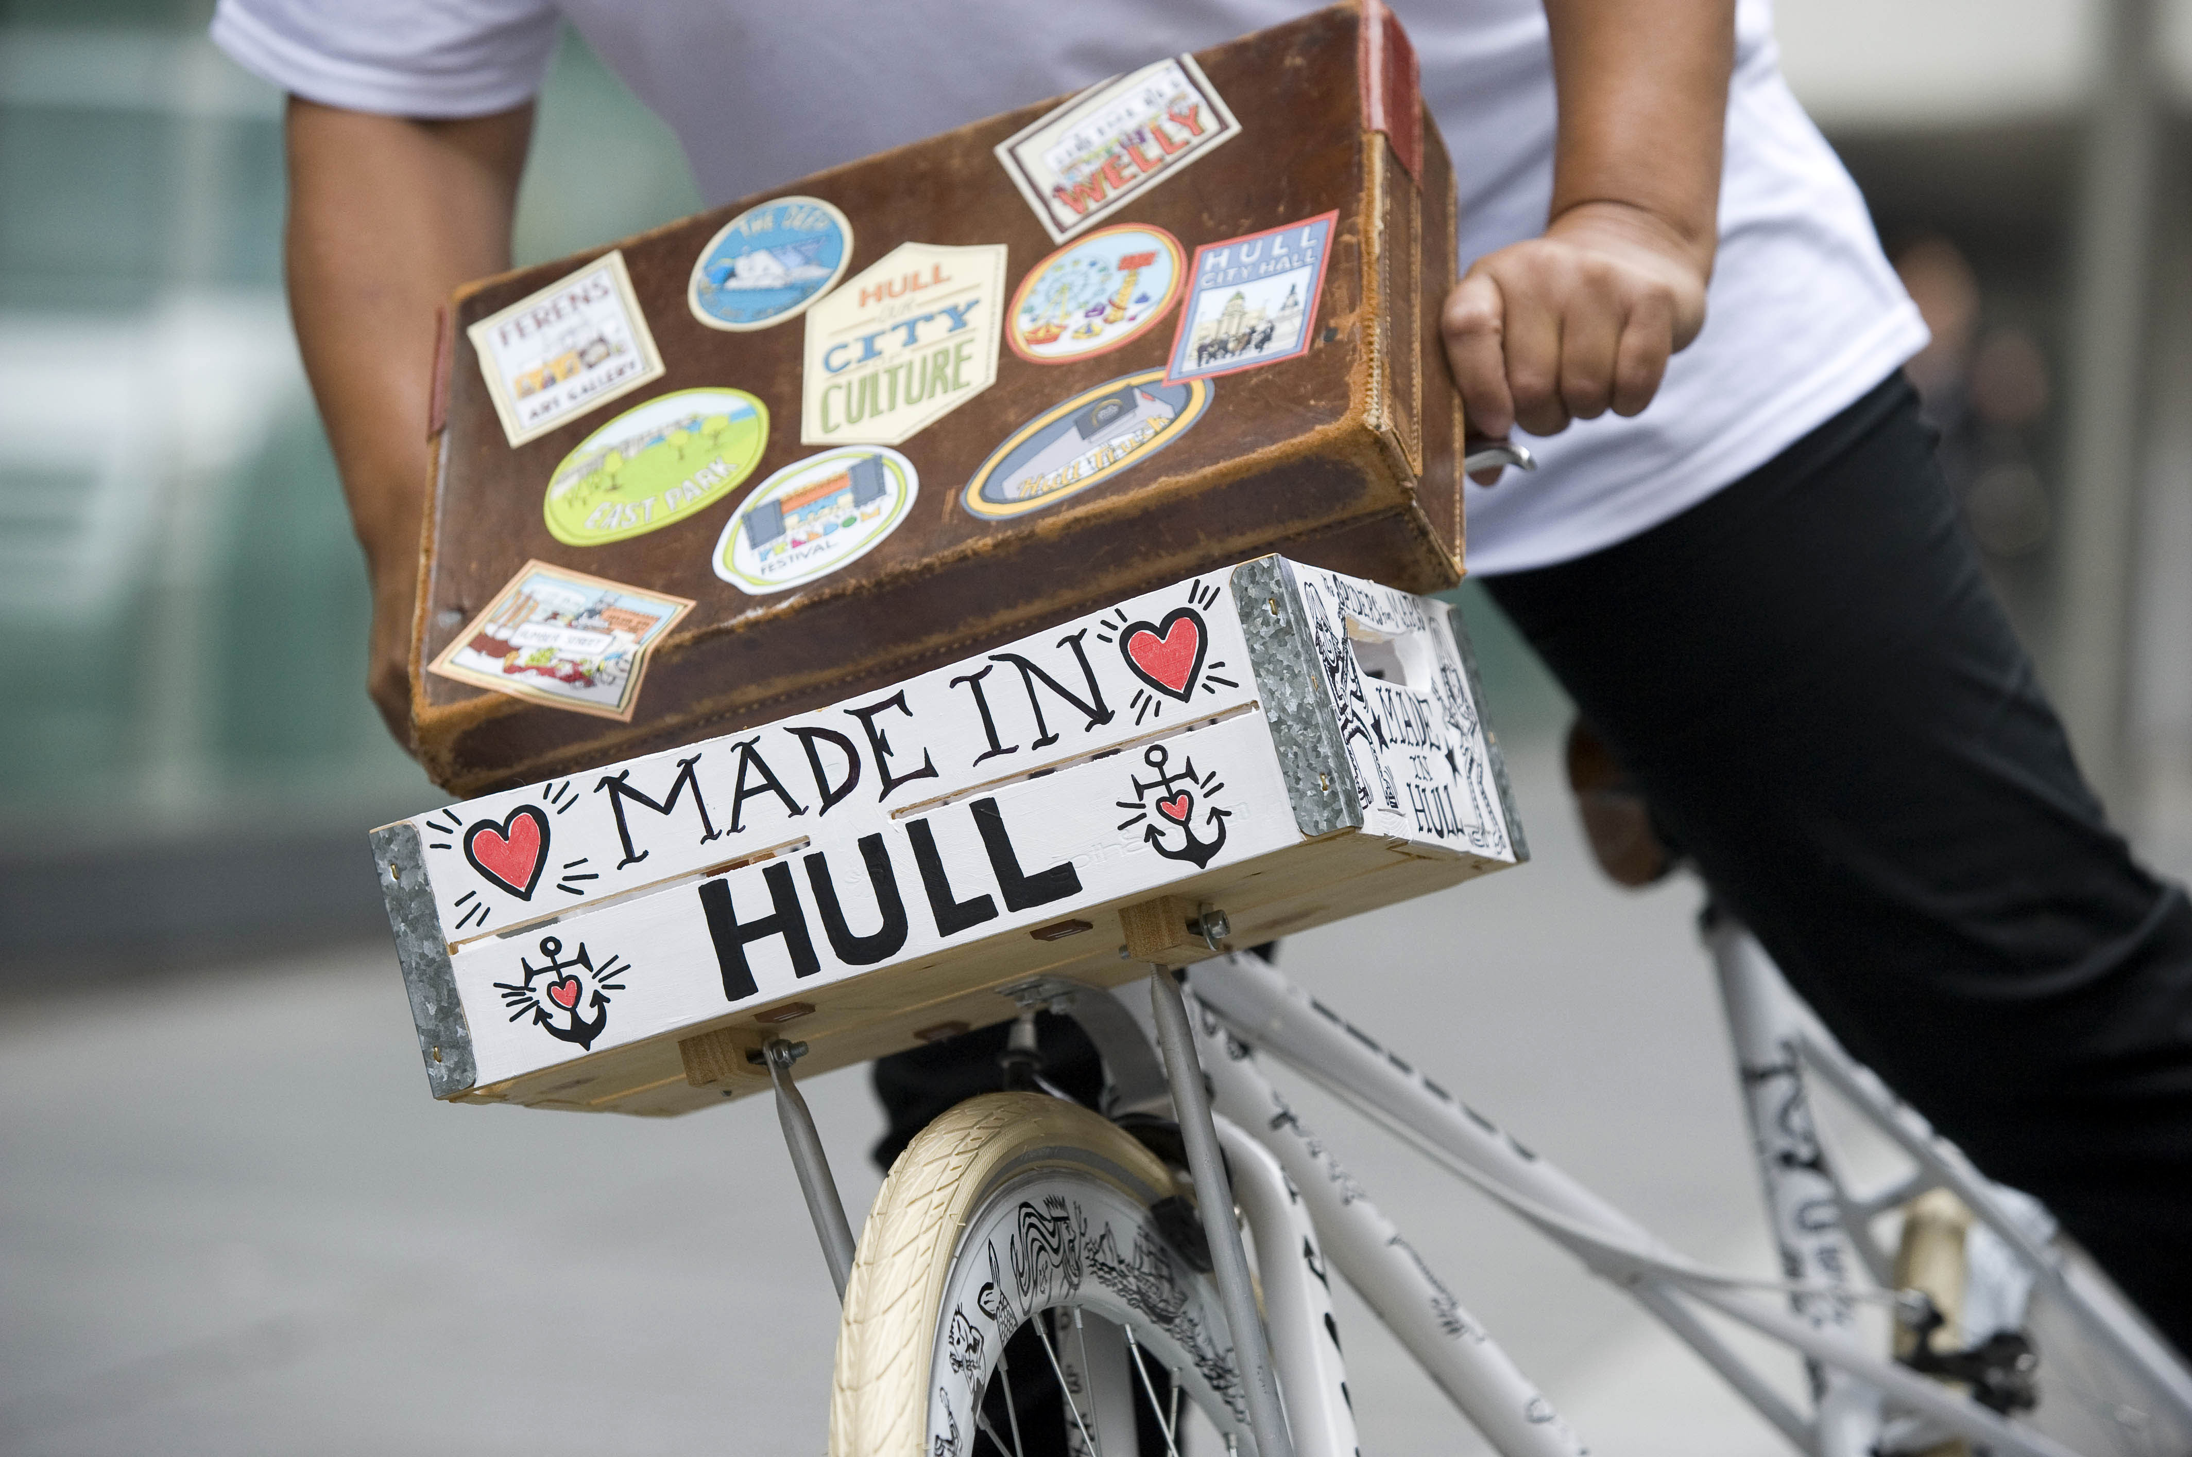
SECONDARY CRITERIA
Working in partnership.
Embracing digital & technology.
Looking beyond 2017.

Slide 8

QUESTIONS:
Who can apply?
What should I prepare?
What support is available?

Slide 9
KEY DATES
FEB 2016 Guidance notes published on website
APR 2016 Application window opens on 4 April 2016 via hull2017.co.uk Information events will take place across communities
MAY 2016 Application deadline: 16 May 2016
JUN 2016 Decisions made on successful projects
JUL 2016 Applicants notified of outcome and successful projects confirmed in a contract
SEP 2016 First wave of projects announced to the general public

Slide 10




HullCityofCulture
@2017Hull
@2017Hull
Hull2017
EMAIL ALERTS
hull2017.co.uk/signup
WEBSITE
hull2017.co.uk

