Slide 1

MONITORING & EVALUATION
CREATIVE COMMUNITIES PROGRAMME
MONDAY 21 NOVEMBER
ELINOR UNWIN

Slide 2
WHAT IS MONITORING & EVALUATION
MONITORING
EVALUATION
Ongoing
Systematic
Pre-planned
Judgement about value
Based on evidence
Learning
Notes:
We use monitoring and evaluation for two key reasons:
To learn about our activities, events and their results; and to inform planning and development both now and in the future
To justify to those that invest time, money and effort into our projects that the projects have value, make a difference and are worthy of support.
In the NOW, monitoring and evaluation can feed into the ongoing improvement and adaptation of the project as it’s delivered, in order that it achieves the best results that it can. For example, you can identify if you are succeeding or struggling to attract your target audience; you can see if communications with partners are working effectively or not; you can identify what your participants want to gain from taking part in the project and identify ways to help them achieve this.
In the FUTURE, monitoring and evaluation provides a pool of evidence, which you can use as an information source to improve what you do generally. It is also useful for backing up the claims you put in future funding applications. You can also use the results and learning to communicate your achievements to the public.
It is therefore really worth investing the time to do monitoring and evaluation, as it’s as much about helping your and your organisation as it is the fulfilling of a funders requirements.

Slide 3
SUPPORT AVAILABLE
M&E SET UP SURGERIES
ONGOING STAFF SUPPORT
VOLUNTEERS
M&E SUCCESS
Notes:
We know that undertaking this type of work may be new to many of you, so please be assured that you won’t be left on your own.
We have designed a monitoring and reporting template to make things as straightforward as possible; we will give you access to a toolkit to help with the project monitoring and data collection; and our staff and volunteers will help you to get everything in place, and undertake ongoing data collection and recording. We’ll cover this in more detail in a while.

Slide 4

YOUR M&E JOURNEY
YOUR RESPONSIBILITY
OUR RESPONSIBILITY
APPLICATION
CONTRACT PROJECT SCHEDULE
PROGRAMME SURVEY
M&E SET UP SURGERY
M&E SET UP SURGERY
ONGOING PROJECT MONITORING AND DATA COLLECTION
ONGOING PROJECT SUPPORT
PROJECT UPDATE REPORT
END OF PROJECT REPORT
END OF PROJECT GRANT SURVEY
Notes:
You have already completed your application form and the contract and project schedule to secure funding for your project.
The majority of the data that you will monitor links back to what you completed within the application form and contract project schedule.
We will circulate the Programme Survey to you all in the next couple of weeks, which one person from your project just needs to fill out. This will be a short survey that asks you about the processes and procedures of the Creative Communities Programme, from pre-application stage through to completing the contract. We would be very grateful if you could all complete this, as it will help us to know what is working or has worked well, and where changes and improvements need to be made, in order that the Creative Communities Programme cab be the best it can be. Should this approach to grant funding of arts and culture continue as a legacy project in the city, your feedback will be vital to shaping how it works in future too.

Slide 5

M&E SET UP SURGERY
PROJECT MONITORING
DESIGN AUDIENCE/PARTICIPANT SURVEY
IDENTIFYING SUPPORT NEEDS
Notes:
At the M&E Set Up Surgery we will support you to identify the data that you need to collect to monitor your project. This will include talking through the various items available to you in the toolkit, which we’ll show you a bit later. We will also help you decide what you’d like to put into your audience survey and agree a final draft version with you. We can also talk about what staff and volunteer support you think you will need and when, so we plan this well ahead.

Slide 6
YOUR M&E JOURNEY
YOUR RESPONSIBILITY
OUR RESPONSIBILITY
APPLICATION
CONTRACT PROJECT SCHEDULE
PROGRAMME SURVEY
M&E SET UP SURGERY
M&E SET UP SURGERY
ONGOING PROJECT MONITORING AND DATA COLLECTION
ONGOING PROJECT SUPPORT
PROJECT UPDATE REPORT
END OF PROJECT REPORT
END OF PROJECT GRANT SURVEY
Notes:
The next stage is the Project Update Report.

Slide 7
PROJECT UPDATE REPORT
Event Planning
Marketing and Participation
Risk Register
Budget
Timeline

Slide 8
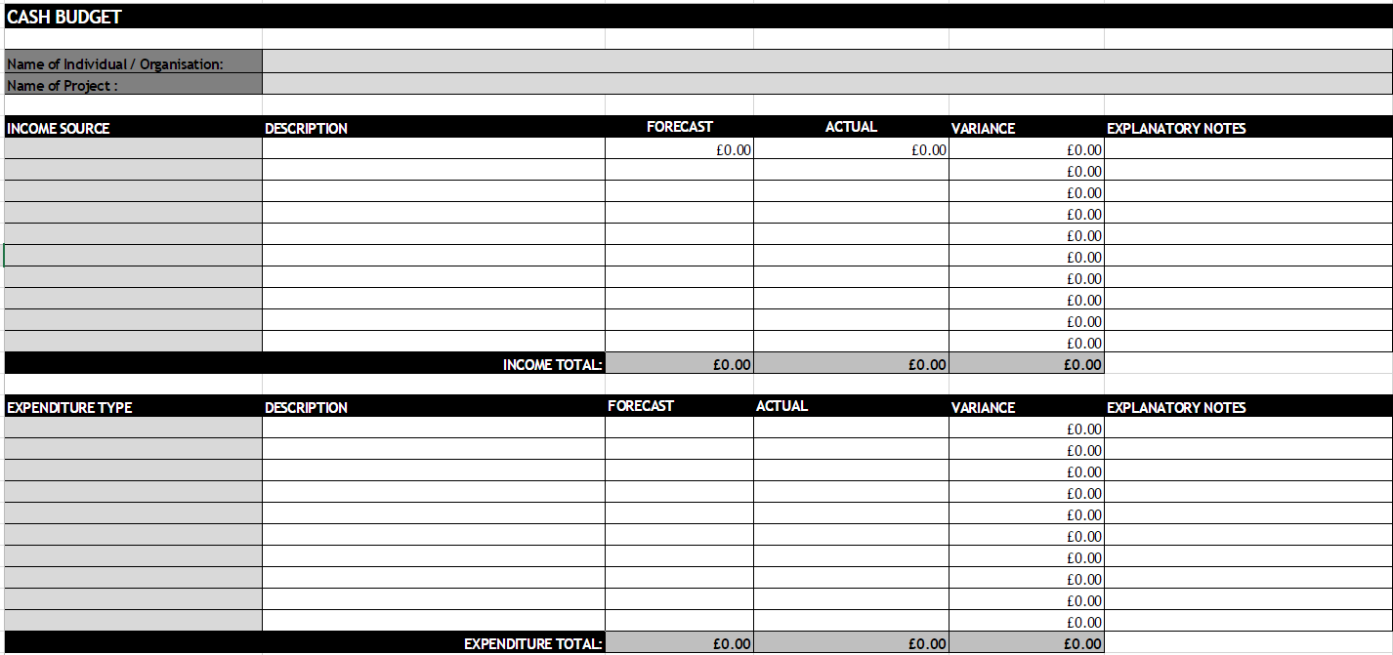
BUDGET UPDATE

Slide 9
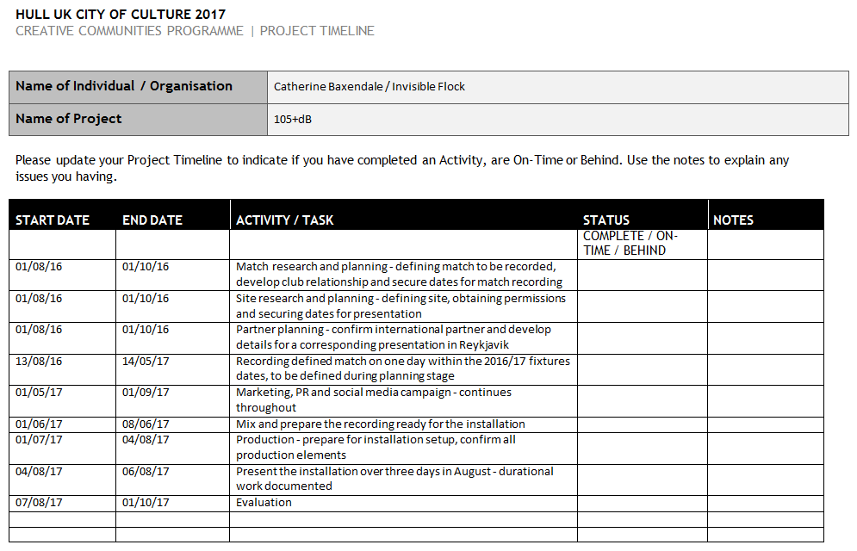
TIMELINE UPDATE

Slide 10
PROJECT UPDATE REPORT
Event Delivery
Your Organisation / Project Team
Public Engagement
Digital Engagement
Partner Engagement
Notes:
We recommend that you undertake ongoing project monitoring and data collection. As part of the management of your project it will help you keep a track on how you are doing against the targets that have been agreed in your contract, and identifying where you might need to call on us for help, if there’s an area your having difficulties with. We’ll take a quick look at each of the things in the list.

Slide 11
EVENT DELIVERY
 | ORIGINAL TARGET | REVISED TARGET | ACTUAL TO DATE
PROJECT VENUE/LOCATION
HU1 – HU9
Not HU1 – HU9
ACTIVITY
No. of performance days
No. of exhibition days
No. of commissions / new products created
No. of sessions for education, training or taking part
No. of accessible activities
Notes:
This ties back to the targets you set in your contract, so the information should all be in your project schedule form for Column 1. As your project is underway you may set a revised target, which you can discuss with us. The Actual to Date is where you can let us know if you have achieved some of these targets.
You will also be asked about how heritage is being incorporated or presented in your project. This may or may not be applicable to you..

Slide 12
YOUR ORGANISATION
Notes:
We’re interested to hear what the main successes and challenges have been for your project to date, so this is just about looking at where an how you might capture learnings along the way. They might come out of team meetings and any minutes you take, conversations between team members, email exchanges, etc.

Slide 13
PUBLIC ENGAGEMENT
TYPE OF ENGAGEMENT | TOTAL NUMBER TO DATE | NUMBER FROM HU1 – HU9
No. of audience members
No. of participants
TOTAL
EQUAL OPPS DATA
Age
Gender
Disability/long term illness
Ethnicity
Notes:
We will supply you with an Equal Opportunities form to use with participants who take part in your project for longer periods of time that those who just attend an event. It is usually good to ask people to complete this as part of their signing up to the project. For audiences you can build the equal opportunities questions into your Audience Survey. We’ll help you with this at the M&E Set Up Meeting.
As before we’re keen to hear what your audiences and participants think are the main successes and challenges of the project, which again you will pick up via ongoing informal and formal communications with them.

Slide 14
PARTNER ENGAGEMENT
 | TOTAL PAGE VIEWS | UNIQUE PAGE VIEWS
Website views relating to project
 | LIKES /FOLLOWERS AT START | LIKES / FOLLOWERS AT END | IMPRESSIONS ON POSTS RELATING TO THE PROJECT | ENGAGEMENTS WITH POSTS RELATING TO THE PROJECT
Facebook
Twitter
Instagram
Other
Notes:
Websites can be easily monitored with Google analytics for this information.
The social media profiles also provide this information via your account information and their inbuilt analytics. The digital team when they talk to you about social media, should be able to provide guidance on this. The impressions and engagements may require some time for picking out those that relate to your project, and this might be something your team or volunteers can help with.
Impressions
Engagements

Slide 15
PARTNER ENGAGEMENT
 | TOTAL BASED IN HU1 – HU9 | TOTAL BASED OUTSIDE HU1 – HU9
PARTNER TYPE
Artistic partner (e.g. theatre, art gallery, music venue)
Heritage partner (e.g. museum, archive)
Funder (e.g. Arts Council England, business, private trust)
Public Sector partner (e.g. libraries, GPs)
Voluntary Sector partner (e.g. community group, charity)
Education (e.g. school, college, university)
Other
PARTNERSHIP STAGE
No. of new partnerships established via this project
No. of existing partners involved in this project
Notes:
You already have a list of partners in your project schedule, as part of the contract, so this just lets you report on how many of these were realised and whether any new partners come onboard after your project is up and running.
As before we’re keen to hear what your partners think are the main successes and challenges of the project, which again you will pick up via ongoing informal and formal communications with them.

Slide 16
YOUR M&E JOURNEY
YOUR RESPONSIBILITY
OUR RESPONSIBILITY
APPLICATION
CONTRACT PROJECT SCHEDULE
PROGRAMME SURVEY
M&E SET UP SURGERY
M&E SET UP SURGERY
ONGOING PROJECT MONITORING AND DATA COLLECTION
ONGOING PROJECT SUPPORT
PROJECT UPDATE REPORT
END OF PROJECT REPORT
END OF PROJECT GRANT SURVEY
Notes:
You have already completed your application form and the contract and project schedule to secure funding for your project.
The majority of the data that you will monitor links back to what you completed within the application form and contract project schedule.
We will circulate the Grantee Survey to you all this week. This will be a short survey focus on the processes and procedures of the Creative Communities Programme, from pre-application stage through to completing the contract. We would be very grateful if you could all complete this, as it will help us to know what is or has worked well, and where changes and improvements need to be made, in order that CCP is the best it can be. Should this approach to grant funding of arts and culture continue as a legacy project in the city, your feedback will be vital to shaping how it works in future too.
M&E Set Up Surgery

Slide 17
END OF PROJECT REPORT
Final Budget
Event Delivery
Your Organisation / Project Team
Public Engagement
Digital Engagement
Partnership Engagement
Notes:
The End of Project Report is pretty much exactly the same as your project update report. The only difference is that you tell us your final numbers and learnings across each area. The only additional information provided here is the data on your project delivery team.
In terms of your learnings around audiences and participants, we would also hope to see findings and analysis from your audience survey referred to in the Public Engagement section.

Slide 18
PARTNER ENGAGEMENT
 | TOTAL NO. OF INDIVIDUAL | TOTAL NO. OF DAYS WORKED | TOTAL NUMBER OF HU1 – HU9 RESIDENTS | TOTAL NO. OF DAYS WORKED BY HU1 – HU9 RESIDENTS
CATEGORY ROLE
Project Manager(s)
Artist(s)
Production/exhibition staff
Other staff
Volunteers
EQUAL OPPS DATA
Age
Gender
Disability/long term illness
Ethnicity
Notes:
We will supply you with an Equal Opportunities form to use with staff. We would say it’s good to get these forms completed at the start of the project and then get any new staff / freelancers that come on board later to fill one out as part of their induction or contracting.

Slide 19
TOOLKIT
In order to support you in keeping a track of your project, and to undertake the data collection that we’ve gone over today, the following have been developed:
Project Monitoring Sheet
Equal Opportunities Monitoring Form
Question Bank to create an Audience Survey.

Slide 20
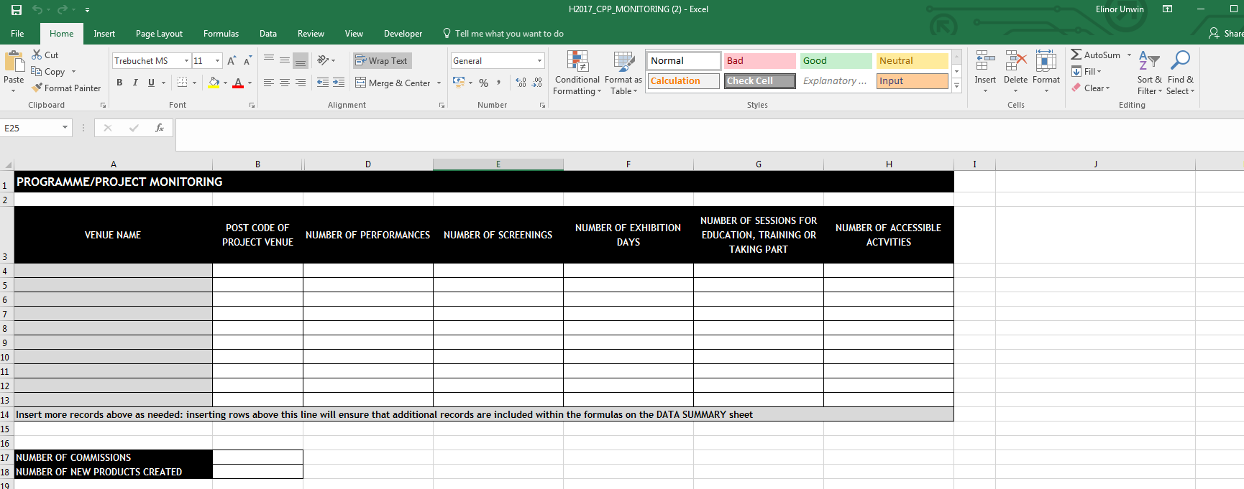
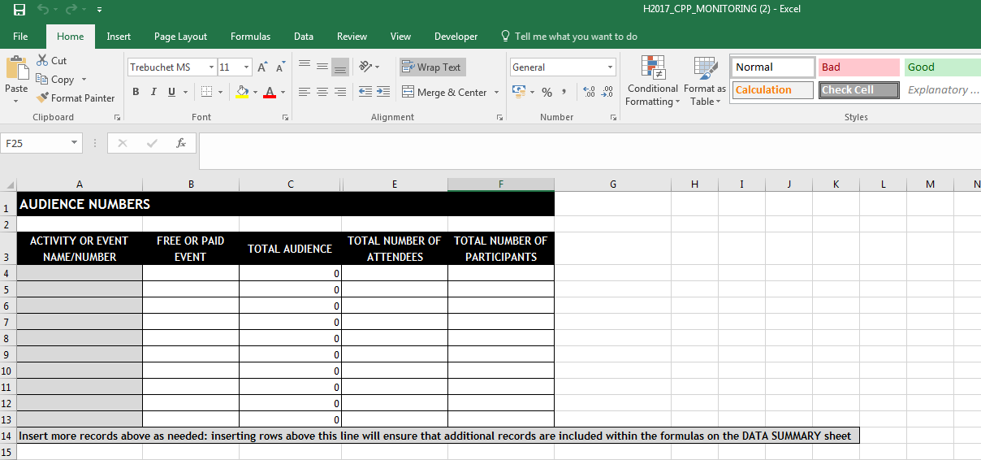
PROJECT MONITORING SHEET
Notes:
An Excel workbook has been developed where you can enter your project information. The spreadsheets have been developed so that you just enter each individual bit of information and then the workbook automatically adds everything up for you. You can use the Data Summary sheet within the workbook to find the totals that you will enter into your project update report and end of activity report.
However, you do not need to use this tool. If you already have your own systems, or approaches to adding up this information then you can stick with those. This is just a tool for anyone who would like to use it.

Slide 21
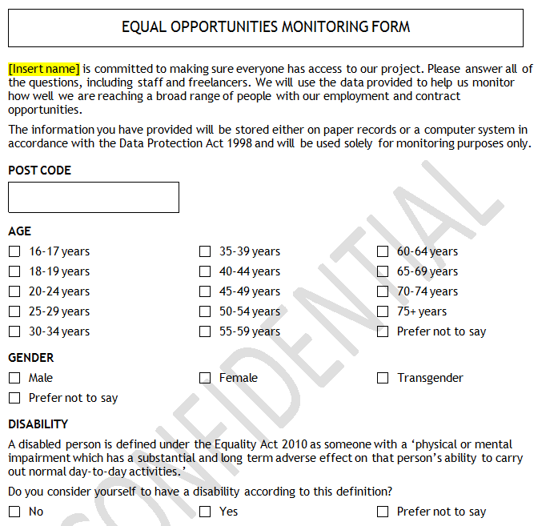
EQUAL OPPORTUNITIES FORM
Notes:
You will be provided with an Equal Opportunities form to collect data on your project team members, and your attenders / participants.
As previously stated, we recommend that you ask all members of your team to fill this out at the beginning of the project, and then make it part of the contracting process if you are likely to bring anyone else on board. Do not ask people to put their name on this. It should stay anonymous. Keep them all in a safe place until you report on your team at the end of the project.
.

Slide 22
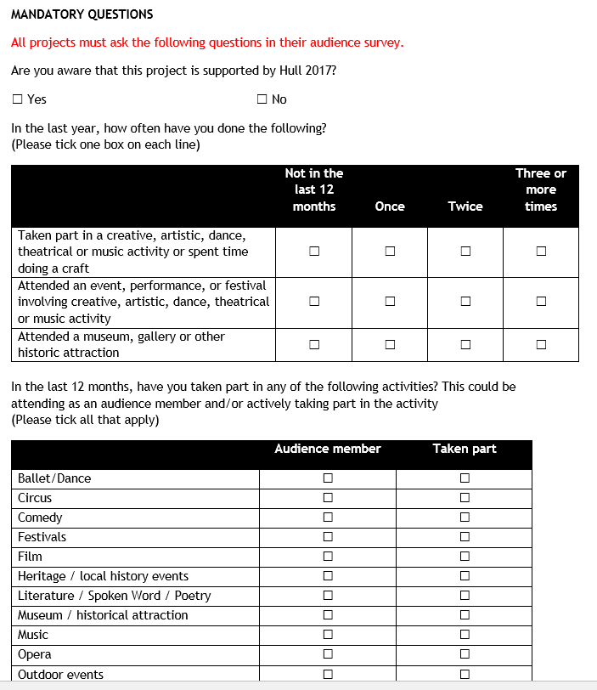
QUESTION BANK
Notes:
There will be a small number of mandatory questions to ask your audiences / participants, in addition to the 5 equal opportunities questions. These are integral questions to the Monitoring & Evaluation of Hull 2017 as a whole. In addition to this the question bank provides some example questions to find out certain things from your audience that can inform how you develop projects in future and provide evidence for funding applications. The Question bank explains in what way the results from these questions can provide useful information for you. It will be your choice whether you decide to use them or not.
In the M&E Set Up Survey we will help you put your questionnaire together. We will also discuss what support you might need to collect this information from a sample of your audience. A sample is a proportion of your audience, so we do not expect projects to collect data from every single person that attends or takes part in the project. We will be training up a core team of volunteers in Monitoring & Evaluation in early January. So where you do need additional staff support, both in terms of skill and capacity, we will work with you to identify when and where they can help.

Slide 23
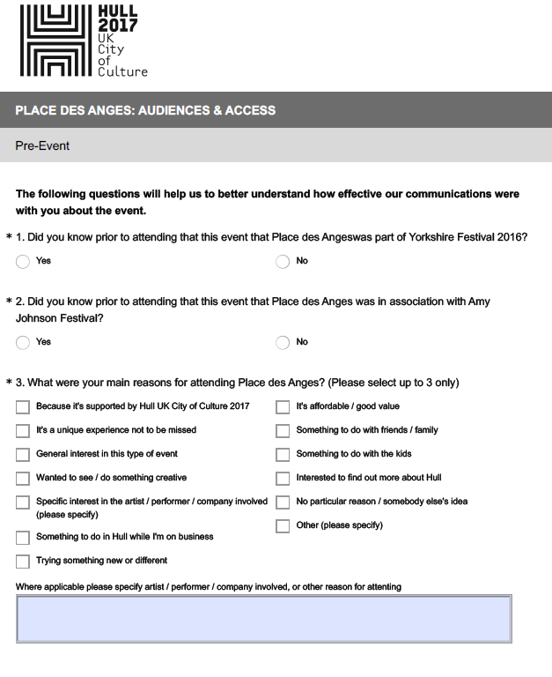
AUDIENCE/PARTICIPANT SURVEY
Notes:
You can choose to do an audience/participant survey in a couple of ways:
Face to face: you can ask people to complete the forms straight after the event, asking them to complete it themselves, or using staff/volunteers to undertake it as a short interview (you could do this using paper surveys, or if you have tablets, they could do an online version).
Online: if you can get access to an online survey account like Survey Monkey or Google Forms, and you have collected audience/participants email address you can email them a link to complete it online.
With Survey Monkey you can get a free account, but it has the restrictions of a maximum of 10 questions and 100 responses.
Google Forms is free and has less restrictions but is less sophisticated. However, it should enable you to get what you need.

Slide 24
Photos
Videos
Press clippings
Case studies
OTHER STUFF…

