Slide 1
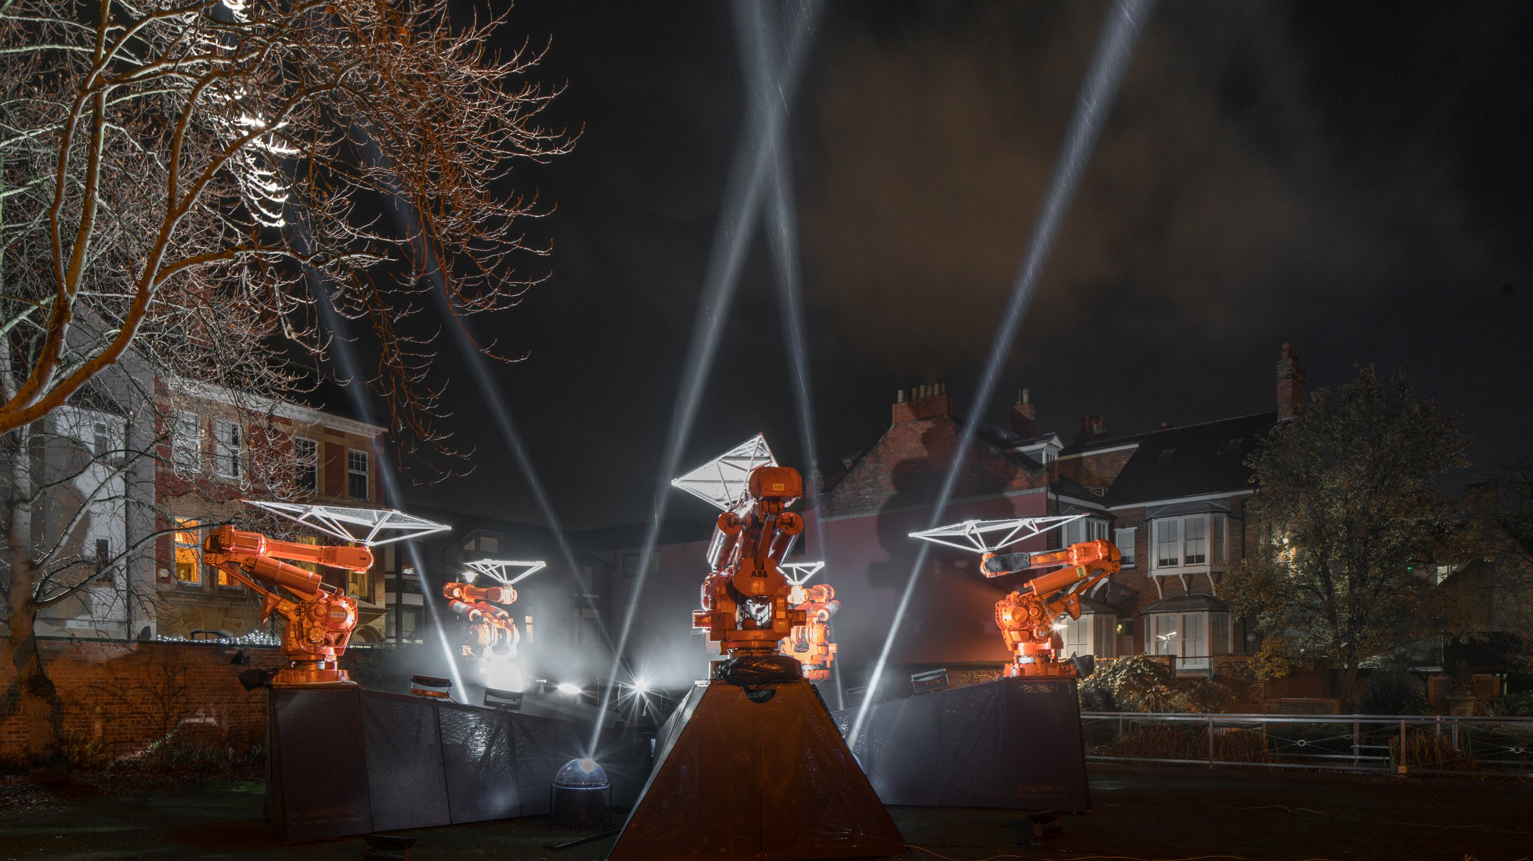
EXPERT CONVERSATIONALIST PROMPT CARD
RESPONSE TO THE ARTWORK
How did you feel watching the robots here at [Beverley Gate/ Trinity Square/ Wilberforce House / Museum Gardens]?
Have you been to any of the other artworks at [Beverley Gate/ Trinity Square/ Wilberforce House / Museum Gardens]?
How did you feel watching the robots at each of those locations?
Overall, what is your reaction to the artwork you’ve seen at Where Do We Go From Here?
How do you feel about it as a piece of art?
Have you seen anything like it before?
How does it work within the setting of Hull’s Old Town?
RESPONSE TO THE QUESTION
What does the question ‘Where Do We Go From Here?’ mean to you?
So, in your opinion, Where Do We Go From Here?
Can you expand on [x]?
Who do you feel is responsible for making this vision happen?

