Slide 1
Project B75
Presentation to Project Board
9th August 2016

Slide 2
Concept <<Andrew Knight>>
H2017 - Made in Hull Season
Siemens in Hull – future for Hull – Black energy to Green energy
Blade manufacture – handcrafted, shipbuilding skills etc. – employing people in Hull
Siemens collaboration – using in blade made by Hull people, made in Hull (tbc)
Timing – why January 1st for installation? Removed on 2nd April
Project B75

Slide 3
The Installation <<Nayan Kulkarni>>
Photos of trip to Albourg – physicality of the blade
Name B75
Project B75

Slide 4
The Installation <<Nayan Kulkarni>>
Ambition for Installation – being disruptive, highly visual statement
Where exhibited – Queen Vic Square
How exhibited - angle
Want it to be a surprise
Project B75

Slide 9
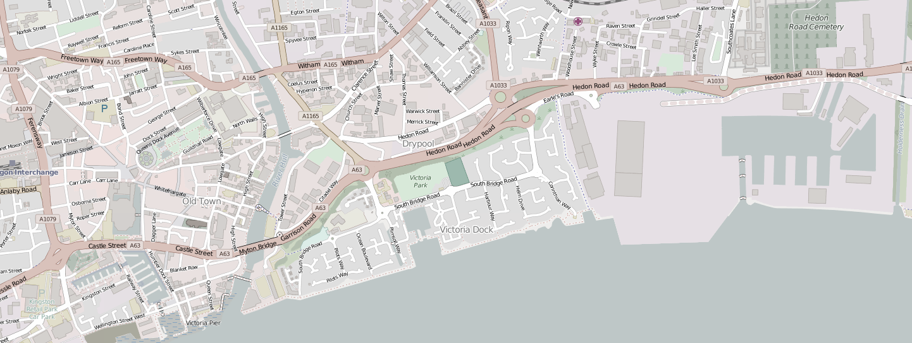
Transport <<Richard Bickers or Mike Millage>>
High level review of routing options found “Route D” to be the most feasible to transport the blade from Alexandra Docks to Queen Victoria Square in Hull.
Queen Victoria Square
Alexandra Docks
Project B75

Slide 10
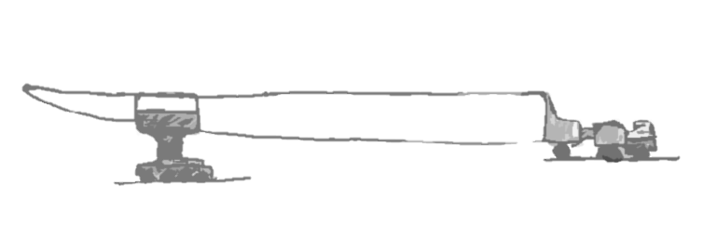
Transport <<Richard Bickers or Mike Millage>>
Blade being delivered by ALE – Specialist abnormal load handlers.
Blade to be transported on SPMTs. Casing at “root” end and clamp towards “tip” end.
Tip end of blade Clamp on SPMT Casing (root end) on Tractor/SPMT
Affected Street Apparatus and “pre-installation” activities.
Project B75

Slide 11
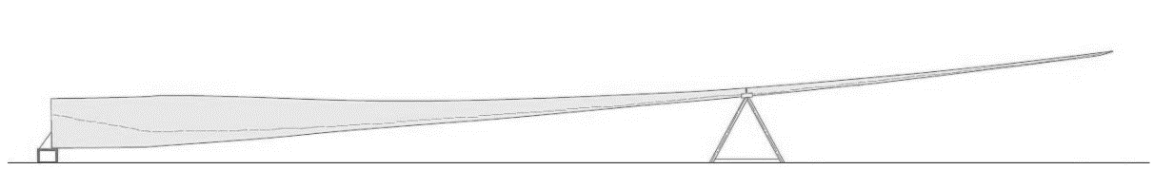
Installation <<Richard Bickers>>
Pre-fabricated steelwork structures at root & tip end incorporating standard fixings used by Siemens
Root support Tip Support
Project B75

Slide 12
Installation <<Richard Bickers>>
Supports sit on Public Realm surface
Mock Up in December 2012
Benches positioned below blade where 2.3m headroom clearance cannot be achieved
Project B75

Slide 13
Preferred Arrangement
Project B75

Slide 14
Alternative Arrangement
Project B75

Slide 15
Permissions <<Richard Bickers>>
Planning Consent – two scenarios
Event license (or similar)
Abnormal Loads license
Removal/reinstatement of street apparatus, regulatory signs and safety barriers
Police escort
Traffic Management/Temporary Traffic Regulation Orders
Oversail license
Project B75

Slide 16
Ownership and Maintenance<<Richard Bickers>>
Ownership and Liabilities – Options for loan agreement
Insurance
Security Presence
Secure Design
Maintenance – cleaning, repairing and repainting
Project B75

Slide 17
Programme <<Richard Bickers>>
Critical Path Activities | 2016 |  |  |  |  | 2017
 | Aug | Sept | Oct | Nov | Dec | Jan | Feb
Presentation to Project Board
Go/No Go decision by Project Board
Design of Supports
Fabricator Procurement
Fabrication of Supports
Pre-installation – Mock Up
Pre-installation – Socketing of Street Furniture
Completion of Queen Victoria Square Public Realm Works
Installation
Removal
Project B75

Slide 18
Programme <<Richard Bickers>>
Initial Detailed Programme for Installation
Date / Time | Activity
Friday 30th December 2016
11.00 | Meeting with key project members to review following: Completion of preparation works Detailed Installation programme Risk Register
13.00 | Team building meeting with all persons involved. Remind them of roles & responsibilities
Sunday 1st January 2017
6.00 | Meet at Siemens Yard. Health and Safety Induction
6.30 | Load steel supports onto lorries – transport to site Cranes into position in Queen Victoria Square Gangs start to remove street-furniture
7.30 | Blade leaves Siemens Yard under police escort Steel supports lifted into position and bolted together
8.30 (approx.) | Blade leaves A63 (Highways England property) Gangs start to replace street furniture
10.00 | Blade arrives in Queen Victoria Square
11.00 | Blade lifted into position
12.00 | Blade securing in position Safety checks
13.00 | Cranes demobilised & removed from site Clean Up
14.00 | Hand-over
Project B75

Slide 19
Costs<<Richard Bickers>>
Description | Estimated Cost
Transportation | £178,900
Removal | £59,100
Total | £228,000
Approach to cost estimate – bottom up
Transportation
Installation
Maintenance
Removal
Management and Consultancy
Cost for Blade, ALE’s input, storage, mock-up, Police and craneage are excluded from the cost estimate.
Description | Estimated Cost
Installation | £119,000
Maintenance (28 days) | £23,320
Management and Consultancy | £70,000
Contingency (5% of above) | £10,616
Total | £222,936
Additional 28 days (incl. 5% Contingency) | £19,236
Project B75

Slide 20
Risk <<Richard Bickers>>
Key Project Risks
Delay to QVS | High winds during installation and removal
Public interference during installation/removal | Planning consent delayed
Damage to Public Realm | Legal enforcement action
Budget exceeded | Temporary planning consent
Political objectors | Surprise element
Planning consent is not granted | New Year’s Eve
Fire | Climbing
People collision with blade | Straps securing blade
Project B75

Slide 21
Concluding Remarks <<Andrew Knight / Chris Clay>>
Potential media coverage – national / global
Messages
Making a Surprise
CGI
Project B75

