Slide 1
Hull 2017
“Look Up” – Feb 2016

Slide 2
Jan – Mar Made in Hull
ZEPHYR (Nayan Kulkarni) installed with huge impact into a City Centre street Siemens Jan co-commissioned
Street scale road graffiti work painted onto Ferensway to link with the street closure and large scale event – Roadsworth January
Large scale installation in Princes Quay occupying the central atrium space Claire Morgan Feb – Easter
Interactive text work on monumental scale by Michael Pinsky occupies Tidal Barrier towers – voices of Hull

Slide 3
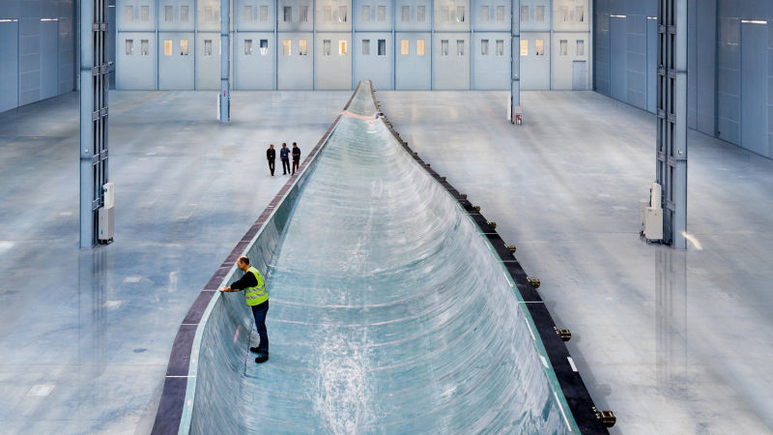
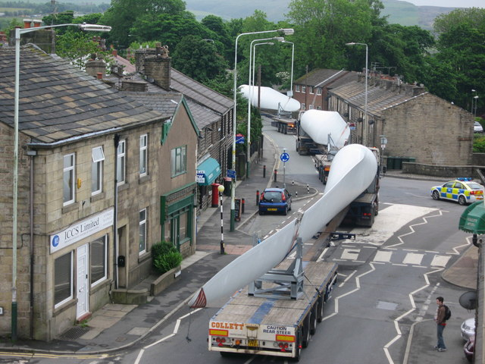
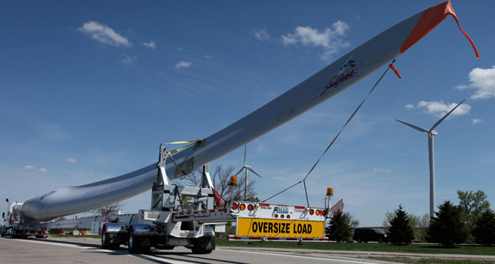
ZEPHYR

Slide 4
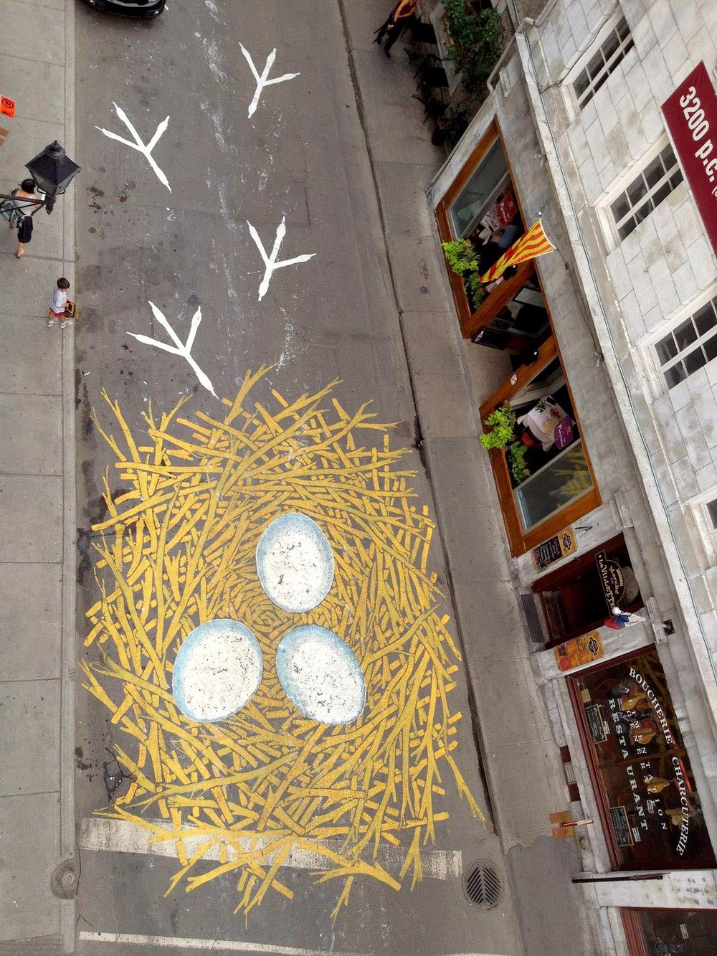
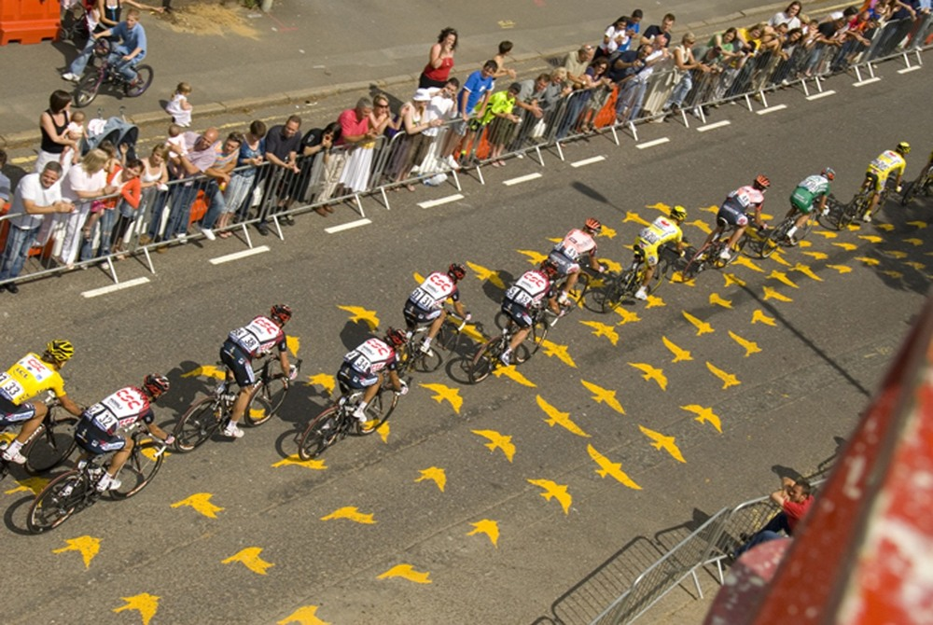
Roadsworth
For Ferensway

Slide 5
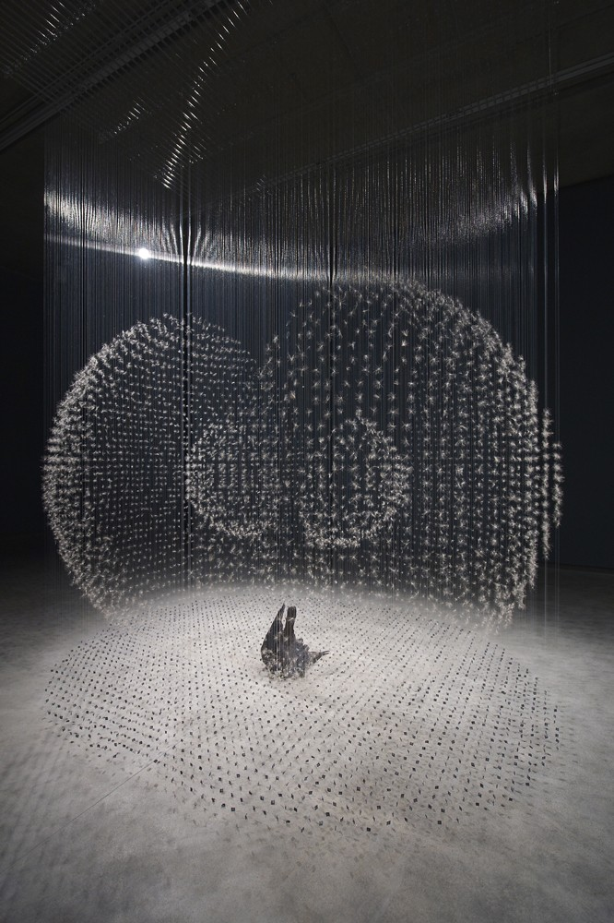
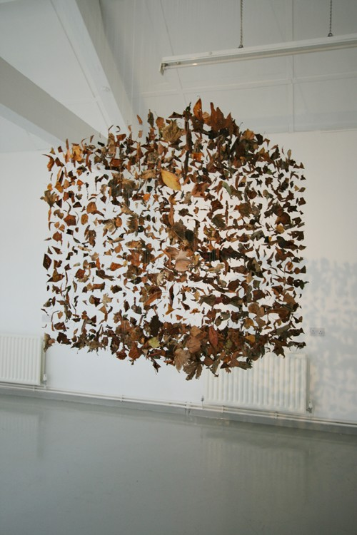
Claire Morgan
For Princes Quay

Slide 6
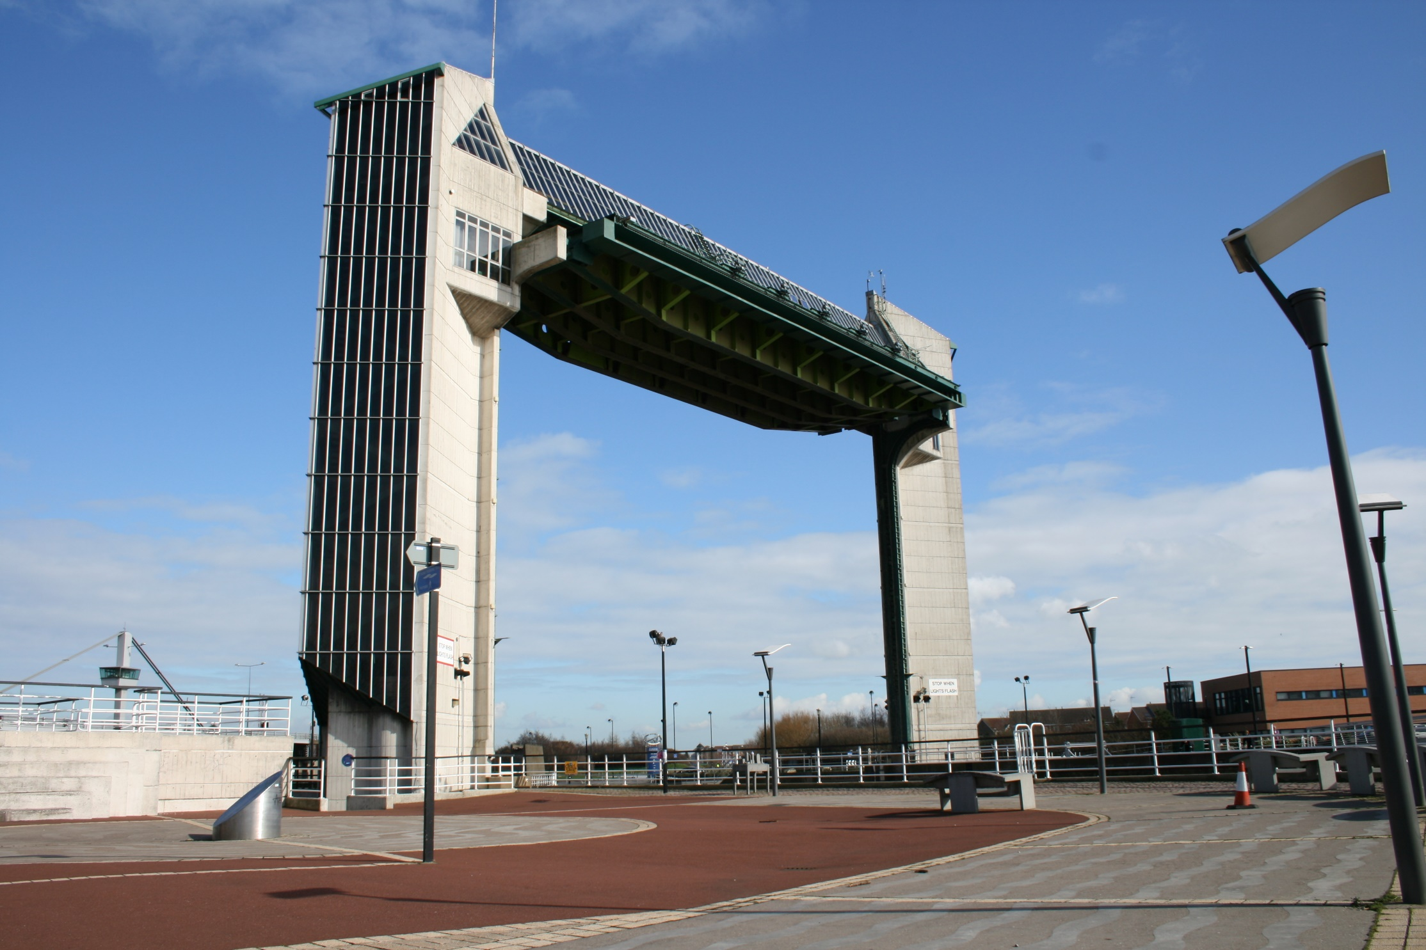
Hull Tidal Barrier
Text will run up the side elevation

Slide 7
Apr – Jun Roots and Routes
Research and installation commission linked to Transmigration – the Lazarus Hotel and the Railway Platform
The Deep commission – runs through April – October
Sound installation for Trinity House Chapel linked to the sea (Chris Watson) possible co commission with BBC and/or The Deep co-commissioned

Slide 8
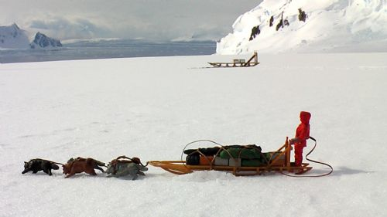
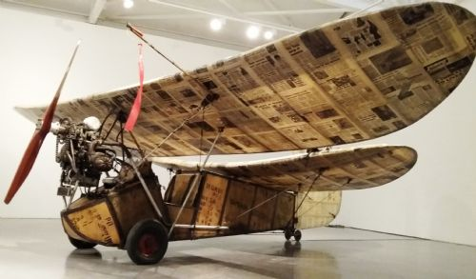
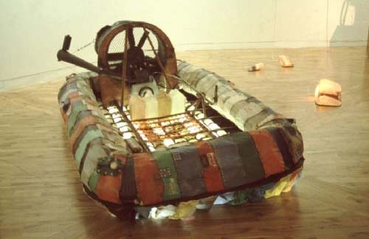
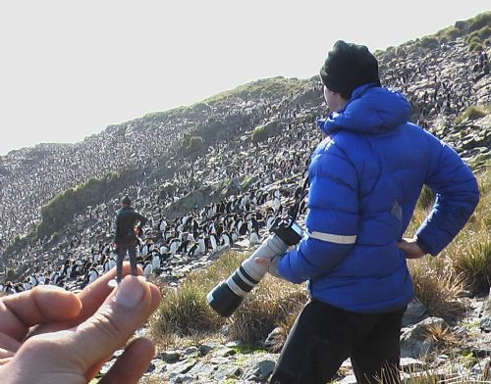
Chris Dobrowolski
For The Deep

Slide 9
Jul – Sept Freedom
“Paper City” GF Smith opens Freedom season with one weekend of high profile installations in paper across Hull co-commissioned
RIBA artist/architect competition winning installation on site July – October co-commissioned
Summer School with a difference at Hull School of Art and Design, plus ongoing events
Participative public work by Candy Chang installed August – September, culminates with Freedom Festival

Slide 10
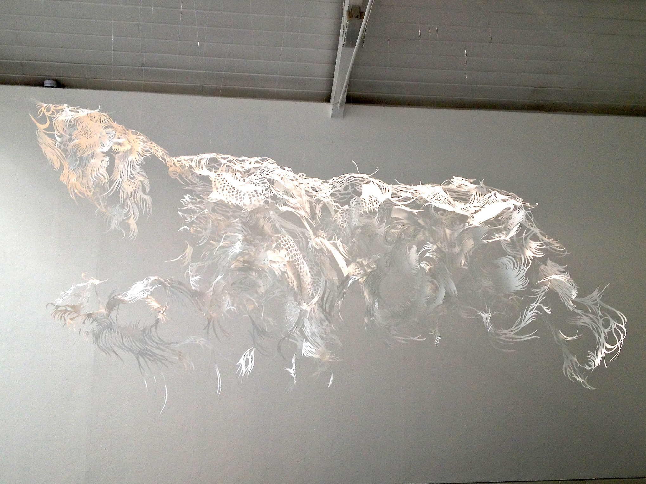
Nahoko Kojima
Paper Cutting

Slide 11
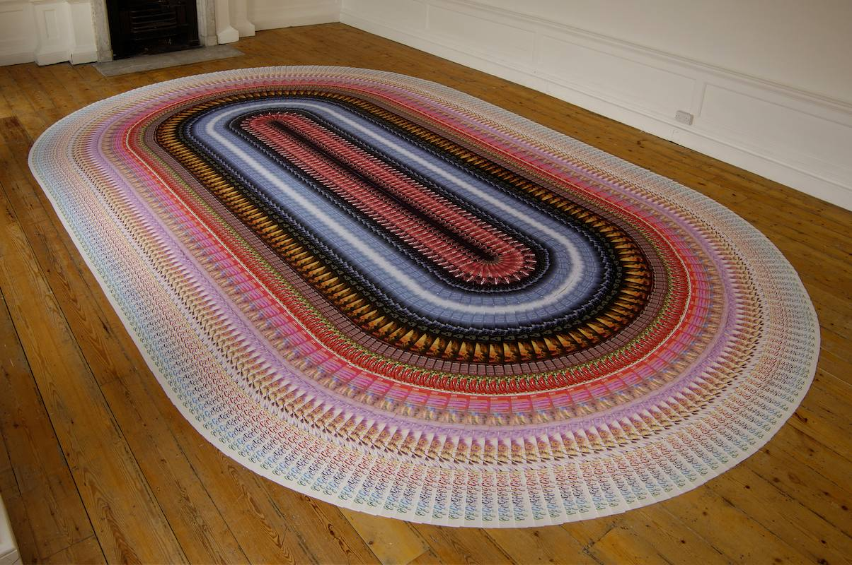
Leo Fitzmaurice
Nightclub flyers rug

Slide 12
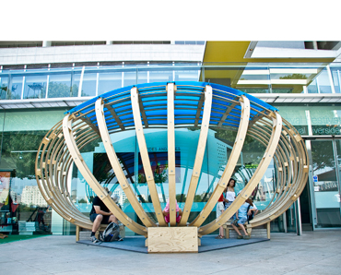
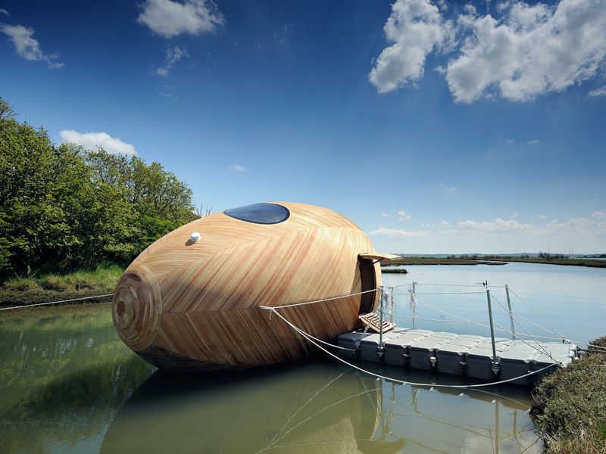
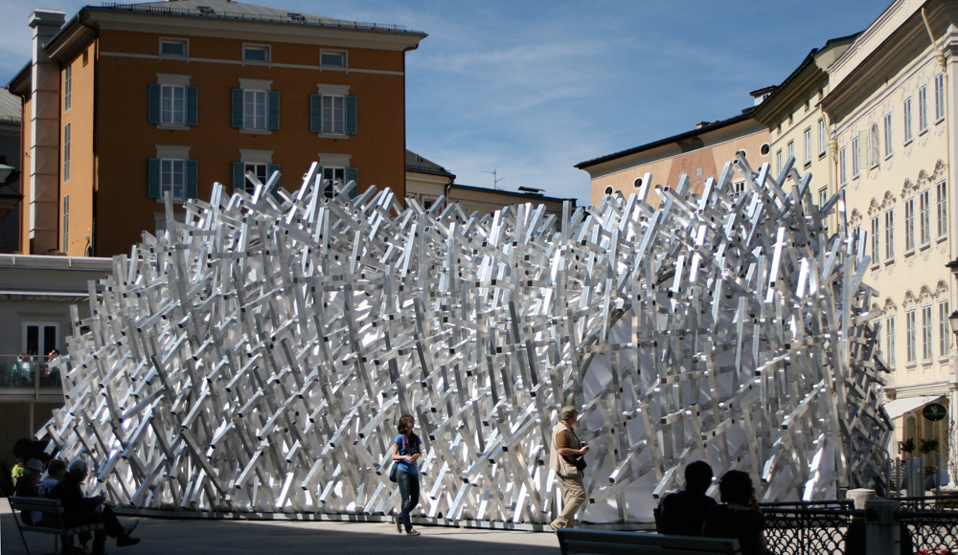
Temporary structures designed for competitions

Slide 13
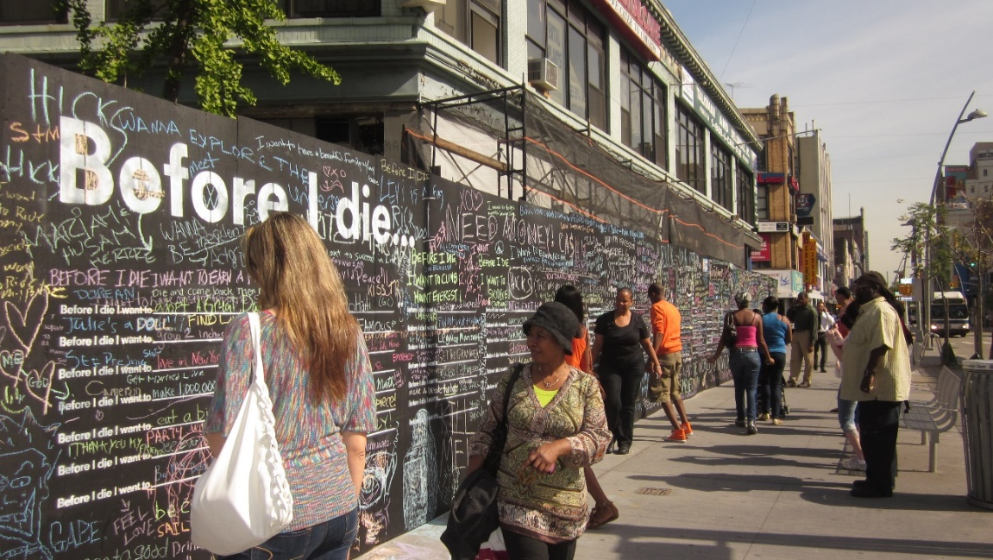
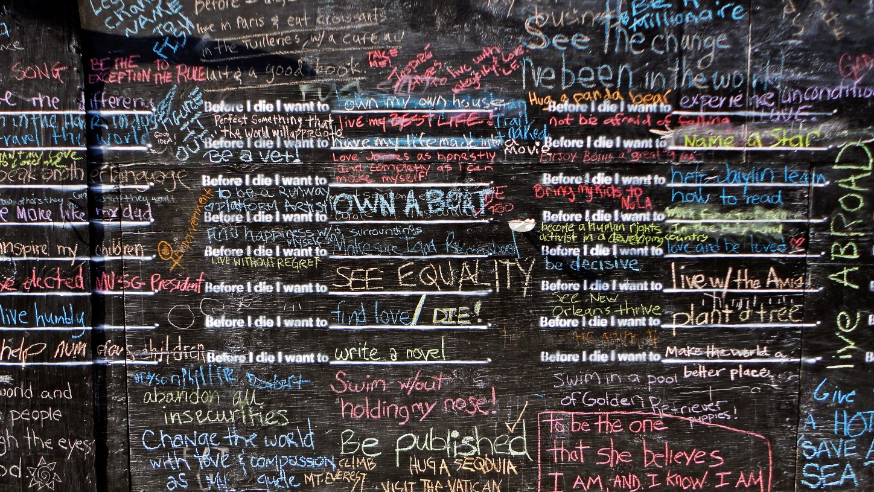
Candy Chang “Before I die”

Slide 14
Oct – Dec Tell the World
Daan Roosegarde (Rotterdam) commissioned installation to coincide with Turner Prize.
Princes Quay Santa’s Grotto and Christmas Decorations - by an artist/designer co-commissioned
Trinity Square/Holy Trinity – Northern Lights lighting transformation by Nayan Kulkarni
Hull Christmas Lights – designed by artist/architect co-commissioned

Slide 15
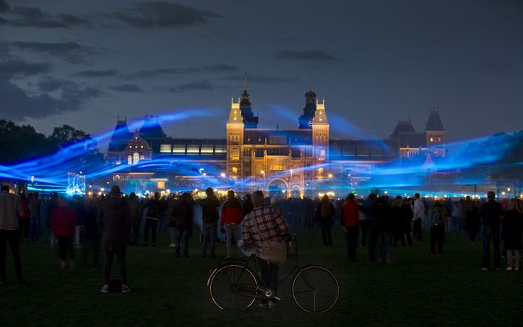
Studio Roosegaard
“Waterlicht”
The big commission…

Slide 16
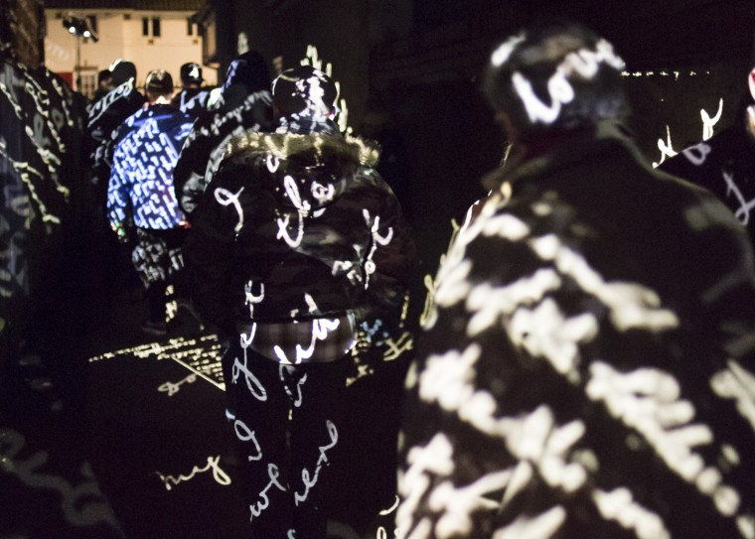
Nayan Kulkarni
For Trinity Square

Slide 17
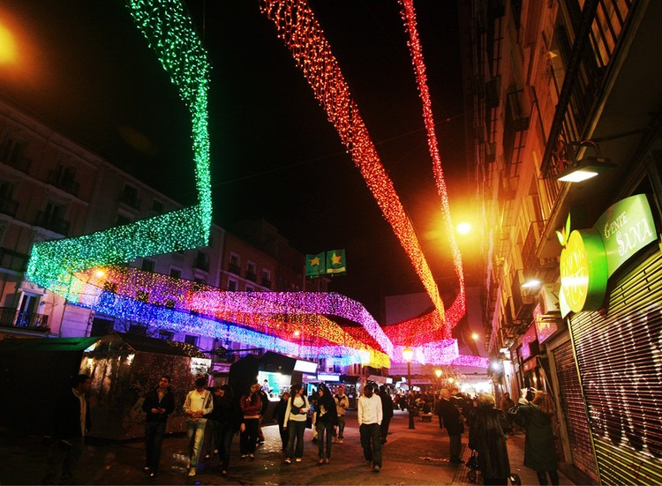
Sergio Sebastian
Christmas Lights, Madrid

Slide 18
Possibles to come…
The Iceland link
Krystof W

