Slide 1
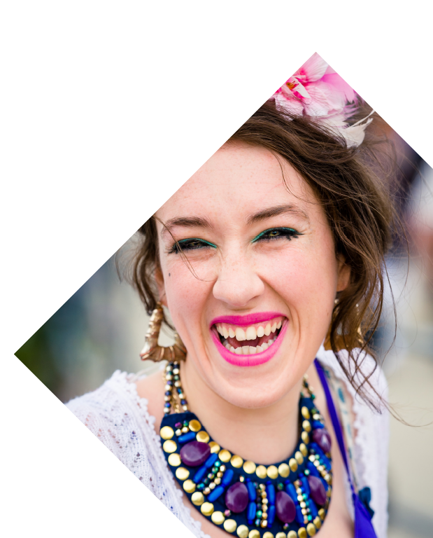

HULL 2017 EVALUATION UPDATE

Slide 2
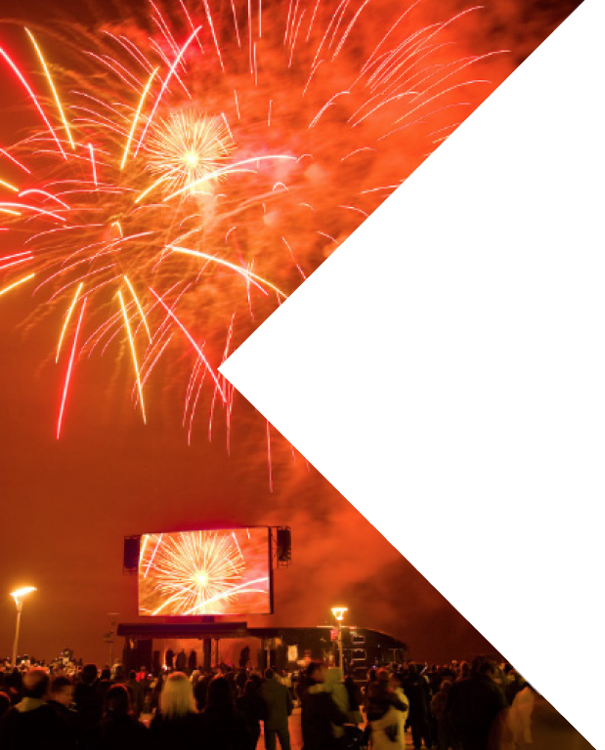
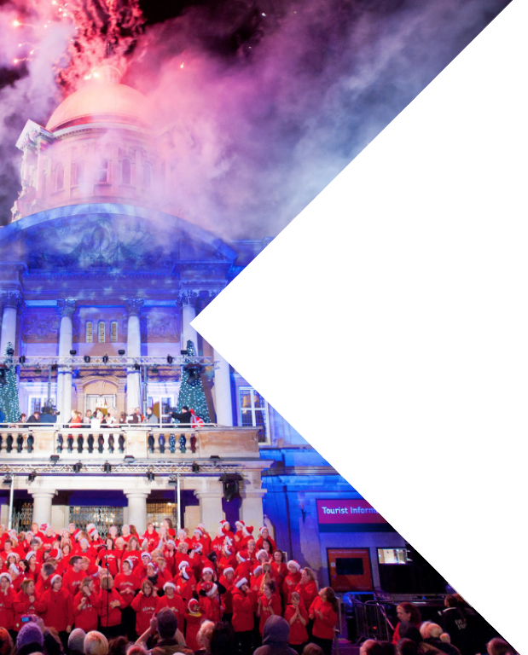
HULL 2017 EVALUATION FRAMEWORK

Slide 3
SUMMARY OF THEMES AND AIMS
ARTS & CULTURE
PLACEMAKING
ECONOMY
SOCIETY & WELLBEING
PARTNERSHIPS & DEVELOPMENT
Produce a high quality, exemplar programme of arts and culture
Develop (new and existing) audiences
Capacity build the local cultural sector
Improve perceptions of Hull internally and externally
Boost Hull’s economy, particularly the visitor economy
Act as a catalyst for wider investment and regeneration
Improve wellbeing through participation and activity that creates social cohesion
Build the skills, knowledge and aspirations of the local population
Exemplar programme delivery and partnerships
Notes:
Explain the background to the framework and that this is the latest revision – comments have been submitted and the final version will be signed off imminently, though only minor changes.
State that there are also a number of objectives that sit under each aim, which can be seen on the handout.
Ask questions as they arise.

Slide 4
THEMES

Slide 5

THEMES
ARTS & CULTURE
Developing the infrastructure and capacity of the local arts and culture sector; delivering and inspiring quality art (incorporating the creative case for diversity); building national and international collaboration; and developing local, national and international audiences for Hull’s cultural offer
Notes:
Explain the background to the framework and that this is the latest revision – comments have been submitted and the final version will be signed off imminently, though only minor changes.
State that there are also a number of objectives that sit under each aim, which can be seen on the handout.
Ask questions as they arise.

Slide 6
THEMES
PLACEMAKING
Changing perceptions and positioning of Hull locally, nationally and internationally via city branding, cultural programming, infrastructure developments, and marketing & communications; with a particular focus on media profile, resident satisfaction, and visitor satisfaction
Notes:
Explain the background to the framework and that this is the latest revision – comments have been submitted and the final version will be signed off imminently, though only minor changes.
State that there are also a number of objectives that sit under each aim, which can be seen on the handout.
Ask questions as they arise.

Slide 7
THEMES
ECONOMY
Achieving regeneration, increased revenue within the culture economy, increased value & volume of tourism, local contract and visitor spend multipliers, job creation, skills development, capacity building, and inward investment
Notes:
Explain the background to the framework and that this is the latest revision – comments have been submitted and the final version will be signed off imminently, though only minor changes.
State that there are also a number of objectives that sit under each aim, which can be seen on the handout.
Ask questions as they arise.

Slide 8
THEMES
SOCIETY & WELLBEING
Developing learning, education & skills, health & wellbeing, and community pride & engagement; with a particular focus on social capital, inclusion, reducing isolation, community cohesion, life satisfaction and changing perceptions of protected characteristics
Notes:
Explain the background to the framework and that this is the latest revision – comments have been submitted and the final version will be signed off imminently, though only minor changes.
State that there are also a number of objectives that sit under each aim, which can be seen on the handout.
Ask questions as they arise.

Slide 9
THEMES
PARTNERSHIPS & DEVELOPMENT
Developing partnerships – political, strategic and commercial – to ensure readiness, enable delivery and secure legacy. Key elements include the investment in access, infrastructure (of the City and connections to the UK & overseas), marketing & positioning, fundraising, visitor welcome, and evidencing of the intrinsic value of arts and culture and well as the broader benefits the sector brings.
Notes:
Explain the background to the framework and that this is the latest revision – comments have been submitted and the final version will be signed off imminently, though only minor changes.
State that there are also a number of objectives that sit under each aim, which can be seen on the handout.
Ask questions as they arise.

Slide 10
AIMS

Slide 11
AIMS: ARTS & CULTURE
ARTS & CULTURE
Produce a high quality, exemplar programme of arts and culture
Develop (new and existing) audiences
Capacity build the local cultural sector

Slide 12
AIMS: PLACEMAKING
PLACEMAKING
Improve perceptions of Hull internally and externally

Slide 13
AIMS: ECONOMY
ECONOMY
Boost Hull’s economy, particularly the visitor economy
Act as a catalyst for wider investment and regeneration

Slide 14
AIMS: SOCIETY & WELLBEING
SOCIETY & WELLBEING
Improve wellbeing through participation and activity that creates social cohesion
Build the skills, knowledge and aspirations of the local population

Slide 15
AIMS: PARTNERSHIPS & DEVELOPMENT
PARTNERSHIPS & DEVELOPMENT
Exemplar programme delivery and partnerships

Slide 16
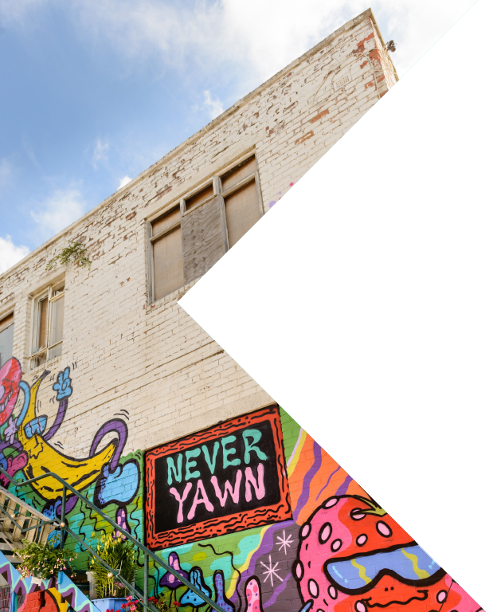
“HERO” PROJECTS AND PROGRAMMES

Slide 17


Land of Green Ginger
Notes:
Made in Hull
Free non-ticketed outdoor spectacular event
High quality commissions
Very “Hull” focused
Exploration of the city’s history and heritage
A celebration using the city’s built environment as a canvas
Bringing a high volume of people to the city centre
Land of Green Ginger
High quality, exquisite artistic commissions focused on community engagement
About creating magic and changing how residents look at, feel and talk about their neighbourhoods
Will give communities a voice
Aims to encourage people to venture to other communities in Hull
Encouraging participation in areas of deprivation and low engagement with arts and culture
Building skills and know-how amongst community partners
Look Up
Year round programme of large scale pubic art commissions
About encouraging people to look at Hull’s public spaces in a different way
About challenging people’s perceptions of what art is and can be
Spectacular in nature and unique, to inspire visitors and residents to come to the city centre
Back to Ours
Arts and culture being taken out to the city’s neighbourhoods
Affordability is central so cost is not a barrier to people getting involved
Developing community venues into arts and cultural spaces with a desire for longer term change
Potential blue print for touring activity in areas of deprivation and low participation
Tackling social isolation and encouraging community cohesion
The Flood
Mix of presentation methods, including digital, live performance and broadcast
National coverage through live broadcast
Aspiration to involve a large community cast
Site specific work will present Hull to the world in new ways
Humber Street Gallery
Diversification of the visual arts offer in Hull
A key part of the cultural quarter developments at the Fruit Market with longer term potential
F&B offer will aid the economic regeneration of the area
Supporting programme of live events within the neighbouring Fruit space will be a key partnership
Hull 2017 Volunteers
Training and development opportunities for local people, increasing employability
Creation of a pool of enthusiastic ambassadors for the city
Volunteers will be encouraged to think about arts and culture differently and take risks in their choices
Longest and most in-depth participatory element to Hull 2017
Development of the city’s volunteer infrastructure that will leave a lasting legacy for volunteers and those who utilise volunteers
Tackling social isolation and encouraging community cohesion
Providing best practice approaches to engaging and retaining volunteers

Slide 18
Made in Hull
Notes:
Made in Hull
Free non-ticketed outdoor spectacular event
High quality commissions
Very “Hull” focused
Exploration of the city’s history and heritage
A celebration using the city’s built environment as a canvas
Bringing a high volume of people to the city centre
Land of Green Ginger
High quality, exquisite artistic commissions focused on community engagement
About creating magic and changing how residents look at, feel and talk about their neighbourhoods
Will give communities a voice
Aims to encourage people to venture to other communities in Hull
Encouraging participation in areas of deprivation and low engagement with arts and culture
Building skills and know-how amongst community partners
Look Up
Year round programme of large scale pubic art commissions
About encouraging people to look at Hull’s public spaces in a different way
About challenging people’s perceptions of what art is and can be
Spectacular in nature and unique, to inspire visitors and residents to come to the city centre
Back to Ours
Arts and culture being taken out to the city’s neighbourhoods
Affordability is central so cost is not a barrier to people getting involved
Developing community venues into arts and cultural spaces with a desire for longer term change
Potential blue print for touring activity in areas of deprivation and low participation
Tackling social isolation and encouraging community cohesion
The Flood
Mix of presentation methods, including digital, live performance and broadcast
National coverage through live broadcast
Aspiration to involve a large community cast
Site specific work will present Hull to the world in new ways
Humber Street Gallery
Diversification of the visual arts offer in Hull
A key part of the cultural quarter developments at the Fruit Market with longer term potential
F&B offer will aid the economic regeneration of the area
Supporting programme of live events within the neighbouring Fruit space will be a key partnership
Hull 2017 Volunteers
Training and development opportunities for local people, increasing employability
Creation of a pool of enthusiastic ambassadors for the city
Volunteers will be encouraged to think about arts and culture differently and take risks in their choices
Longest and most in-depth participatory element to Hull 2017
Development of the city’s volunteer infrastructure that will leave a lasting legacy for volunteers and those who utilise volunteers
Tackling social isolation and encouraging community cohesion
Providing best practice approaches to engaging and retaining volunteers

Slide 19
Look Up
Notes:
Made in Hull
Free non-ticketed outdoor spectacular event
High quality commissions
Very “Hull” focused
Exploration of the city’s history and heritage
A celebration using the city’s built environment as a canvas
Bringing a high volume of people to the city centre
Land of Green Ginger
High quality, exquisite artistic commissions focused on community engagement
About creating magic and changing how residents look at, feel and talk about their neighbourhoods
Will give communities a voice
Aims to encourage people to venture to other communities in Hull
Encouraging participation in areas of deprivation and low engagement with arts and culture
Building skills and know-how amongst community partners
Look Up
Year round programme of large scale pubic art commissions
About encouraging people to look at Hull’s public spaces in a different way
About challenging people’s perceptions of what art is and can be
Spectacular in nature and unique, to inspire visitors and residents to come to the city centre
Back to Ours
Arts and culture being taken out to the city’s neighbourhoods
Affordability is central so cost is not a barrier to people getting involved
Developing community venues into arts and cultural spaces with a desire for longer term change
Potential blue print for touring activity in areas of deprivation and low participation
Tackling social isolation and encouraging community cohesion
The Flood
Mix of presentation methods, including digital, live performance and broadcast
National coverage through live broadcast
Aspiration to involve a large community cast
Site specific work will present Hull to the world in new ways
Humber Street Gallery
Diversification of the visual arts offer in Hull
A key part of the cultural quarter developments at the Fruit Market with longer term potential
F&B offer will aid the economic regeneration of the area
Supporting programme of live events within the neighbouring Fruit space will be a key partnership
Hull 2017 Volunteers
Training and development opportunities for local people, increasing employability
Creation of a pool of enthusiastic ambassadors for the city
Volunteers will be encouraged to think about arts and culture differently and take risks in their choices
Longest and most in-depth participatory element to Hull 2017
Development of the city’s volunteer infrastructure that will leave a lasting legacy for volunteers and those who utilise volunteers
Tackling social isolation and encouraging community cohesion
Providing best practice approaches to engaging and retaining volunteers

Slide 20
Back to Ours
Notes:
Made in Hull
Free non-ticketed outdoor spectacular event
High quality commissions
Very “Hull” focused
Exploration of the city’s history and heritage
A celebration using the city’s built environment as a canvas
Bringing a high volume of people to the city centre
Land of Green Ginger
High quality, exquisite artistic commissions focused on community engagement
About creating magic and changing how residents look at, feel and talk about their neighbourhoods
Will give communities a voice
Aims to encourage people to venture to other communities in Hull
Encouraging participation in areas of deprivation and low engagement with arts and culture
Building skills and know-how amongst community partners
Look Up
Year round programme of large scale pubic art commissions
About encouraging people to look at Hull’s public spaces in a different way
About challenging people’s perceptions of what art is and can be
Spectacular in nature and unique, to inspire visitors and residents to come to the city centre
Back to Ours
Arts and culture being taken out to the city’s neighbourhoods
Affordability is central so cost is not a barrier to people getting involved
Developing community venues into arts and cultural spaces with a desire for longer term change
Potential blue print for touring activity in areas of deprivation and low participation
Tackling social isolation and encouraging community cohesion
The Flood
Mix of presentation methods, including digital, live performance and broadcast
National coverage through live broadcast
Aspiration to involve a large community cast
Site specific work will present Hull to the world in new ways
Humber Street Gallery
Diversification of the visual arts offer in Hull
A key part of the cultural quarter developments at the Fruit Market with longer term potential
F&B offer will aid the economic regeneration of the area
Supporting programme of live events within the neighbouring Fruit space will be a key partnership
Hull 2017 Volunteers
Training and development opportunities for local people, increasing employability
Creation of a pool of enthusiastic ambassadors for the city
Volunteers will be encouraged to think about arts and culture differently and take risks in their choices
Longest and most in-depth participatory element to Hull 2017
Development of the city’s volunteer infrastructure that will leave a lasting legacy for volunteers and those who utilise volunteers
Tackling social isolation and encouraging community cohesion
Providing best practice approaches to engaging and retaining volunteers

Slide 21
The Flood
Notes:
Made in Hull
Free non-ticketed outdoor spectacular event
High quality commissions
Very “Hull” focused
Exploration of the city’s history and heritage
A celebration using the city’s built environment as a canvas
Bringing a high volume of people to the city centre
Land of Green Ginger
High quality, exquisite artistic commissions focused on community engagement
About creating magic and changing how residents look at, feel and talk about their neighbourhoods
Will give communities a voice
Aims to encourage people to venture to other communities in Hull
Encouraging participation in areas of deprivation and low engagement with arts and culture
Building skills and know-how amongst community partners
Look Up
Year round programme of large scale pubic art commissions
About encouraging people to look at Hull’s public spaces in a different way
About challenging people’s perceptions of what art is and can be
Spectacular in nature and unique, to inspire visitors and residents to come to the city centre
Back to Ours
Arts and culture being taken out to the city’s neighbourhoods
Affordability is central so cost is not a barrier to people getting involved
Developing community venues into arts and cultural spaces with a desire for longer term change
Potential blue print for touring activity in areas of deprivation and low participation
Tackling social isolation and encouraging community cohesion
The Flood
Mix of presentation methods, including digital, live performance and broadcast
National coverage through live broadcast
Aspiration to involve a large community cast
Site specific work will present Hull to the world in new ways
Humber Street Gallery
Diversification of the visual arts offer in Hull
A key part of the cultural quarter developments at the Fruit Market with longer term potential
F&B offer will aid the economic regeneration of the area
Supporting programme of live events within the neighbouring Fruit space will be a key partnership
Hull 2017 Volunteers
Training and development opportunities for local people, increasing employability
Creation of a pool of enthusiastic ambassadors for the city
Volunteers will be encouraged to think about arts and culture differently and take risks in their choices
Longest and most in-depth participatory element to Hull 2017
Development of the city’s volunteer infrastructure that will leave a lasting legacy for volunteers and those who utilise volunteers
Tackling social isolation and encouraging community cohesion
Providing best practice approaches to engaging and retaining volunteers

Slide 22
Humber Street Gallery
Notes:
Made in Hull
Free non-ticketed outdoor spectacular event
High quality commissions
Very “Hull” focused
Exploration of the city’s history and heritage
A celebration using the city’s built environment as a canvas
Bringing a high volume of people to the city centre
Land of Green Ginger
High quality, exquisite artistic commissions focused on community engagement
About creating magic and changing how residents look at, feel and talk about their neighbourhoods
Will give communities a voice
Aims to encourage people to venture to other communities in Hull
Encouraging participation in areas of deprivation and low engagement with arts and culture
Building skills and know-how amongst community partners
Look Up
Year round programme of large scale pubic art commissions
About encouraging people to look at Hull’s public spaces in a different way
About challenging people’s perceptions of what art is and can be
Spectacular in nature and unique, to inspire visitors and residents to come to the city centre
Back to Ours
Arts and culture being taken out to the city’s neighbourhoods
Affordability is central so cost is not a barrier to people getting involved
Developing community venues into arts and cultural spaces with a desire for longer term change
Potential blue print for touring activity in areas of deprivation and low participation
Tackling social isolation and encouraging community cohesion
The Flood
Mix of presentation methods, including digital, live performance and broadcast
National coverage through live broadcast
Aspiration to involve a large community cast
Site specific work will present Hull to the world in new ways
Humber Street Gallery
Diversification of the visual arts offer in Hull
A key part of the cultural quarter developments at the Fruit Market with longer term potential
F&B offer will aid the economic regeneration of the area
Supporting programme of live events within the neighbouring Fruit space will be a key partnership
Hull 2017 Volunteers
Training and development opportunities for local people, increasing employability
Creation of a pool of enthusiastic ambassadors for the city
Volunteers will be encouraged to think about arts and culture differently and take risks in their choices
Longest and most in-depth participatory element to Hull 2017
Development of the city’s volunteer infrastructure that will leave a lasting legacy for volunteers and those who utilise volunteers
Tackling social isolation and encouraging community cohesion
Providing best practice approaches to engaging and retaining volunteers

Slide 23
Hull 2017 Volunteers
Notes:
Made in Hull
Free non-ticketed outdoor spectacular event
High quality commissions
Very “Hull” focused
Exploration of the city’s history and heritage
A celebration using the city’s built environment as a canvas
Bringing a high volume of people to the city centre
Land of Green Ginger
High quality, exquisite artistic commissions focused on community engagement
About creating magic and changing how residents look at, feel and talk about their neighbourhoods
Will give communities a voice
Aims to encourage people to venture to other communities in Hull
Encouraging participation in areas of deprivation and low engagement with arts and culture
Building skills and know-how amongst community partners
Look Up
Year round programme of large scale pubic art commissions
About encouraging people to look at Hull’s public spaces in a different way
About challenging people’s perceptions of what art is and can be
Spectacular in nature and unique, to inspire visitors and residents to come to the city centre
Back to Ours
Arts and culture being taken out to the city’s neighbourhoods
Affordability is central so cost is not a barrier to people getting involved
Developing community venues into arts and cultural spaces with a desire for longer term change
Potential blue print for touring activity in areas of deprivation and low participation
Tackling social isolation and encouraging community cohesion
The Flood
Mix of presentation methods, including digital, live performance and broadcast
National coverage through live broadcast
Aspiration to involve a large community cast
Site specific work will present Hull to the world in new ways
Humber Street Gallery
Diversification of the visual arts offer in Hull
A key part of the cultural quarter developments at the Fruit Market with longer term potential
F&B offer will aid the economic regeneration of the area
Supporting programme of live events within the neighbouring Fruit space will be a key partnership
Hull 2017 Volunteers
Training and development opportunities for local people, increasing employability
Creation of a pool of enthusiastic ambassadors for the city
Volunteers will be encouraged to think about arts and culture differently and take risks in their choices
Longest and most in-depth participatory element to Hull 2017
Development of the city’s volunteer infrastructure that will leave a lasting legacy for volunteers and those who utilise volunteers
Tackling social isolation and encouraging community cohesion
Providing best practice approaches to engaging and retaining volunteers

Slide 24
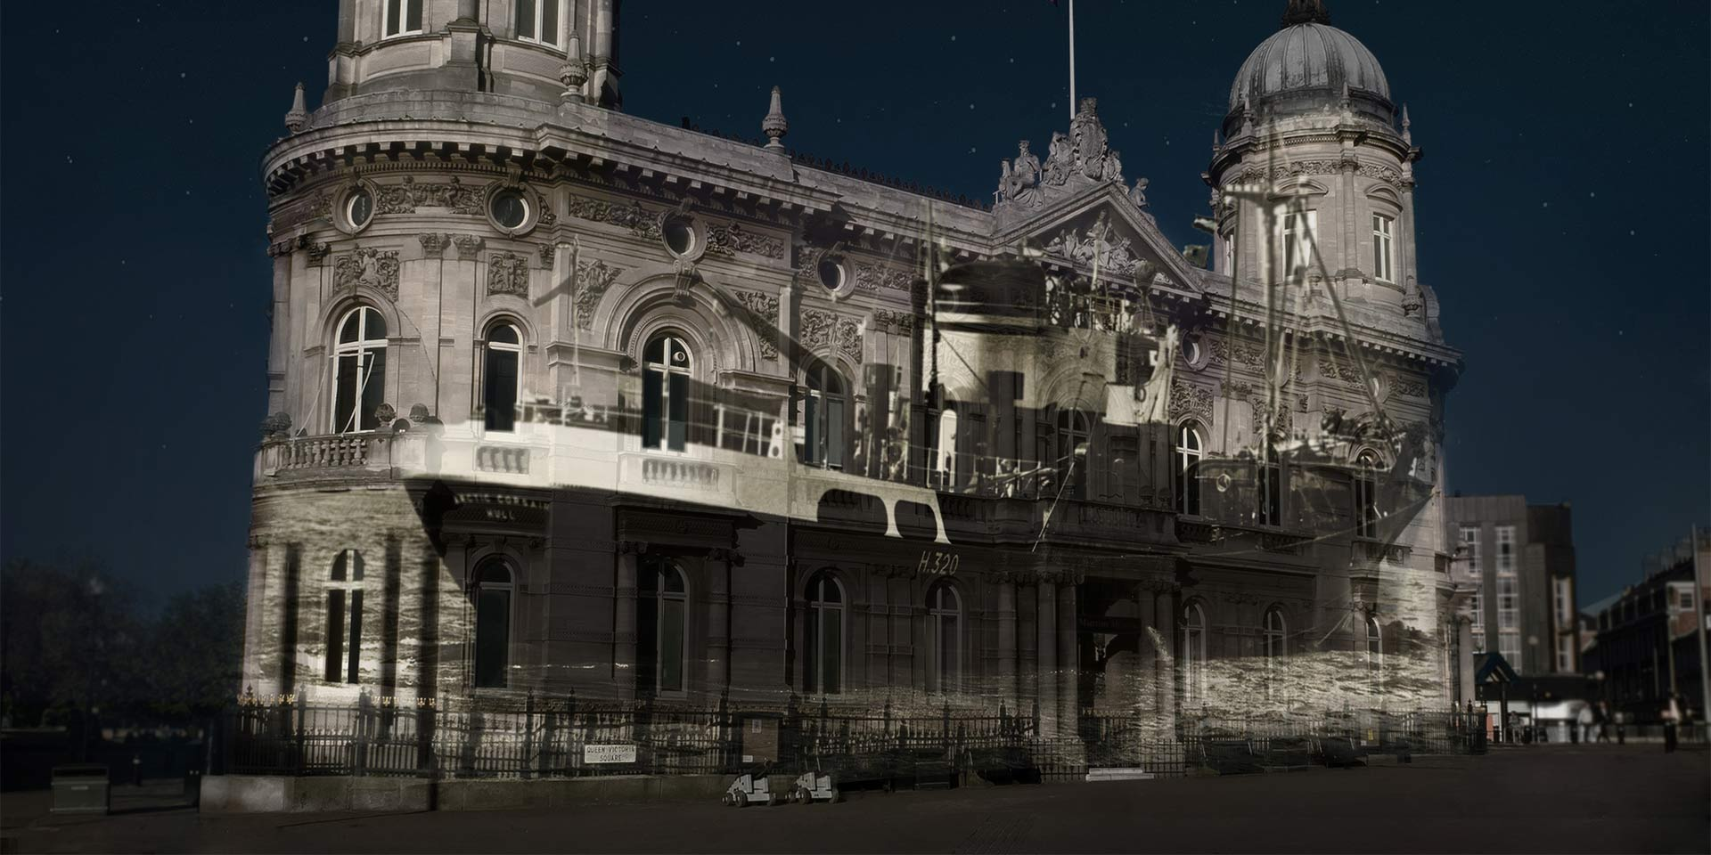
Notes:
As a “hero” project we have been undertaking a programme of in-depth evaluation for the event Made In Hull
This have involved research with a range of stakeholder groups:
Core Creative Team
Commissioned Artists
Audiences
Local Businesses
Media Analysis
Explain that the following slides will present some headline findings
Ask people what they think we have found out when undertaking monitoring and evaluation activity on Made in Hull

Slide 25
CORE TEAM: PERSONAL OUTCOMES
4 out of 6 said the experience had made them want to work on heritage inspired arts events in future
4 out of 6 reported having increased existing skills / knowledge through working on the project
3 out of 6 reported having gained new skills / knowledge through working on the project
All had built new working relationships and 4 out of 6 developed existing working relationships further
From the Core Creative Team’s viewpoint there were key learnings to take forward into further projects linked to the production of events of this type and scale
All would speak more positively about Hull after working on the project
Notes:
Explain these findings are based upon survey answers only and more in-depth qualitative interviews have also been taking place
Skills built upon or gained included project management; creative/artistic; MLA based; audience development; marketing; production and technical
The city is feeling empowered to have a profile on the world stage; the local audiences have embraced the event; history and heritage has been discovered or rediscovered; and people outside Hull are taking it seriously as a city

Slide 26
CORE TEAM: KEY SUCCESSES
Ownership of event by Hull residents
Sharing of Hull’s stories and histories
Strengthened sense of identity and community
Audiences participation and understanding
Content of the work and its quality
Emotional engagement of audiences
Retelling of a living history
Use of archive materials
The sound and light approach
Notes:
Skills built upon or gained included project management; creative/artistic; MLA based; audience development; marketing; production and technical

Slide 27
ARTISTS: PERSONAL OUTCOMES
An average score of 7 out of 10 was given by artists in relation to the amount they learnt about Hull’s history working on the event, and 8 out of 10 to the amount they learnt about Hull’s heritage working on the event
6 out of 9 said the experience had made them want to work on heritage inspired arts events in future
All reported having increased existing skills / knowledge through working on the project
7 out of 9 reported having gained new skills / knowledge through working on the project
Notes:
Explain these findings are based upon survey answers only and more in-depth qualitative interviews have also been taking place
History was defined as ‘past events connected with a person, thing or place’
Heritage was defined as ‘valued objects and qualities such as historic buildings and cultural traditions that have been passed down or preserved from previous generations)’
Skills built upon or gained included project development; creative/artistic; MLA based; project management; community engagement

Slide 28
ARTISTS: PERSONAL OUTCOMES
6 out of 9 had built new working relationships and developed existing working relationships further
From the Artists viewpoint there were key learnings to take forward and improvements to be made in relation to future projects of this type and scale
On average, artists agreed / strongly agreed, that as a result of Made in Hull, they were more confident working on high quality outdoor arts projects and heritage inspired arts events; they enjoyed working with a wider creative team; their profile had improved; and they reached more diverse audiences for their work
6 out of 9 would speak more positively about Hull after working on the project
Notes:
Explain these findings are based upon survey answers only and more in-depth qualitative interviews have also been taking place
Skills built upon or gained included project development; creative/artistic; MLA based; project management; community engagement

Slide 29
ARTISTS: KEY SUCCESSES
Participant connection and their reaction to the work
Developing skills to deliver work of this scale
The context it gave to Hull’s history
Working with artists from other art forms
Use of archive materials
Emotional engagement of audiences
Notes:
Skills built upon or gained included project management; creative/artistic; MLA based; audience development; marketing; production and technical

Slide 30
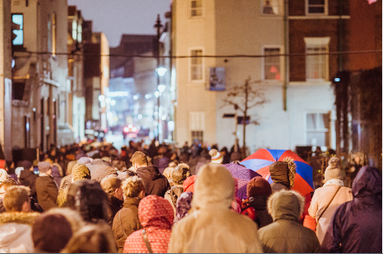
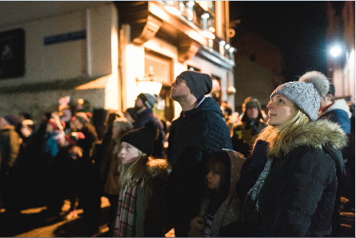
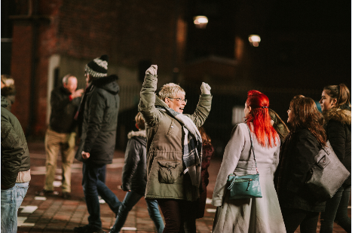
AUDIENCES
Notes:
We will be doing two focus groups this week to discover more about the reasons behind these findings

Slide 31
AUDIENCES: VISITOR NUMBERS
342,098
Notes:
This figure includes those attending the Fireworks on 1 January
Saturday 7 January was by far the busiest night with more the 103,000 visitors
64% of people only visited Made in Hull once
25% of people visited Made in Hull twice
11% of people visited Made in Hull three or more times
47% were Hull residents and 39% East Riding residents

Slide 32

AUDIENCES: MARKETING & COMMS
Word of Mouth
Newspaper
TV
Printed advertising materials
Notes:
Family/friends/ colleagues told me in person - 37%
TV – 36%
Newspaper – 25%
Advertising and printed promotional materials (e.g. brochure, leaflet, poster, billboard) – 20%

Slide 33
AUDIENCES: MOTIVATIONS
Hull 2017
Unique Experience
General Interest
Notes:
In addition 8 out of 10 visitors are being motivated to come to the city by the event or the city’s status in 2017:
60% visited Hull just for the event
21% visited because Hull is UK City of Culture in 2017

Slide 34
AUDIENCES: INSTALLATIONS VISITED
Installations visited in descending order:
Queen Victoria Square (100%)
Whitefriargate (90%)
The Deep (77%)
Zebedee’s Yard (77%)
High Street Underpass (63%)
Scale Lane (60%)
Humber Street (42%)
Silver Street/Queen Street (40%)
More than half of people (54%) visited 6 of the 8 installations.
9 out 10 people said Queen Victoria Square was their favourite installation.
Notes:
We will be doing two focus groups this week to discover more about the reasons behind these findings

Slide 35
AUDIENCE REACTION | AVERAGE SCORE OUT OF 10
Likeliness to recommend | 9.6
It was an interesting idea | 9.7
It was well produced and presented | 9.5
It was different from things I’ve experienced before | 9.3
It was thought-provoking | 9.3
It was absorbing and held my attention | 9.3
I would come to something like this again | 9.7
It is important it’s happening here (in Hull) | 9.7
It has something important to say about the world in which we live | 8.8
It was well thought through and put together | 9.3

Slide 36
NB: On the scale of 1-5, 4 = Agree and 5 = Strongly Agree

Slide 37
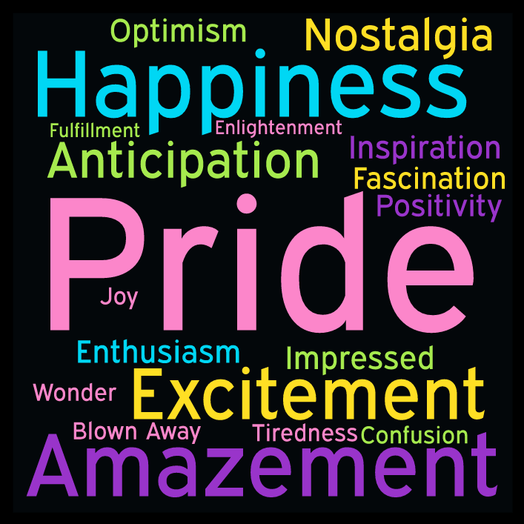
Overriding feeling ‘walk and talk group’ participants were left with
Notes:
53 People took part in walk and talk groups
2 Hull residents groups
1 East Riding group
1 tour with staff from partner organisations
1 tour led by local historian Paul Schofield
Participants aged from 11 years to 75+ years

Slide 38
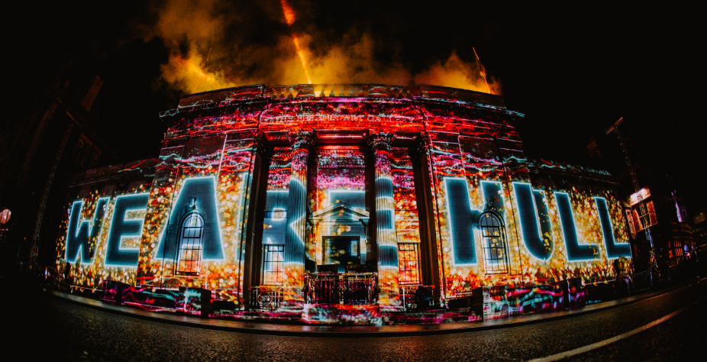

Slide 39
QUEEN VICTORIA SQUARE: WE ARE HULL
“The trawler bit was really sad, because it is so cold tonight, and just thinking about them out there when it was so cold.”

Slide 40
QUEEN VICTORIA SQUARE: WE ARE HULL
“It’s historical elements, you know the ones that happened before my time? I think those ones because those are quite a lot of the stories that we grow up on living on Hull and to have it depicted on the walls is absolutely brilliant.”

Slide 41
QUEEN VICTORIA SQUARE: WE ARE HULL
“I think seeing the fire and the flames coming out of all the buildings and then further on, highlighting the Hull Fair, the juxtaposition of those two, going from real lows to real highs and just being able to see it on all three buildings was pretty awesome.”

Slide 42
QUEEN VICTORIA SQUARE: WE ARE HULL
“The bit which stood out for me was the air raid first of all, and that made me feel sad because I’ve got family connections when that happened and family being bombed out and so on. And then the next bit I guess which really sticks in my mind is Deano’s goal at Wembley, 2008. And I wanted to cheer again – I still can’t believe it went in.”

Slide 43
QUEEN VICTORIA SQUARE: WE ARE HULL
“I remember one year when I went as a kid there was bare-knuckle boxers when I went when I was a kid, and I’m thinking really?! It was colourful Hull Fair. And there used to be a man who was a chicken as well wasn’t there – oh there was everything there!”

Slide 44
QUEEN VICTORIA SQUARE: WE ARE HULL
“Well I mean I’ve never seen scenes in town like this. It’s surreal.”

Slide 45
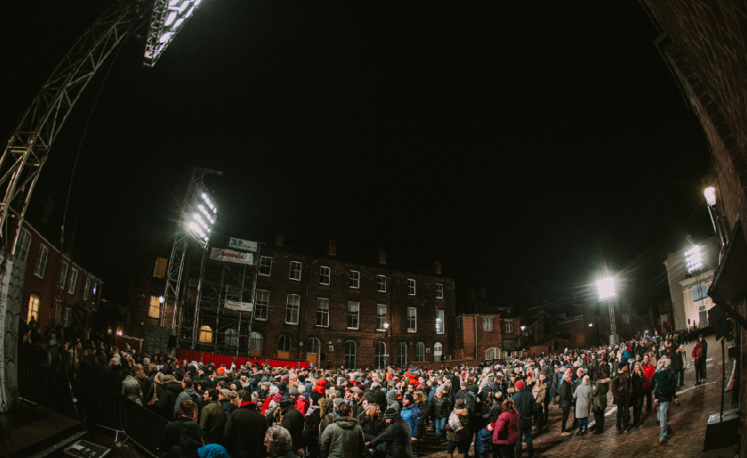

Slide 46
ZEBEDEE’S YARD: 105+dB
“When I heard them singing ‘Come on you Ull’, you know that chant ‘Come on you Ull’. And also the roar - that’s when they’ve scored a goal or just missed a goal or missed an opportunity. I think that was the surprise of that.”

Slide 47
ZEBEDEE’S YARD: 105+dB
“I just thought it was like spine tingling. I just thought it was… I just felt so elated. Just like every time they cheered I just got a spine tingle. You feel so good. And I’ve never been to a football match before. I’m not a massive fan but I’m a supporter. But I can’t imagine what the fans would feel like if they went in there.”

Slide 48
ZEBEDEE’S YARD: 105+dB
“I’m a photographer and I do a bit of videography as well, and the sounds, the sound of the goals is absolutely fantastic. You could feel it.”

Slide 49
ZEBEDEE’S YARD: 105+dB
“Yeah because Nikki was at the match so she said ‘Just wait a minute, just wait a minute, we’re gonna score’ and we were stood right near the speaker and was like woah! But that’s amazing because as somebody who goes to watch the football, to kind of almost feel that from what would essentially be a player’s point of view was amazing. Because how loud we got because we scored that goal. Because it sort of went quite quiet because you’ve got the Newcastle fans chanting, and then all of a sudden that – it was like ‘yaay’.”

Slide 50
ZEBEDEE’S YARD: 105+dB
“I think to be quite honest, all it did was… I thought – can you imagine when like a group of medieval people were going to do battle? Like primeval really isn’t it?”

Slide 51
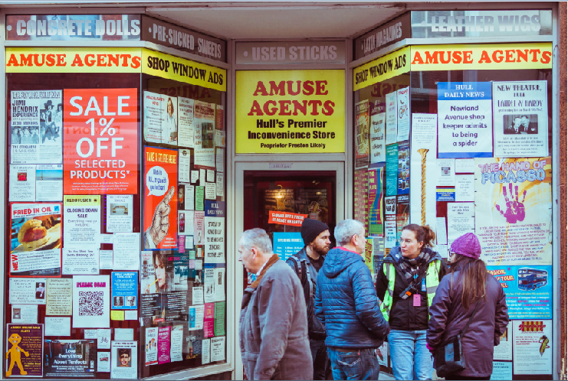

Slide 52
WHITEFRIARGATE: CHARACTERS OF HULL
“I think it was a good insight into Hull and the past. Just seeing the normal people of Hull just doing their thing just like everybody else.”

Slide 53
WHITEFRIARGATE: CHARACTERS OF HULL
“It’s just part of the city isn’t it. You live it, you love it. You know, it’s there. Just looking at the shirts, we’ve got all the shirts and all the memorabilia there. Happy memories.”

Slide 54
WHITEFRIARGATE: CHARACTERS OF HULL
“(Pauline’s gift shop) Next door but one to Sainsbury’s…It’s just one of those things that you just took for granted, and then when she died… it’s incredibly sad really. I taught her granddaughter, and I know Roland a little bit and so yeah, it’s a fixture and fitting really of Princes Avenue.”

Slide 55
WHITEFRIARGATE: CHARACTERS OF HULL
“And it was really nice to hear actual people’s stories, that was really nice. I liked [the Whitefriargate installations].”

Slide 56
WHITEFRIARGATE: CHARACTERS OF HULL
“It’s all different ways of getting the information across that you don’t normally see. Not just text to read, it’s stuff to see and look at and watch.”

Slide 57
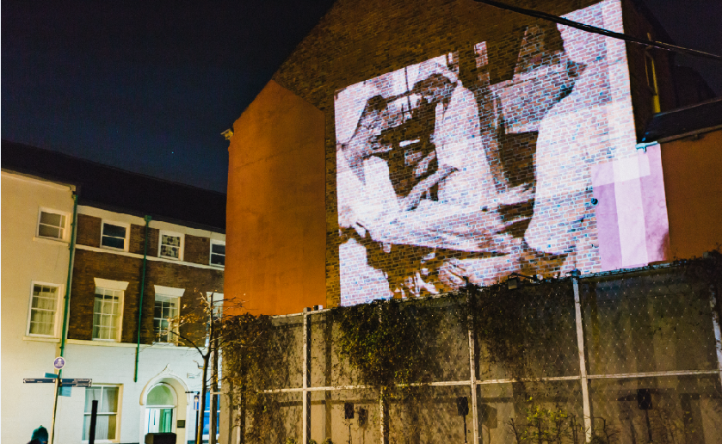

Slide 58
SCALE LANE: (IN) DIGNITY OF LABOUR
“Walking down the streets when he was sort of kicking his heels where there was just nothing there. As if it was just all gone and empty. Really good.”

Slide 59
SCALE LANE: (IN) DIGNITY OF LABOUR
“It was very poignant wasn’t it? It was really, really….you don’t think the youngsters can feel like that. It was as if, especially in that one little bit where he was like.. picking him up and then he was getting down and then picking him up…It’s really sad.”

Slide 60
SCALE LANE: (IN) DIGNITY OF LABOUR
“A lot of sadness. Very much so. You know it was just. I don’t know. I’ve got very mixed emotions after that one. It was hard to read that one. I wish more people had a positive attitude. You know, about the city. But yeah a lot of sadness there wasn’t there. I feel really sad, I do, honestly.”

Slide 61
SCALE LANE: (IN) DIGNITY OF LABOUR
“If you’ve been unemployed or you are unemployed, that idea of queuing or that never ending senseless toil. It’s very clever. Because at first you’re thinking ‘what?’ and then you realise.”

Slide 62
SCALE LANE: (IN) DIGNITY OF LABOUR
“I don’t know it’s quite hard really to put my finger on it. It’s not negative is it, but it’s quite down, it seems to be quite downbeat, you know like as in the decline of industry into like joblessness and that kind of thing.”

Slide 63
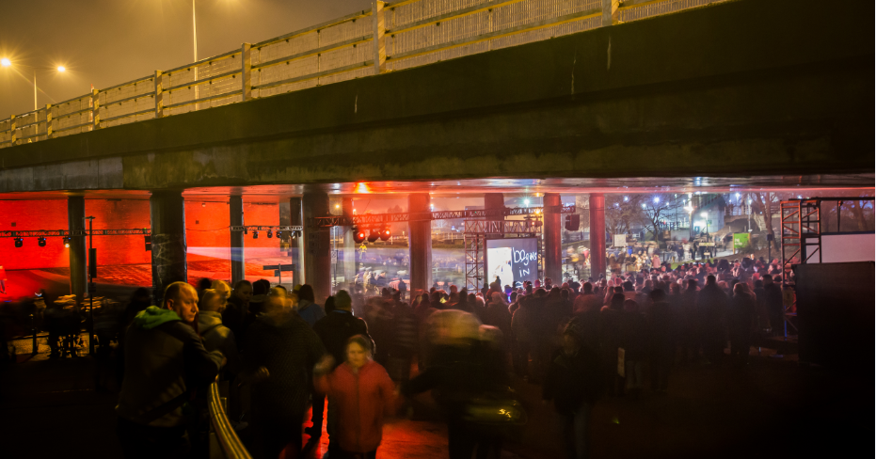

Slide 64
HIGH STREET UNDERPASS: EMBERS
“Disturbing. It was just like they had no control over what they were doing.”

Slide 65
HIGH STREET UNDERPASS: EMBERS
“I didn’t walk away thinking that was rubbish, I just thought, I’ve seen it now. But that’s probably only one out of all of them where I didn’t think ‘Gosh I could just watch that again and again.’”

Slide 66
HIGH STREET UNDERPASS: EMBERS
“It was very, very confusing...the images were a little bit obscure. The music with the images didn’t match, the music on top of that didn’t match and personally…We were expecting a sort of 90s kind of music themed thing and it wasn’t. A lot of people were disappointed.”

Slide 67
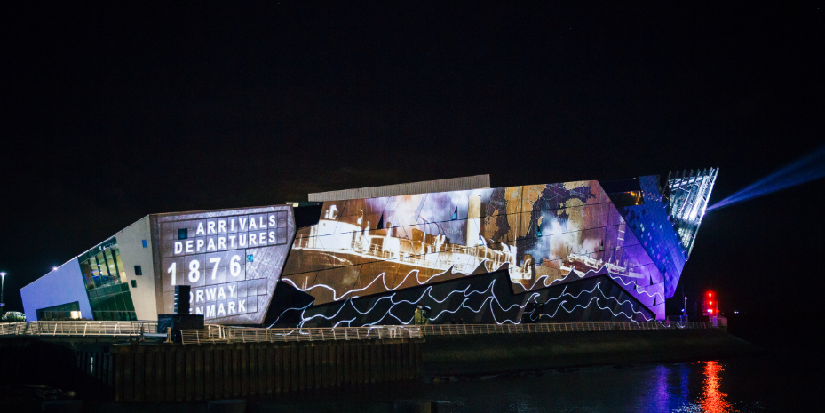

Slide 68
THE DEEP: ARRIVALS AND DEPARTURES
“Yeah that was really good. I saw my mother’s maiden name come up so it’s interesting isn’t it when you see someone come up that you know. It was good, interesting. Because it is all about people coming and going isn’t it. Yeah it’s just nice to get a reminder.”

Slide 69
THE DEEP: ARRIVALS AND DEPARTURES
“Amazing just to see the changes that have taken place. And the waves of change.”

Slide 70
THE DEEP: ARRIVALS AND DEPARTURES
“I just loved the kind of multi-cultural-ness of it. I’m not sure that kind of comes out of the other ones really. And [Hull] being quite an inclusive place…You know people think Hull is quite an insular place, but it is really diverse actually - it’s not as diverse as other places, but in terms of people coming through the docks and stuff.”

Slide 71
THE DEEP: ARRIVALS AND DEPARTURES
“I thought it was lovely, because I’ve got relatives that came from Russia and Poland. And everybody has, if you go back 3 or 4 generations, most people came from somewhere else. And now we’re all here and some go on elsewhere. It’s just lovely.”

Slide 72
THE DEEP: ARRIVALS AND DEPARTURES
“Yeah they talk about Hull being the end of the road, but actually, it’s the beginning. A lot of people I know have been talking to this lady here, lots of people born here travelled all over the country and all over the world, and eventually come back and settle back here. So this has been a bit nostalgic for me, like a walk down memory lane, you know some of the different things that were portrayed meant a lot. And one of the most significant things is the music, the one hymn ‘Those in peril on the sea’ we used to sing that often in our school assemblies, because of course with the trawler-men going out to sea and so many tragedies, we used to sing it often, so when that music came on it just took me back to those days.”

Slide 73
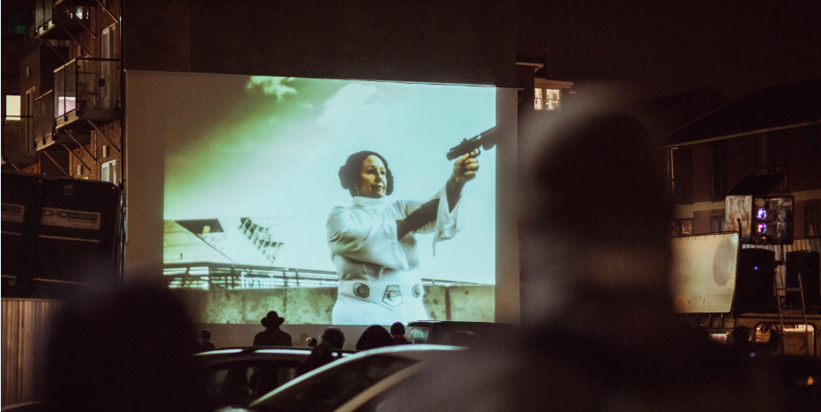

Slide 74
HUMBER STREET: HULLYWOOD ICONS
“Yeah I think that’s really fun. It’s good to see the people of Hull getting stuck in and doing something different.”

Slide 75
HUMBER STREET: HULLYWOOD ICONS
“I thought that was quite fun, especially because you know it’s people from here as well and everyone’s got involved in that.”

Slide 76
HUMBER STREET: HULLYWOOD ICONS
“Awesome, I love the Hullywood one, we’re doing one back at the University, we’re going to do a few of them. I think I’m doing Weird Science, Jurassic Park or Honey I Shrunk the Kids.”

Slide 77
MEDIA
2,350 pieces of coverage across print, online and broadcast
3.2 billion total readership across print, online and broadcast
38 national newspaper pieces
More than 1,750 mentions across TV and radio
More than 550 online pieces
More than 3,500 click-throughs to www.hull2017.co.uk

Slide 78
MEDIA: BROADCAST HIGHLIGHTS

Slide 79
MEDIA: PRESS HIGHLIGHTS

Slide 80
MEDIA: SENTIMENT
Notes:
Editorial coverage was largely neutral (65%), but with a strong positive skew at 32%.

Slide 81
LOCAL BUSINESS: POSITIVES
51% reported that Made in Hull had a positive / very positive impact on their business, citing increased passing trade; increased footfall; positive atmosphere; reduction in stock wastage; new and more diverse customers as their motivations for giving this response
37% reported an increase in turnover compared to 2016 for the same week and 27% an increase in profit
Increased turnover ranged from +8% to +567% and increased profit from +10% to +610%
22 businesses increased the hours of current staff and a few employed additional staff
28% reported an increase in customers / room bookings compared to 2016 for the same week
85% rated the event with 4 or 5 stars
Notes:
72 local businesses (members of Hull BID) responded to a survey linked to the Made in Hull event

Slide 82
LOCAL BUSINESS: NEGATIVES
12% reported that Made in Hull had a negative / very negative impact on their business, citing orange barriers, traffic congestion; Queens Gardens being dug up; and visitors only wanting food and drink (not other products) as their motivations for giving this response
21% reported an decrease in turnover compared to 2016 for the same week and 16% an decrease in profit
Decreased turnover ranged from -1% to -100% and decreased profit of 100% (only 1 respondent)
15% reported a decrease in customers / room bookings compared to 2016 for the same week
3% rated the event with 1 or 2 stars
Notes:
Those businesses reporting decreases in turnover and profit were mostly closed on Sundays; opened only until 5:30pm, and did not change their opening hours in responses to the Made in Hull event
2 of the 3 that did change their hours opened a few additional hours – one and additional two hours on Thursday (to 6pm) and one hour (to 5pm) on Saturday; the other opened specially on the Monday and for an additional 90 minutes Tuesday to Sunday
1 of the 3 was closed for the entire week, where normally their business would run from 11-4pm over the weekend (it is not clear if they were unable to open because of the event)

