Slide 1


Slide 2
MARTIN GREEN
CEO & DIRECTOR

Slide 3
THE BEGINNING
Hull was announced the winner of UK City of Culture 2017 in 2013.
The award is given to a city every four years that demonstrates the belief in the transformational power of culture

Slide 4
THE BID IN BRIEF
High-quality international programme
Global in outlook, locally rooted
“The city is the venue”
Environmental legacy
4000 volunteers
365 days, more than 60 commissions and 25 festivals

Slide 5
THE VISION
  365 days of transformative, artistic adventures.
  Raising aspirations, changing perceptions, celebrating talent.
  Hull will be the epicentre of cultural activity and debate in the UK in the run up to and during 2017

Slide 6
THE PROGRAMME
The arts and cultural programme for the year will celebrate the unique character of the city, its people, history and geography
In 2017, the programme will run from 1 Jan to 31 Dec

Slide 7
THE FOUR SEASONS
The year will be split into four seasons, each with something distinctive, intriguing and created to challenge and thrill
MADE IN HULL
ROOTS & ROUTES
FREEDOM
TELL THE WORLD

Slide 8
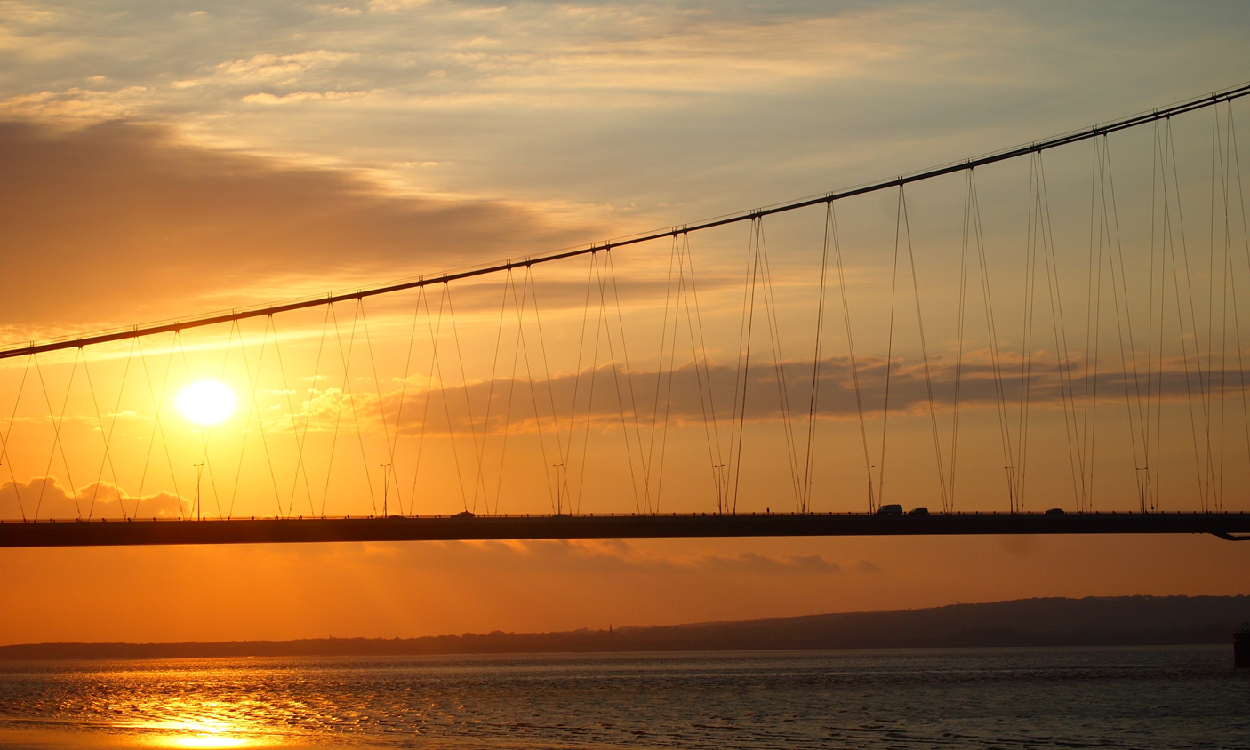
The Humber Lights

Slide 9
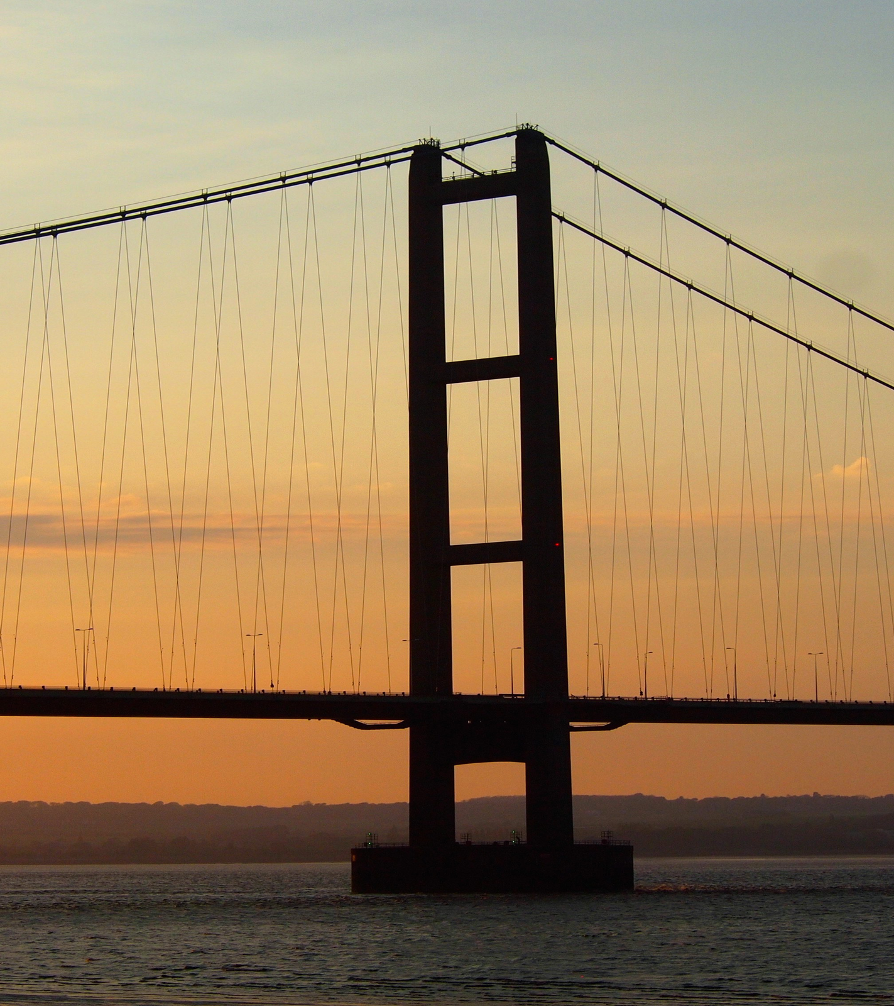
THE HUMBER LIGHTS
The largest interactive artwork in
the world
A national visitor attraction
A global media and online
destination
Showcasing regional innovation
and ambition
With potential for significant
positive economic impact

Slide 10
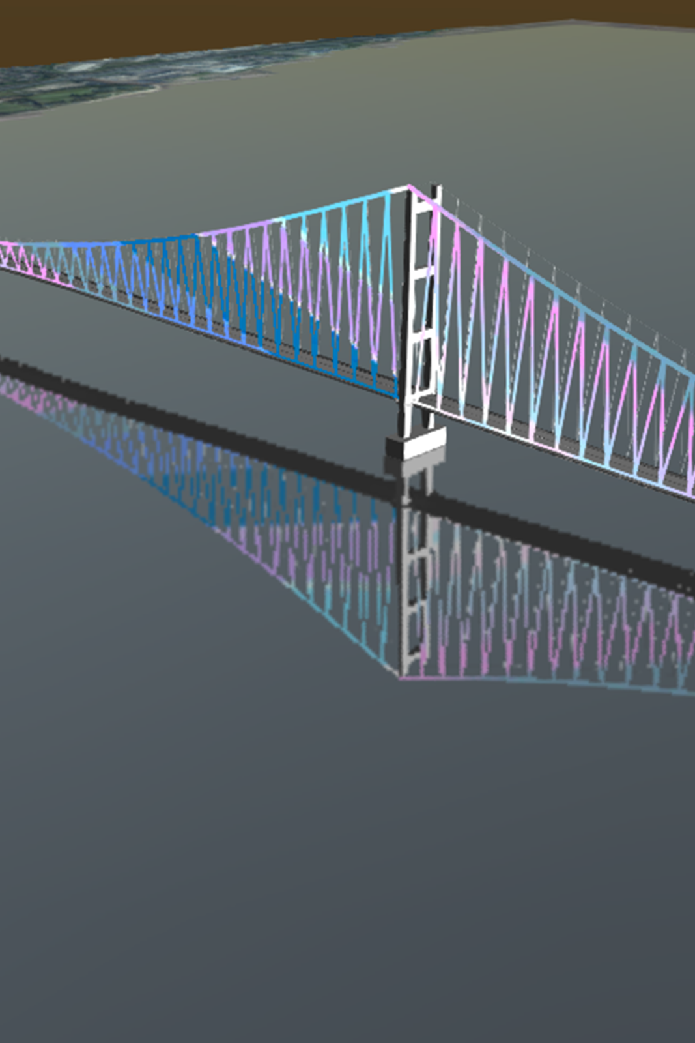
AMBITION AND SCALE
Over 20km of state-of-the-art LED
lights
In excess of 70,000 light nodes
Connected to the internet
Designed and controlled using
leading-edge technology
Making the most of one of the
region’s greatest assets
Changing the way in which people
see the region for ever

Slide 11

A VISITOR ATTRACTION,
MEDIA DESTINATION
AND UNIQUE LEGACY
Will increase physical visits with
potential to drive evening economy
Will provide a media focus and
ongoing global attention
Created as a lasting legacy of Hull
UK City of Culture 2017
Initial planning for one year with
intended long-term extension

Slide 12
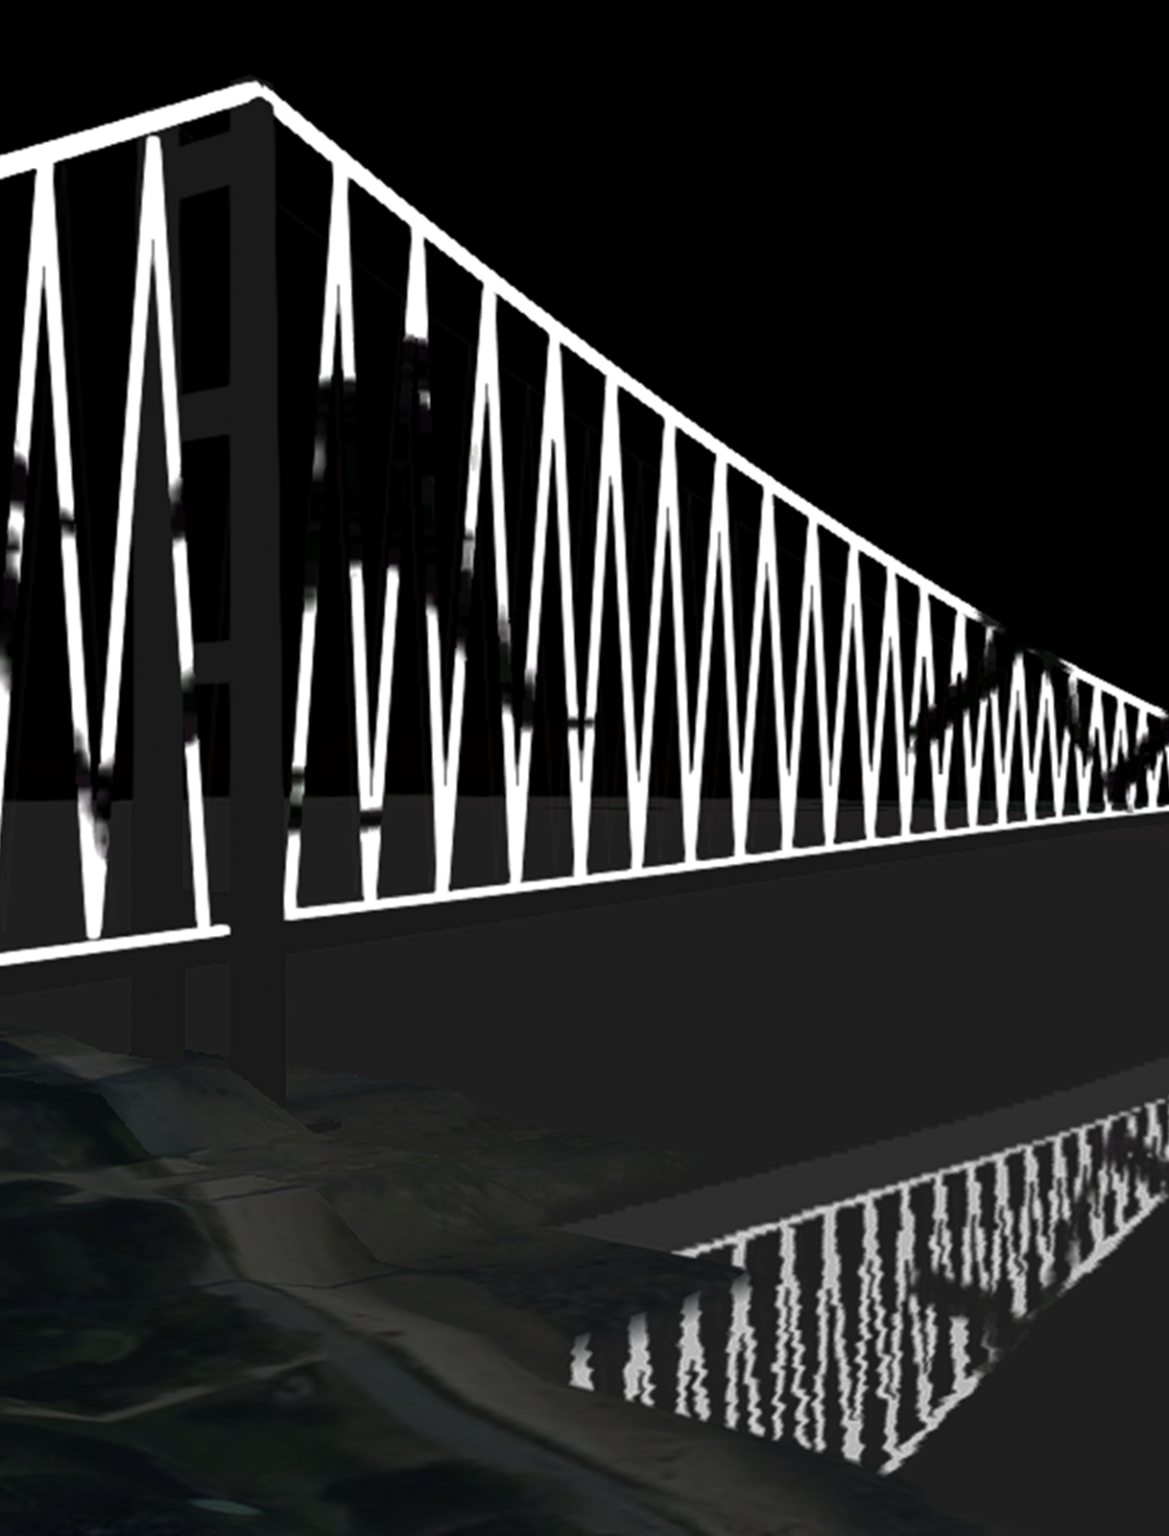
ARTISTIC PROGRAMME
Unique, flexible creative tools to
design displays
By well-known and emerging
artists
Games and data visualisation
designers
Via design competitions, public
vote and commissions
Local coding challenge supported
by major tech player

Slide 13
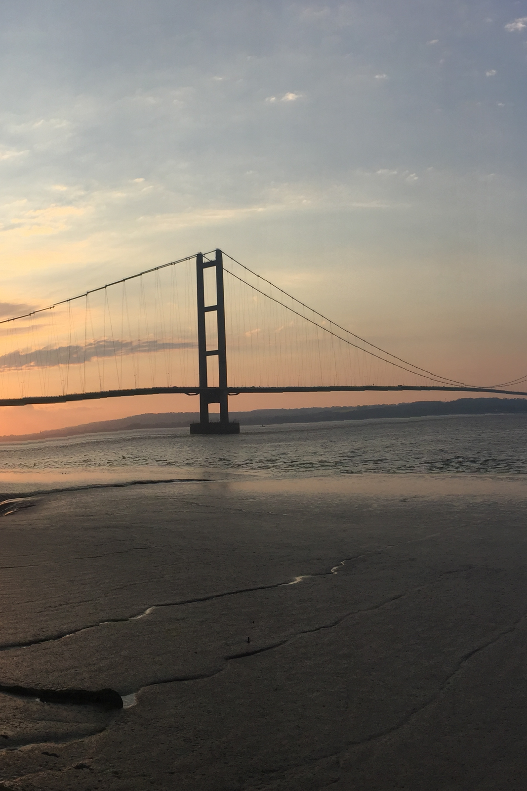
LOGISTICS
Budget £4.3M
£1.0M secured
Decision to proceed by
December 2016
Project Greenlight January 2017
Equipment installations
Summer 2017
Launch October 2017

Slide 14






HullCityofCulture
@2017Hull
@2017Hull
Hull2017
EMAIL ALERTS
hull2017.co.uk/signup
WEBSITE
hull2017.co.uk

Slide 15


