Slide 1
The ‘Not-Knowns’
Dr Sarah Jane Dickenson
University of Hull

Slide 2
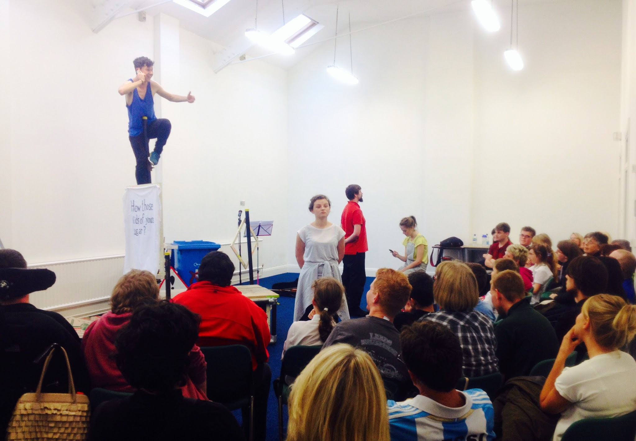

Slide 3
Project aims
Engage the ‘not known’ young people in a process of exploring their ideas of memory and autobiography, and in creative arts experiences;
Produce a play which would explore the ‘not known’ young people’s life stories, and bring together these disciplines in that development process;
Share the play with other young people in Hull and support engagement with it through a participatory workshop element looking at memory, science, narrative and autobiography, and a resource pack for follow-up work in schools receiving the play;
Support the ‘not known’ young people in developing their own creative work, including a group authored play which was performed to an audience at the end of the project.

Slide 4
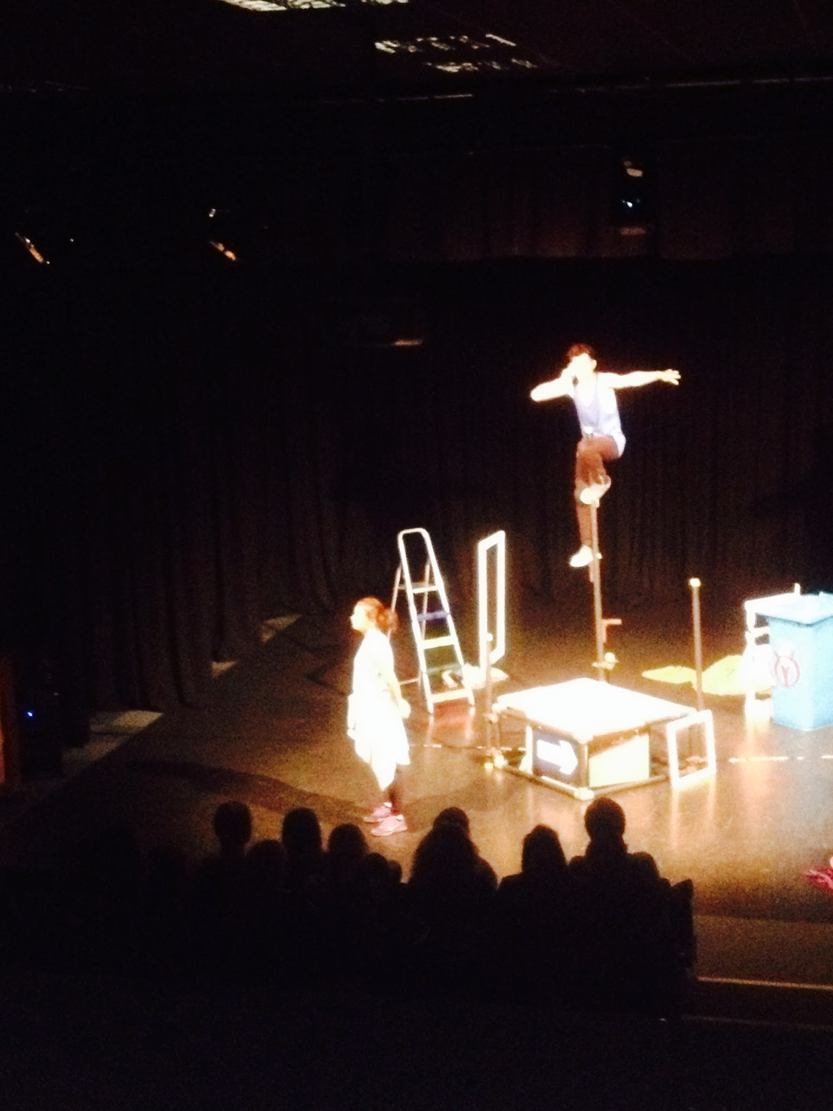

Slide 5
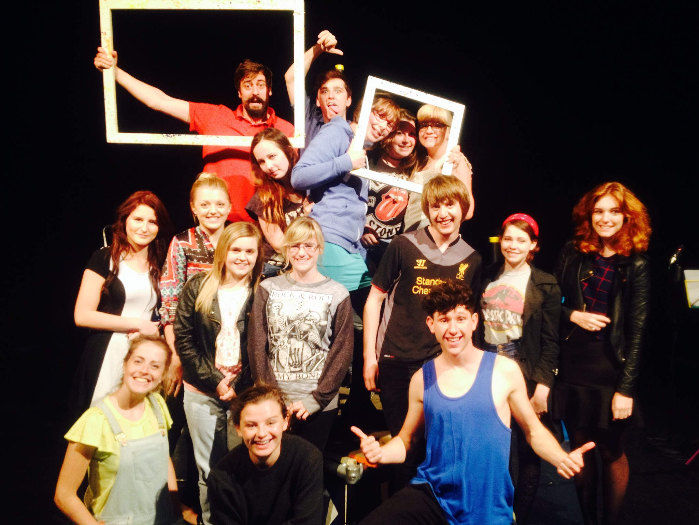

Slide 6
Participation data
Participatory phase one: 25 young people.
Participatory phase two (audience for play and workshop) 1255 young people.
Participatory phase three: 38 young people at IGEN and Hull Training

Slide 7
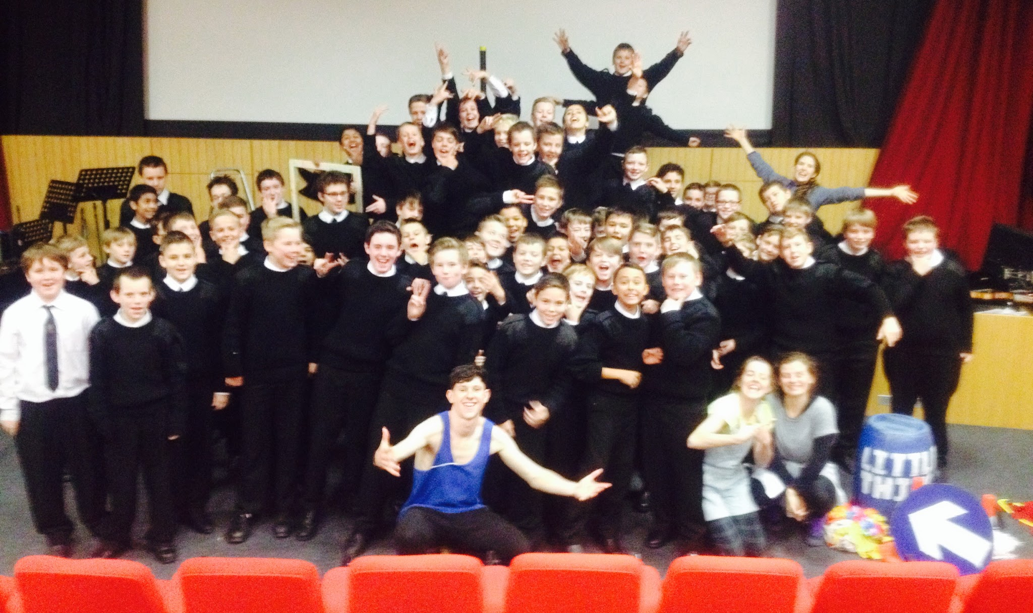

Slide 8
Contact
S.J.Dickenson@hull.ac.uk

