Slide 1


Slide 2
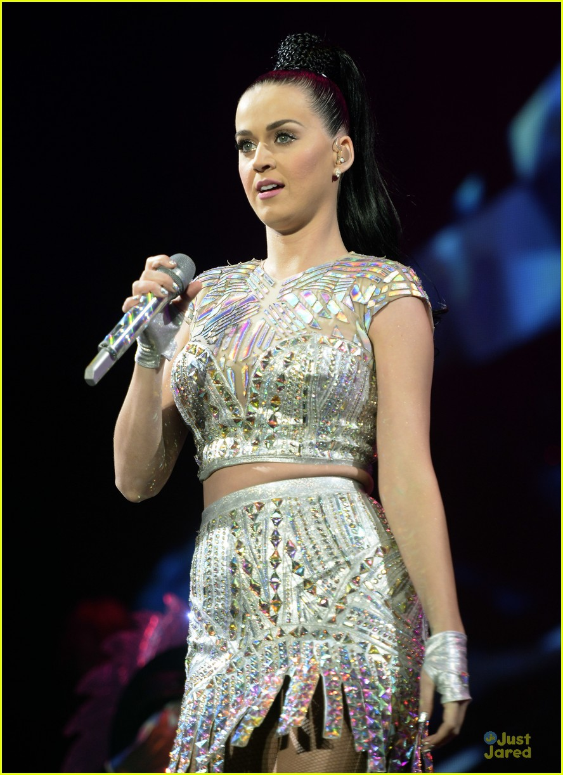
Radio 1’s Big Weekend is the stations’ flagship event each year Hull is the 16th Big Weekend, previous host cities include Glasgow, Derry Londonderry, Bangor, Norwich & Exeter Artists performing this year include Katy Parry, Little Mix, Kings of Leon and Stormzy Radio 1 reaches 42% of all 15-24 year olds in the UK Radio 1’s Big Weekend Hull will be a major part of Hull UK City of Culture 2017 The event is covered on BBC Radio 1, BBC Radio 1 Extra, BBC iPlayer and BBC Red Button.
Notes:
Overview of reach of Radio 1 and Big Weekend
How it fits into Hull 2017 music programme
Reaches a younger audience
Major event in the Hull 2017 Programme

Slide 3
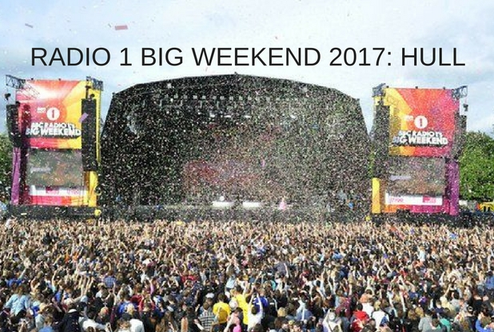
ECONOMIC BENEFITS Radio 1 Big Weekend brought over £3.5m to the local economy in Exeter and Teignbridge An average spend of £58 per person (off site) Exeter recorded 100% hotel occupancy across Big Weekend Glasgow estimated a Press and Marketing value of £10.2m
Notes:
Big Weekend has economic benefits for the area in which it is held
Some examples here from Exeter
Similar to this year, it was not in Exeter boundary, but in Teignbridge council area
Visitor spend is across many area
Accomodation
Travel
Restaurants
Bars
Shops

Slide 4
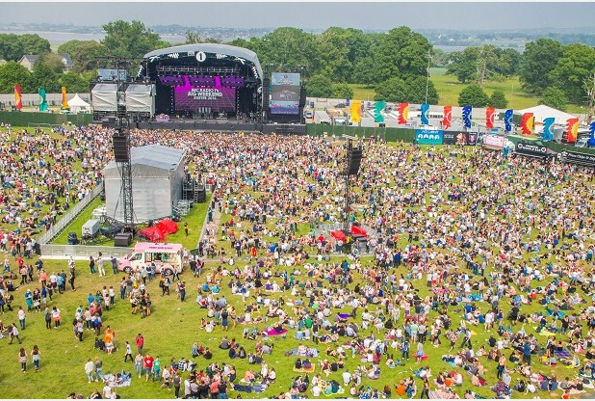
Exeter & Teignbridge “That was outstanding – the experience of a lifetime for me and much of Devon. Thanks from the bottom of my heart” – Earl of Devon “It’s been a memorable weekend for the people of Teignbridge and one which has truly put our wonderful region on the the national and world stage. In years to come, this will still be the talk of Teignbridge and it’s a proud chapter in our local history. Such a huge event would not have been possible without the support of our residents” – Cllr Jeremy Christophers, Leader, Teignbrdige Council.
Notes:
Some quotes from the Earl of Devon and the Leader of Teignbridge Council

Slide 5
WHO IS DELIVERING RADIO 1’S BIG WEEKEND
Delivering an event like Radio 1’s Big Weekend requires co-operation between many organisations and agencies, these include:
Radio 1 Hull UK City of Culture 2017 East Riding of Yorkshire Council Hull City Council Humberside Police Yorkshire Ambulance Service | Burton Constable Foundation Burton Constable Estate Natural England Historic England Humberside Fire & Rescue
Notes:
Talk through the various parties and what their role in delivering the event is

Slide 6
The
Site
Notes:
Talk through the wider site map
Highlight:
Security perimeter
Access routes
Bus area

Slide 7
The
Arena
Notes:
Details of
Stages
Fairground (not white knuckle)

Slide 8
THE SITE
Burton Constable is an historic site, why has the event been allowed to go ahead here?
Burton Constable is an historic location and was originally landscaped by Capability Brown. All the plans for the event have been drawn up with this in mind. It is a unique opportunity to introduce this beautiful house and grounds to a new audience both live and on television.
All the plans for the event have been approved by the Burton Constable Foundation, Natural England and Historic England.
Notes:
Talk about
Collaboration with Natural England / Historic England and approvals process
Why this site
Opportunity to showcase the region on TV
Foundation were very keen to introduce new visitors to the area

Slide 9
TRAFFIC MANAGEMENT
How will the local area cope with all the visitors and traffic?
Ticket holders are being brought to and from the site in a fleet of shuttle buses, which dramatically reduces the environmental impact.
An extensive traffic management plan has been developed to deal with the additional traffic, this will be operated by a company who have extensive experience of this type of event.
How will you stop people dropping off ticket holders in Sproatley for the local shuttle bus?
The local shuttle bus is not being advertised publicly and is by invitation only. Special wristbands will be issued to local residents on proof of address and event tickets.
Notes:
How many buses?
Ingrees – 116 average 3 trips each over 4.5 hours (09:30 – 14:00)
Egress – 169 – average 2 trips over 2hrs 40mins (21:20 – 23:59)
A lot of buses, but better than upto 12,500 private vehicles

Slide 10
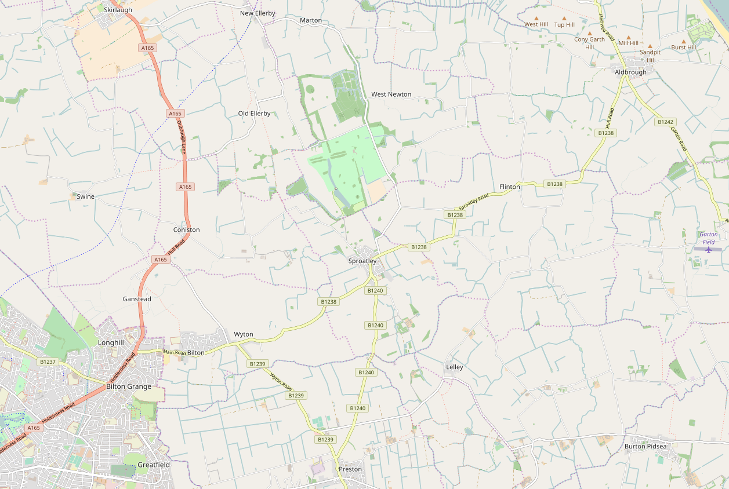

Figure 6: Burton Constable Local Area Traffic Management Plan : General Arrangement
Vehicle check area
SITE ENTRY
(A165 Skirlaugh)
Source Imagery: Copyright Google Earth Pro (License Key-JCPMR5M58LXF2GE)
N
DRAFT
Temporary Bus Station and Taxi/PHV area
Coniston
Event
Blue Badge/Special Guest Parking
SITE EXIT
(B1238 east of Sproatley)
Authorised vehicles route (Bus, Taxi, PHV, Operations, Production, Artistes, Local Residents)
Unauthorised vehicles exit route
Production Route (Event)
Blue Badge/Special Guest route
Local resident route
One-Way Traffic
Two Way Traffic
Control point
Notes:
Explain:
Traffic control points
In place to ease access to the site and reduce disruption to local residents
Need for Pasture lane closure to stop unauthorised vehicles
Residents on affected routes will be given passes

Slide 11
Figure 7: Burton Constable Local Area Traffic Management Plan : Exit Phase
Authorised Vehicle Route operates South to North during Exit Phase on both days of event (14:30 to 00:00)
SITE EXIT
(A165 Skirlaugh)
Source Imagery: Copyright Google Earth Pro (License Key-JCPMR5M58LXF2GE)
N
DRAFT
Temporary Bus Station and Taxi/PHV area
Coniston
Event
Blue Badge/Special Guest Parking
SITE ENTRY
(B1238 east of Sproatley)
Authorised vehicles route (Bus, Taxi, PHV, Operations, Production, Artistes, Local Residents)
Production Route (Event)
Blue Badge/Special Guest route
Local resident route
One-Way Traffic
Two Way Traffic
Control point
Notes:
Reversal of route for egress

Slide 12
Figure 8: LATMP : Extents of proposed temporary Clearway order
Source Imagery: Copyright Google Earth Pro (License Key-JCPMR5M58LXF2GE)
N
DRAFT
Parking limited to 1 hour no return within hour adjacent to Post Office, local shops and Public Houses
KEY
No Stopping At Any Time
Notes:
Clearways in place under TTRO
To keep traffic moving
To prevent people from parking and trying to walk to site
Tow away vehicles will be used
Advance signage and adverts will be used
Sproatley will have limited parking for local shops

Slide 13
Source Imagery: Copyright Google Earth Pro (License Key-JCPMR5M58LXF2GE)
Figure 9: LATMP : Proposed temporary road closures except for authorised vehicles
N
KEY
Proposed temporary road closures
Notes:
Map of road closures
Residents on these routes will be able to access these routes

Slide 14
TRAVEL TO SITE
Drop-offs and Pick ups
It is not possible to drop off or pick up concert goers at Burton Constable. Vehicles attempting to drop off or pick up passengers will not be allowed into the road closure and will be redirected to Leconfield Park & Ride
Walking & Cycling
For public safety reasons it will not be possible to walk or cycle to the event.
Taxis/PHVs
A taxi/PHV area will be provided at the site to facilitate drop-offs and pick-ups. The facility will not operate as a hackney carriage rank and will be available for both taxi and PHV usage.
Notes:
Taxis – ticket holders are being encouraged to use shuttle services to reduce number of small vehicles on the routes

Slide 15
LOCAL TICKET HOLDERS
As a local resident do I need to use the shuttle bus services?
Residents who live directly on the road closure route will be offered a shuttle service. Other local residents will need to use other services.
As a local resident will a walking path be available?
Owing to volume of traffic on narrow rural roads, it will not be safe to walk to the site
As a local resident will I be able to leave and return to site?
No, there is no readmission for any ticket holders
Notes:
Unfortunately we can only offer the shuttle service to ticket holders living directly on the route.
We now have the ticket data from Radio 1 so will be able to contact these tickets holders directly.
Getting to and from a large event like this always requires a degree of inconvenience and hopefully this wont detract from the enjoyment of the show.
Because of the large number of attendees we cannot tailor the arrangements to everyone's satisfaction
Safety is our number one concern
Radio 1 always brings the event to areas that do not usually attract events of the this scale.
Walking and cycling will not be a safe option owing the large number of buses in the area, especially after dark. The road closure order does allow the prevention of waling and cycling.

Slide 16
RESIDENT INFORMATION
NOISE MANAGEMENT
What measures will be in place to minimise noise pollution?
Noise levels at the concert will be monitored at all times and will not breach regulated levels. A resident hotline number will be distributed in case of complaints.
How much traffic is anticipated in the lead up to the event?
The onside build starts on May 11th and production vehicles will be arriving at the site throughout the following 2 weeks. The break down will take 1 week.
Notes:
There statutory noise levels that have to be complied with.
Initial calculations show that the nearest properties to the event will experience levels well below these
Noise propagation tests will be carried out on the Friday before the event
Numbers of trucks will vary but should be no more than 10 or 12 on the busiest days.
These will be timed to avoid school bus times

Slide 17
RESIDENT INFORMATION
NOISE MANAGEMENT
How late will busses run after the event?
The last buses are scheduled to leave the site at 23:59
What time does the event end – can you guarantee this will finish as scheduled and there will be no late night noise issues?
The last performances finish at 22:00. This is a condition of the event licence, so performances cannot continue after then.

Slide 18
RESIDENT INFORMATION
SECURITY AND WASTE MANAGEMENT
How is security at the event site being managed?
Event security is being provided by a specialist company who have decades of experience of managing crowds at large music events.
Will audience attending the event be able to access local properties?
The event site is surrounded by a 3 metre high ‘steel shield’ fence. It will not be possible for concert goers to leave the site other than via the main entrance/exit and shuttle buses.
Notes:
Security levels have been discussed and agreed with Humberside Police
All event plans are agreed by the Safety Advisory Group
ERYC & HCC
Highways
Environmental health
Licencing
Health & Safety
Humberside Police
Yorkshire Ambulance Service
Humberside Fire & Rescue

Slide 19
RESIDENT INFORMATION
SECURITY AND WASTE MANAGEMENT
What measures are in place to minimise waste coming out of the site area and into the local area?
A specialist waste management company have been engaged keep the site clean. They are onsite from the start of the build to the end of the break down. Although sites are always left clean, extra care will be taken at Burton Constable because of the historic nature of the land.

Slide 20
RESIDENT INFORMATION
AUDIENCE PROFILE & WELFARE
What is the anticipated age range of the event?
Radio 1’s target demographic is 15-24 year olds, however Big Weekend is a family friendly event that attracts a wide age range of attendees.
Are unaccompanied minors allowed on site?
No. Anyone under 16 must be accompanied by an adult. ID checks are carried out at the ticket gates.
What is the provision for the sale of alcohol on site?
There are several bars onsite. All operate a Challenge 25 policy. The family nature of this event means that large volumes of alcohol are not consumed.
Notes:
Emphasise the family nature of the event

Slide 21
RESIDENT INFORMATION
AUDIENCE PROFILE & WELFARE
Will the event put a strain on local medical resources?
No, the event has it own private medical team with doctors, paramedics, nurses and first aiders onsite. There are onsite treatment facilities and three ambulances should anyone require transport to hospital.
What welfare provisions are there onsite?
A welfare team are onsite to reunite lost children with their families and to deal with any issues such as dehydration or over exposure to the sun.

Slide 22
RESIDENT INFORMATION
AUDIENCE PROFILE & WELFARE
How do you intend to prevent audience attending becoming a nuisance to local residents?
The audience will arrive on shuttle buses and from that moment they are in an enclosed event site until they leave.
What measures will be in place for nuisance audience members and the welfare of local residents?
Along with the security personnel, Humberside Police will have a presence at the event. If necessary troublesome audience members will be ejected and removed from site. This is a rare occurrence at Radio 1’s Big Weekend

Slide 23

Notes:
Any questions?

