Slide 1

HAZEL COLQUHOUN
ANDREW KNIGHT
LOOK UP

Slide 2
HAZEL COLQUHOUN ANDREW KNIGHT
Large scale public art programmes Canterbury, Whitstable, A13 Artscape, Newcastle upon Tyne NHS Trust, Yorkshire Wolds Way, Sustrans
High profile temporary commissions Illuminating York, York Curiouser
Hull projects Hull Truck Theatre, Riverside Extra Care
Skills and services curation, programming, project management, strategy/policy development, research, writing, funding, marketing, PR, capacity building, training, consultation
Employment Arts Council Yorkshire, London Docklands Development Corporation
Qualifications BA Hons Geography, MA Arts Management; Research Associate, University of York
Large scale public art programmes Bridlington Promenades, Tyne & Wear Metro, Ashford Ring Road, Newcastle upon Tyne NHS Trust, Yorkshire Wolds Way
High profile temporary commissions 'Lost O’ Ashford, Illuminating York,
Hull projects Fish Pavement, HCC Public Art Strategy, STAND, Hull BSF, HCC Public Realm Strategy 2014, Turner Prize in Hull Feasibility Study, Riverside Extra Care
Skills and services contemporary art and design practices, creative collaboration, urban design, curation, programming, project management, strategy/policy development
Employment AIR & SPACE Studios, Institute of Contemporary Arts, Welsh Arts Council, Andrew Knight Gallery/Consultancy, Humberside/ERYC
Qualifications BA Hons Fine Art, FRSA

Slide 3
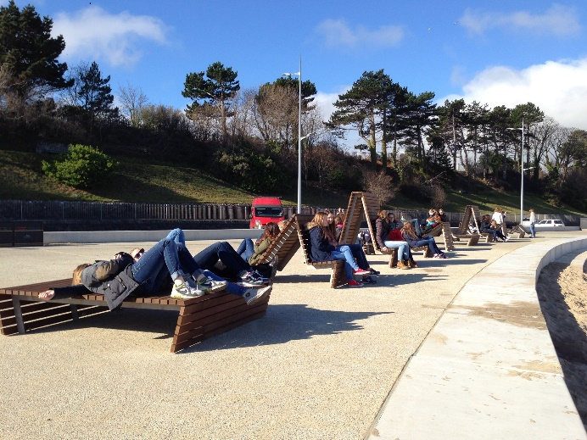
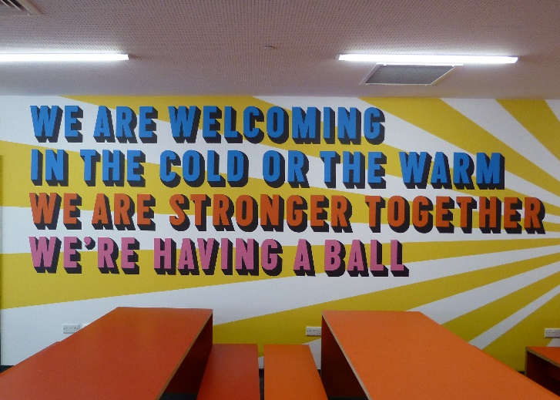
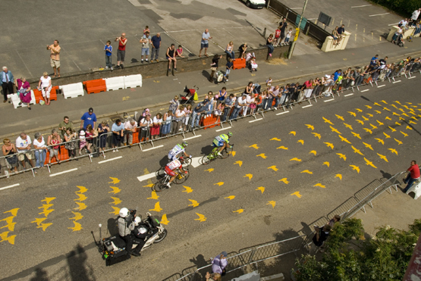
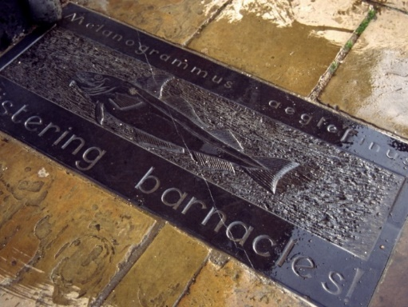
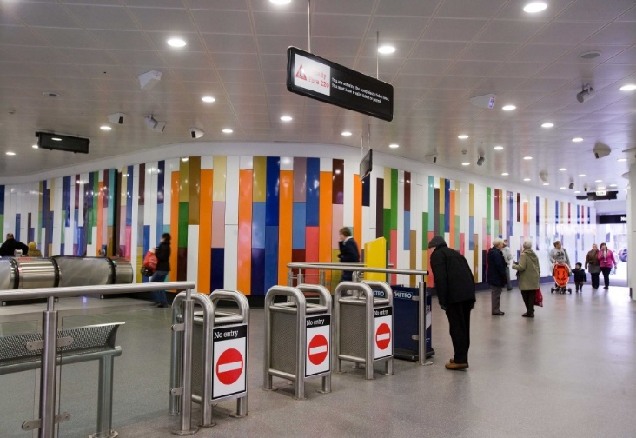
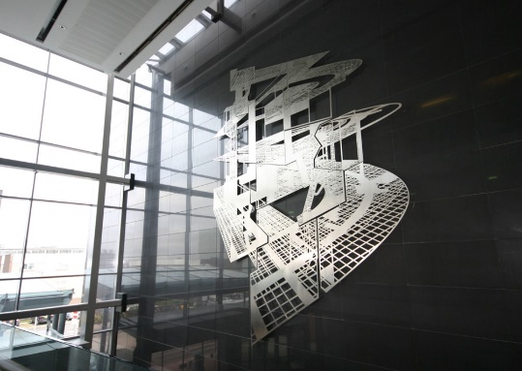
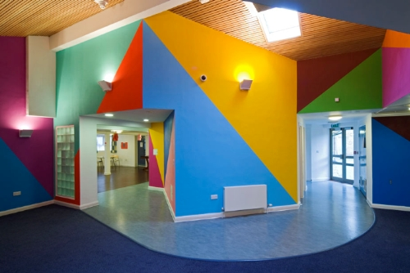
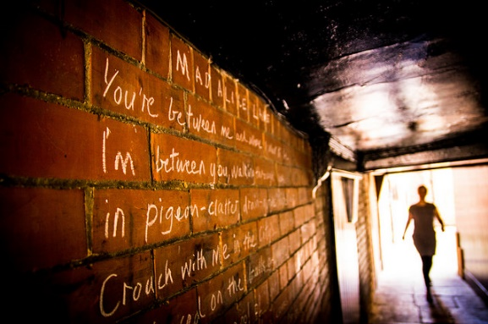
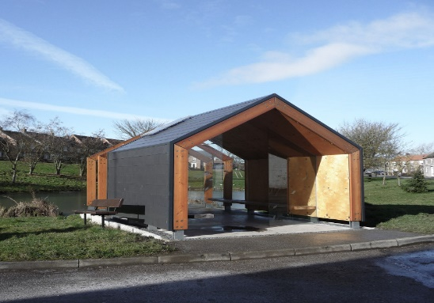

Slide 4
ASSOCIATES
SAM WILKINSON
Curation, Project Management
Visual Art/Public Art Consultant:
Commissions management, curation, collections management. Strategy, policy,
Key projects
NW Cambridge, Olympic Park, Bristol Broadmead, Exeter Princesshay
STUART GLADSTONE
Production Management
Event Manager
Skyride York (2015 &2014); Tour de Yorkshire 2014 (York); Tour de France
Stage 2 2014
Film Industry
Assistant Director and Production Manager
ALAN SYKES
National Press & PR
Arts PR/Comms Clients
Baltic; Arts Council England; English Heritage; The Lowry; MIMA; Nottingham Contemporary
Commission PR includes
Goldsworthy/Sheepfolds
Gormley/Angel

Slide 5
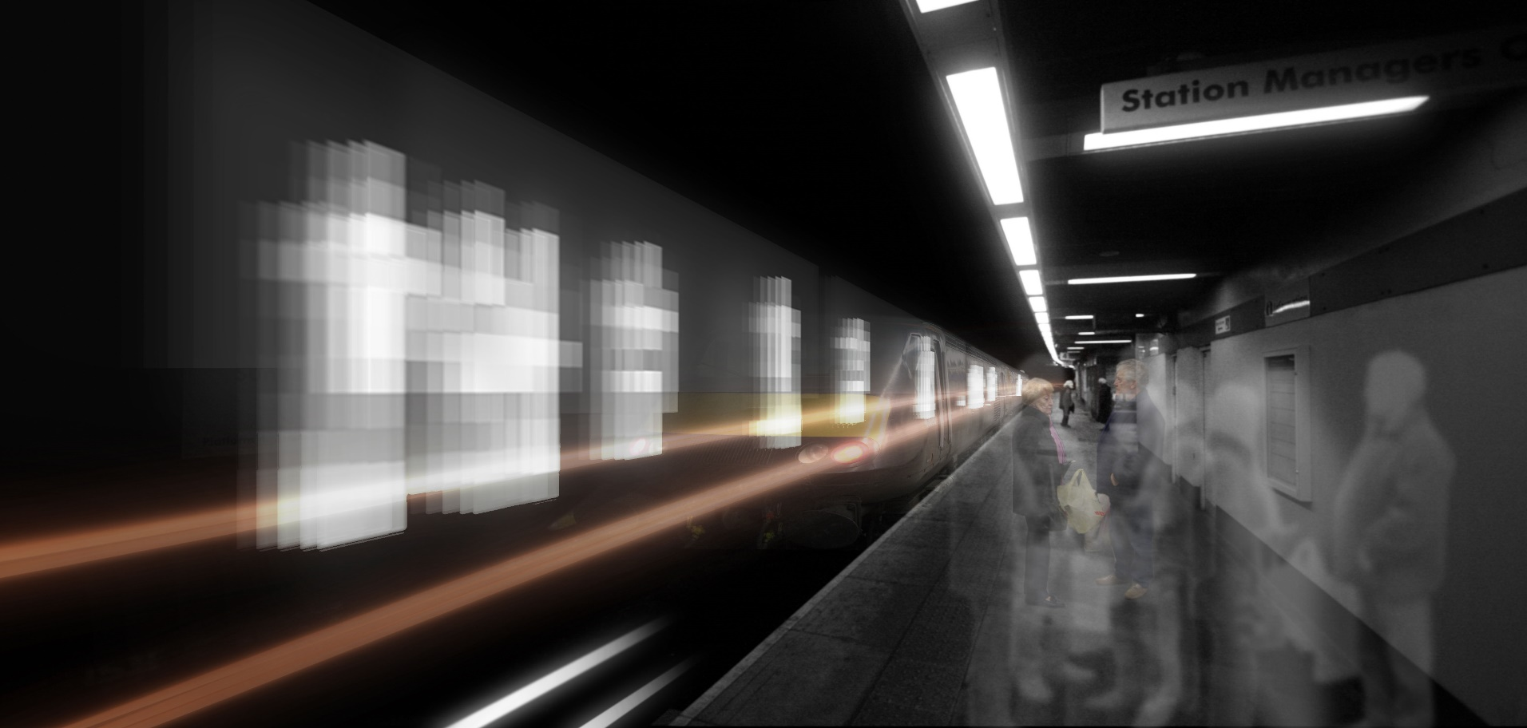
CASE STUDY 1 – NEXUS, TYNE & WEAR PTA
Platform 5 - Jason Bruges Studio

Slide 6
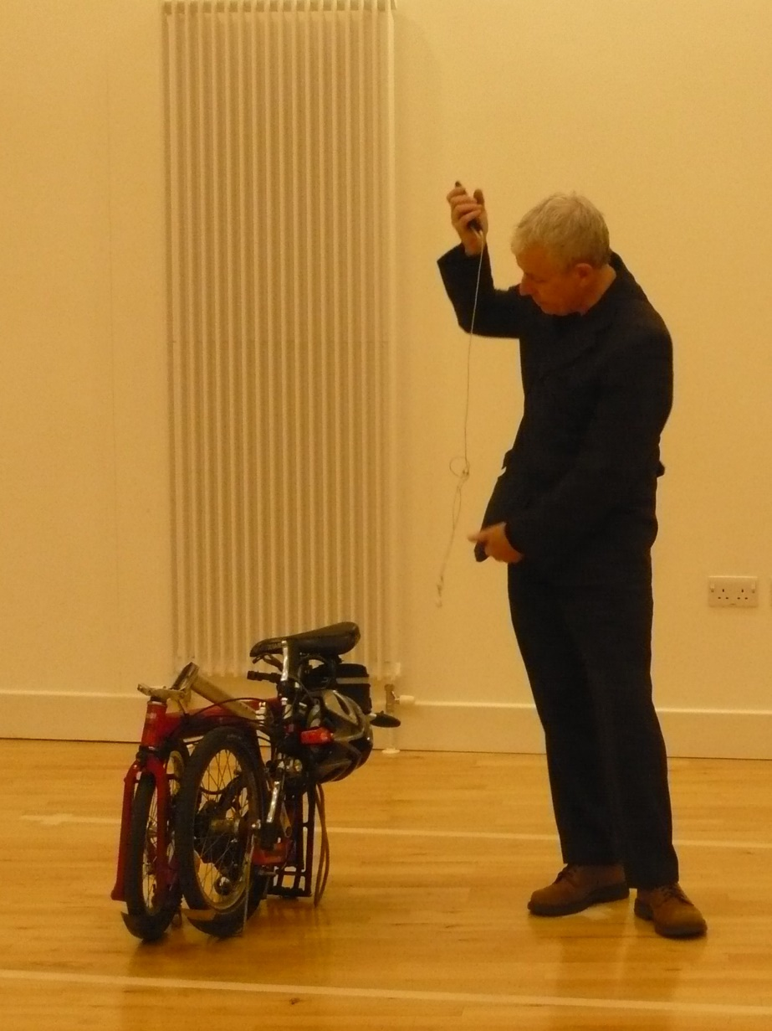
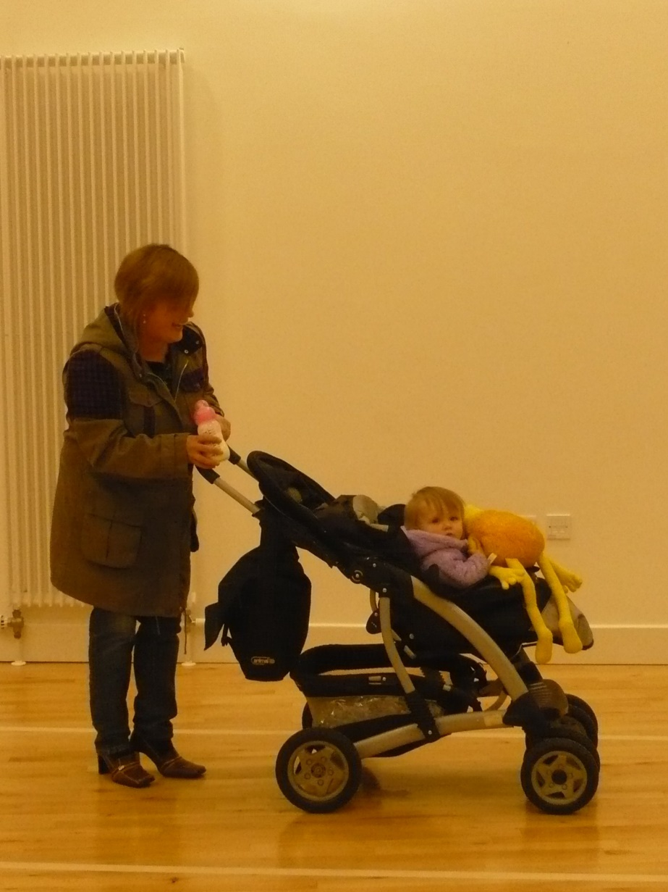

Slide 7
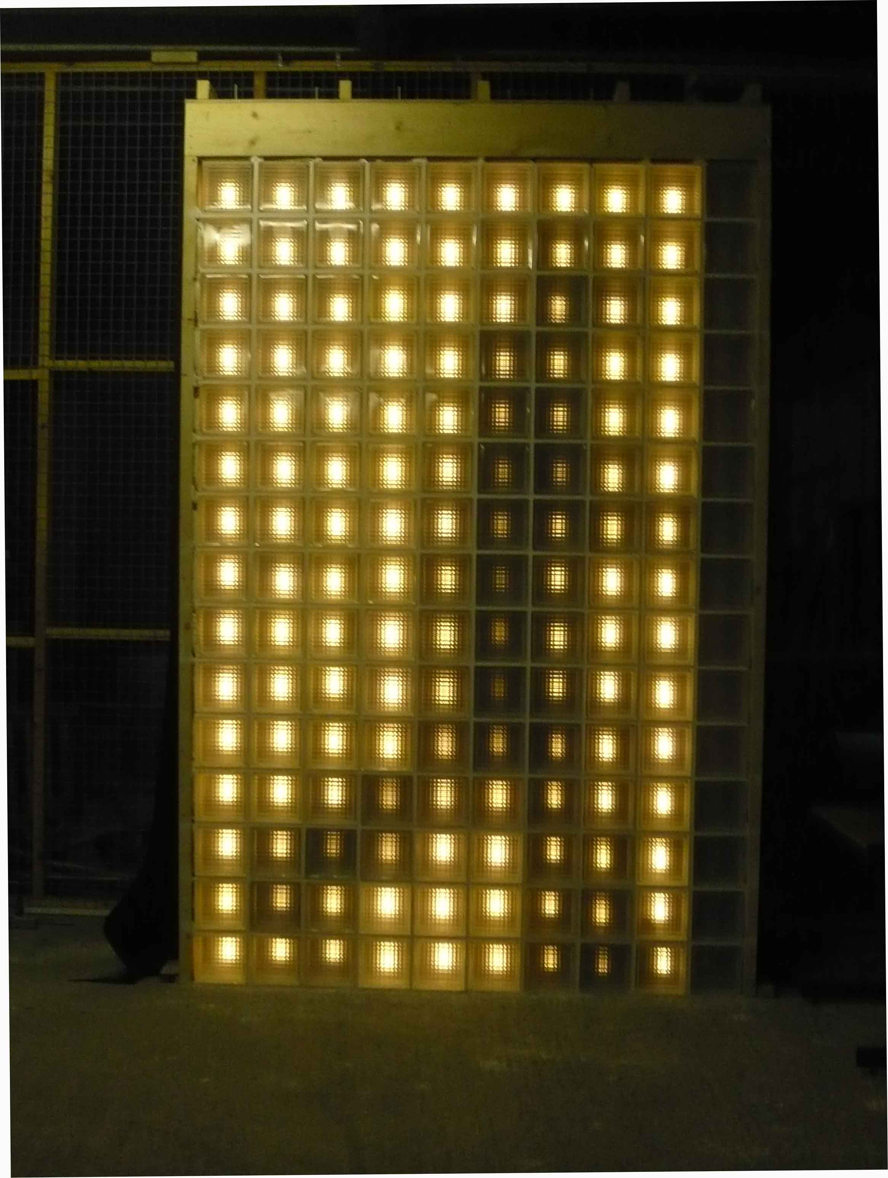
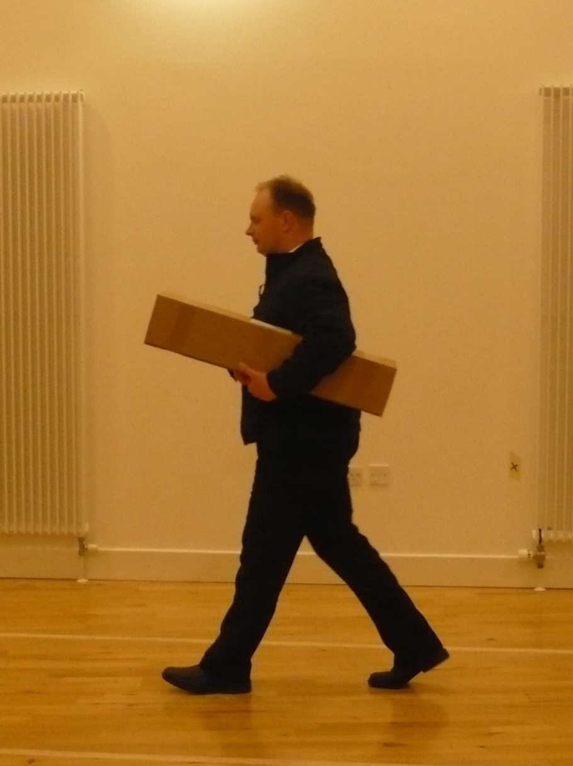

Slide 8
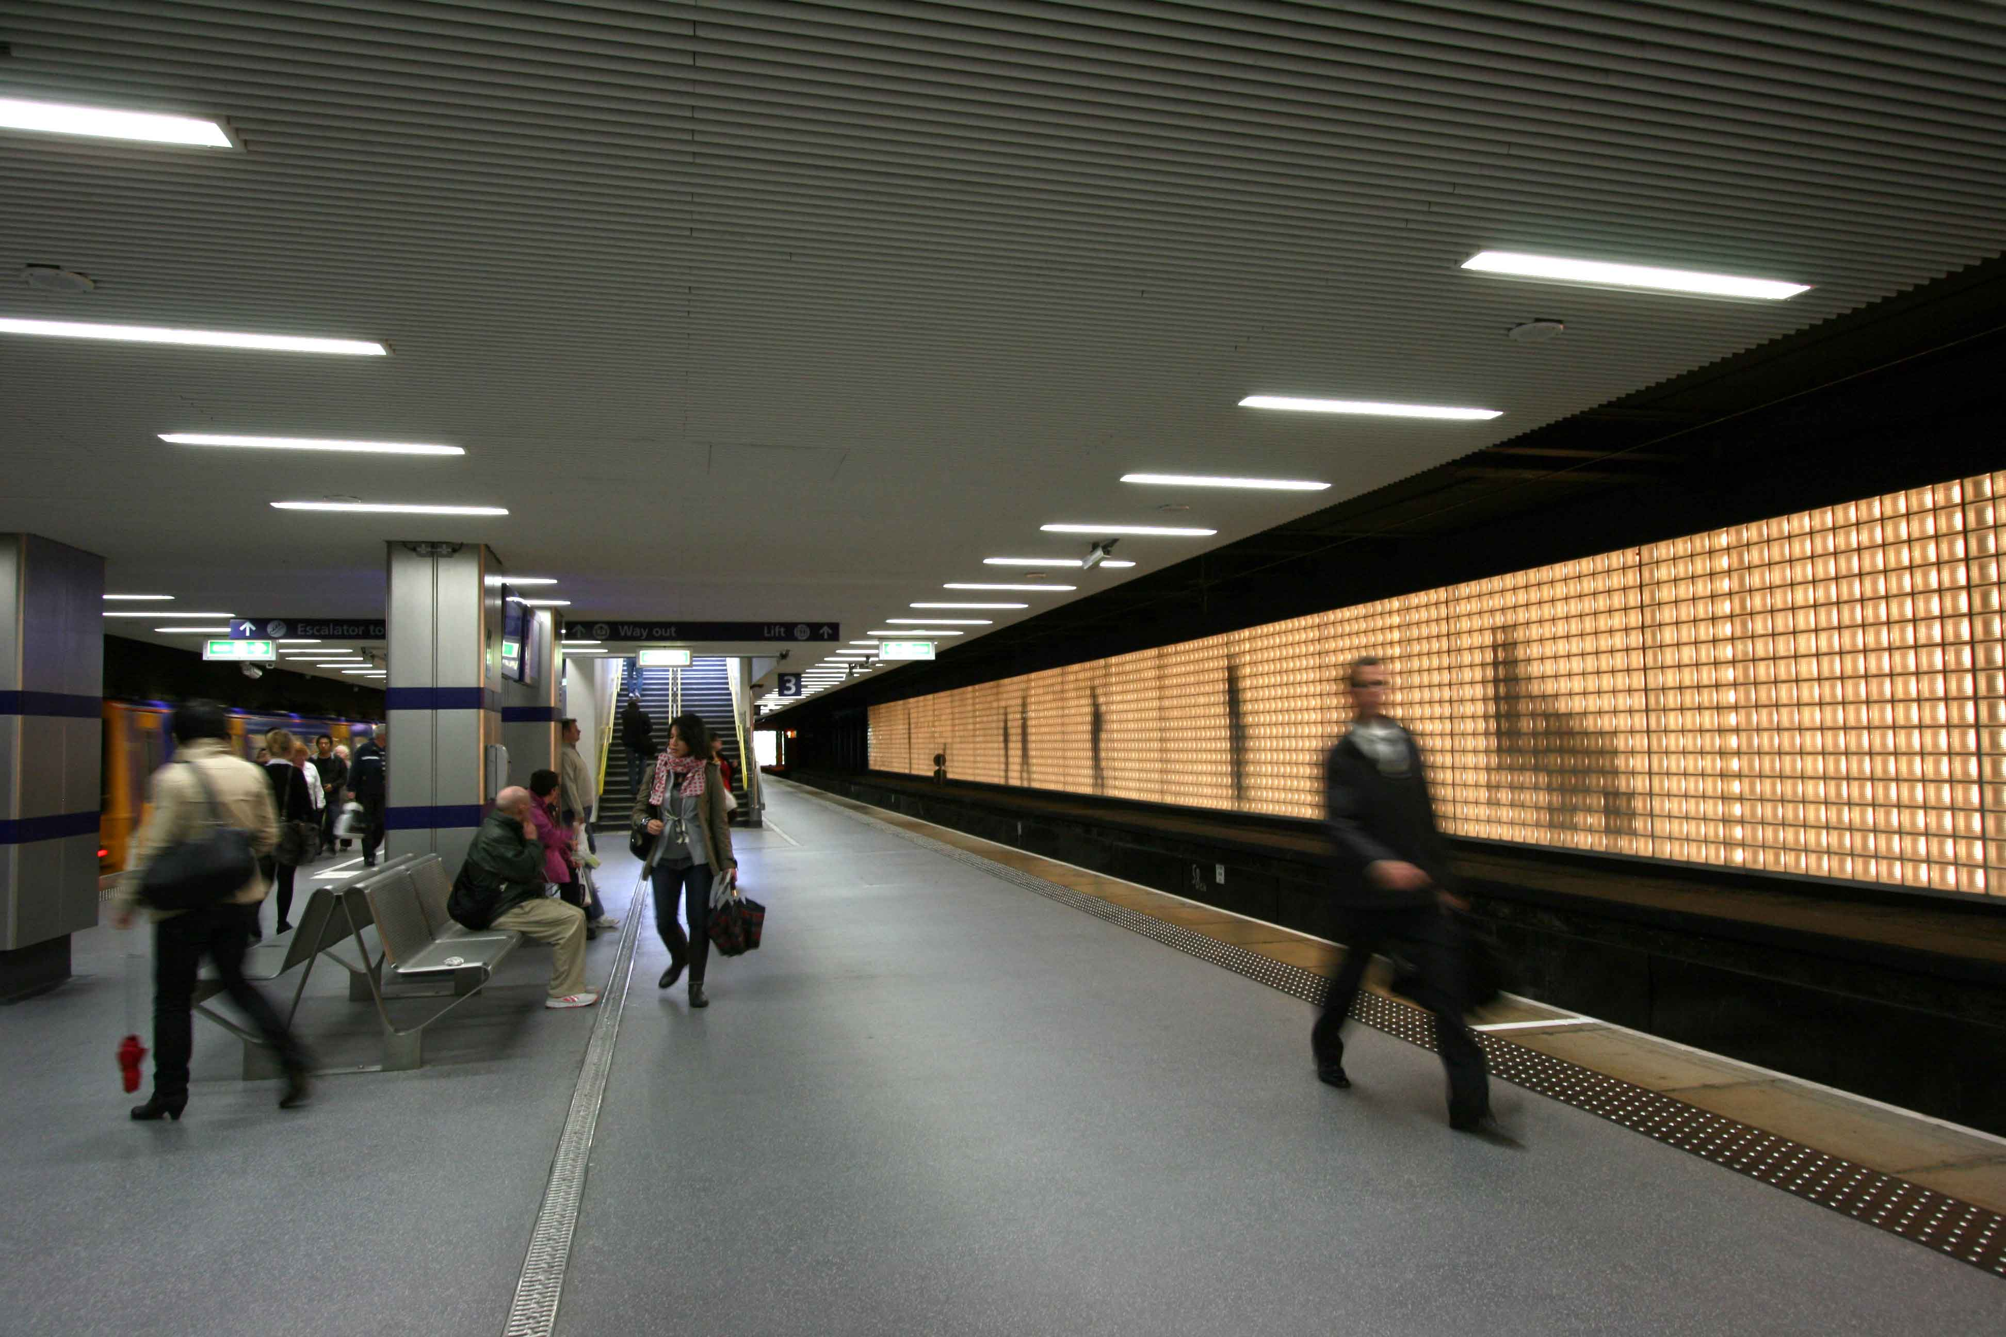

Slide 9
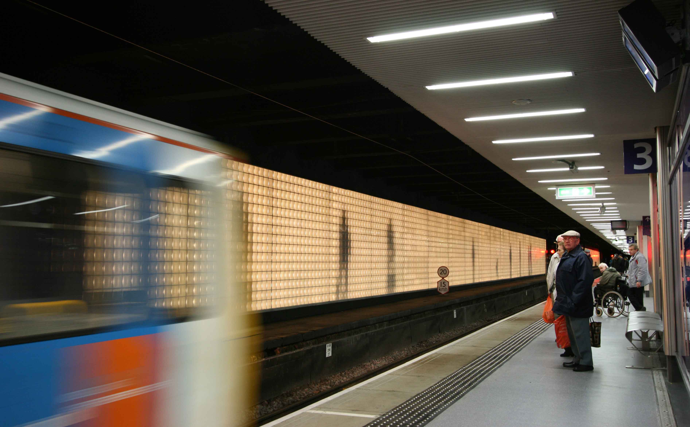

Slide 10
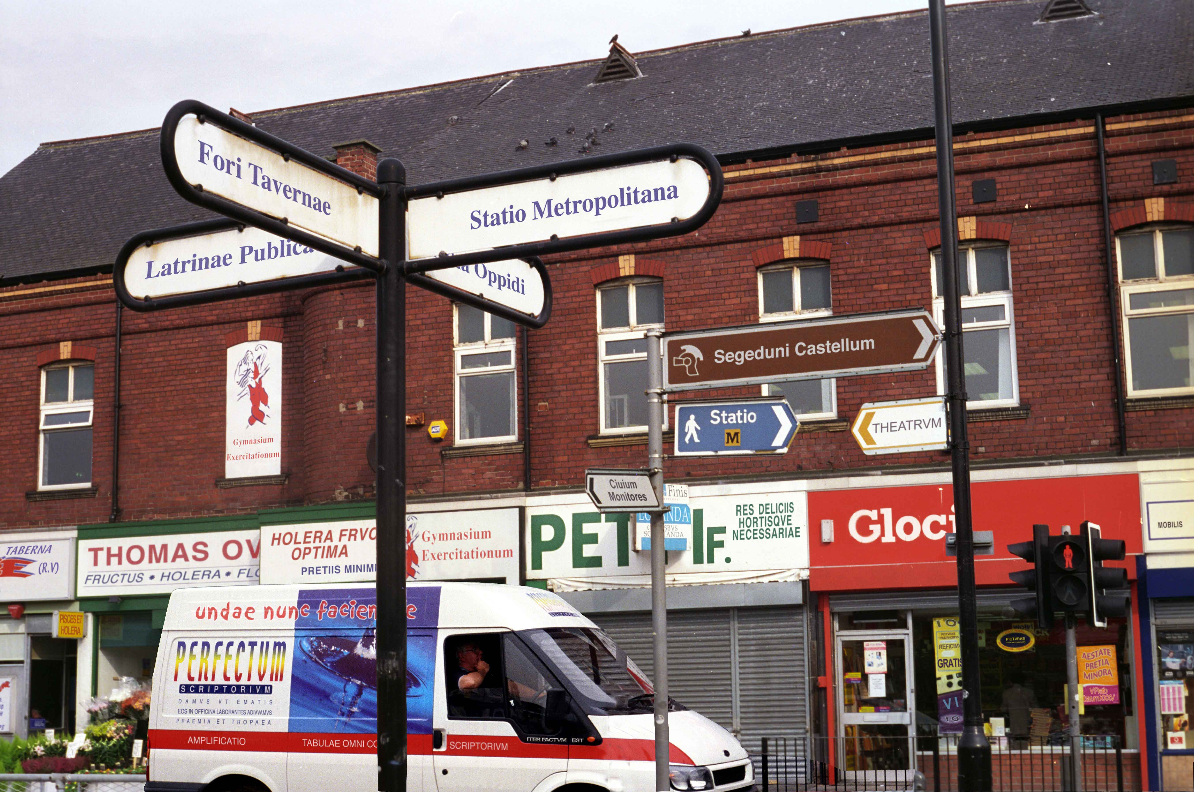
Pontis – Michael Pinsky

Slide 11
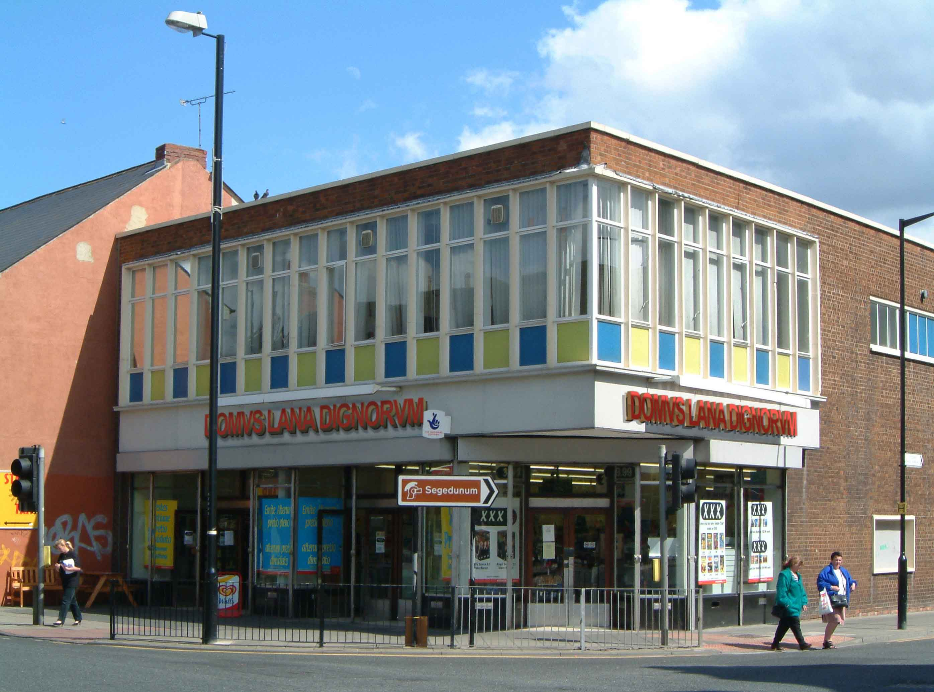

Slide 12
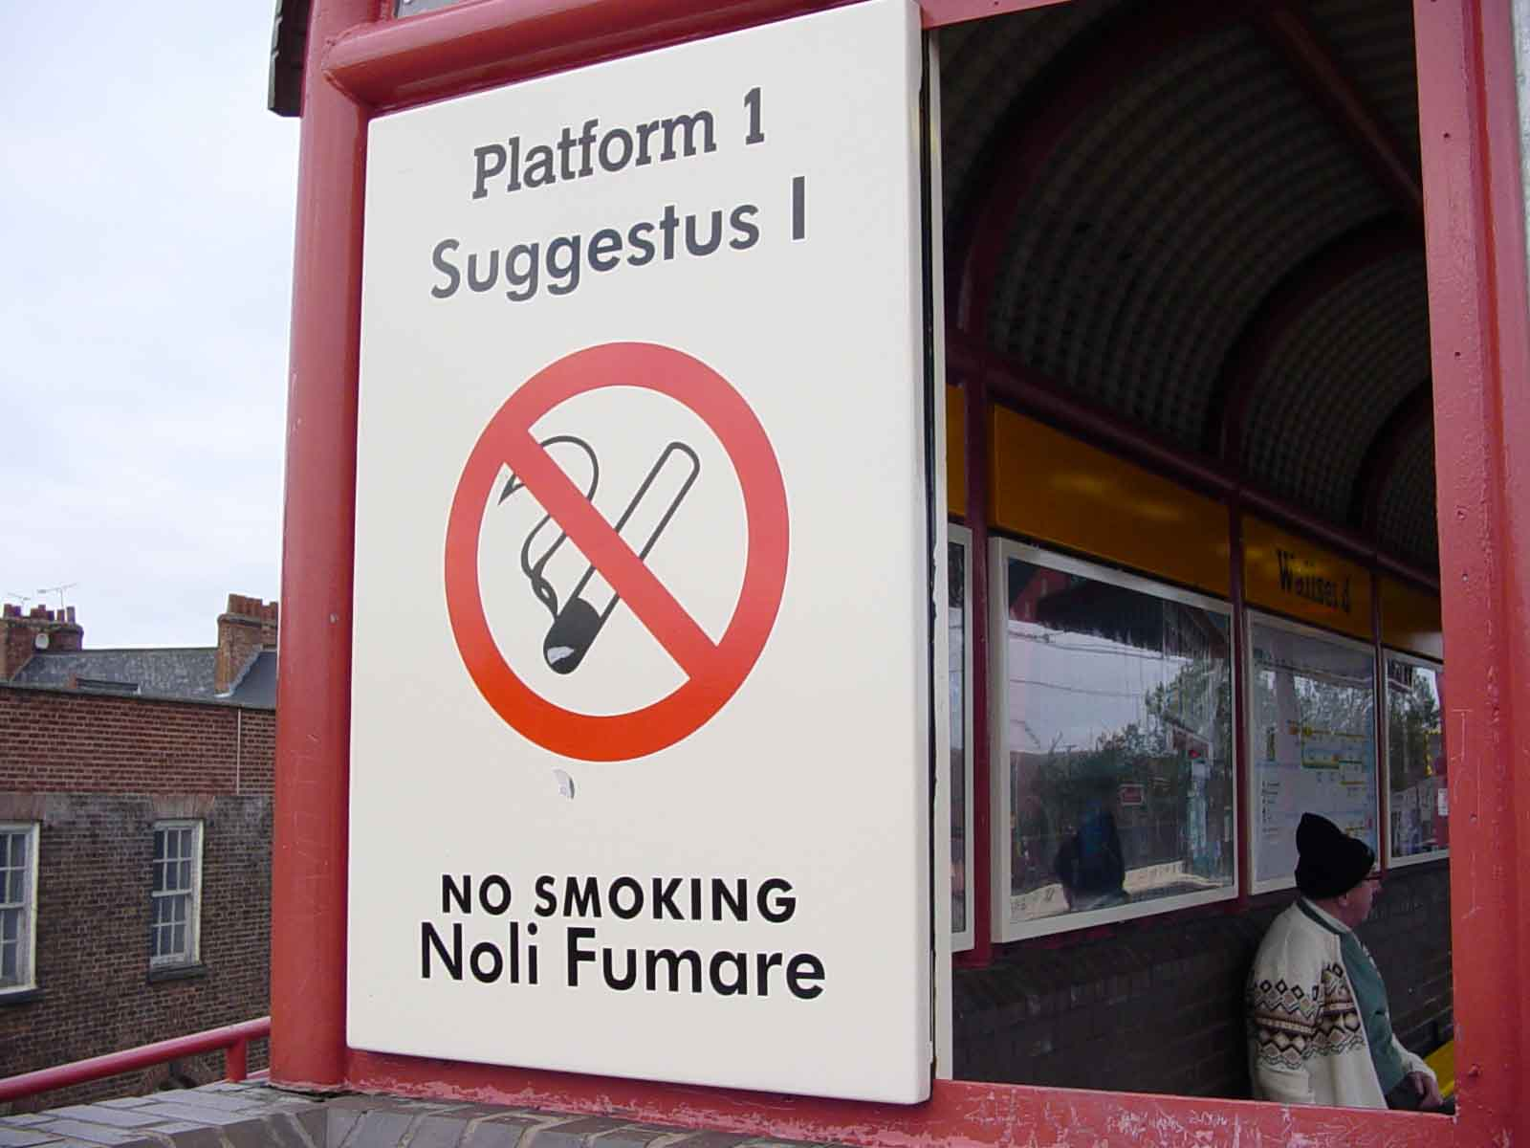
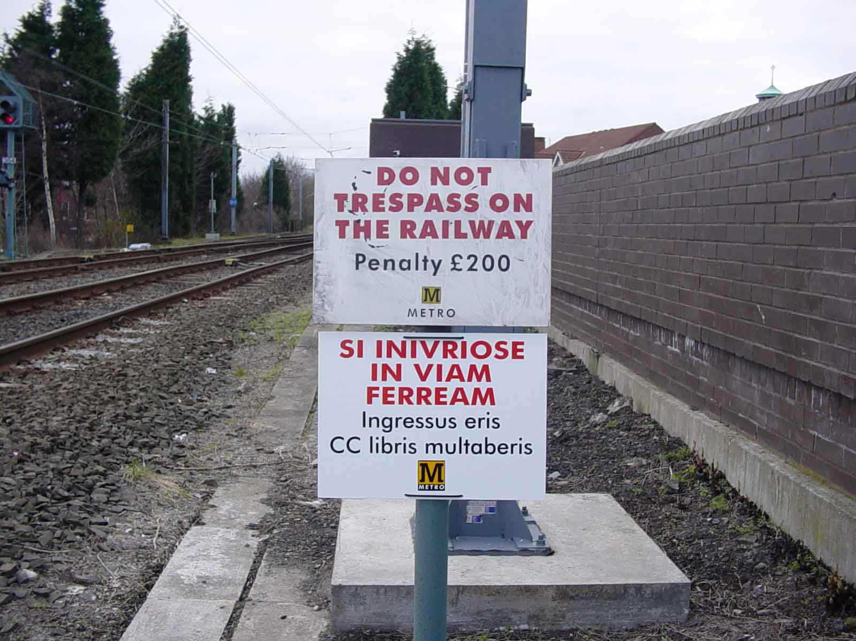
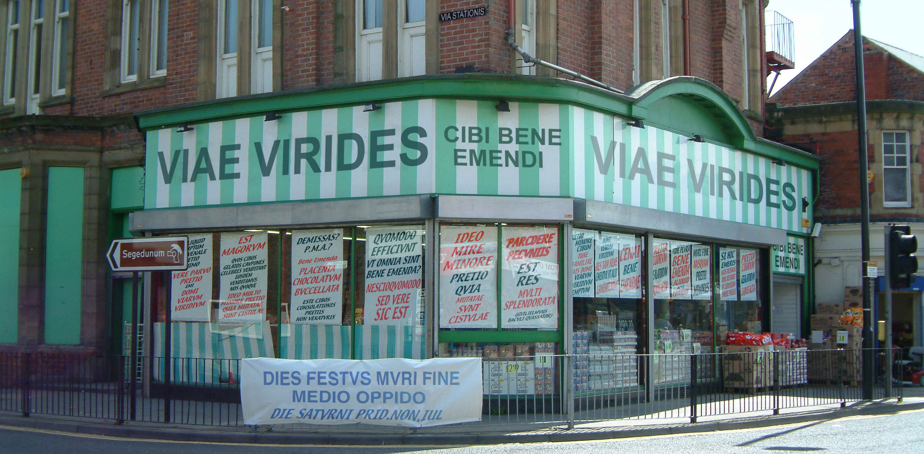

Slide 13
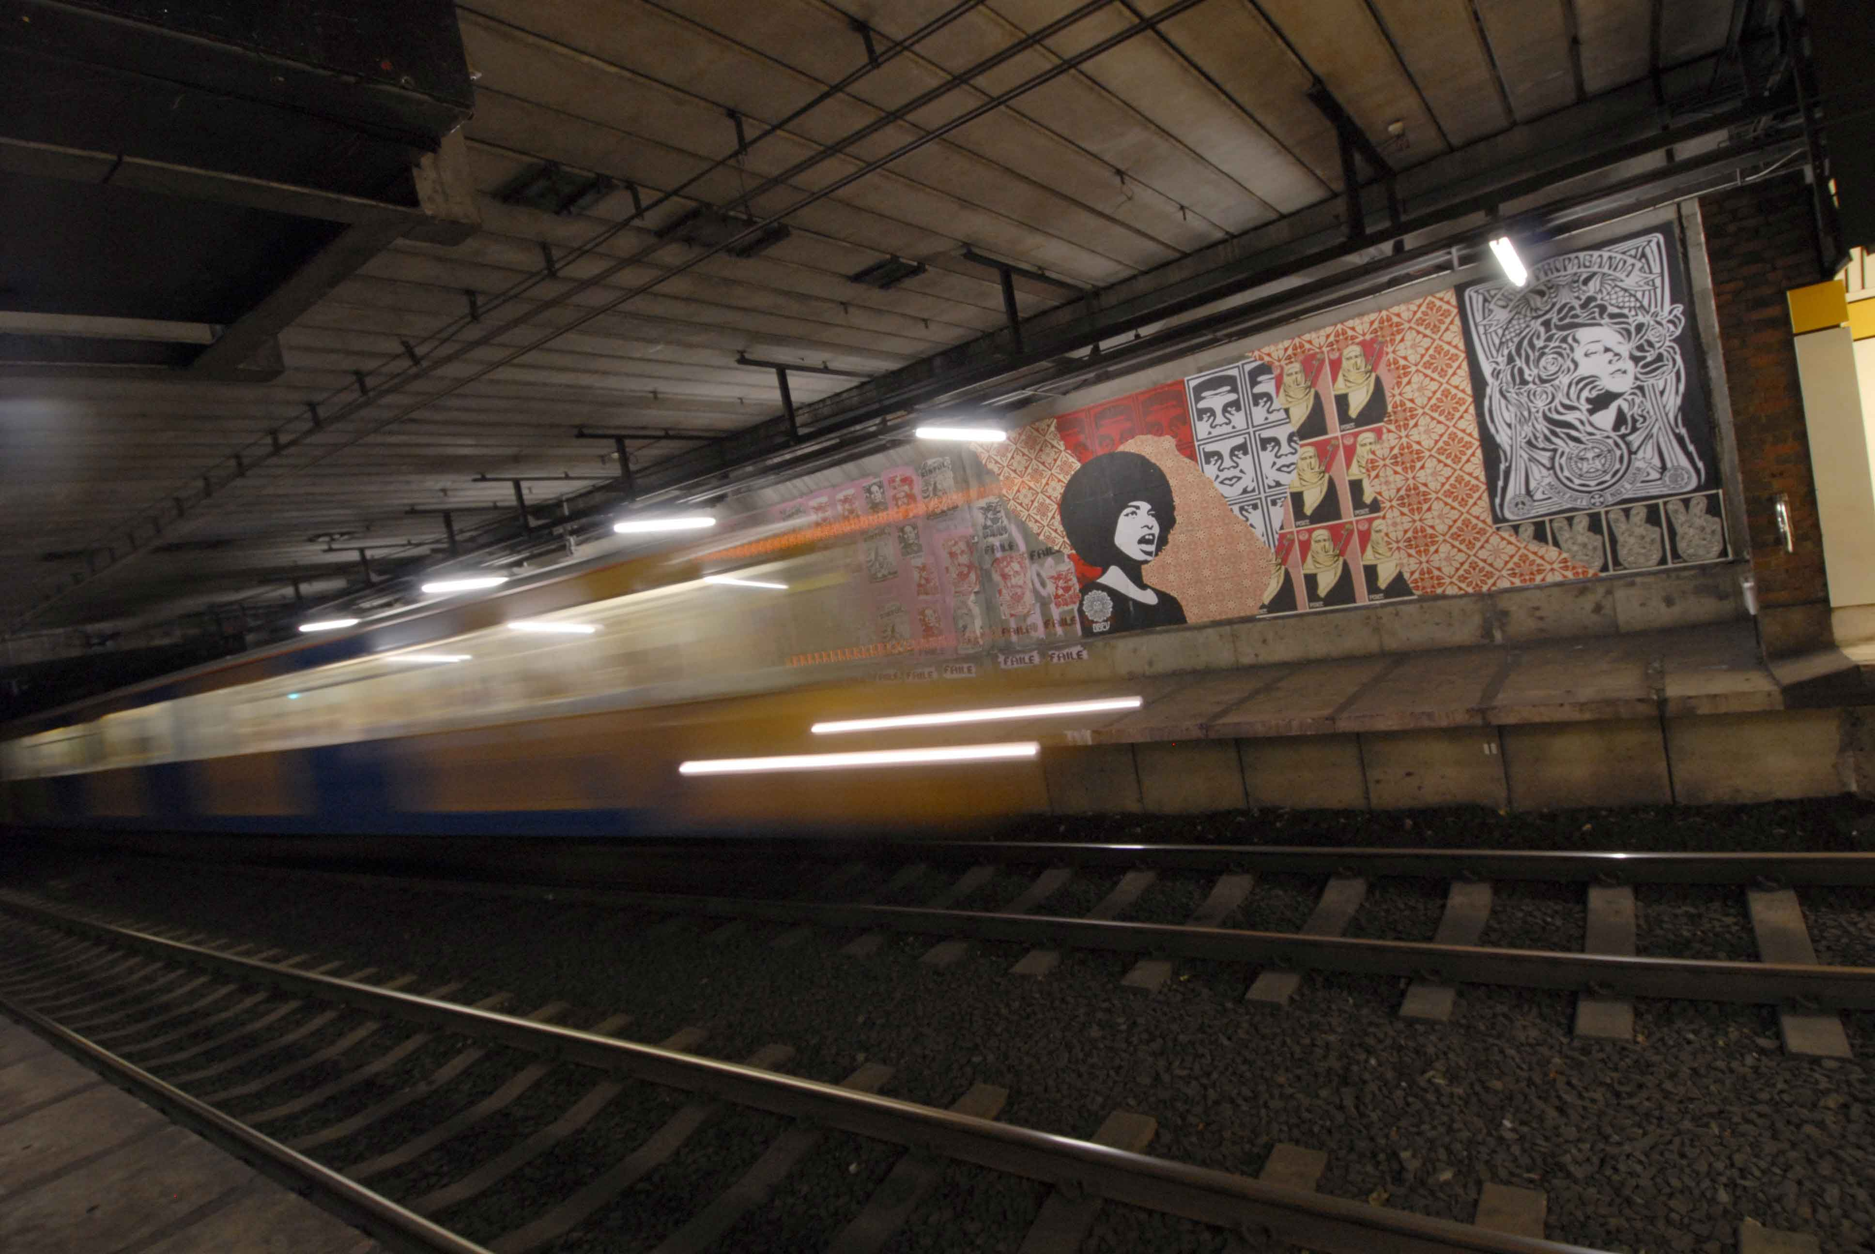
Spank the Monkey – Shepard Fairey

Slide 14
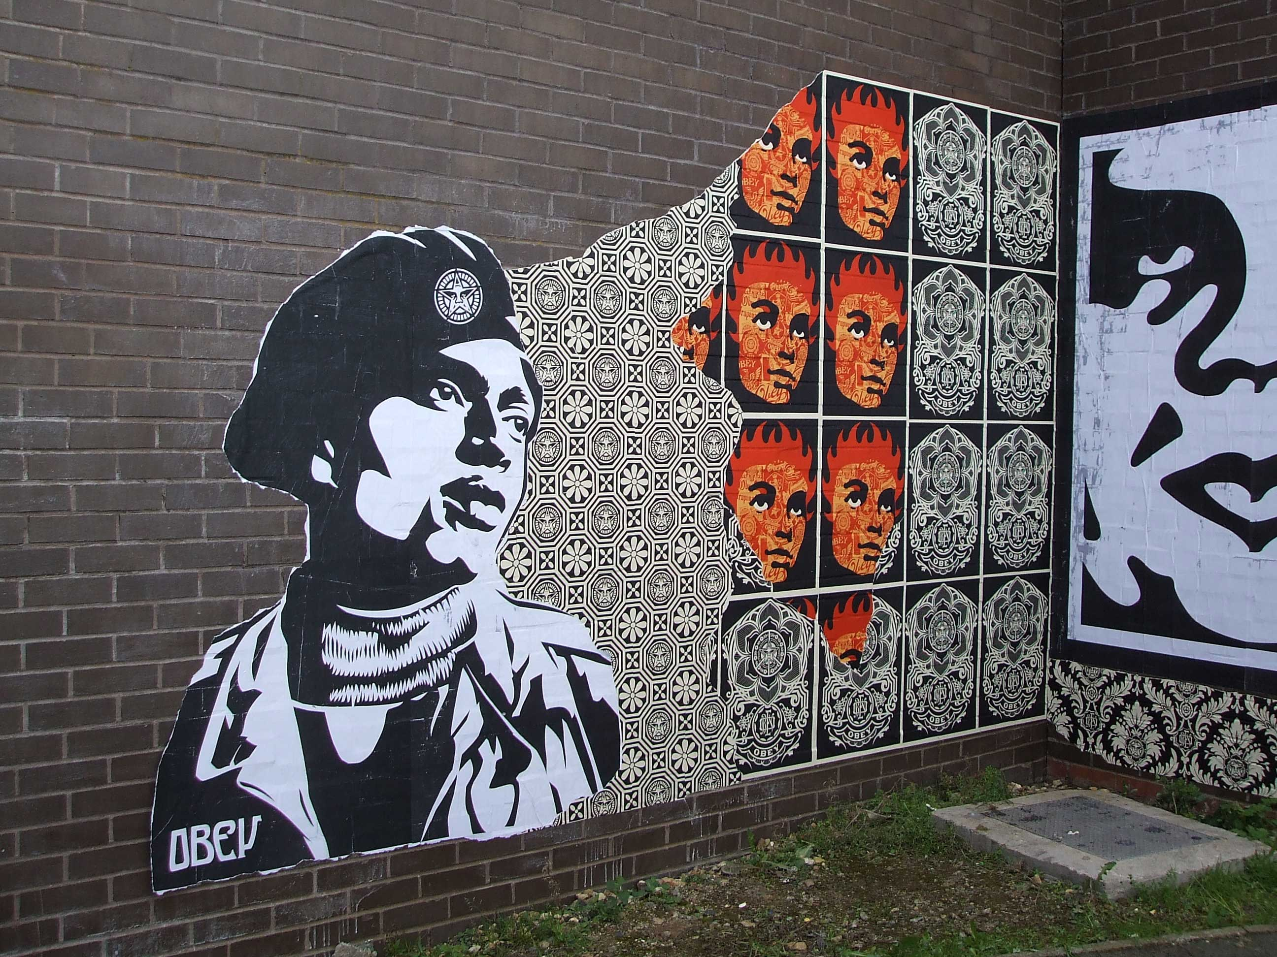

Slide 15
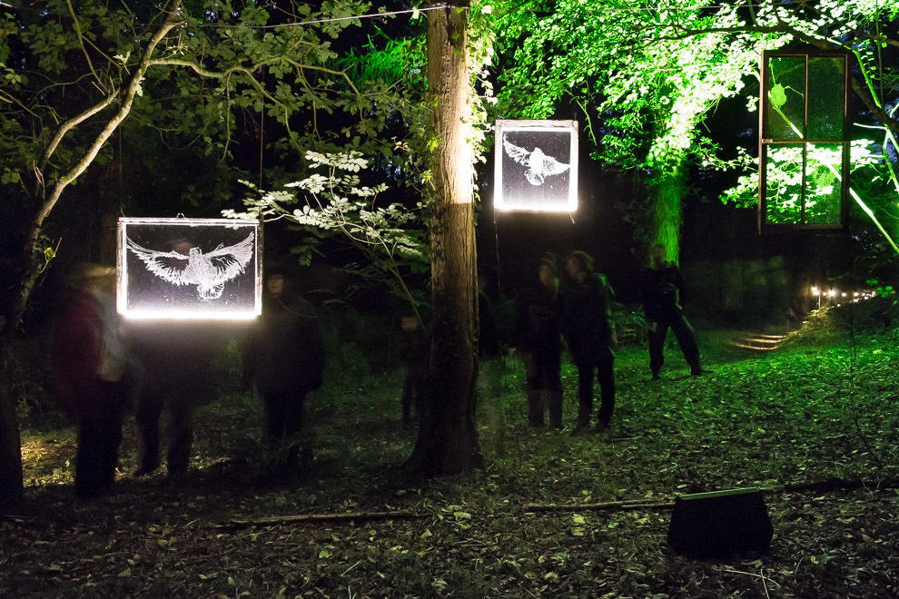
CASE STUDY 2 - ILLUMINATING YORK
Illuminati Botanica – Jony Easterby

Slide 16
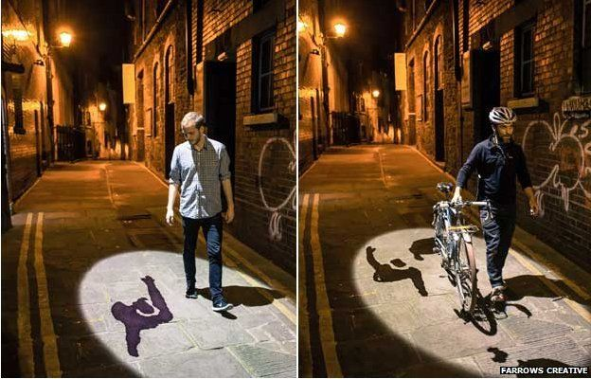
Shadowing - Chomko and Rozier

Slide 17
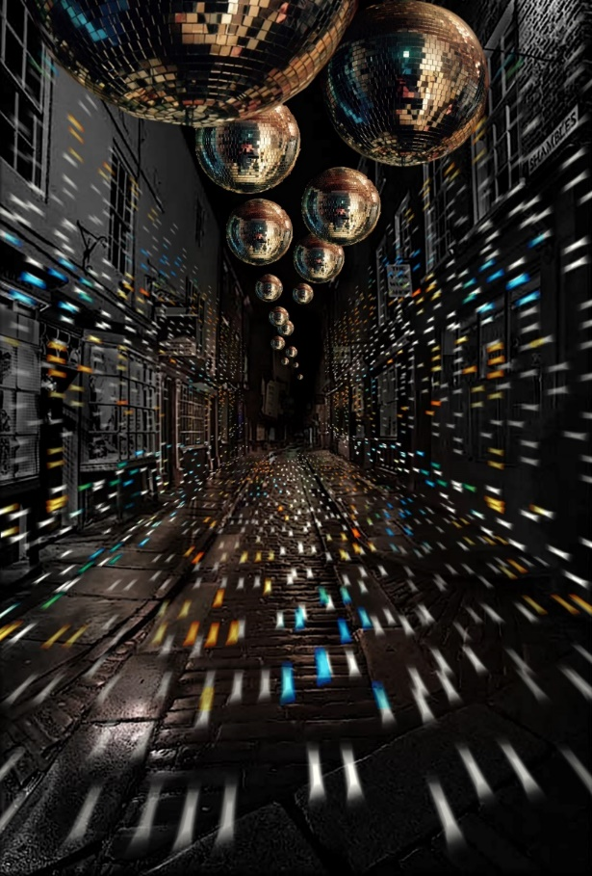
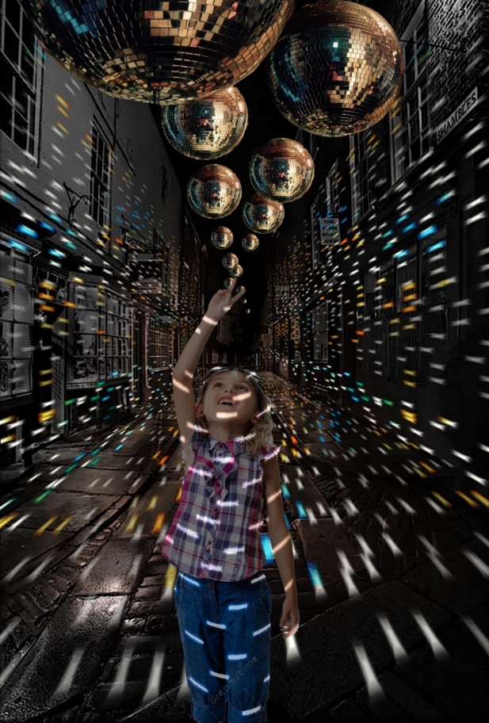
Join the Revolution - Freshwest

Slide 18
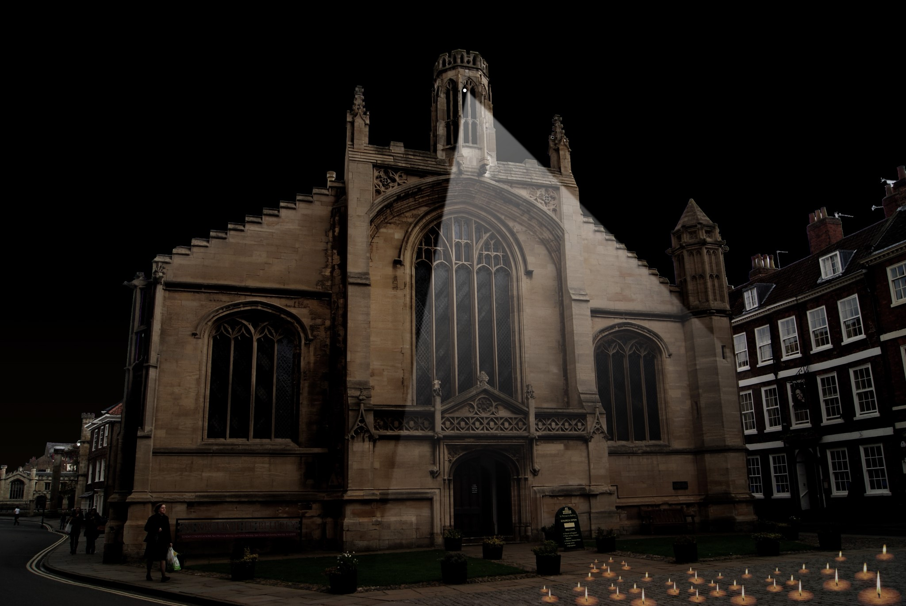
Three Graces - Nayan Kulkarni

Slide 19
THINKING ABOUT 2017
CONTEXT
Hull – unique character, one of the most distinctive and unusual cities in England
Artists – 300 years of engagement with the city, creating works woven into the fabric and psychology of Hull
Seasons – Made in Hull/Roots & Routes/Freedom/
Tell the World
Audiences – people new to the city and people rediscovering their city
Creativity – working collaboratively to make the most of the city’s resources

Slide 20
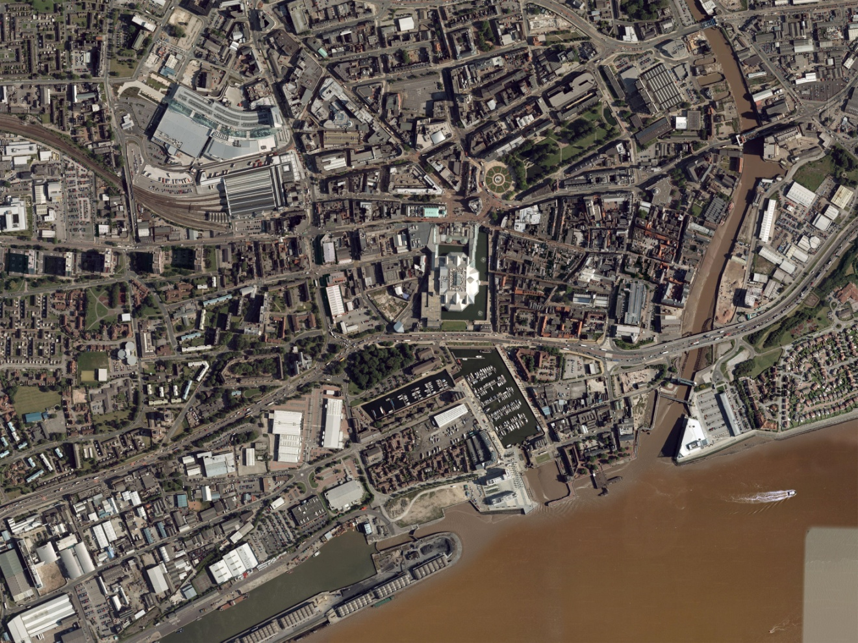
Artists & the City

Slide 21
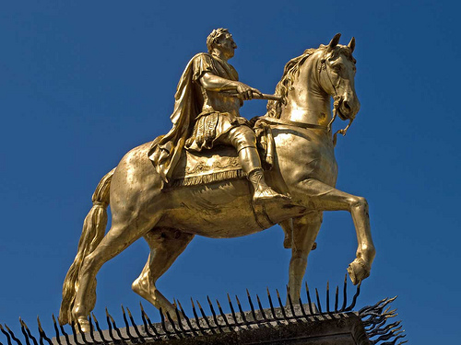
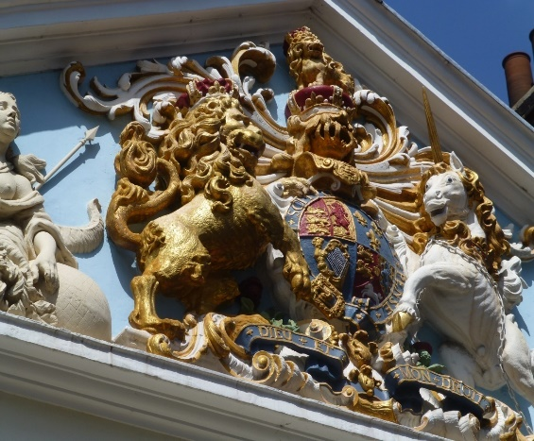
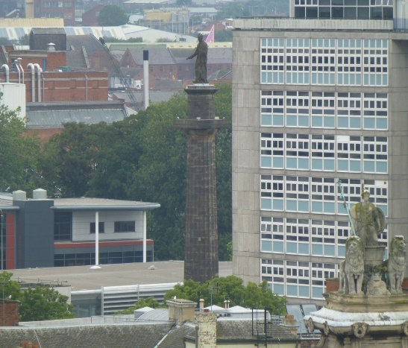
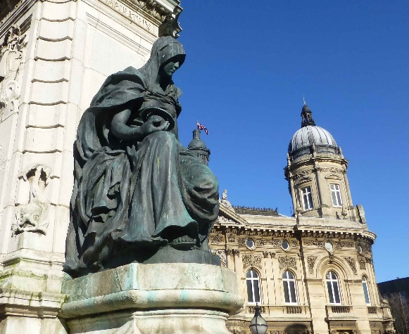
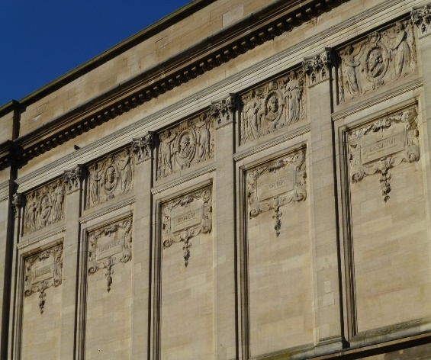
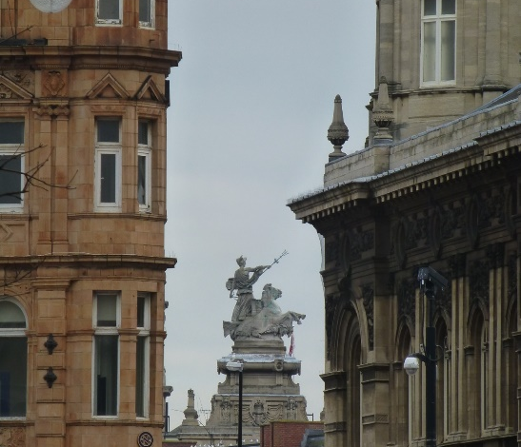
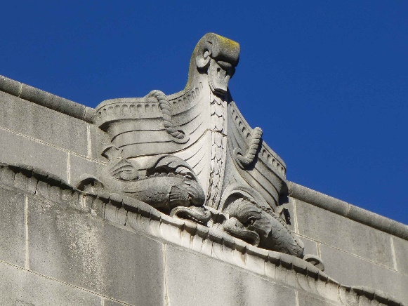
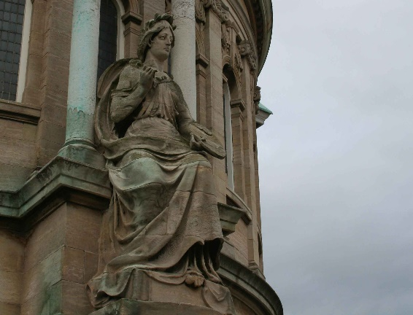
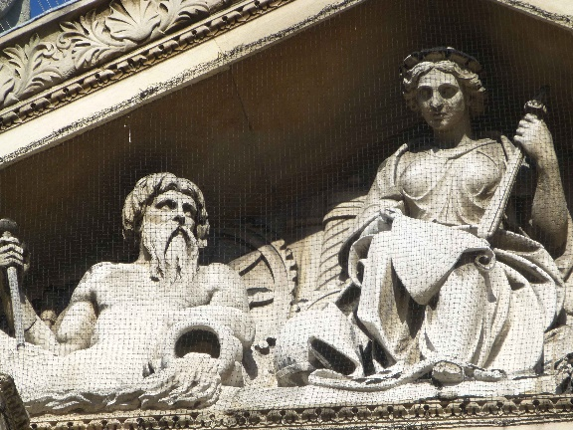

Slide 22
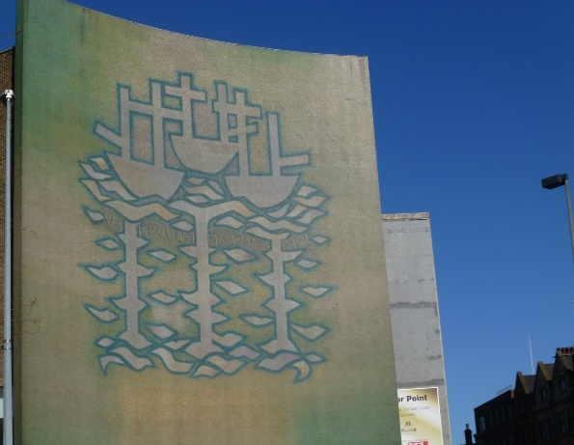
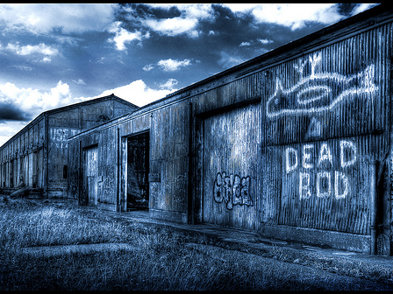
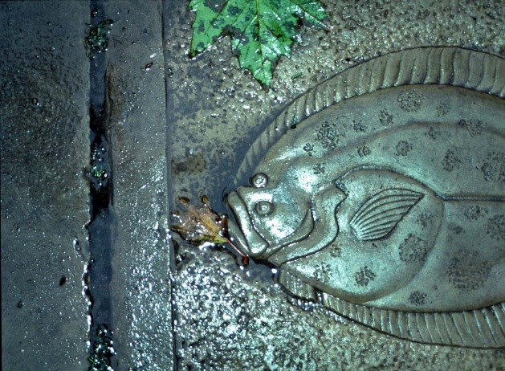
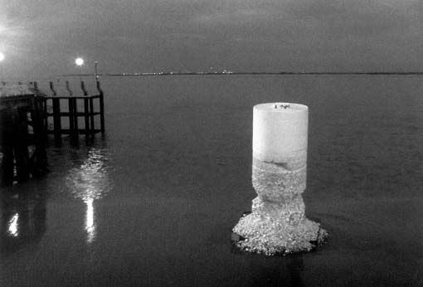
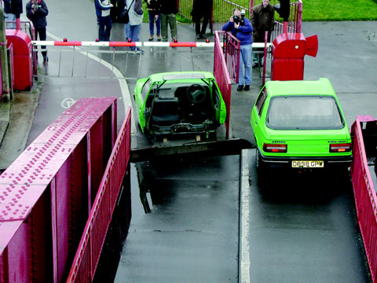
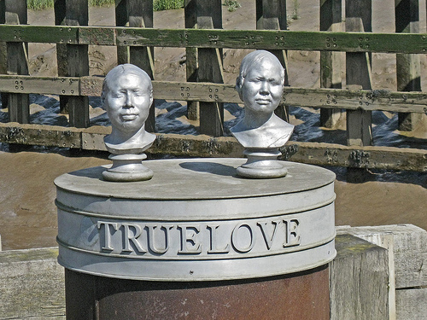
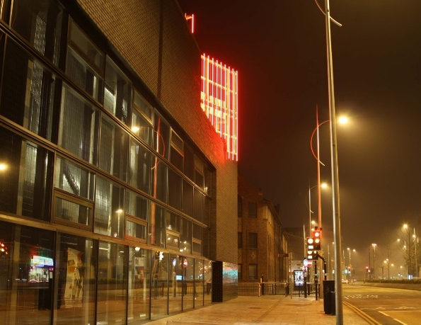
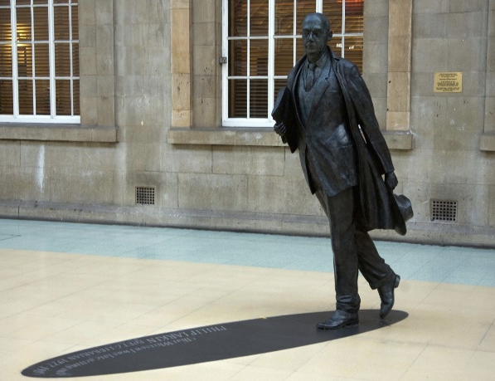
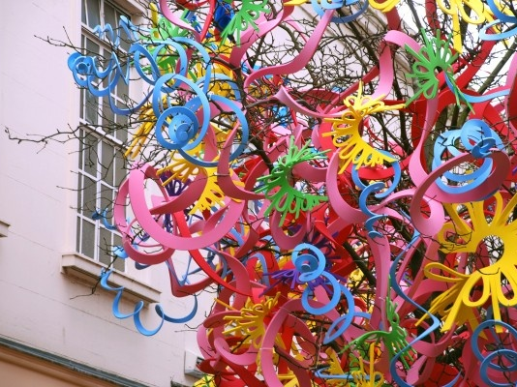

Slide 23
THINKING ABOUT 2017
VISION
‘Look Up’ is inspired by Hull and the City of Culture’s commitment to drawing on the past and present of the city in order to define and celebrate its future.
Our vision is to transform people’s understanding, appreciation and enjoyment of Hull through the imagination and creative skills of artists invited to make works for and of the city.
Different media, diverse experience - from immersive installation to participative, cumulative work, to include day and night-time presence.

Slide 24
THINKING ABOUT 2017
PROCESS
Programme developed through research and dialogue with Hull 2017 and partners to:
  Define objectives and scope
  Identify sites, synergies and opportunities
  Engage and support ‘invited’ artists to explore the city and respond with proposals

Slide 25
SOME OF THE ARTISTS WE ARE THINKING ABOUT FOR 2017
Heather ACKROYD & Dan HARVEY/ASSEMBLE/Tine BECH/ Balint BOLYGO/ Alan BOYSON/ Candy CHANG/ Jonathan CHOMKO & Matt ROSIER/ John CLARK/ Susan COLLINS/ David COTTERELL/Ian DAVENPORT/Chris DOBROWSKI/Leandro ERLICH/Cosey FANNY TUTTI/Shepard FAIREY/HC FEHR/Bettina FURNEÉ/ Neville GABIE/Anya GALLACIO/Stefan GEC/Jeremiah HARGREAVE/HEINRICH & PALMER/Albert HODGE/Mark JENNINGS/Nayan KULKARNI/LONDON FIELDWORKS/Vong PHAOPHANIT & Claire OBOUSSIER/Michael PINSKY/ ROADSWORTH/Len ‘Pongo’ ROOD & Gordon MASON/Peter SCHEEMAKERS/Gilbert SEAL/Matt STOKES/TSAI & YOSHIKA /Chris WATSON/Jane WATT/Richard WOOD/Gordon YOUNG

Slide 26
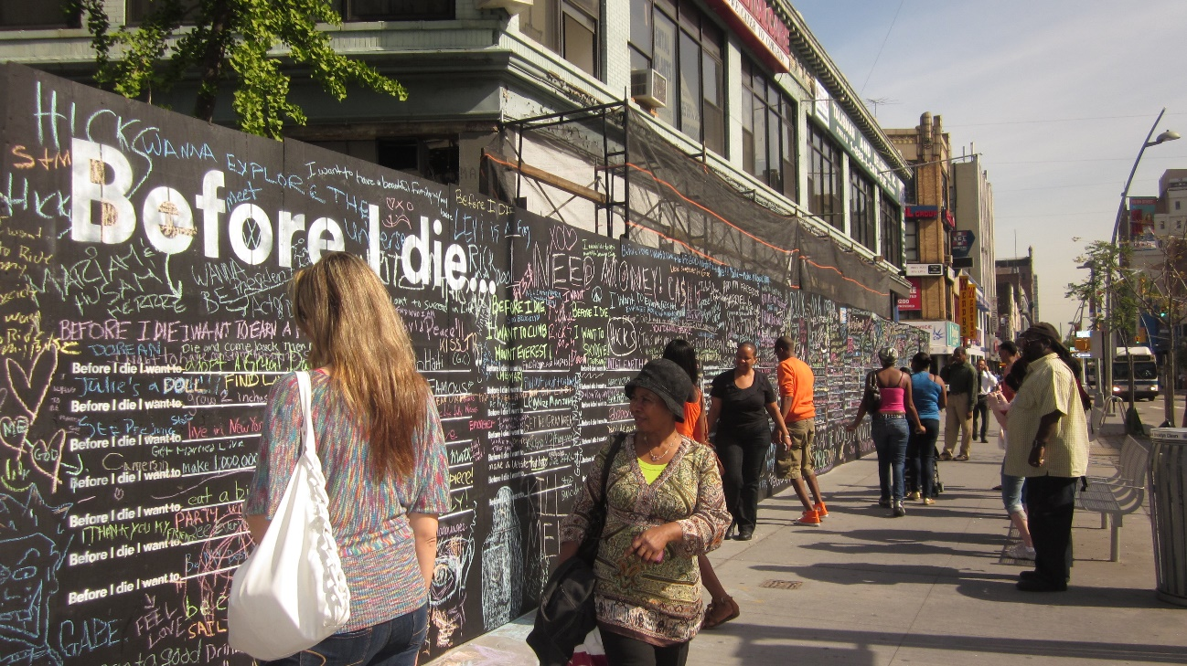
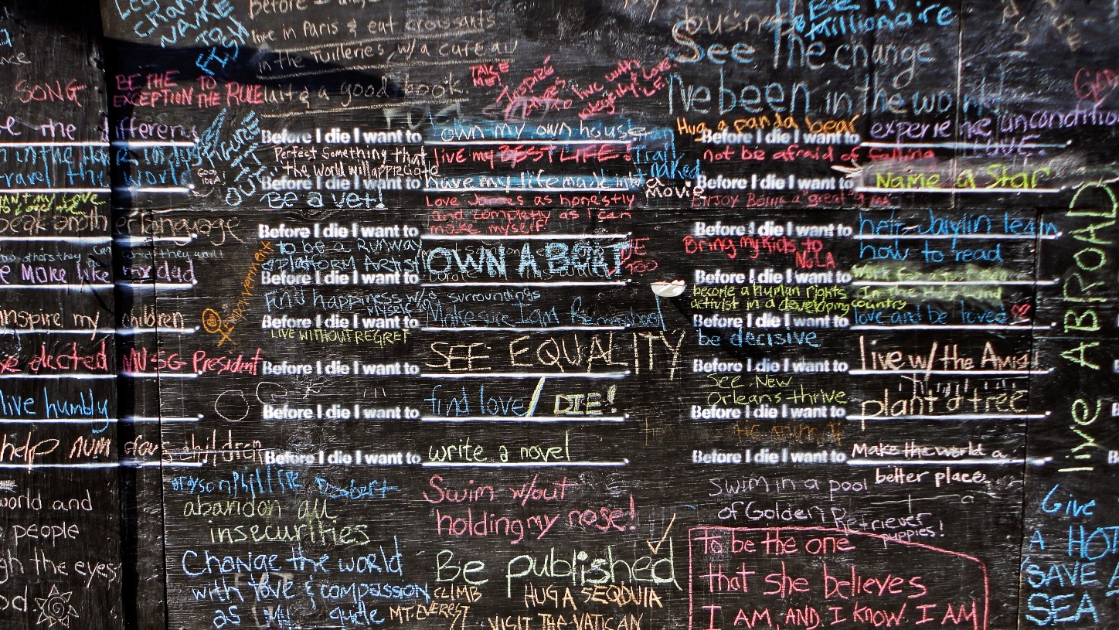

Slide 27
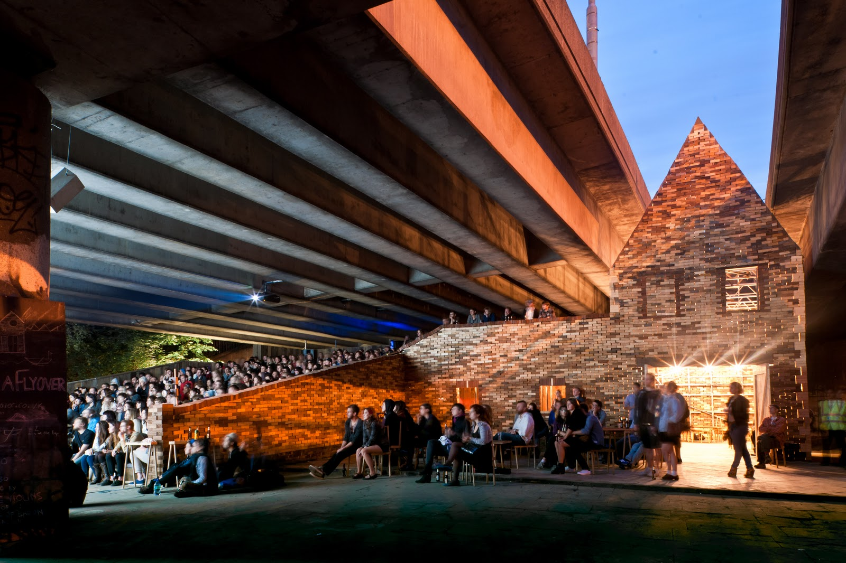

Slide 28


Slide 29


Slide 30


Slide 31


Slide 32


Slide 33


Slide 34


Slide 35


Slide 36


Slide 37


Slide 38
INDICATIVE BUDGET
Item | £ | notes
Large commissions – 2 @ 70,000 | 140,000
Medium commissions – 3 @ 50,000 | 150,000
Small commissions – 4 @ 20,000 | 80,000
Events, education, engagement | 20,000
Marketing/Communications | 30,000
Stage 1 - Curation/Programme development | 10,000
Stage 2 - Project Management | 80,000
Contingency | 20,000
TOTAL | 530,000 | Assumes additional income (grant/sponsorship/trusts) @ £50,000

Slide 39
INDICATIVE PROGRAMME

Slide 40
PROGRAMME/DELIVERY
STAGE 1 - Oct 2015 – Jan 2016
Programme Scoping & Consultation:
Agree brief, services, programme, communication
Research potential sites, partners, risks and constraints
Research and recommend artists
Agree procurement and contracts
Initiate artists’ site visits
Develop marketing, education, engagement strategies
Budget and fundraising review
Programme approval Jan 2016

Slide 41
PROGRAMME/DELIVERY
STAGE 2 – Feb 2016 – Sept 2016
Research and Development:
Artists’ site visits lead to proposals. Agreed proposals progressed to detailed designs
Marketing/engagement strategies refined according to artists’ approach and proposals
Further funding opportunities identified, linked to approach and proposals
Confirm sites, secure consents
Advance press/PR
Bi-monthly risk register and budget reviews
Final programme presented September 2016

Slide 42
PROGRAMME/DELIVERY
STAGE 3 – Oct 2016 – Dec 2017
Delivery:
Programme content finalised by Nov 2016
Budgets finalised Dec 2016
RAMS
Installation and maintenance schedules submitted for review 8 weeks before install
Monthly budget and risk register reviews
Monthly review with partners
Delivery of marketing, event, engagement programmes
Ongoing documentation and audience/response data gathering

Slide 43
PROGRAMME/DELIVERY
STAGE 4 Jan – Mar 2018
Programme Review
Evaluation Completed
Documentation Completed

Slide 44
PROGRAMME ELEMENTS
All elements of the programme will be informed and inspired by the artists’ response to Hull and the works they will make – marketing, engagement, education, local relationships,legacy…

Slide 45
MARKETING AND COMMUNICATIONS
Attracting visitors to discover the city and communities to rediscover it
Presenting heritage and culture in a new light
Aligned to City of Culture 2017 strategies and programmes
Dedicated expertise to secure national coverage
Maximise use of social media

Slide 46
AUDIENCE DEVELOPMENT, EDUCATION, PARTICIPATION
Through programme of creative events and initiatives across the year
Dovetailed with targeted PR/Comms strategy
Dovetailed with Hull 2017 programme, align with audience development initiatives including Roots and Wings
Bespoke events according to commission – artist/curator walks and talks; hands-on family workshops; participative launch events; academic seminars; makers/fabricators presentations to creative industry sectors; artist residencies and visits to schools and community groups

Slide 47
SUPPORTING CREATIVE INDUSTRIES
Agree commitment to consideration of local sourcing of materials and talent for every commission and contract
Work with the sector to identify a particular commission opportunity that they can deliver

Slide 48
LEGACY
Capacity building with partner organisations – ensure involvement in artist briefing, selection, proposal approvals
Offer opportunities for internships/work experience/student placements
Offer opportunity for documentation/case studies – an archive of the processes for future examples

Slide 49
SUSTAINABLE PRODUCTION
Agree code of conduct and procurement from outset
Include – transport and travel; office, studio and fabrication premises recycling policies; local fabrication where possible;
Include – sustainable methods requirement for production/fabrication assessment as well as quality and price

Slide 50

Please see our Expression of Interest
for more detail and CVs

