Slide 1
PLACE DES ANGES
AUDIENCE ANALYSIS & FEEDBACK
September 2016

Slide 2


Slide 3
EVENT DETAILS
TITLE:
PLACE DES ANGES
COMPANY:
GRATTE CIEL
DATE & TIME:
2 JULY 2016, 20:00
PRICE:
FREE - TICKETED
ART FORM:
CIRCUS
EVENT TYPE:
OUTDOOR
VENUE:
QUEENS GARDENS

Slide 4
TICKETING

Slide 5
TICKETS ISSUED AND USED (data from scanned tickets - excludes Guest & VIP wrist bands)
Total tickets sold | 10,264
Total tickets scanned | 6,689
Total audience, including tickets not scanned | 7,555
% of tickets used (based on total audience) | 73.6%
% of tickets not used (based on total audience) | 26.4%
Average no. of unused tickets per order | 1.8
Bookers who used every ticket | 737
Bookers who did not use every ticket | 1,159
Bookers who did not use any ticket | 305
KEY STATS

Slide 6
NO. OF TICKETS REQUESTED | NO.OF BOOKERS | NO. OF TICKETS REQUESTED BY NO. OF BOOKERS | % OF BOOKERS
One | 18 | 18 | 0.9%
Two | 179 | 358 | 9.4%
Three | 78 | 234 | 4.1%
Four | 295 | 1,180 | 15.6%
Five | 67 | 335 | 3.5%
Six | 1,199 | 7,194 | 63.2%
Seven to nine | 3 | 23 | 0.2%
Ten or more | 58 | 730 | 3.1%
TOTAL | 1,897 | 10,072 | 100%
TICKETS BOOKED

Slide 7
SIZE OF GROUP | NO. OF TICKETS SCANNED | NO. OF GROUPS | NO. OF TICKETS NOT USED
0 | 0 | 0 | 1,477
1 | 76 | 76 | 194
2 | 560 | 280 | 476
3 | 579 | 193 | 358
4 | 1,248 | 312 | 401
5 | 1,430 | 286 | 277
6 | 2,478 | 413 | 68
7-9 | 149 | 18 | 61
10+ | 169 | 14 | 17
TOTAL | 6,689 | 1,592 | 1,852
3.5
6
Average group size
Most frequent group size
TICKETS SCANNED

Slide 8
NO. OF TICKETS REQUESTED | NO. OF BOOKERS | NO. OF TICKETS REQUESTED x NO. OF BOOKERS
One | 9 | 9
Two | 31 | 62
Three | 16 | 48
Four | 50 | 200
Five | 12 | 60
Six | 183 | 1,098
Seven to nine | 0 | 0
Ten or more | 4 | 54
TOTAL | 305 | 1,531
1.8
1
Average number of unused tickets
Most frequent number of unused tickets
BOOKERS WHO USED NO TICKETS

Slide 9
POST CODES: BOOKERS & SCANNED TICKETS

Slide 10
MILES FROM HU1: BOOKERS
Average Distance from HU1 | 12.99 miles
Longest distance from HU1 | 297.7 miles
DRIVE TIME FROM HU1: BOOOKERS
Average drive time from HU1 | 22.5 minutes
Longest drive time from HU1 | 293 minutes (4 hours 53 minutes)
MILES FROM HU1: SCANNED TICKETS
Average Distance from HU1 | 11.66 miles
Longest distance from HU1 | 272 miles
DRIVE TIME FROM HU1: SCANNED TICKETS
Average drive time from HU1 | 22.1 minutes
Longest drive time from HU1 | 289 minutes (4 hours 49 minutes)
AVERAGE & LONGEST DISTANCE TRAVELLED

Slide 11
TICKETING
In total 12,000 tickets were made available, with an expectation that being a free event there would be a percentage of ‘no shows’
A target of 10,000 was set for ticket “sales” to the public
2,000 additional tickets were made available for Guests and VIPs
Actual ticket “sales” totalled 10,264, selling out in 51 minutes
Actual tickets for guests and VIPs totalled 1,736
A total of 6,689 tickets were scanned on the night
An estimated 866 entrants were not scanned, due to a technical issue with a scanner
The total public audience for the event is therefore estimated to be 7,555
Guests and VIPs entered with wristbands, which were not scanned – they are not included within the total audience figure.

Slide 12
TICKETING: POST CODE DATA
1,646 of 1,897 bookers (86.7%) - came from HU post codes:
1,001 (52.7%) from the HU1-HU9 (Kingston Upon Hull LA area)
645 (34.0%) from HU10-HU20 (East Riding of Yorkshire LA area)
1,497 of 1,592 scanned tickets (94.0%) - came from HU post codes
852 (53.5%) from the HU1-HU9 (Kingston Upon Hull LA area)
565 (34.5%) from HU10-HU20 (East Riding of Yorkshire LA area)
The booker living the furthest from HU1 (EX4 7HX), lived 298 miles away
The average distance from HU1 for all bookers to HU1 was 13 miles
The booker with the longest drive time to HU1 (EX4 7HX), lived 293 minutes away
The average drive time for all bookers to HU1 was 22.5 minutes
The scanned ticket furthest from HU1 (BN1 3RP), lived 272 miles away
The average distance from HU1 for all scanned tickets to HU1 was 11.7 miles
The scanned ticket with the longest drive time to HU1 (BN1 3RP), lived 289 minutes away
The average drive time for all scanned tickets to HU1 was 22.1 minutes

Slide 13
TICKETING
73.6% of tickets “sold” were used at the event
26.4% of tickets “sold” were not used at the event
The average number of unused tickets per order was 1.8
737 (7.2%) of all bookers used every ticket they requested
1,159 (61.1%) of all bookers did not use any OR every ticket they requested
305 (16.1%) of all bookers did not use any of the tickets they requested
6 tickets was the most frequent number requested (the maximum allowed)*
1,199 (63.2%) of all bookers requested 6 tickets
On the night, the average group size, reviewing scanned tickets, was 3.5 people
On the night, the most frequently occurring group size was 6 people
On the night, the next most frequently occurring group size was 4 people
The average number of unused tickets per booking was 1.8
The most frequently occurring number of tickets unused was 1.
* Due to a technical error a number of bookers were able to order more than 6 tickets

Slide 14
SAMPLE

Slide 15
SAMPLING METHODOLOGY
PRE-EVENT
A target of 371 surveys was set, to ensure a 95% confidence level for a 10,000 strong audience
This would result in a confidence interval of +/- 5, i.e. should 55% of people strongly agree with a statement we could be 95% sure that 50-60% of respondents would give the same answer
Originally, questionnaires were planned to be undertaken onsite, face-to-face following the show. During the dress rehearsal, this methodology was tested and it was determined there would not be sufficient time to undertake the necessary number of interviews. As such, an alternative approach was designed.

Slide 16
SAMPLING METHODOLOGY
ON THE NIGHT
Audiences contact details were collected onsite at the event:
Teams of locally-based fieldwork staff were deployed onsite on the night of the event to engage audiences and gather basic information from potential respondents
Team members introduced themselves, described the purpose of the research and sought audiences’ agreement to be contacted via telephone to complete the questionnaire in the weeks following the event
The basic information collected from audiences, in order to ensure a representative sample, was Name; Telephone Number; Gender; Age; Post code; and Number of people in group
Contact details were collected from 1,003 audience members.

Slide 17
SAMPLING METHODOLOGY
CATI SUREVYS
CATIs (Computer Aided Telephone Interviews) were undertaken with a sample of 357 attendees between 3 and 15 July 2016 (i.e. fieldwork therefore being completed within 2 weeks of the event)
The sample of 357 gives a confidence level of 95%, with a confidence interval of +/- 5 (as required by the contract)
It should be noted that there was routing on the questionnaire, and so the base size in some of the questions is less than 357.

Slide 18
AUDIENCE PROFILE

Slide 19
Base: 357
AGE OF RESPONDENT

Slide 20
GROUP KEY STATS
Average group size | 4.2 people
Most frequent group size | 2 people
Median group size | 4 people
Biggest group size | 16 people
Smallest group size | 1 person
Base: 357
GROUP PROFILE

Slide 21
Base: 357
Base: 357
GENDER & ETHNICITY

Slide 22
Base: 357
Base: 25
DISABILITY

Slide 23
Base: 357
EMPLOYMENT STATUS

Slide 24
DEMOGRAPHICS
The majority of respondents were aged over 35, but below 75 years
Almost half of attendees (48.4%) were aged between 45 and 64 years
Respondents provided details of the number of people in their group by age:
Average group size was 4.2 people
The most frequent group size was 2 people
2 in 3 respondents were female
Almost all respondents were White/White British
Around 1 in 10 respondents’ day-to-day activities were limited by health problems and/or a disability
The most frequently sited health problems or disabilities were a physical impairment and/or long term illness or condition
More than half of respondents were employed full-time/part-time and a quarter were retired.

Slide 25
Base: 357
Base: 357
PLACE OF RESIDENCE

Slide 26
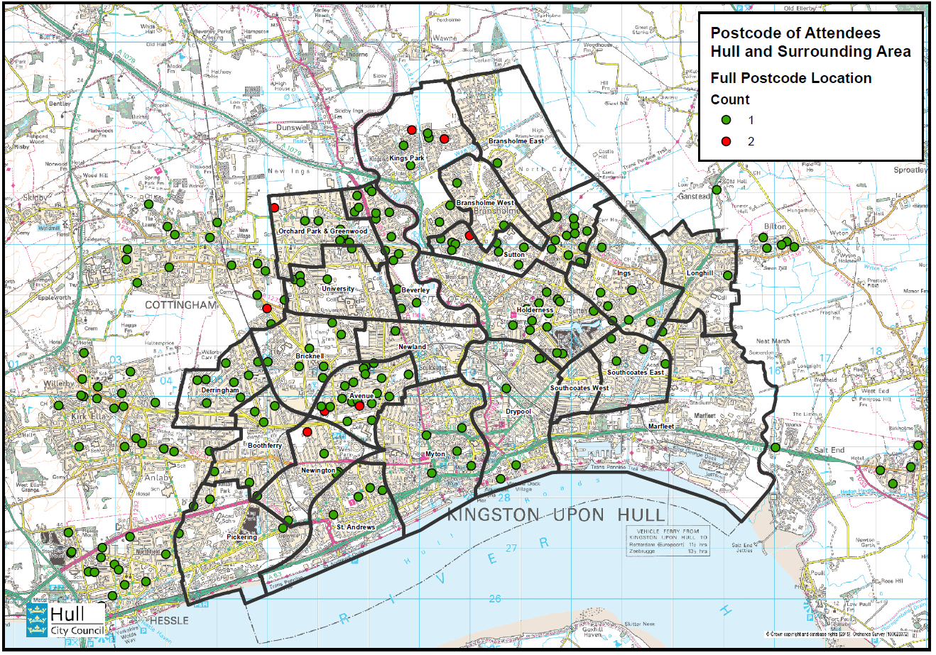
PLACE OF RESIDENCE

Slide 27
 | All Attendees | Hull Attendees | All Hull Residents | Difference: Hull Attendees vs. All Hull Residents
10% Most Deprived | 13.7% | 23.6% | 45.1% | -21.5%
10% - 20% Deprived | 5.7% | 8.2% | 7.7% | 0.6%
20% - 30% Deprived | 9.1% | 14.3% | 11.8% | 2.4%
30% - 40% Deprived | 8.3% | 12.6% | 10.8% | 1.8%
40% - 50% Deprived | 12.0% | 15.4% | 9.7% | 5.7%
50% - 60% Deprived | 10.3% | 9.3% | 6.3% | 3.1%
60% - 70% Deprived | 11.4% | 7.7% | 4.6% | 3.1%
70% - 80% Deprived | 10.5% | 8.2% | 3.4% | 4.8%
80% - 90% Deprived | 5.4% | 0.5% | 0.6% | 0.0%
90% - 100% Deprived | 13.7% | 0.0% | 0.0% | 0.0%
DEPRIVATION DECILE

Slide 28
Base: 182
DEPRIVATION DECILE

Slide 29
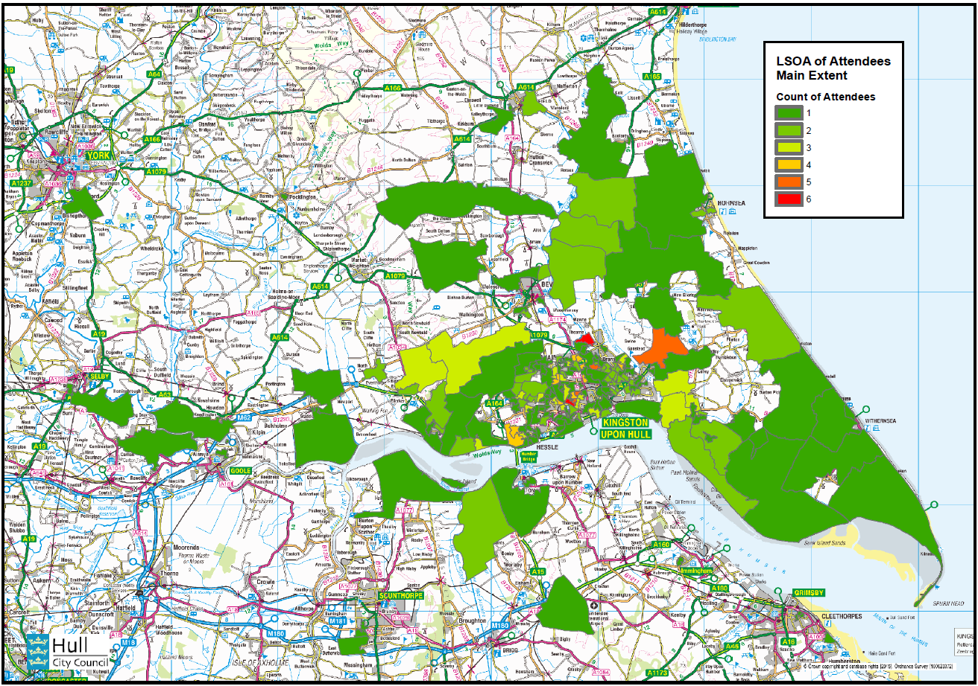
LSOA: HEAT MAP REGION

Slide 30
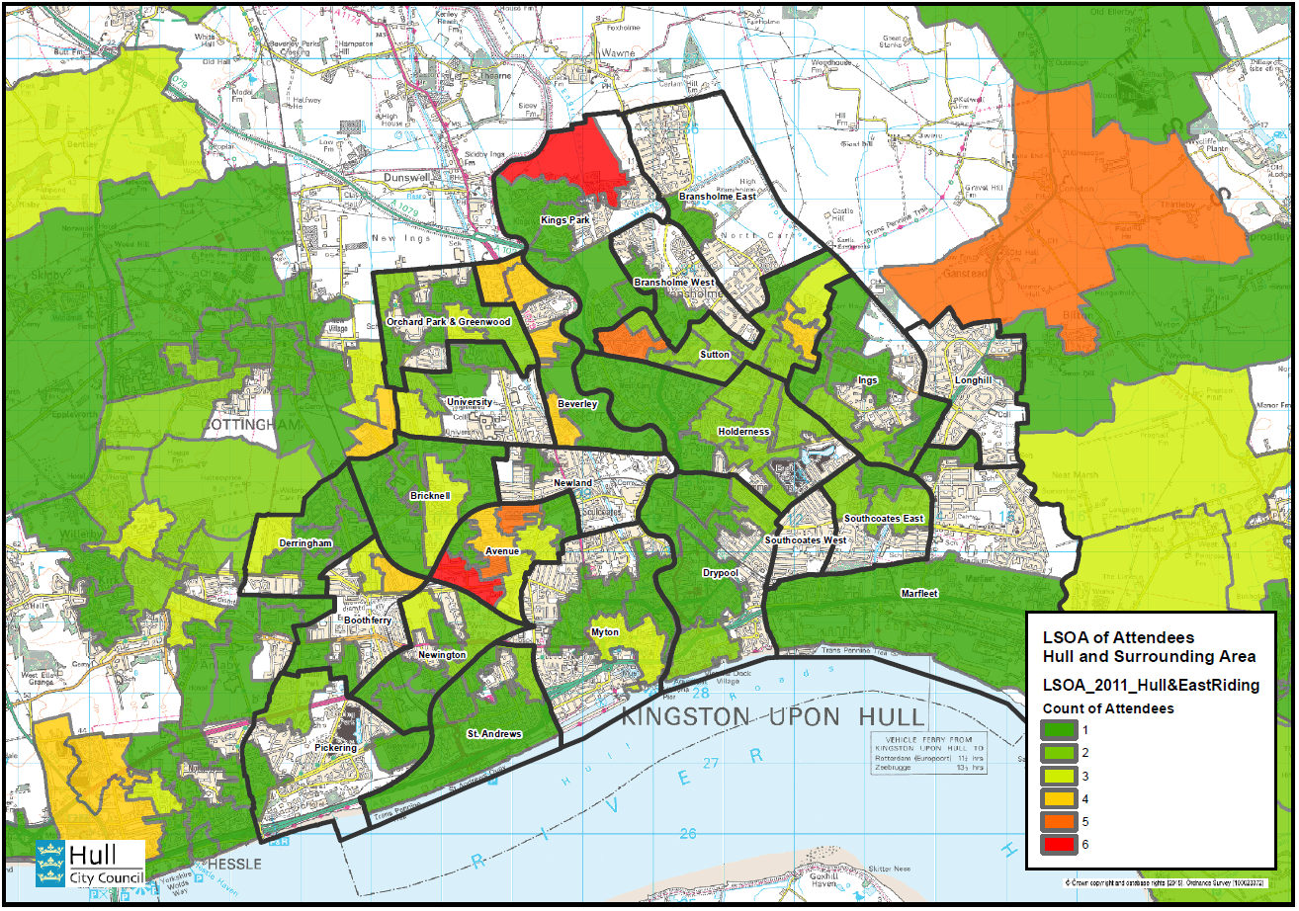
LSOA: HEAT MAP HULL

Slide 31
DEMOGRAPHICS
POST CODE - ALL
9 in 10 respondents were from a HU post code area
1 in respondents were form a HU1 – HU9 post code area (Kingston upon Hull)
Mapping of post codes from Hull and surrounding areas shows clusters of respondents from the following areas:
Kingston upon Hull: The Avenues; Sutton; Orchard Park & Greenwood; and Derringham
East Riding of Yorkshire: Kirk Ella & Willerby; Beverley; Hessle; Holderness; and Cottingham.

Slide 32
DEMOGRAPHICS
DEPRIVATION DECILE
The Indices of Deprivation are prepared using the Lower Super Output Area (LSOA) geography which has the dual benefits of consistent size throughout England, and being stable over time so that changes in deprivation levels can be measured.
There are 32,844 LSOAs in England (166 in Kingston upon Hull). Deprivation scores are calculated for each LSOA and they are then ranked from 1 (most deprived) to 32,844 (least deprived). The rankings are often reported as deciles of deprivation from 0-10% (most deprived), 10-20%, 20-30%.…..90-100% (least deprived).
It should be noted that:
The Indices of Deprivation measure relative deprivation, not absolute.
Not all residents of deprived areas are deprived, and not all deprived people live in deprived areas.

Slide 33
DEMOGRAPHICS
DEPRIVATION DECILE - ALL
13.7% are from the 0-10% deprived LSOAs (most deprived)
13.7% are from the 90-100% deprived LSOAs (least deprived)
12.0% are from the 45-50% deprived LSOAs
Almost 1 in 3 (28.5%) are from the 0-30% deprived LSOAs.
DEPRIVATION DECILE – HULL RESIDENTS ONLY
23.6% are from the 0-10% deprived LSOAs (most deprived)
15.4% are from the 45-50% deprived LSOAs
14.3% are from the 20-30% deprived LSOAs
Almost 1 in 2 (46%) are from the 0-30% deprived LSOAs.
This data suggests Place des Anges over performed in Hull, in terms of attracting people from more deprived areas. However, this is because of the higher than average number of residents living within deprived areas in Kingston upon Hull, compared to the UK average. Relative to the population of Kingston upon Hull, residents from the 10% most deprived deciles were under-represented by 21.5%, with all other deprivation deciles over-represented. The 40-80% deprived deciles were the most significantly over-represented among Hull residents.

Slide 34
SEGEMENTATION

Slide 35
Base: 357
ARTS & CULTURAL PARTICIPATION

Slide 36
 | Target (Place des Anges Attendees) |  | Base (UK Population)
Group | Count | Count % | Count | Count % | Index
A City Prosperity | 0 | 0.00 | 1,167,516 | 4.27 | 0
B Prestige Positions | 18 | 5.14 | 1,817,172 | 6.65 | 77
C Country Living | 17 | 4.86 | 1,747,561 | 6.39 | 76
D Rural Reality | 28 | 8.00 | 1,881,374 | 6.88 | 116
E Senior Security | 31 | 8.86 | 2,173,848 | 7.95 | 111
F Suburban Stability | 32 | 9.14 | 1,590,692 | 5.82 | 157
G Domestic Success | 38 | 10.86 | 2,183,748 | 7.99 | 136
H Aspiring Homemakers | 51 | 14.57 | 2,479,450 | 9.07 | 161
I Family Basics | 26 | 7.43 | 2,039,994 | 7.46 | 100
J Transient Renters | 34 | 9.71 | 1,701,688 | 6.23 | 156
K Municipal Challenge | 20 | 5.71 | 1,820,167 | 6.66 | 86
L Vintage Value | 22 | 6.29 | 1,931,204 | 7.07 | 89
M Modest Traditions | 15 | 4.29 | 1,327,772 | 4.86 | 88
N Urban Cohesion | 6 | 1.71 | 1,311,824 | 4.80 | 36
O Rental Hubs | 11 | 3.14 | 2,158,311 | 7.90 | 40
U Unclassified | 1 | 0.29 | 0 | 0.00 | 0
Total | 350 | 100.00 | 27,332,321 | 100.00 | 100
MOSAIC GROUPS: ATTENDEES vs. UK

Slide 37
 | Target (Place des Anges Attendees) |  | Base (UK Population)
Type | Count | Count % | Count | Count % | Index
H31 Affordable Fringe | 31 | 8.86 | 692,319 | 2.53 | 350
G29 Mid-Career Convention | 22 | 6.29 | 577,709 | 2.11 | 297
K48 Low Income Workers | 19 | 5.43 | 551,812 | 2.02 | 269
J43 Renting a Room | 17 | 4.86 | 568,771 | 2.08 | 233
I39 Families with Needs | 16 | 4.57 | 672,061 | 2.46 | 186
E20 Classic Grandparents | 15 | 4.29 | 450,964 | 1.65 | 260
Total | 98 | 28 | 2,935,927 | 10.74
MOSAIC TYPES: ATTENDEES VS. UK

Slide 38
 | Target (Place des Anges Attendees) |  | Base (Kingston Upon Hull & East Riding of Yorkshire Population)
Group | Count | Count % | Count | Count % | Index
A City Prosperity | 0 | 0.00 | 6,178 | 0.27 | 0
B Prestige Positions | 18 | 5.14 | 110,569 | 4.84 | 106
C Country Living | 17 | 4.86 | 114,689 | 5.02 | 97
D Rural Reality | 28 | 8.00 | 131,515 | 5.75 | 139
E Senior Security | 31 | 8.86 | 221,515 | 9.69 | 91
F Suburban Stability | 32 | 9.14 | 153,639 | 6.72 | 136
G Domestic Success | 38 | 10.86 | 142,692 | 6.24 | 174
H Aspiring Homemakers | 51 | 14.57 | 236,466 | 10.35 | 141
I Family Basics | 26 | 7.43 | 225,348 | 9.86 | 75
J Transient Renters | 34 | 9.71 | 233,150 | 10.20 | 95
K Municipal Challenge | 20 | 5.71 | 137,326 | 6.01 | 95
L Vintage Value | 22 | 6.29 | 208,462 | 9.12 | 69
M Modest Traditions | 15 | 4.29 | 139,637 | 6.11 | 70
N Urban Cohesion | 6 | 1.71 | 95,962 | 4.20 | 41
O Rental Hubs | 11 | 3.14 | 128,417 | 5.62 | 56
U Unclassified | 1 | 0.29 | 0 | 0.00 | 0
Total | 350 | 100.00 | 2,285,565 | 100.00 | 100
MOSAIC GROUPS: ATTENDEES VS. Y&H

Slide 39
 | Target (Place des Anges Attendees) |  | Base (Kingston Upon Hull & East Riding of Yorkshire Population)
Type | Count | Count % | Count | Count % | Index
H31 Affordable Fringe | 31 | 8.86 | 98,828 | 4.32 | 205
G29 Mid-Career Convention | 22 | 6.29 | 54,982 | 2.41 | 261
K48 Low Income Workers | 19 | 5.43 | 81,395 | 3.56 | 152
J43 Renting a Room | 17 | 4.86 | 97,472 | 4.26 | 114
I39 Families with Needs | 16 | 4.57 | 105,351 | 4.61 | 99
E20 Classic Grandparents | 15 | 4.29 | 61,034 | 2.67 | 160
Total | 120 | 34 | 499,062 | 22
MOSAIC TYPES: ATTENDEES VS. Y&H

Slide 40
PARTICIPATION & ATTENDANCE
ARTS & CULTURAL PARTICIPATION & ATTENDANCE
In the 12 months prior to the survey taking place 6.2% had not attended or participated in any arts or cultural activity
93.8% had attended or participated in arts and cultural events or activities – the top five most popular types of event or activity were:
No. 1: Museums/historical attractions - 72.8% of respondents
No. 2: Film – 71.4% of respondents
No. 3: Outdoor events – 67.8% of respondents
No. 4: Music – 65.3% of respondents
No. 5: Theatre – 64.1% of respondents
Less than 10% had attended or participated in the following types of event or activity:
Other arts – 6.7% of respondents
Opera – 7.3% of respondents
Circus – 8.7% of respondents

Slide 41
MOSAIC SEGMENTATION
Mosaic classifies consumers in the UK into 15 groups and 66 types.
Indices under 80 indicate significant under-representation of the segment amongst the audience compared to the population of the base area
Indices over 120 illustrate significant over-representation of a segment
The tables above compare audience profile for Place des Anges with:
(1) that of households in the UK; and
(2) households in the Yorkshire & Humber region.

Slide 42
MOSAIC SEGMENTATION
The most significant MOSAIC Groups amongst Place des Anges respondents were H Aspiring Homemakers; G Domestic Success; J Transient Renters; F Suburban Stability; E Senior Security; D Rural reality
Aspiring Homemakers, Suburban Security, Transient Renters and Domestic Success are over-represented MOSAIC Groups amongst Place des Anges respondents, relative to the UK population
City Prosperity, Urban Cohesion, Rental Hubs, Country Living and Presitge Positions are under-represented MOSAIC Groups amongst Place des Anges respondents, relative to the UK population.
Domestic Success, Aspiring Homemakers, Rural Reality and Suburban Security are over-represented MOSAIC Groups amongst Place des Anges respondents, relative to the Yorkshire & Humber population
City Prosperity, Urban Cohesion, Rental Hubs, Vintage Value, Modest Traditions and Family Basics are under-represented MOSAIC Groups amongst Place des Anges respondents, relative to the Yorkshire & Humber population.

Slide 43
MOSAIC SEGMENTATION
The most significant MOSAIC Types amongst Place des Anges respondents were H31 Affordable Fringe; G29 Mid-Career Convention; K48 Low Income Workers; J43 Renting a Room; I39 Families with Needs; and E20 Classic Grandparents
23 of 66 MOSAIC Types (34.8%) are over-represented amongst Place des Anges respondents, relative to the UK population
37 of 66 MOSAIC Types (56.1%) are under-represented amongst Place des Anges respondents, relative to the UK population.
21 of 66 MOSAIC Types (31.8%) are over-represented amongst Place des Anges respondents, relative to the Yorkshire & Humber population
36 of 66 MOSAIC Types (54.5%) are under-represented MOSAIC Types amongst Place des Anges respondents, relative to the Yorkshire & Humber population.

Slide 44
MOSAIC GROUPS
H Aspiring Homemakers
Younger households settling down in housing priced within their means. Key features of this group are:
Younger households
Starter salaries
Affordable housing costs
Private suburbs
Full-time employment
Buy and sell on ebay.
Demographics for this group are:
26-35 years
40-49k household income
Pseudo family
2 children

Slide 45
MOSAIC GROUPS
G Domestic Success
Thriving families who are busy bringing up children and following careers. Key features of this group are:
Families with children
Upmarket suburban homes
Owned with a mortgage
3 or 4 bedrooms
High Internet use
Own new technology.
Demographics for this group are:
36-45 years
70-99k household income
2 children.

Slide 46
MOSAIC GROUPS
J Transient Renters
Single people privately renting low cost homes for the short term. Key features of this group are:
Private renters
Low length of residence
Low cost housing
Singles and sharers
Older terraces
Few landline telephones.
Demographics for this group are:
18-25years
20-29k household income
No children.

Slide 47
MOSAIC GROUPS
F Suburban Stability
Mature suburban owners living settled lives in mid-range housing. Key features of this group are:
Older families
Some adult children living at home
Suburban mid-range homes
3 bedrooms
Have lived at same address some years
Research on internet.
Demographics for this group are:
56-65 years
40-49k household income
Family and other adults
1 child.

Slide 48
MOSAIC GROUPS
E Senior Security
Elderly people with assets who are enjoying a comfortable retirement. Key features of this group are:
Elderly singles and couples
Homeowners
Comfortable homes
Additional pensions above state
Don’t like technology
Low mileage drivers.
Demographics for this group are:
66+ years
15k+ household income
No children.

Slide 49
MOSAIC GROUPS
D Rural Reality
Householders living in inexpensive homes in village communities. Key features of this group are:
Rural locations
Village and outlying houses
Agricultural employment
Most are homeowners
Affordable value homes
Slow Internet speeds.
Demographics for this group are:
46-55 years
20-29k household income
Single
No children.

Slide 50
MOSAIC TYPES
H31 Affordable Fringe
Settled families with children owning modest, 3-bed semis in areas where there's more house for less money. Key features of this group are:
Married couple in 30s or 40s
Many in receipt of Tax Credits
School age children
Own semis in affordable suburbs
Have lived there 5 years or more
Most likely to have small pets.
Demographics for this group are:
36-45 years
40-49k household income
3 children.

Slide 51
MOSAIC TYPES
G29 Mid-Career Convention
Professional families with children in traditional mid-range suburbs where neighbours are often older. Key features of this group are:
Married couples with kids
High proportion with mortgage
Likely to have life cover
Professional jobs
Traditional suburbs
Online grocery shopping.
Demographics for this group are:
36-45 years
50-59k household income
3 children.

Slide 52
MOSAIC TYPES
K48 Low Income Workers
Older social renters settled in low value homes in communities where employment is harder to find. Key features of this group are:
Older households
Areas with low levels of employment
Longer length of residence
Social landlords
Renting low cost semi and terraces
2 or 3 bedrooms.
Demographics for this group are:
56-65 years
<15k household income
No children.

Slide 53
MOSAIC TYPES
J43 Renting a Room
Transient renters of low cost accommodation often within subdivided older properties. Key features of this group are:
Singles and homesharers
Most likely to get a lift to work
Often Victorian terraces
Low rent accommodation
Short term private renters
Low wage occupations.
Demographics for this group are:
26-35 years
15-19k household income
No children.

Slide 54
MOSAIC TYPES
I39 Families with Needs
Families with many children living in areas of high deprivation and who need support. Key features of this group are::
Cohabiting couples and singles with kids
Moves tend to be within local community
Small socially rented terraces and semis
Low household income
Areas with high unemployment
Shop for computer games online.
Demographics for this group are:
26-35 years
<15k household income
Pseudo family
4+ children.

Slide 55
MOSAIC TYPES
E20 Classic Grandparents
Lifelong couples in standard suburban homes enjoying retirement through grandchildren and gardening. Key features of this group are:
Elderly couples
Traditional values
Not good with new technology
Long length of residence
Most likely to have a basic mobile
Own value suburban semis and terraces.
Demographics for this group are:
66+years
20-29k household income
Family
No children.

Slide 56
MARKETING & COMMS

Slide 57
Base: 357
Base: 357
Base: 357
Base: 357
BRAND AWARENESS

Slide 58
Base: 357
BRAND AWARENESS

Slide 59
Base: 357
MOTIVATION TO ATTEND

Slide 60
MARKETING & COMMS
BRAND AWARENSS OF Place des Anges Partners
Almost all audience members were aware of Hull UK City of Culture 2017, suggesting, at least, the successful communication that Place des Anges was a Hull 2017 event, and at best successful communication of Hull as Uk City of Culture for 2017
Less successful was the communication that Place des Anges was part of the Yorkshire Festival 2016, or associated with the Amy Johnson Festival:
1 out of 2 respondents knew the event was part of the Yorkshire Festival prior to attending
2 out of 3 respondents knew the event was in association with the Amy Johnson Festival.
INTENTION TO ATTEND OR PARTICIPATE IN HULL 2017
9 out of 10 respondents intend to attend or participate in activities programmed for Hull 2017 UK City of Culture
Less than 2% intend to attend or participate; however, given the fact that they have already engaged with Place des Anges this is cause for concern. Test against enjoyment, post code, awareness

Slide 61
MARKETING & COMMS
HOW THEY FOUND OUT ABOUT Place des Anges
Word of Mouth and print media were the most effective communication tools, with 1 in 2 people finding out via family/friends/colleagues; and 1 in 4 people via the newspaper/ press:
Existing audiences should be nurtured, in order to move them up the Customer Loyalty Ladder
The existing relationship with the Hull Daily Mail and increasing profile of Hull 2017 with other newspapers should be nurtured in order to secure as much editorial coverage as possible for individual Hull 2017 events and activities
Printed marketing collaterals; promotion via other organisations digital platforms; and the Hull 2017 e-newsletter were the least effective communication tools for Place des Anges. An assessment should therefore be made about:
The level of spend on event specific print, and whether its success rate at converting people into audiences is a worthwhile investment;
The visibility of Hull 2017 events on partners’ digital platforms, as well as a more general strategic assessment about websites where a presence may be more successful at reaching target audiences
The call to action within the Hull 2017 e-newsletter linked to specific events, and whether this can be made more visible/effective.

Slide 62
MARKETING & COMMS
MOTIVATIONS TO ATTEND PdA
There are a number of stand out motivations as to why people chose to attend Place des Anges, which can be utilised to inform messaging and “calls to action” for future events that share similar characteristics. These are UNIQUENESS; HULL 2017 CONNECTION; SOCIALISING:
2 in 3 people selected ‘it’s a unique experience not to be missed’
1 in 3 people selected ‘because it’s supported by Hull UK City of Culture 2017’
1 in 3 people selected ‘because it’s something to do with friends and family’.
Motivations to attend that had little sway in attracting respondents to Place des Anges were BUSINESS TOURISM, CURISOITY OF PLACE, CELEBRITY, PEER PRESSURE, and COST:
Those visiting Hull on business represented less than 2% of respondents, which explains the low % of people who selected ‘something to do in Hull while I’m on business’
The event rather the location in which it was taking place was of more significance in deciding to attend
The content of the event, rather than the performers sparked interest to attend
People were more likely to be leaders than followers in deciding to attend
Perhaps because tickets were free, cost was not a significant motivating factor.

Slide 63
RESPONSE TO PLACE DES ANGES

Slide 64
Base: 357
Average score out of 10 | 9.6
Most frequent score given | 10
RECOMMENDATION

Slide 65
Base: 357
QUALITY METRICS

Slide 66
Base: 357
VALUE STATEMENTS

Slide 67
TOP MARKS
80.4% gave a score of 10/10
The average score across all 357 respondents was 9.6/10
96% of people gave a score of 8/10 or more
The lowest score awarded was 4/10 by 1 person

Slide 68
QUALITY
All quality metrics scored and average of more than 9 out of 10
It was an interesting idea; It was different from things I’ve experienced before; I would come to something like this again; and It is important it’s happening here were the four quality metrics that received the highest average score of 9.6
It has something to say about the world in which we live was the quality metric that received the lowest average score of 7.7

Slide 69
VALUE STATEMENTS
9 in 10 respondents Strongly agreed or Agreed that Place des Anges:
Is an enjoyable experience
303 (84.9%) Strongly agreed with the statement
47 (13.2%) Agreed agreed with the statement
I felt welcomed by staff / volunteers
297 (83.2%) Strongly agreed with the statement
53 (14.8%) Agreed agreed with the statement
Has encouraged me to attend more similar events in future
261 (73.1%) Strongly agreed with the statement
81 (22.7%) Agreed agreed with the statement
Gives everyone the chance to share and celebrate experiences together
258 (72.2%) Strongly agreed with the statement
84 (17.0%) Agreed agreed with the statement
Places the community at the centre
229 (64.1%) Strongly agreed with the statement
94 (16.9%) Agreed agreed with the statement.

Slide 70
VALUE STATEMENTS
7 in 10 respondents, or more, Strongly agreed or Agreed with the remainder of the value statements tested – that Place des Anges:
Has shown me that there is more to Hull than I had expected
185 (51.8%) Strongly agreed with the statement
115 (32.2%) Agreed agreed with the statement
Was accessible to those with disabilities/access issues
149 (41.7%) Strongly agreed with the statement
145 (40.6%) Agreed agreed with the statement
Has given me the opportunity to interact with other people who I wouldn’t have normally interacted with
151 (42.3%) Strongly agreed with the statement
125 (35.0%) Agreed agreed with the statement
Has made me think that getting involved in a project as a volunteer looks like fun
126 (35.3%) Strongly agreed with the statement
128 (34.0%) Agreed agreed with the statement.

Slide 71
VISITORS

Slide 72
Base: 164
VISITOR TYPE

Slide 73
VISIT TO HULL
Base: 164

Slide 74
Base: 164
Base: 164
Base: 164
Base: 164
Base: 164
VISITOR SATISFACTION

Slide 75
Base: 14
Base: 112
Base: 53
Base: 137
Base: 99
VISITOR SATISFACTION

Slide 76
STAYING VISITORS: NUMBER OF DAYS & NIGHTS (BASE:16)
Average number of days | 2.75
Most frequent number of days | 2
Longest number of days | 7
Average number of nights | 2
Most frequent number of nights | 1
Longest number of nights | 7
VISITOR SPEND
Accommodation (Base: 16)
Average spend on accommodation | £44.13
Highest spend on accommodation | £240.00
Lowest spend on accommodation | £0.00
Other spend (Base: 162)
Average spend – other spend | £22.90
Highest spend – other spend | £200.00
Lowest spend – other spend | £0.00
Base: 164
STAYING VISITORS & VISITOR SPEND

Slide 77
VISITORS
Nearly all visitors (9 in 10) defined themselves as day visitors
Three-quarters of visitors gave the reason ‘Other’ as their reason for being in Hull, with almost all specifying that they had come specifically for Place des Anges
General leisure purposes and to take in some arts/heritage/culture were the other reasons that approximately 1 in 10 visitors cited as their reason for being in Hull on the day of Place des Anges
Nearly all visitors to Hull had visited the city before attending for Place des Anges.

Slide 78
VISITOR SATISFACTION
There were three areas of visitor satisfaction that a high percentage of visitors had experienced and had therefore given a rating to, all scoring 4 or more out of 5:
Overall value for money: 92% of visitors rated this aspect of the visitor experience to Hull and gave an average score of 4.7
General visitor welcome: 84% of visitors rated this aspect of the visitor experience to Hull and gave an average score of 4.5
Places to eat and drink: 68% of visitors rated this aspect of the visitor experience to Hull and gave an average score of 4.0.
City centre signposting was the least satisfactory aspect of the visitor experience to Hull:
City centre signposting: 60% of visitors rated this aspect of the visitor experience to Hull and gave an average score of 3.7.

Slide 79
VISITOR SPEND
9 out of 10 respondents stated that their motivation for being in Hull that day was Mainly because of Place des Anges.
Of the 16 people who were overnight visitors:
The average number of days spent in Hull was 2.75 and the average number of nights 2
The most likely number of days and nights spent in Hull by respondents was 2 days
The longest stay was 7 days and 7 nights
The average spend on accommodation was £44.13
The highest spend on accommodation was £240 and the lowest £0, suggesting many were staying with friends or family.
Among all visitors to Hull for Place des Anges:
The average ‘other spend’ was £22.90
The highest ‘other spend’ was £200’ and the lowest £0.

