Slide 1
WOW Hull
City Hall Dressing Proposals

Slide 2
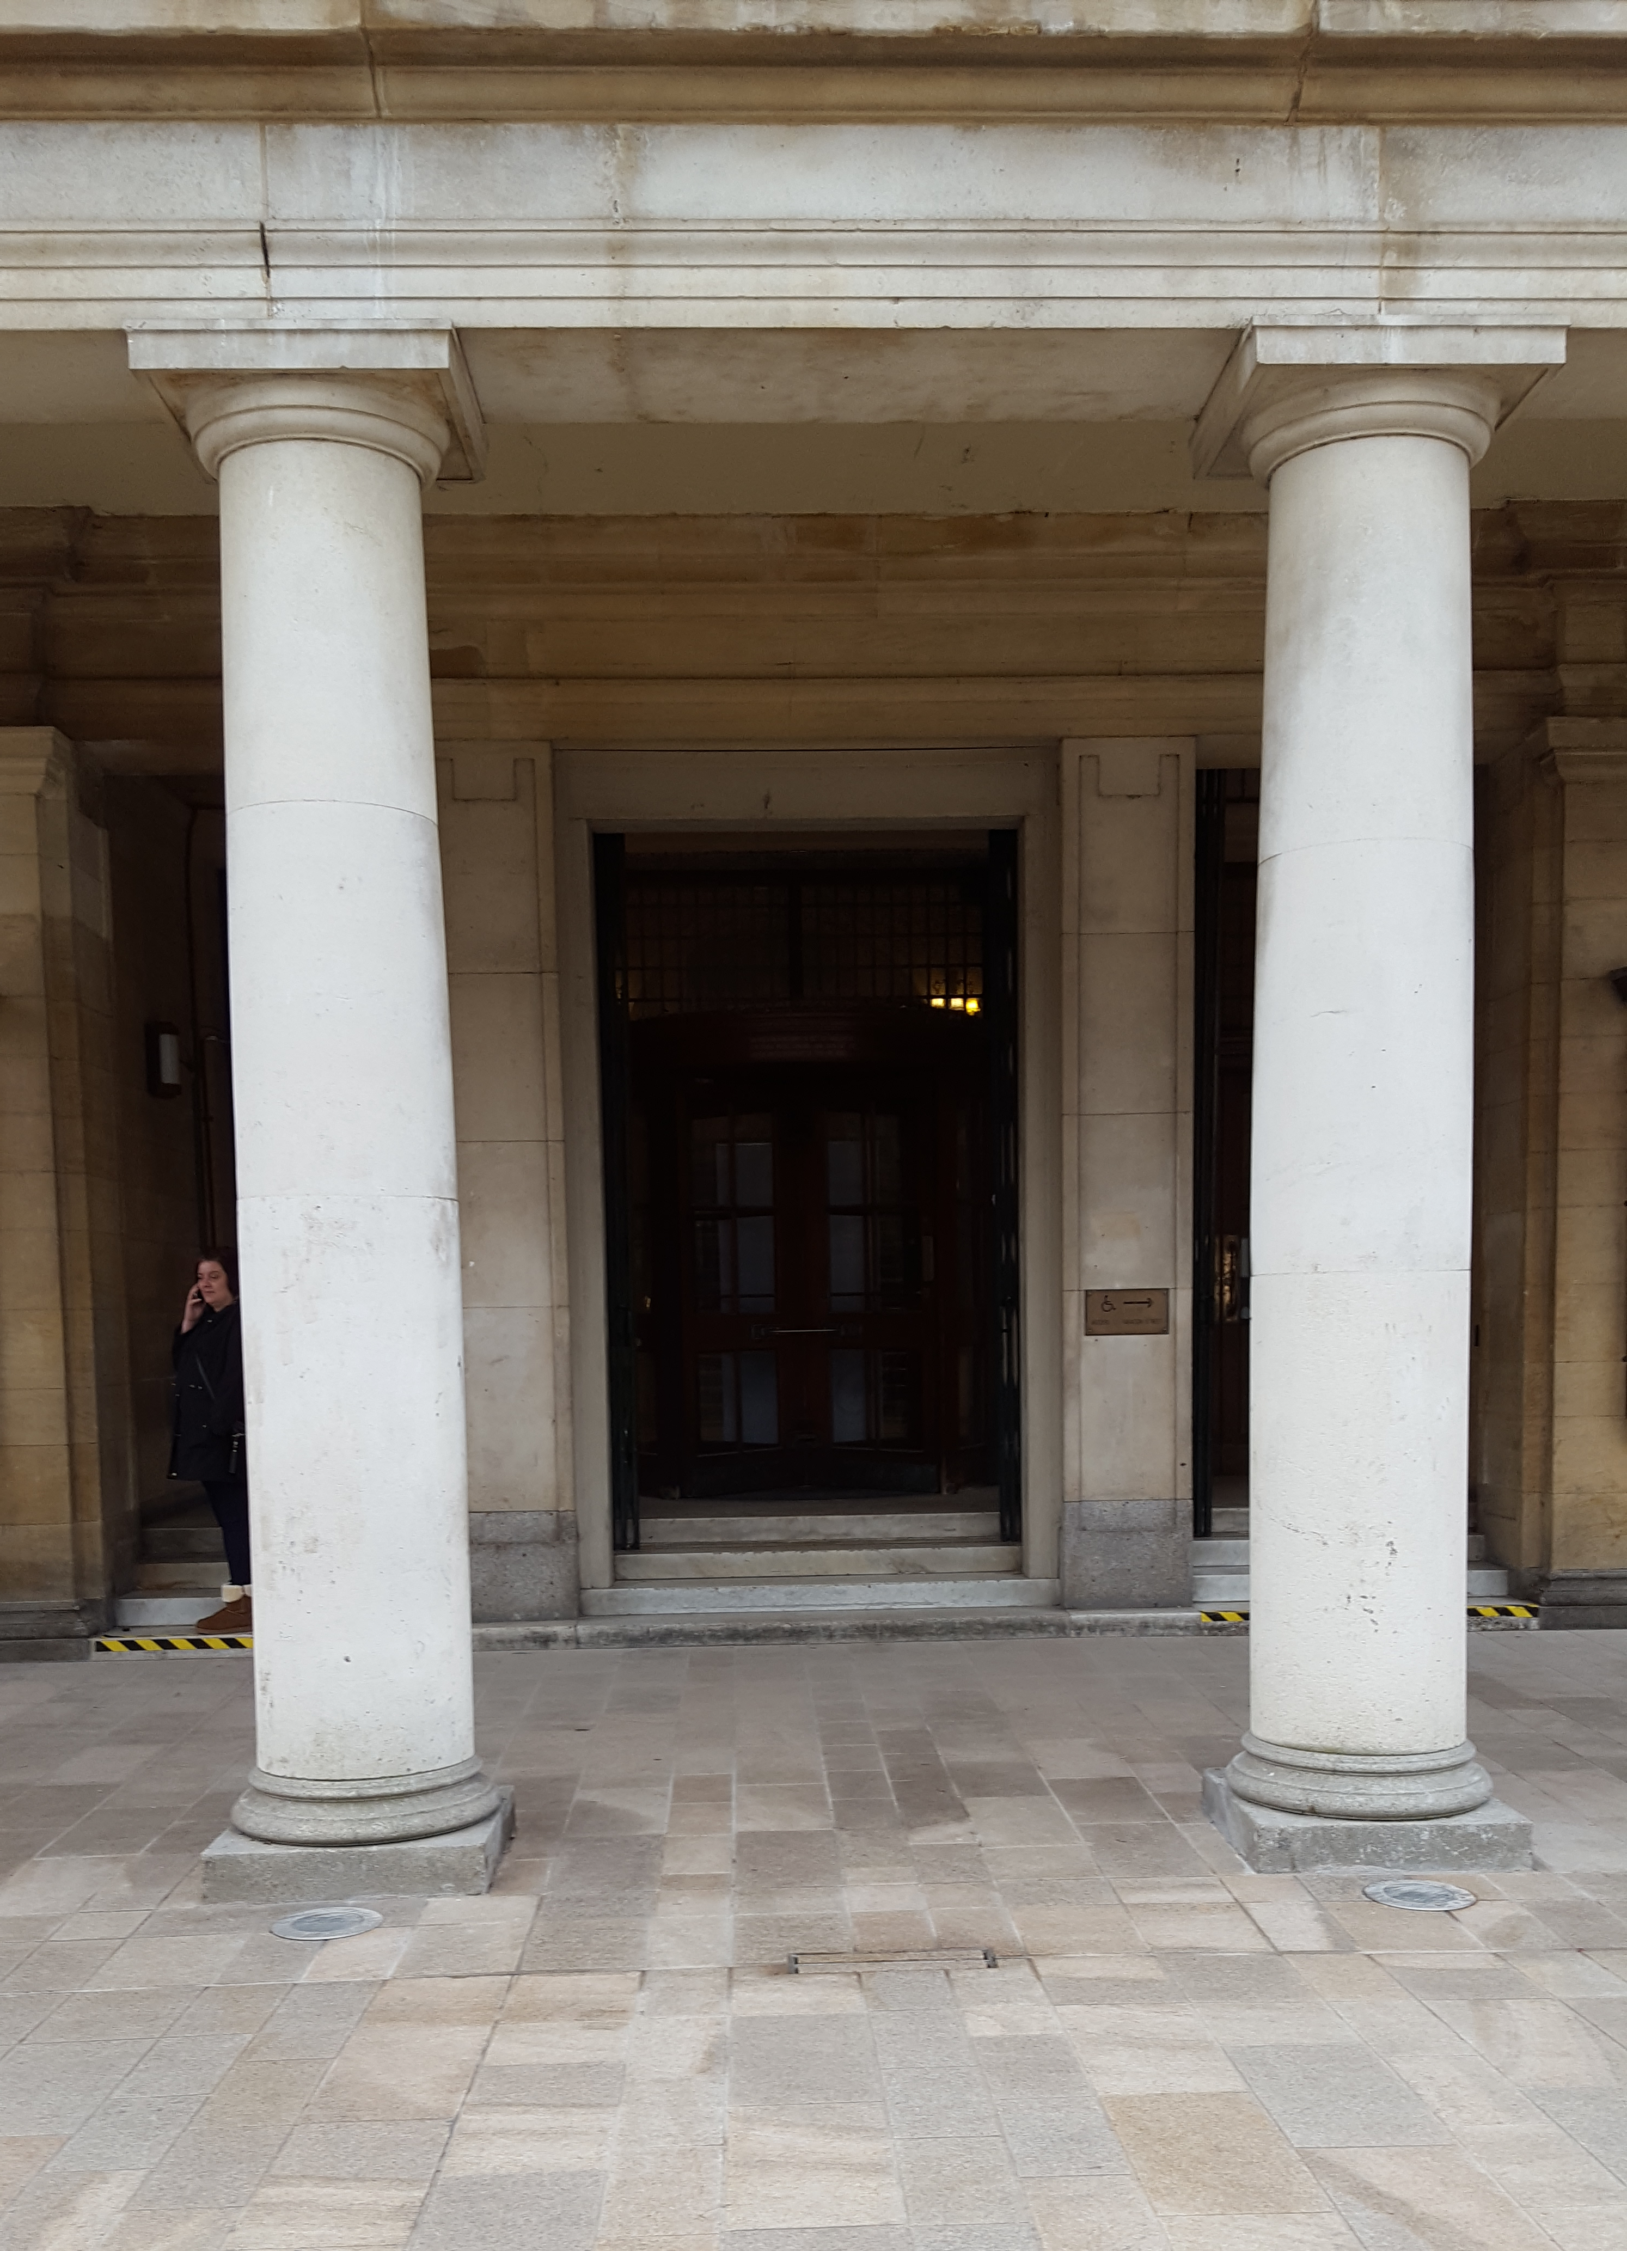
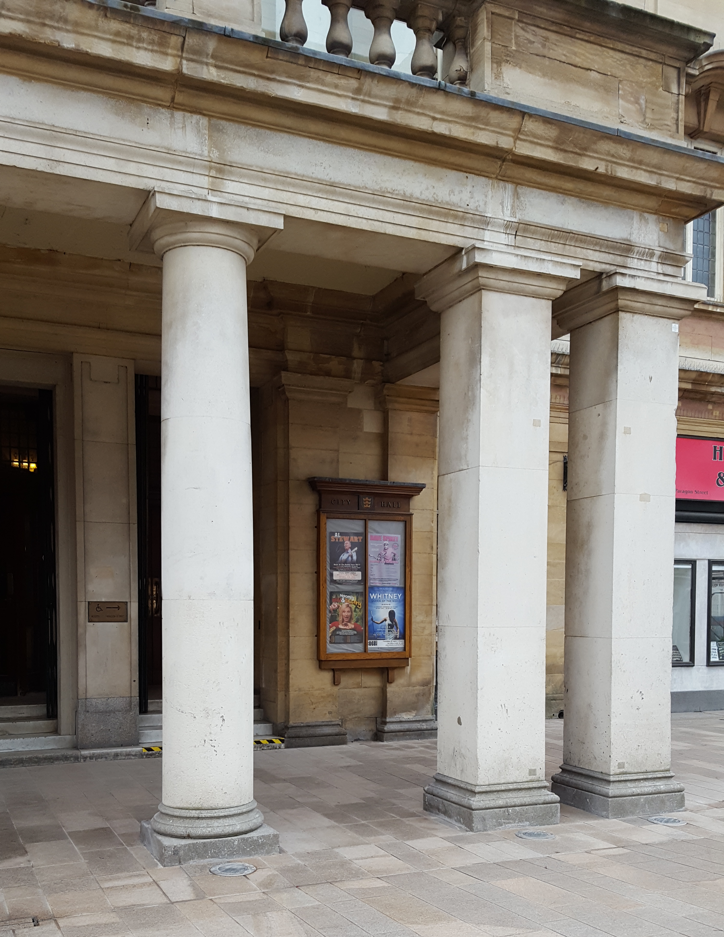

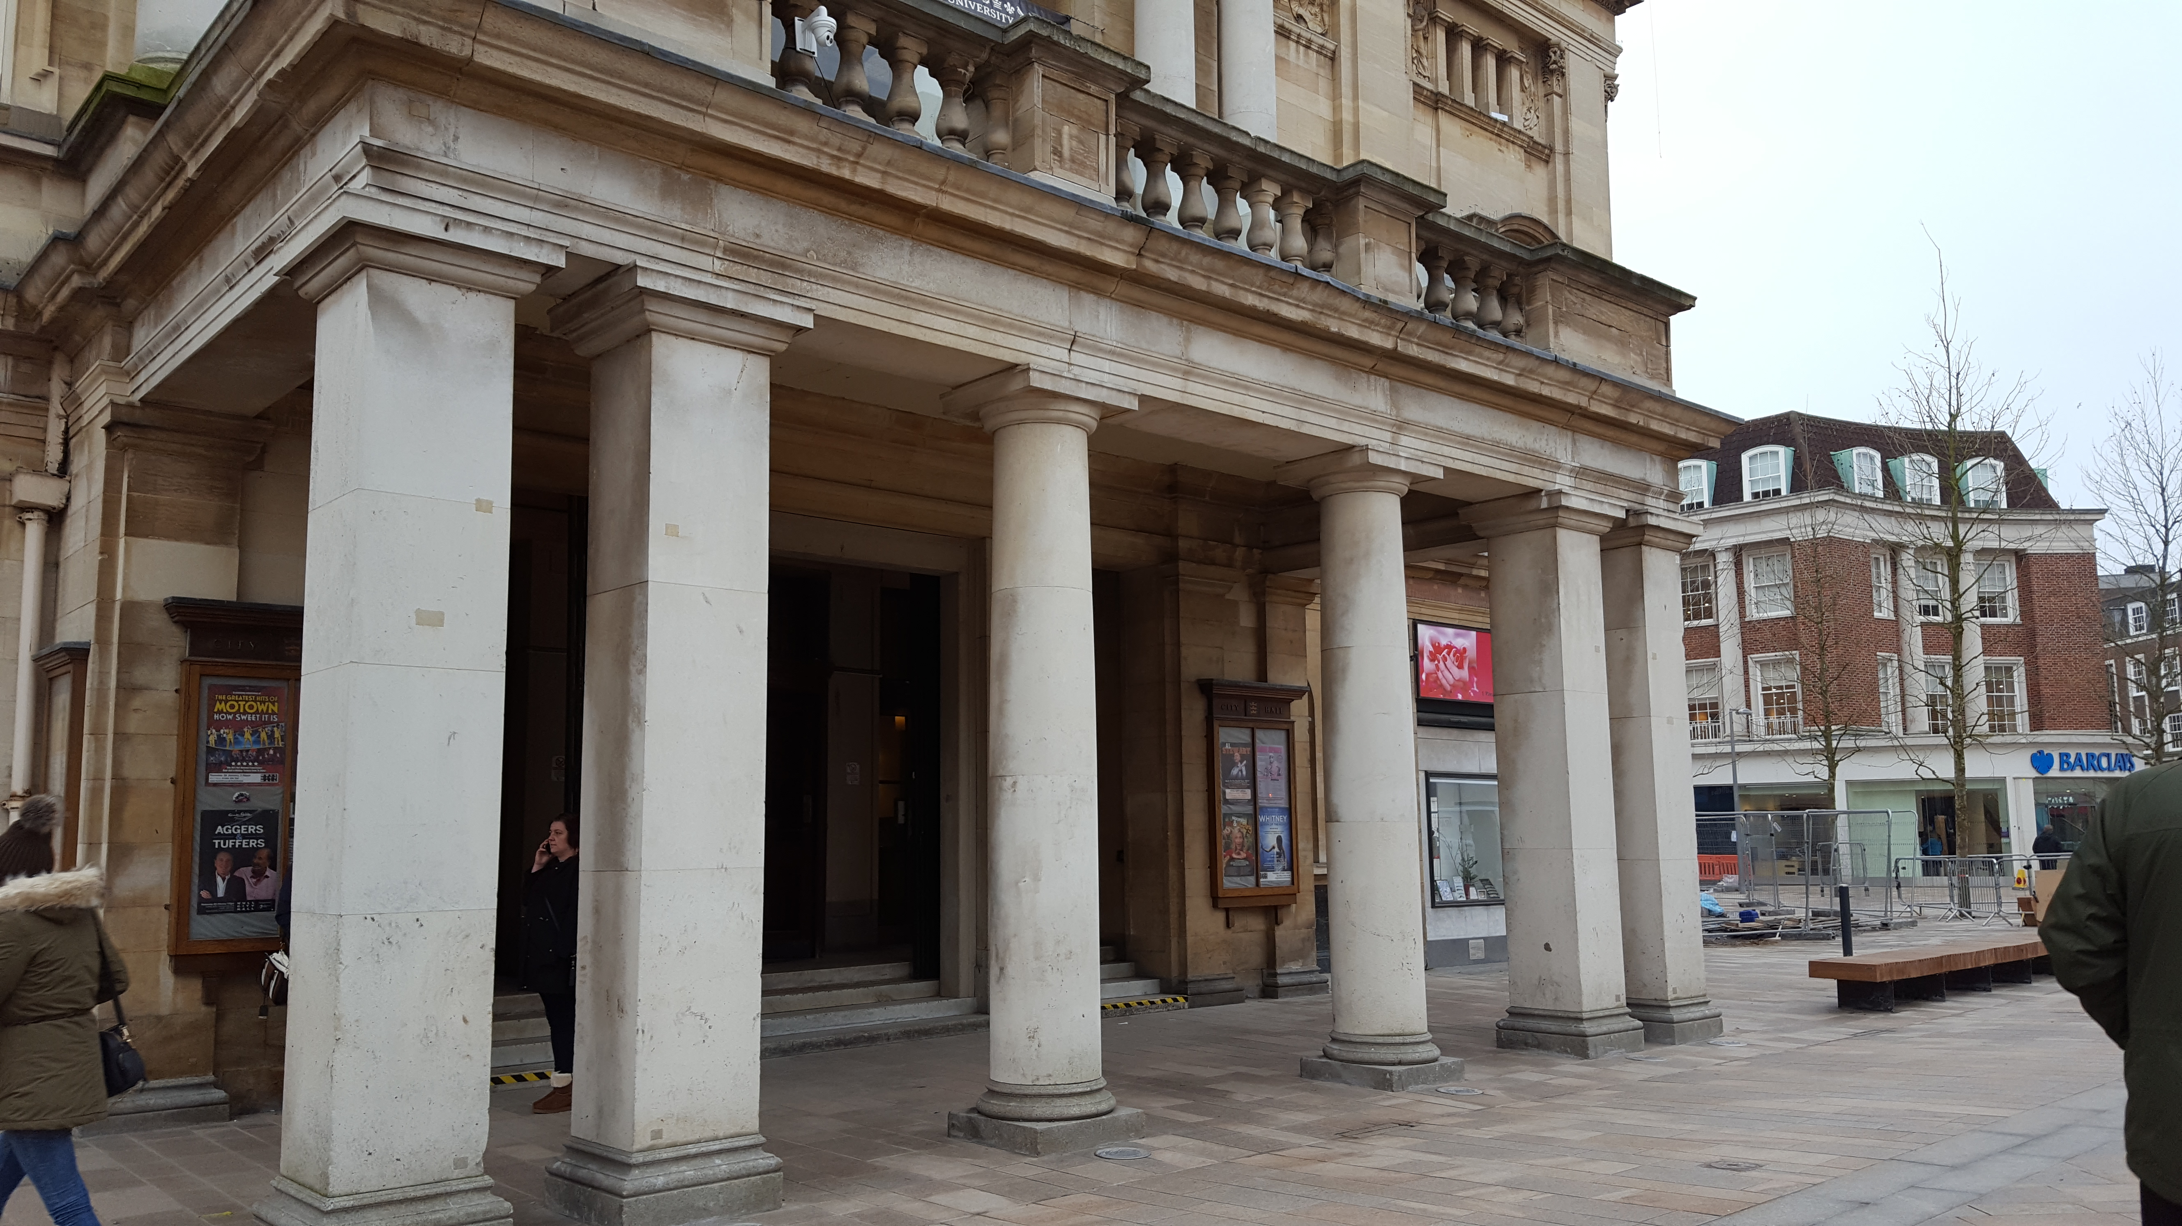
Outside City Hall
Main Entrance
Poster: 1510 high x 480 wide (x 4)
Two vinyl banners wrapped around each of
the pillars directly in front of the main
entrance. One cream like the lamppost
banners, one red featuring the festival line-up
Bespoke festival line
up poster in red
Pillar : 1.8m round x 2m high (x 2)
Columns:
1.8m wide x 600mm deep x 2m high

Slide 3
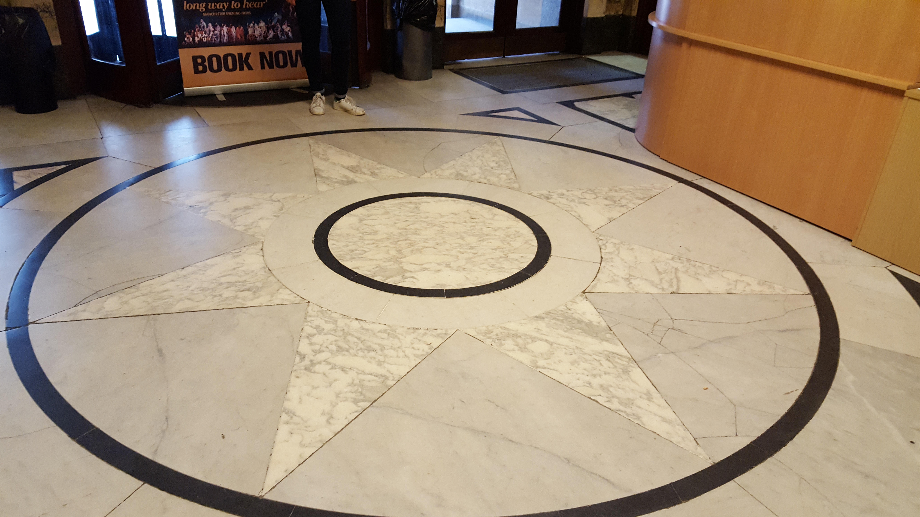

Main Entrance
Inner circle: 1.5m
Wow Hull logo in centre of circle on the floor
as people walk into the main entrance. T
his, together with the work JZ flowers are doing in this area will create a real WOW factor
Full circle: 3170
This could be repeated in the dome area and the rear of the main hall. All would be fixed using low tack adhesive which will leave no marks or sticky residue.

Slide 4
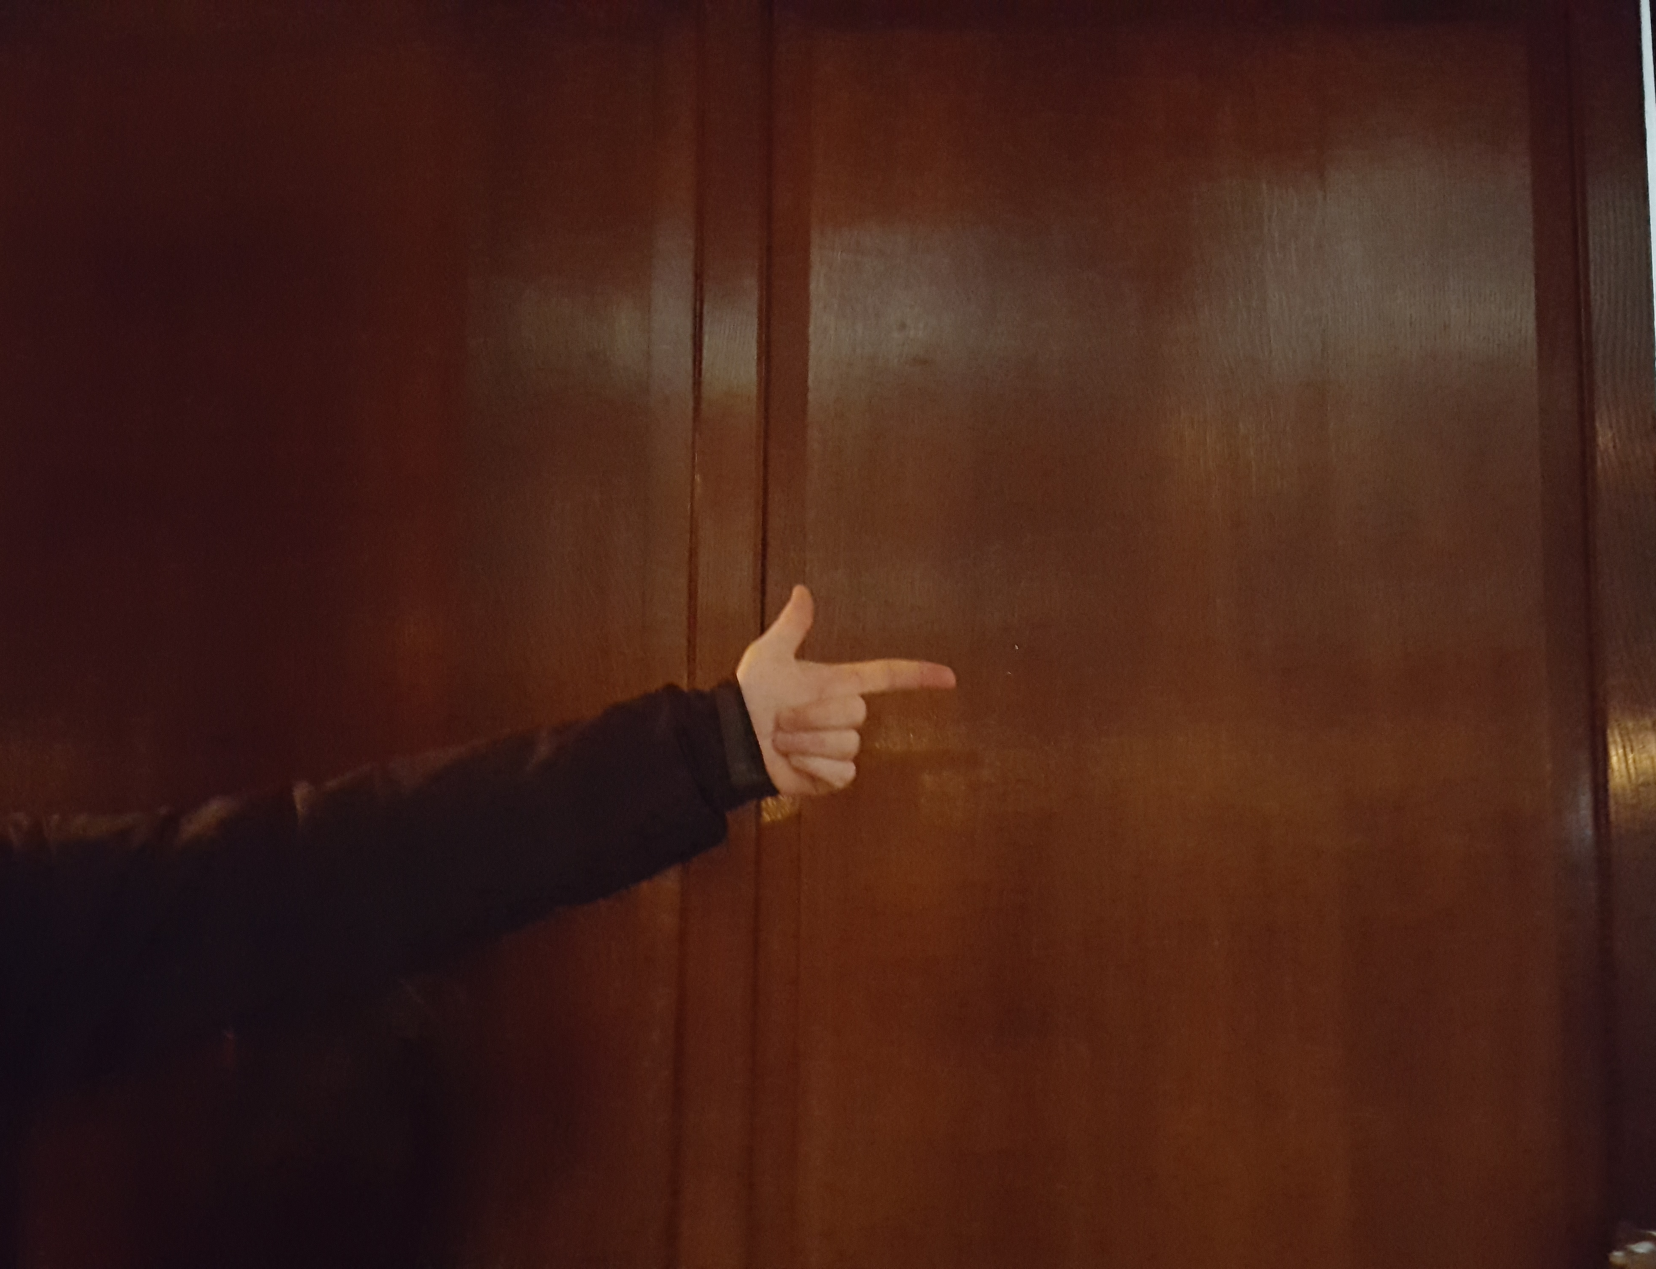
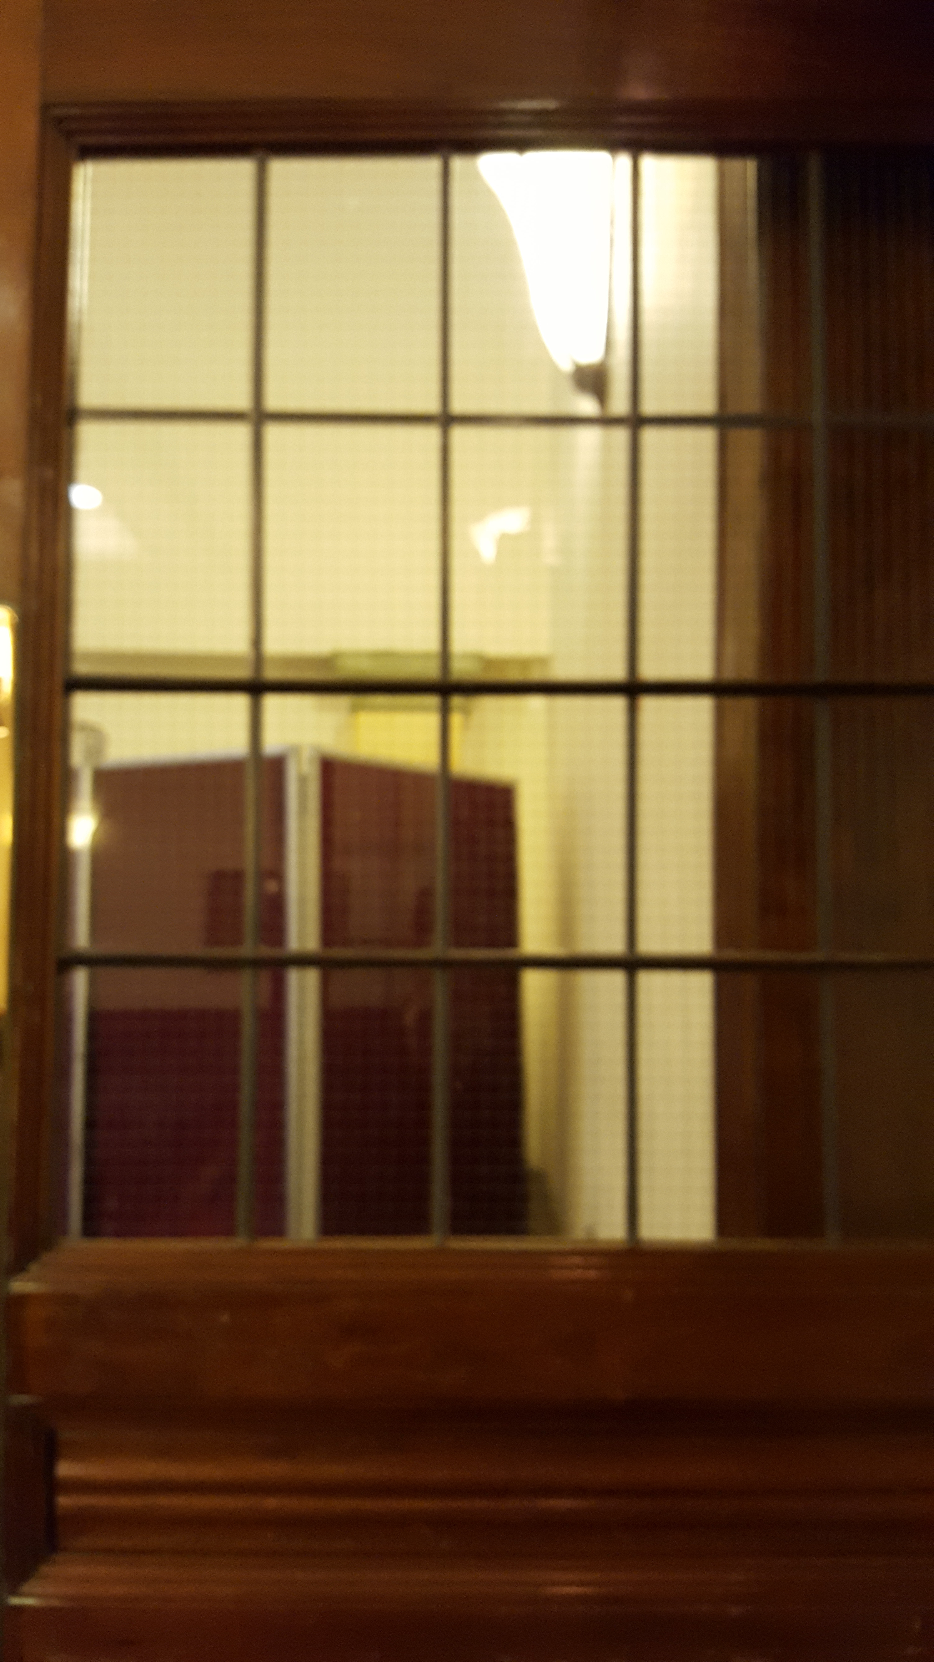


Signage
An assortment of signs including:
A4 vinyl/foamex board to go under existing metal sign
A3 signs x 6
A4 signs x 6
Arrows (roughly A4 size) x 6
In addition I will need approx 16 coarex boards (the same size as used for the fireworks ) and some cable ties
MORTIMER SUITE
LIFT &
ACCESSIBLE TOILETS
Generic signs can be reused across a number of events throughout the year.
Foamex signs can either be plain or
arrow shaped with text in centre.
Transparent door vinyls offer additional signage to accessible areas

Slide 5
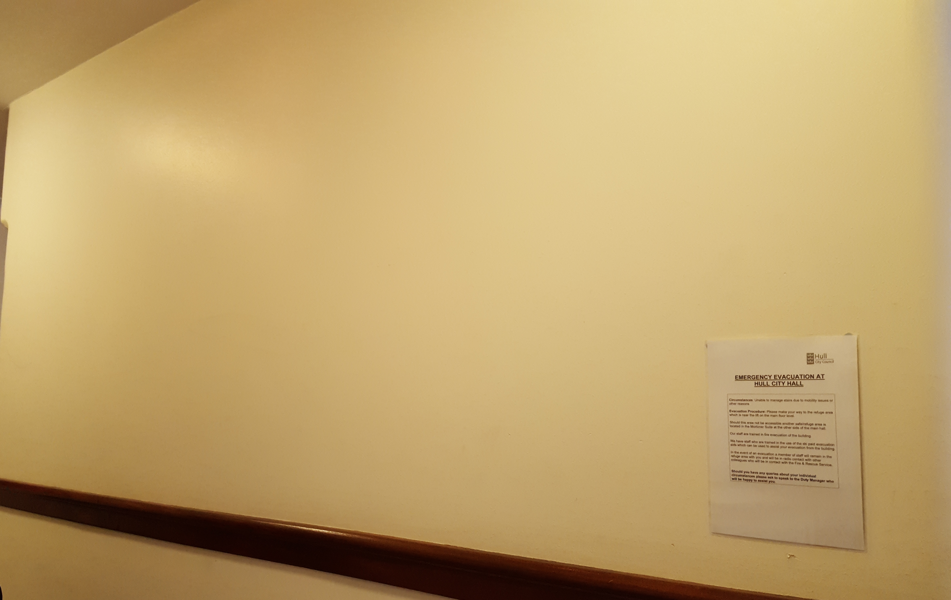
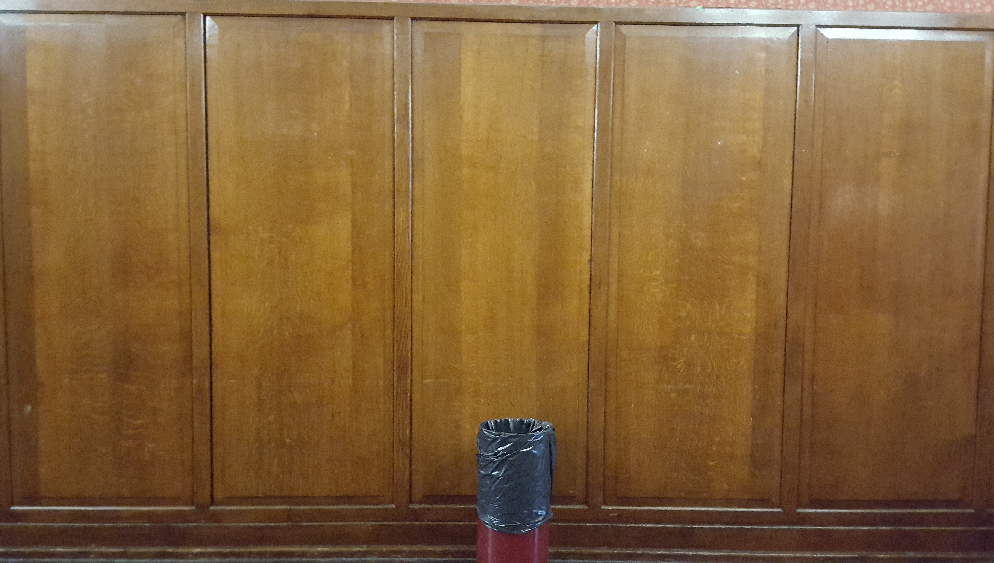
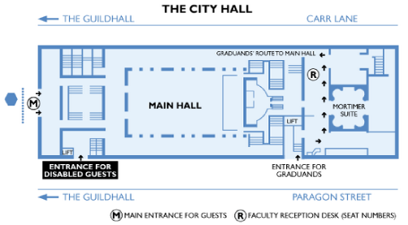
Information Walls
1200 wide x 600 high
Welcome to WOW Hull
Entrance this way
The wall as you come out of the lift on the first floor is bare it would be a nice touch to welcome mums with buggies and the less mobile to WOW as soon as they walk out of the lift. This large sign could be a wall vinyl or large foamed board depending what City Hall will allow on the walls
Map: 1200 with velcro
Large foamex mounted wall map

