Slide 1


PRINCIPAL AMBITIONS
a new celebration of the creativity, cultural diversity and future of the North
Performances, installations and events promoting ground-breaking, innovative and pioneering artists, and bringing them to a new audience
Creating an event that really gets industry and artists talking about future collaborations and how they imagine the future of the North

Slide 2

SUBSTANCE FESTIVAL
CELEBRATING CULTURE, CREATIVITY AND FUTURE OF THE NORTH
THURSDAY 7 DECEMBER – Questions of Substance – a symposia on the imagined futures of The North
We Made Ourselves Over will act as the the principal provocation from artists Blast Theory. Using the themes that underpin the films to inspire a series of conversations led by global experts on the role of arts and culture in society and how it must adapt to meet the demands of an ever changing world.
Working in collaboration with FutureEverything who will co-curate provocations.
AUDIENCE
Invited
Leaders in the Creative Industries
Artists
Partners of Hull 2017
Business partners who are signed up to the
Northern Powerhouse initiative.
WHERE
Hull Minster
Fruit
C4DI
Empty shops where possible

Slide 3

SUBSTANCE FESTIVAL
CELEBRATING CULTURE, CREATIVITY AND FUTURE OF THE NORTH
THURSDAY 7 DECEMBER
WHO ARE FUTUREEVERYTHING?
Award-winning innovation lab for digital culture and annual festival.
Established in Manchester in 1995.
For 21 years FutureEverything has been exploring the meeting point of technology, society and culture which lies at the heart of the digital debate.
Through a community network and regular events it makes connections between thinkers, developers, coders, artists, designers, urbanists and policy makers – inspiring them to experiment and to collaborate in new ways.

Slide 4
SUBSTANCE FESTIVAL
CELEBRATING CULTURE, CREATIVITY AND FUTURE OF THE NORTH
THURSDAY 7 DECEMBER
HOW WILL IT LOOK
Meet in the morning at Fruit to set out the 2097 provocation and potentially watch one of the films. Breakfast and drinks will be available. Standing. The day is not a spectator sport
Using Humber Street and other venues in regenerated areas
High profile artists (film curators, musicans, etc) will also make up the days panel discussion. These are conditions on which artists will be programmed throughout the weekend
Each panel discussion or provocation will be chosen with real change in mind

Slide 5
SUBSTANCE FESTIVAL
CELEBRATING CULTURE, CREATIVITY AND FUTURE OF THE NORTH
THURSDAY 7 DECEMBER
AUDIENCE/DELEGATES
POLICY MAKERS
ARTISTS
CREATIVE INDUSTRY LEADERS
BUSINESS LEADERS
LEADING NORTHERN ACADEMICS IN THE ARTS AND DIGITAL TECHNOLOGIES
HOW DO WE GET THE RIGHT PEOPLE THERE
Working very closely with Hull 2017 Partnerships team
Working very closely with Rebecca Horn and Pete Massey to make contact with different government departments shaping policy in the north
Using contacts as the British Council to assist with international networks

Slide 6
SUBSTANCE FESTIVAL
CELEBRATING CULTURE, CREATIVITY AND FUTURE OF THE NORTH
Substance
Thursday 7 December | Budget
Future Everything | £ 15,000
Additional Keynotes | £ 2,000
Venue Hires | £ 2,500
Food | £ 2,000
Drink | £ 2,000
Subsidy for those who can't afford to attend | £ 2,000
Production | £ 3,000
Accommodation | £ 3,000
Per Diems | £ 600
Site Dressing | £ 2,500
Total | £ 34,600
BUDGET
MAKES SURE THAT PEOPLE WHO MIGHT BE ABLE TO AFFORD TO COME OTHERWISE CAN MAKE IT.
THIS FEELS VERY IMPORTANT.

Slide 7

SUBSTANCE FESTIVAL
CELEBRATING CULTURE, CREATIVITY AND FUTURE OF THE NORTH
COMMISIONS
MARSHMELLOW LASER FEAST (MLF)
In partnership with the British Council, Strata and Montreal; MLF will create The Colossal Wave which is a large installation by the Marina and an installation in Humber Street Gallery.
A bowling ball thrown from a high tower by the Marina. It lands on the crash mat and effects films that can be viewed in VR at Humber Street Gallery. Using a local writer to give these films a Hull sense of humour. This will run across the weekend.

Slide 8
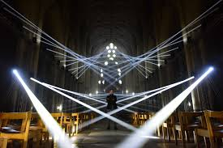
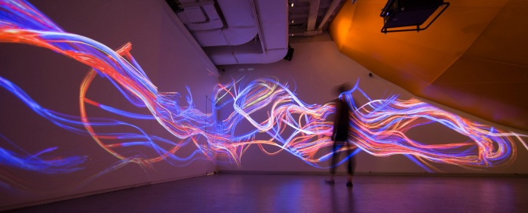


LOOK UP – The Deep #3
Field.io are working on a spectacular intervention in collaboration with The Deep on and around the building, inspired by the architect Terry Farrell’s original vision as a iceberg rising and sinking. The building is emblematic of the decades long regeneration of the city, arguably the catalyst that kick started the changes 2017 is a product of.
Produced as part of the Look Up programme this will be a free event.
Beyond The Stars
Jason Bruges
The large scale light installation will be taking place across Hull’s Old Town and in the very early stages of its run. Substance gives the opportunity for critical engagement and peer review within the symposia.

Slide 9
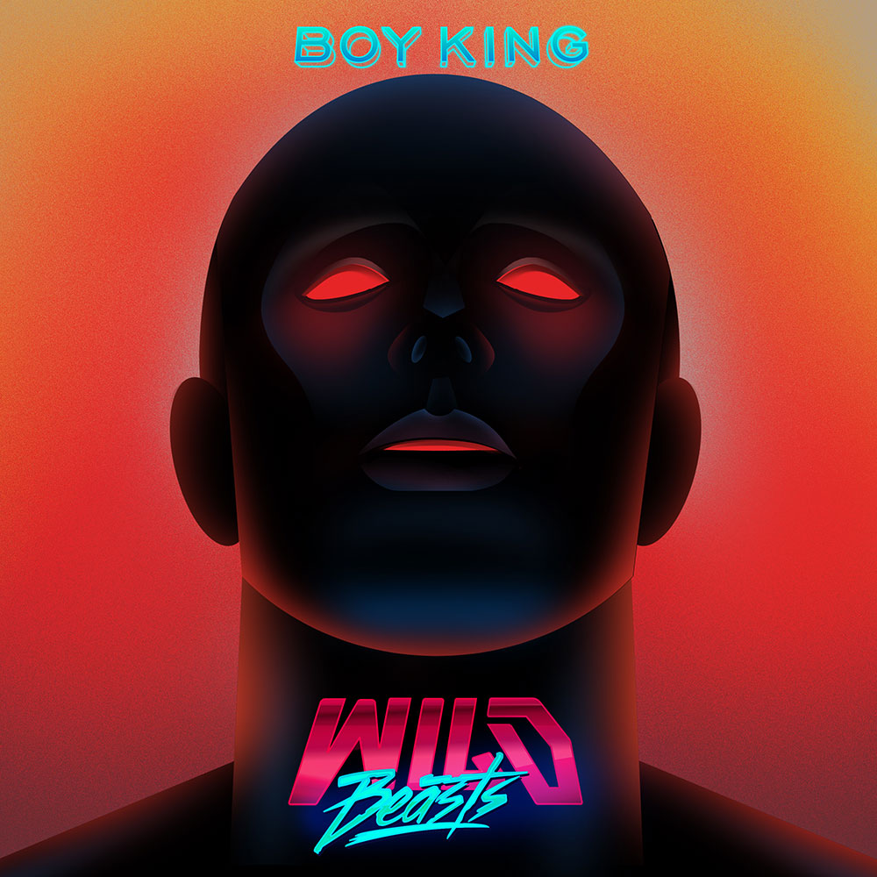
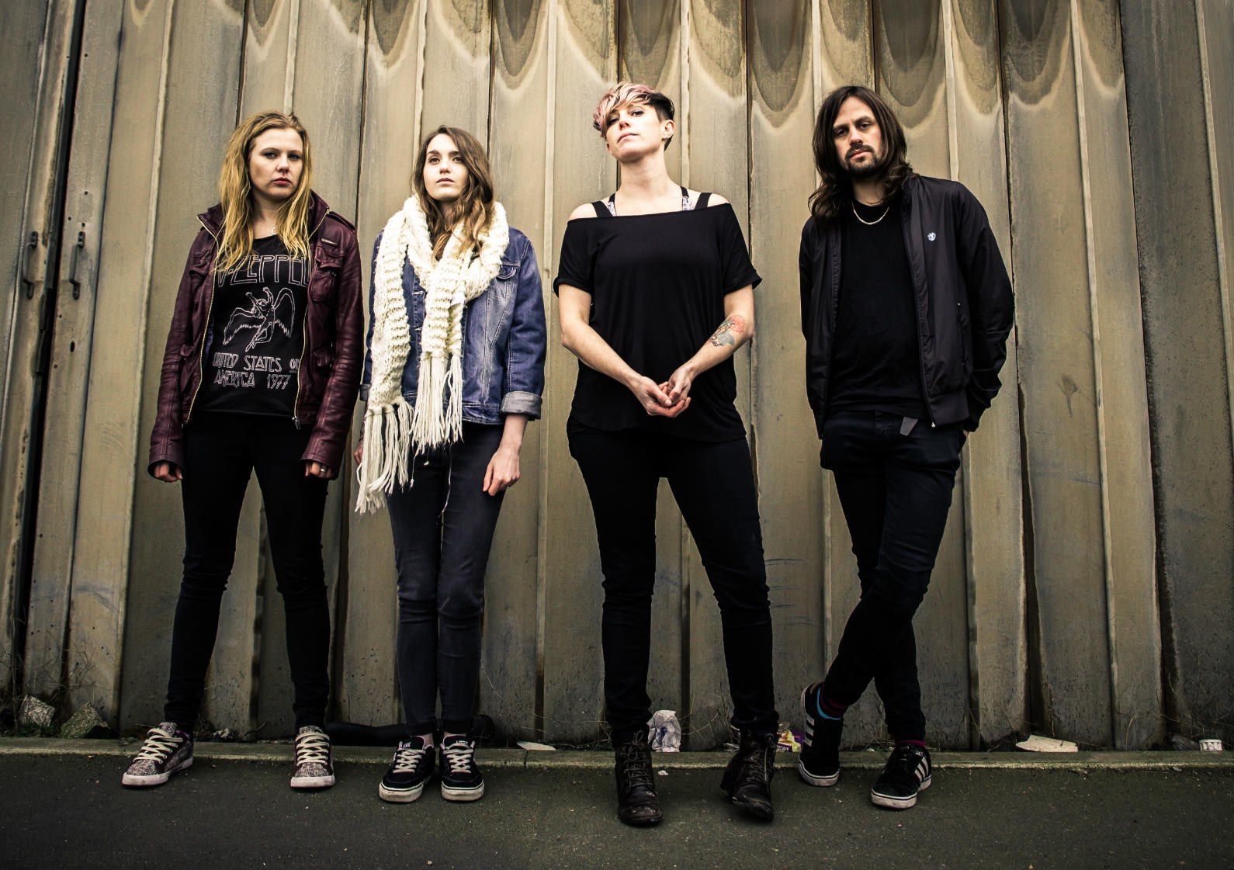
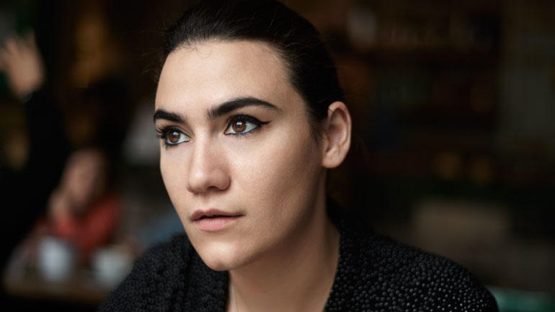
SUBSTANCE FESTIVAL
CELEBRATING CULTURE, CREATIVITY AND FUTURE OF THE NORTH
WILD BEASTS WITH ORCHESTRA
From Kendal and across the festival scene this Summer. Want to contribute to panel discussions on the Thursday.
SHE DREW THE GUN
From Merseyside. Chosen as a younger political northern voice. On Skeleton Key Records – a record label that hasn’t been afraid to carve out it’s own path.
NADINE SHAH
Part Norwegian and part Pakistani. From Whitburn just north of Sunderland – talks passionately about the neglect of her own northern seaside town.
“When you grow up in a seaside town, you’re constantly surrounded by this faded glory. They were tourist hotspots.”

Slide 10



SUBSTANCE FESTIVAL
CELEBRATING CULTURE, CREATIVITY AND FUTURE OF THE NORTH
Other Music
Late night adventures with City of Vultures final event on Sat 9th Dec, the final party following a year-long programme with Steve Cobby. Working with promoters Under The Influence, VMS and Fractal from Hull and key Manchester promoters.
Collaboration between Pork Recordings and ATIC Records, two seminal labels that bookmark the real Northern Powerhouse (Barrow In Furness and Hull) and will give platform to a new generation of artists collaborating with new northern talent.

Slide 11
SUBSTANCE FESTIVAL
CELEBRATING CULTURE, CREATIVITY AND FUTURE OF THE NORTH
FILM FESTIVAL
WHAT IS IT:
Three things
Showcase emerging northern film makers
Respond to Martin Parr’s Portrait of the City
Guest curation from a well known name
(talking to Ken Loach, Julian Barrett, Reece Shearsmith, Lauren Laverne currently)
HOW
Premiere of Sean Macalister’s new film
Around this a series of films that react to the social realism and grittiness of the north
Guest curator who will choose a few films and talk about their relevance to the rest of the festival. Either choosing those new film makers or films that have significance with the future

Slide 12
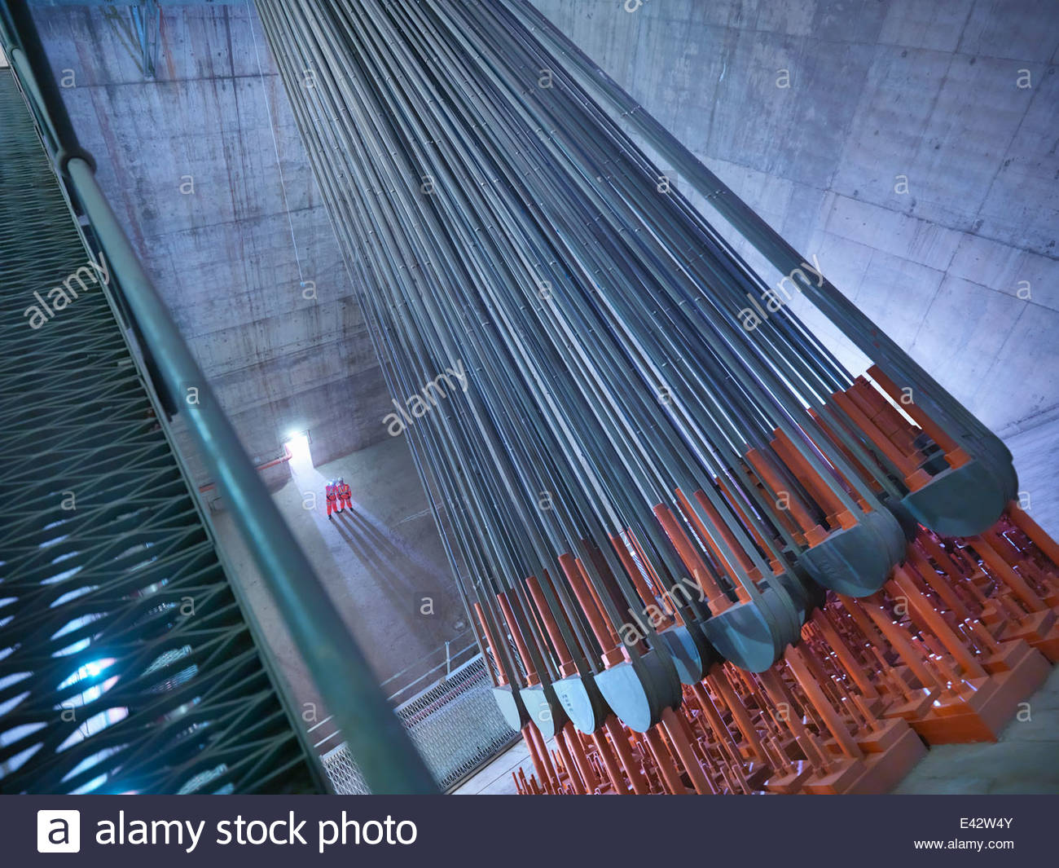
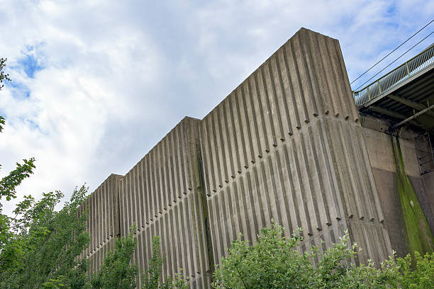

SUBSTANCE FESTIVAL
CELEBRATING CULTURE, CREATIVITY AND FUTURE OF THE NORTH
SPECTACLE
IN PARTNERSHIP WITH BOILER ROOM TV A UNQIUE EVENT (speaking to Warp Records or similar) WITH SEMINAL NORTHERN ARTISTS LIVE FROM THE HUMBER BRIDGE ANCHORAGE. THIS WILL BE BROADCAST LIVE TO A POTENTIAL AUDIENCE OF 3 MILLION. ALSO STREAMED LIVE INTO CITY HALL ON SATURDAY AFTERNOON. SATURDAY AFTERPARTY WITH THE ARTISTS

Slide 13
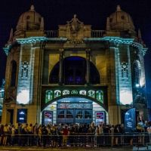
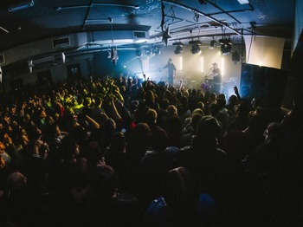



SUBSTANCE FESTIVAL
CELEBRATING CULTURE, CREATIVITY AND FUTURE OF THE NORTH
SORE HEADS & AFTERSHOW PARTIES
A CRUCIAL ELEMENT OF THE WEEKEND WILL BE THESE. WE WILL WORK WITH LOCAL PROMOTERS AND VENUES TO MAKE SURE THEY ARE PROGRAMMING EVENTS AROUND THE FESTIVAL TO FACILITATE THIS ACTIVITY.
PEOPLE SHOULD BE COMING FOR THE CONFERENCE AND MAKING A WEEKEND OF IT

