Slide 1


MADE IN HULL
Niccy Hallifax, Opening Lead Producer
Chris Clay, Technical Director.
September 2016

Slide 2
The first and opening event of our year as UK City of culture, and the first of the season Made in Hull will be a large scale and comprehensive celebration of the heritage and culture of the city, and a statement of intent of the way we intend to (re)position the city & to engage in meaningful ways with its communities.

Slide 3
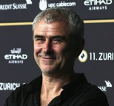
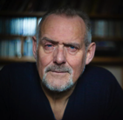
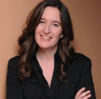
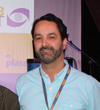
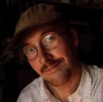
CREATIVE TEAM
Sean McAllister
Creative Director
Rupert Creed
Writer
Ala Lloyd
3D & Environmental Designer
Durham Marenghi
Lighting Designer
Dan Jones
Composer & Sound Designer
Sean McAllister a documentary director and the creative team have been brought onto the project which is a 7 day event to help create a spectacular start to 2017. The event captures Hull's history in the last 70 years, culture and residents in a dramatic and thematic way by using some of the heritage buildings and structures as a canvas to hold the conversation about Hull and its psyche.
The core creative team are experts in their fields and as well as being part of the process of commissioning several local and national artists to create a responses to briefs, they are also looking at the project in its whole form and ensuring there is a coherence and cohesion between sites.

Slide 4
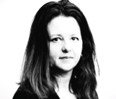
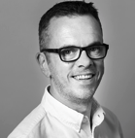
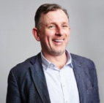
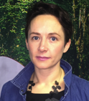
PRODUCTION TEAM
Niccy Hallifax
Creative Producer
Chris Clay
Technical Director
Jon Drape
Ground Control
Kate Doyle
Ground Control
Working with Niccy Hallifax (Creative Producer) and Chris Clay (technical director) the production and technical teams will be working with Ground Control an independent events company. GC have been brought in to manage and help deliver the technical and operations aspects of the overall project for the Opening.
This team will work with the core creative team in tandem to help the artists and to ensure their visions are realised, as well as ensuring that the event is smooth running and operationally delivered in a befitting manner with the correct licenses and permissions etc.

Slide 5

Project Aims
to kick off a year long programme that really does showcase the City as the national cultural centre for 2017
to unlock Hulls heritage and show its prospects in a dynamic & inclusive way using the buildings as canvases & the people as the live performance.
to connect individuals and communities & build the cultural input into the UK psyche .
to uncover and celebrate the intangible things which make Hull unique: the “Spirit of Hull”

Slide 6
Key Themes: Opening….
The story of a city and its people over the past 70 years- told on its buildings, shop windows, streets, skyline and public spaces through projected film, image, sound, words, light and live performance.
Significant shared events and achievements
Connectivity & insularity.
The community’s values & attitudes- innovators & achievers- its humour
Hull people at work Hull people at play
The Characters of Hull
Dead Bod- a local folklore icon.

Slide 7
LOCATIONS, ARTISTS
Phase 1 & 2.

Slide 8
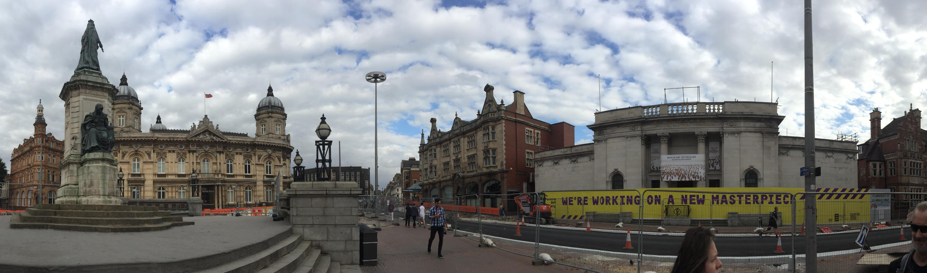
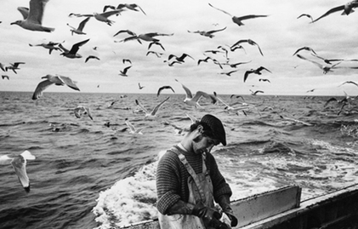
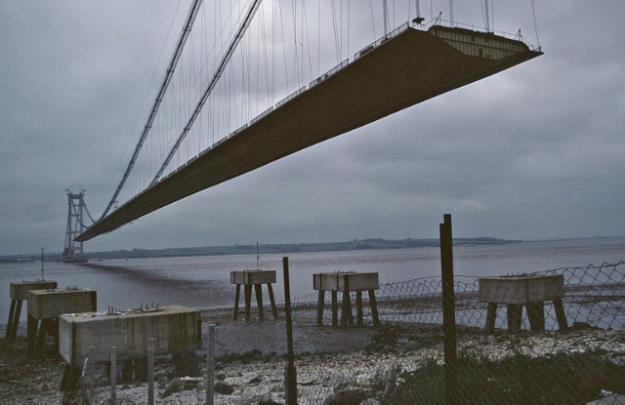
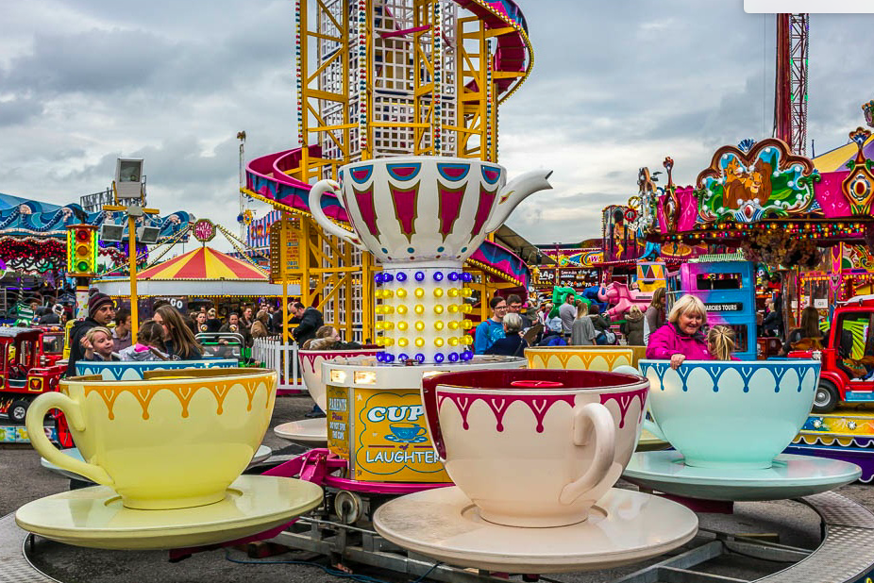
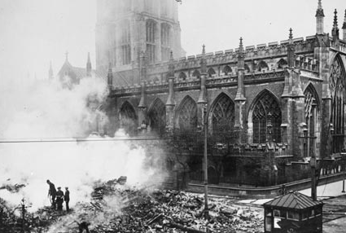
Location One: Queen Victoria Square.
The ‘big theme’ story of Hull over 75 years- what we’ve achieved, endured & celebrated at work, at play & in our culture- the significant shared city experiences that have instilled confidence, creativity, resilience, a strong community identity, an ability to re-invent ourselves and seize the moment that is 2017.
The Blitz - bombing raid, city devastation, the people’s resilience, barrage balloons, the rebuild & regeneration
The docks & fishing (the flooding wave, the post war boom in port & maritime trade & employment, the loss of men & the 1968 Headscarf Revolutionaries / 70’s decline)
Hull game-changers, achievers (in politics, art, sport, construction & industry)
& shared events & achievements’ – Hull Fair- Humber Bridge- The future & wind power.

Slide 9
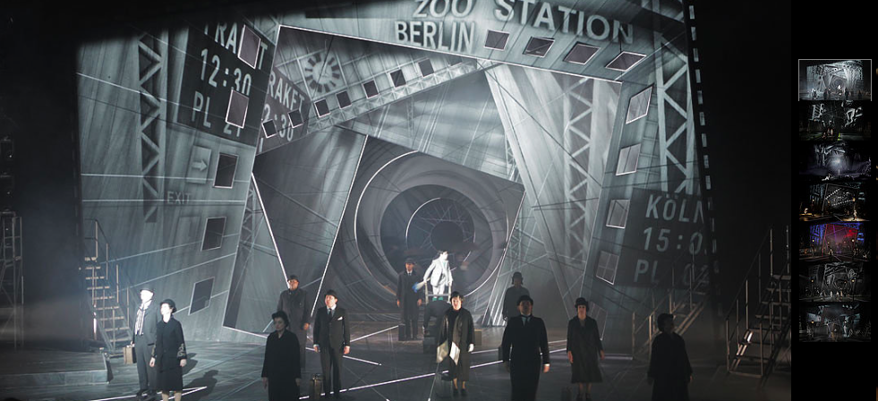
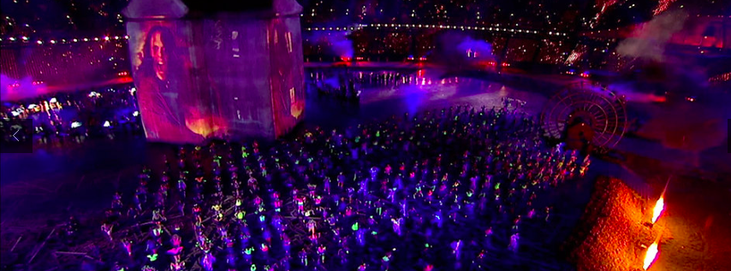

ZSOLT BALOGH
Zsolt Balogh is an innovative animation director and video designer. Trained at NFTS and the Royal College of Art, London, his creative portfolio spans live events, theatre, exhibitions, and film production. The artistry and visual power of his designs have been widely acclaimed. As freelance designer he has worked for 59 Productions, SDNA, One of Us, The Mill, The People Speak, Tate Modern, Tate Britain, BFI, LIFT festival, National Theatre, Royal Opera House. His work for 59 Prouctions has been seen on flagship projects including the London 2012 Olympic opening ceremony, exhibitions for the V and A, and productions for the National Theatre, ENO and Metropolitan Opera.

Slide 10
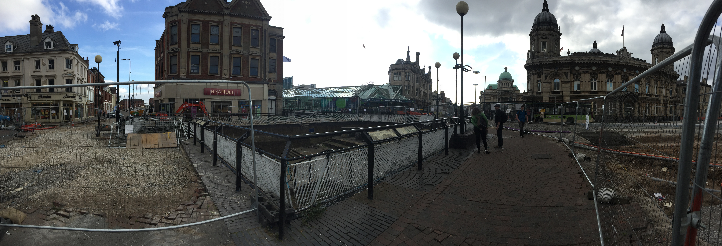
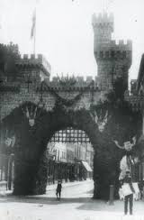
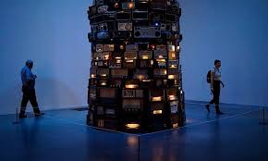
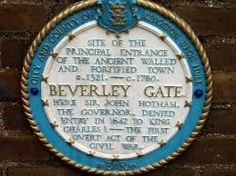
Location two: Beverley Gate.
The site of the refusal of King Charles into Hull – theme of Defiance? Or introducing the characters of Hull
A gate of defiance & protest? Underpinned by the values of democracy, humanity, civilisation & inclusivity?
A whispering gate?- where the public are encouraged to share their wishes, dreams, secrets for the future of Hull, how they want to see their city - what & how they would like Hull to be – broadcast to the Victoria Square toilets

Slide 11
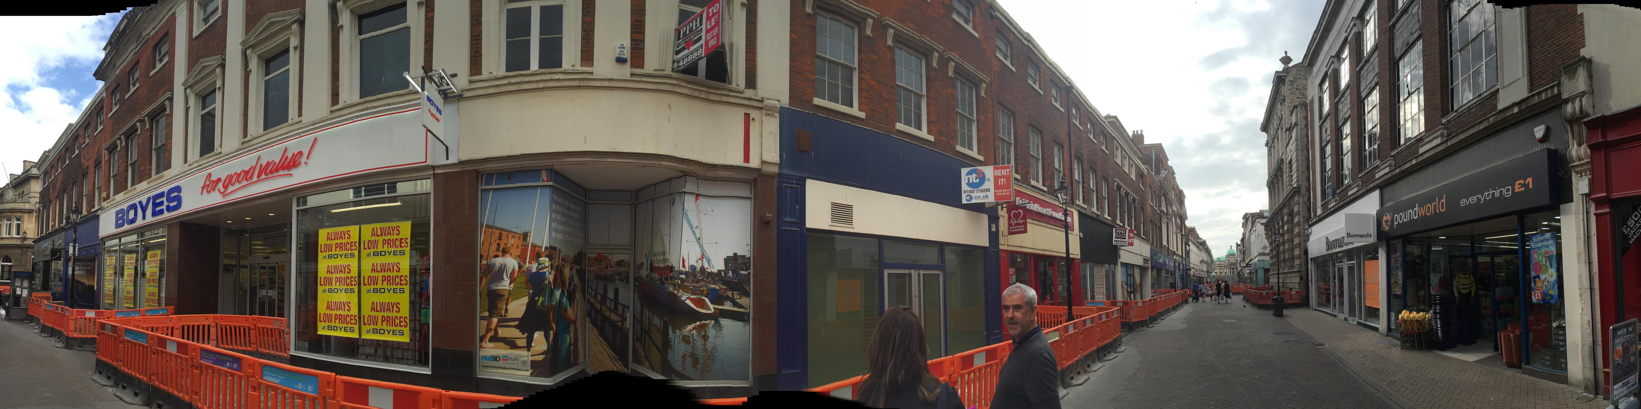
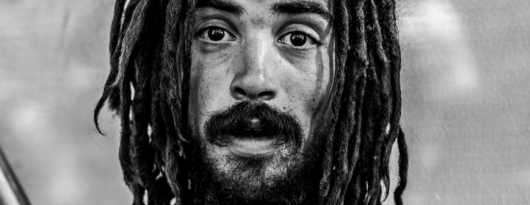
Location One: Whitefriargate Street.
THE CHARACTERS OF HULL
The major themes we are exploring but told in a more intimate & in-depth way through the people of Hull.
Hull characters take us in and through the archive material giving it a human face
The street of folklore – a chance to meet the characters of Hull telling their stories
The street narrative focuses on ‘Hull at Play’- how we enjoyed ourselves – how we spent our hard earned cash from work, our leisure time in the city and on holiday- through times of full employment in the 60s, declining in the 70s and 80s to the BSF initiative in the 00’s. Then through to now through each generation, linking economic prosperity & leisure of the city.

Slide 12
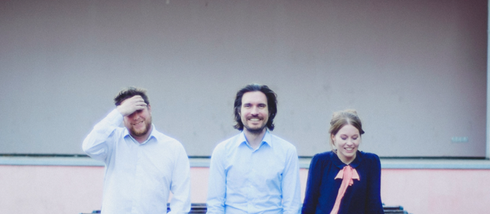
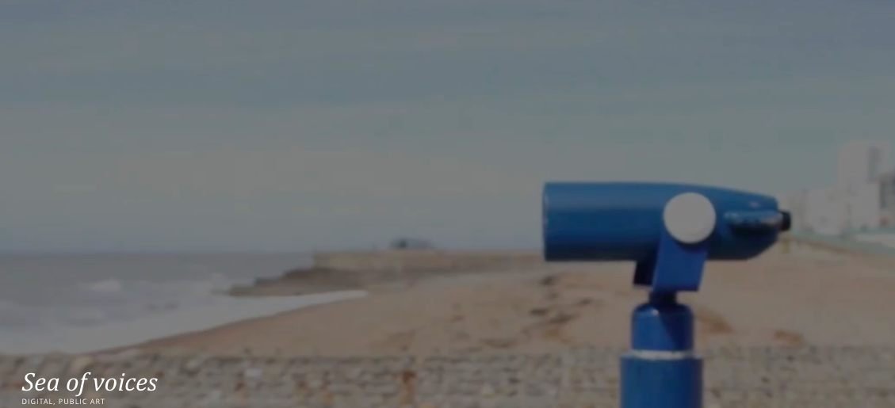
INVISABLE FLOCK
Invisible Flock are an interactive arts organisation based in Leeds, formed in 2009 by three lead artists Ben Eaton, Victoria Pratt and Richard Warburton.
Described by the Guardian as “real innovators” of digital and interactive art we are renowned for creating ground breaking hybrid work across forms. We create artworks that invite people to re-imagine the world they live in and how they participate in it, using technology to incite meaningful encounters.

Slide 13
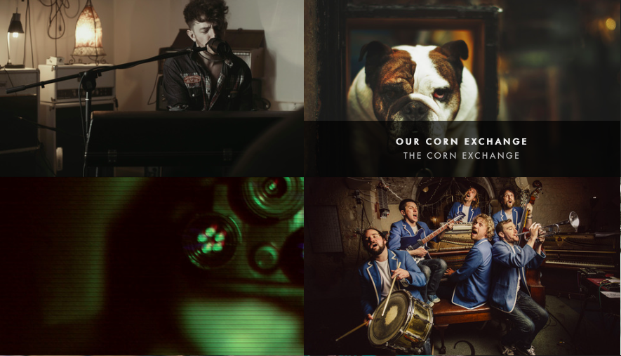
SODIUM
Sodium are a film and photography agency that create campaigns and take them from sketch to screen, employing the best talent for the idea and utilising the best platforms for the content.
They do this through creating short-form cinematic stories and making extraordinary photographs.
.....they have one vision in mind; to tell a story in the most authentic and beautiful way they can.

Slide 14
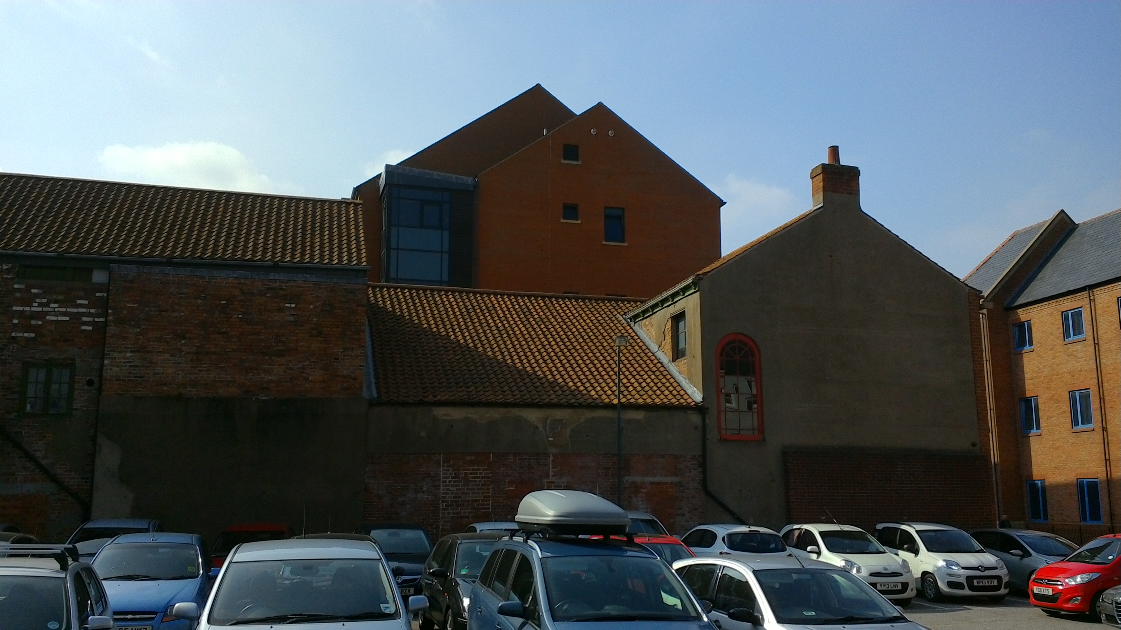
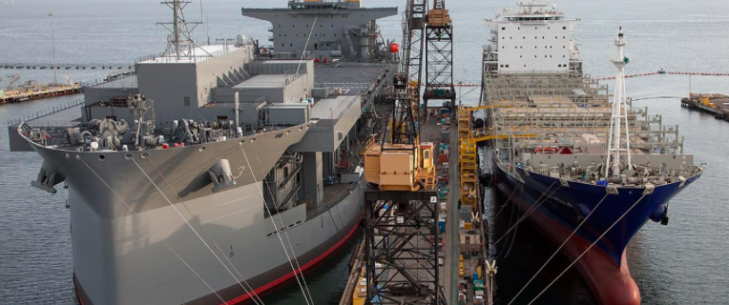
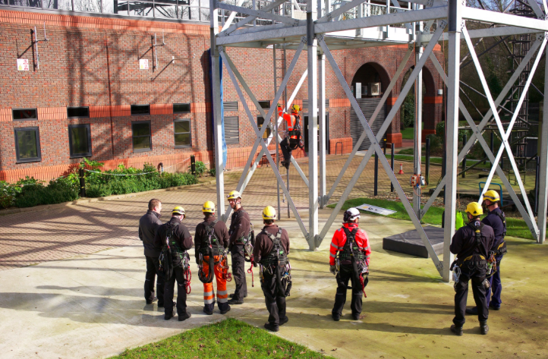
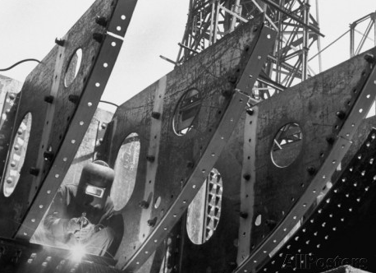
Location three: Oriel House.
THE DIGNITY OF LABOUR
A hard working city- a city of great inventiveness, manufacturing and international trade / the fight for worker’s rights / the decline of manual labour industries- the despair of dole / a future power house of ideas
We turn a place of frustration, anger & despair into a place of beauty & creative energy
Possible elements:
Production lines- inc caravans, fish, peas, household & medical
Products- retro and current
Film, photo & press archive of work on docks, fishing & other
19th C, 60s & 70s dockers strike archive
Big Lil- headscarf wives campaign
Decline of industry – fishing and docks
Spoken audio sound bites- sanctions, lost ambitions & dreams
Reaffirming of the docks, most whit goods in the UK come through Hull docks, the building the Humber Bridge
Siemens- wind power- our future

Slide 15
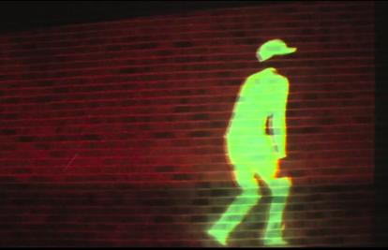
MAKE AMPLIFY
Jenifer Irons and Zach Walker together make amplify. Working together and with a wide range of people around the world, they create site-specific installations and interactive live performances that engage, challenge and surprise.
Using movement and digital technology they reveal the hidden, the ignored, the discarded and the forgotten to inspire people and create meaningful experiences for audiences, clients and participants alike.

Slide 16
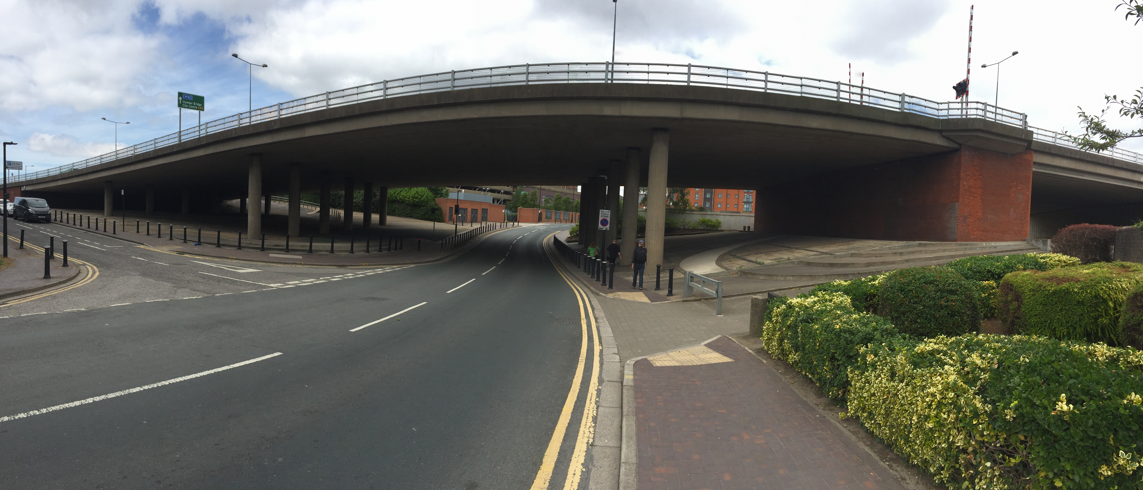
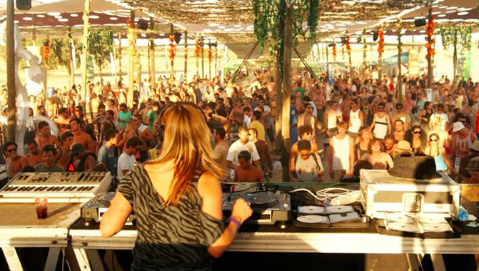
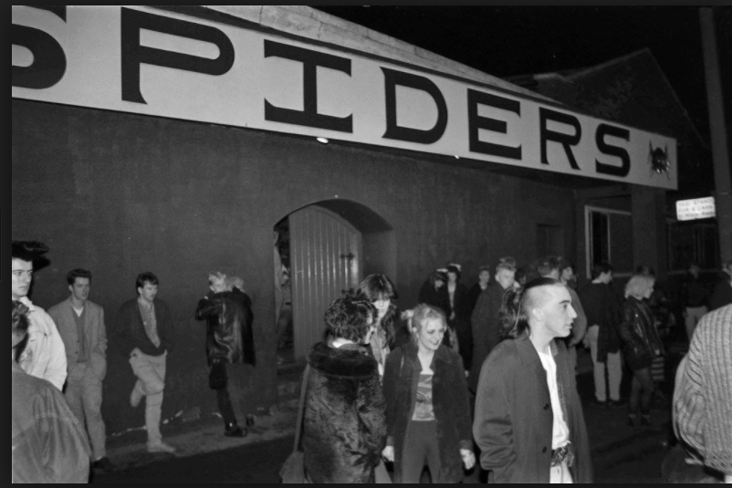
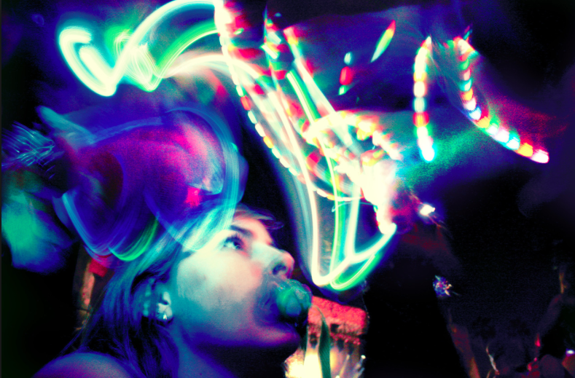
Location four: The Underpass.
Hull People Love to Party.
A sound & light installation with live performance portraying the culture of Hull’s clubbing scene and the people’s passion to party. A sound & light driven event with flash-mob performances, where the public can participate or pass through, where dance styles and fashions can move through time, or mix and morph, with a music soundtrack incorporating spoken word sound bite mash-ups referencing Hull’s clubbing experience & the social and political context.
Possible elements:
Hulls clubbing scene over time- from dance hall to disco, house party & rave, the Tower, LA’s, the Silhouette & Fuel
Dance & fashion styles over the decades
The changing social & political context and the emergence of the festival culture in Hull.

Slide 17
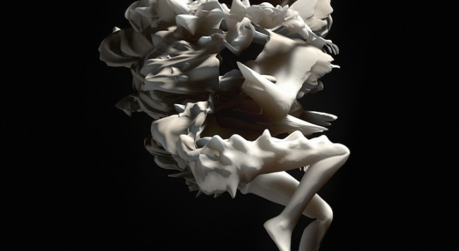
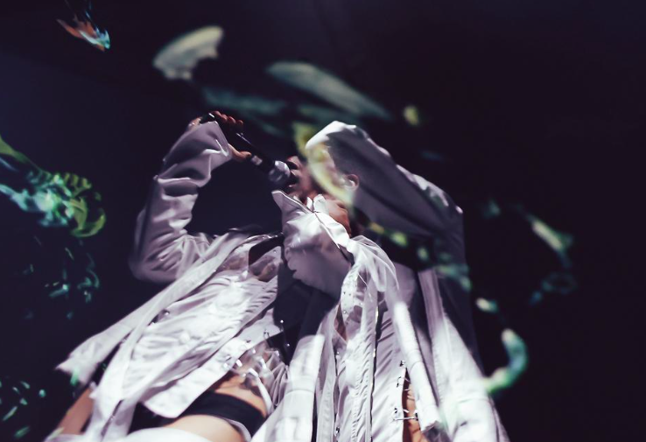
JESSE KANDA
Jesse Kanda’s films are a trip through the subconscious in which images of dancing babies and alien car crashes contort then distort, lost in purgatory. The self–taught, Dalston-based artist’s world is pained yet playful, and apparently untainted by boundaries. Nothing seems impossible.
Jesse is a Japanese-born, Canadian-raised 26-year-and works with Venezuelan-born producer Arca, his best friend and closest creative ally. Together, they’re currently creating TRAUMA, a film project in seven parts that’s premiering at galleries such as MoMA PS1. He insists that his artistic vision is automatic. Concepts come later, nothing is planned and mistakes often turn into his best work.

Slide 18
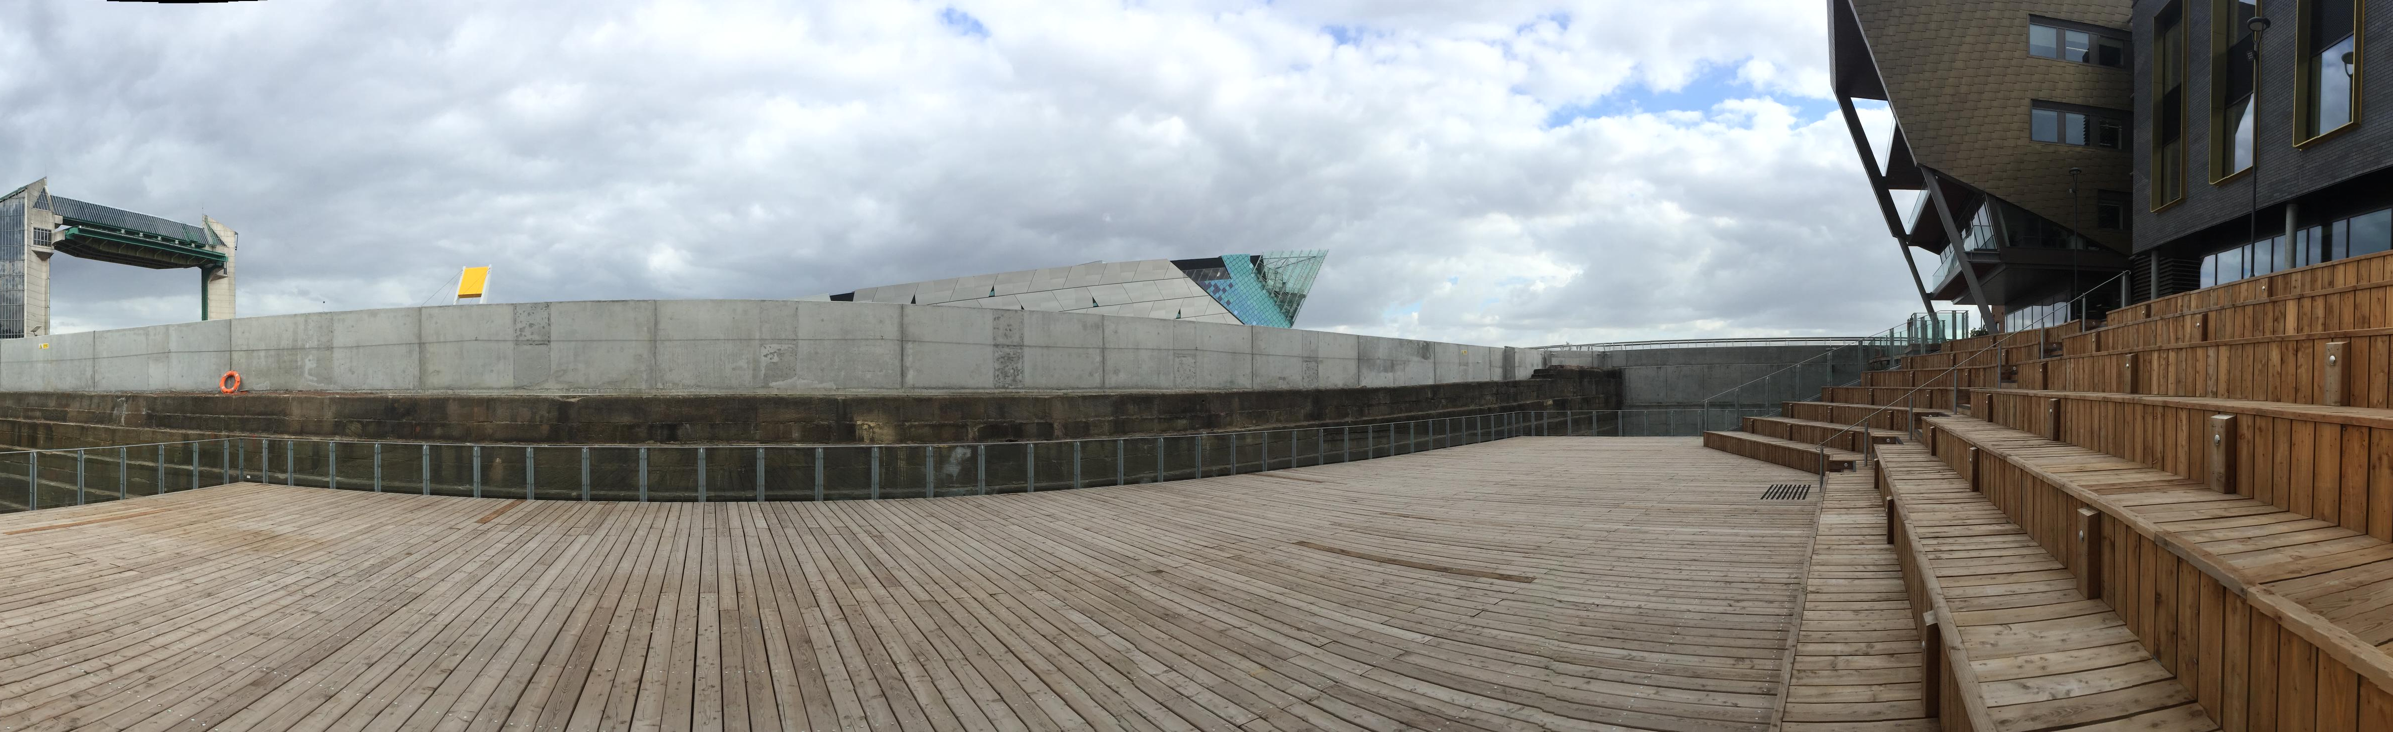
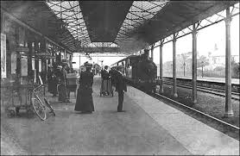
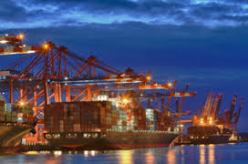
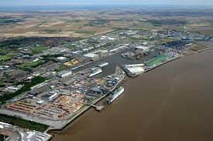
Location five: The Deep.
DEPARTURES & ARRIVALS- HULLS CONNECTIVITY- THE FLOW OF PEOPLE INTO AND THROUGH THE CITY
Migrations- The flows of people over time, through and into the city:
Fleeing war, persecution, poverty. Seeking refuge and freedom. (17th C Hugenots, 19th C Jews from Eastern Europe, children fleeing the Spanish Civil War, Kosovans, Afghans, Iraqis, Congolese, Eritrians, Syrians
Seeking work – the Irish to build Hull docks, Brixham fishermen, young men from Scandinavia, incomers like Larkin who came for a new job as University Librarian, and many more
The transit route from the riverside to Lazarus Hotel to the Station / Brexit- the tension between a welcoming and insular city
Arrivals and Departures now and the port & station.

Slide 19
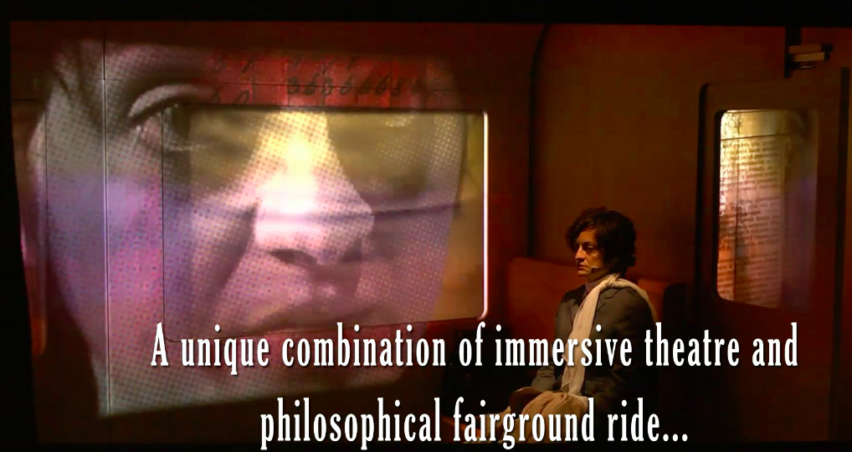
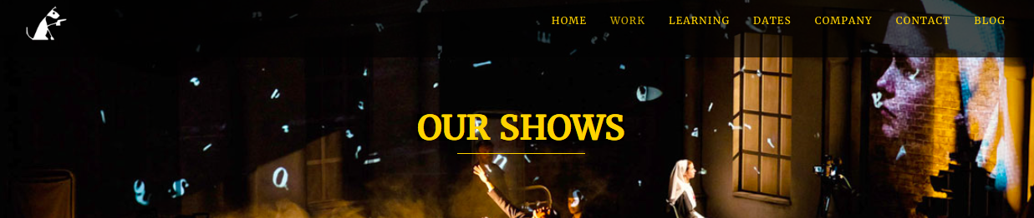
IMITATING THE DOG
imitating the dog creates outstanding work that challenges and connects with audiences, tests theatrical conventions and brings high-end design, technical and thematic ambition to audiences at small and medium-scales.
Learning is at the heart of the company’s ethos. The company initiates, tests and shares its creative process and technological expertise with students, practitioners and community groups through its extensive and focused education programme.

Slide 20
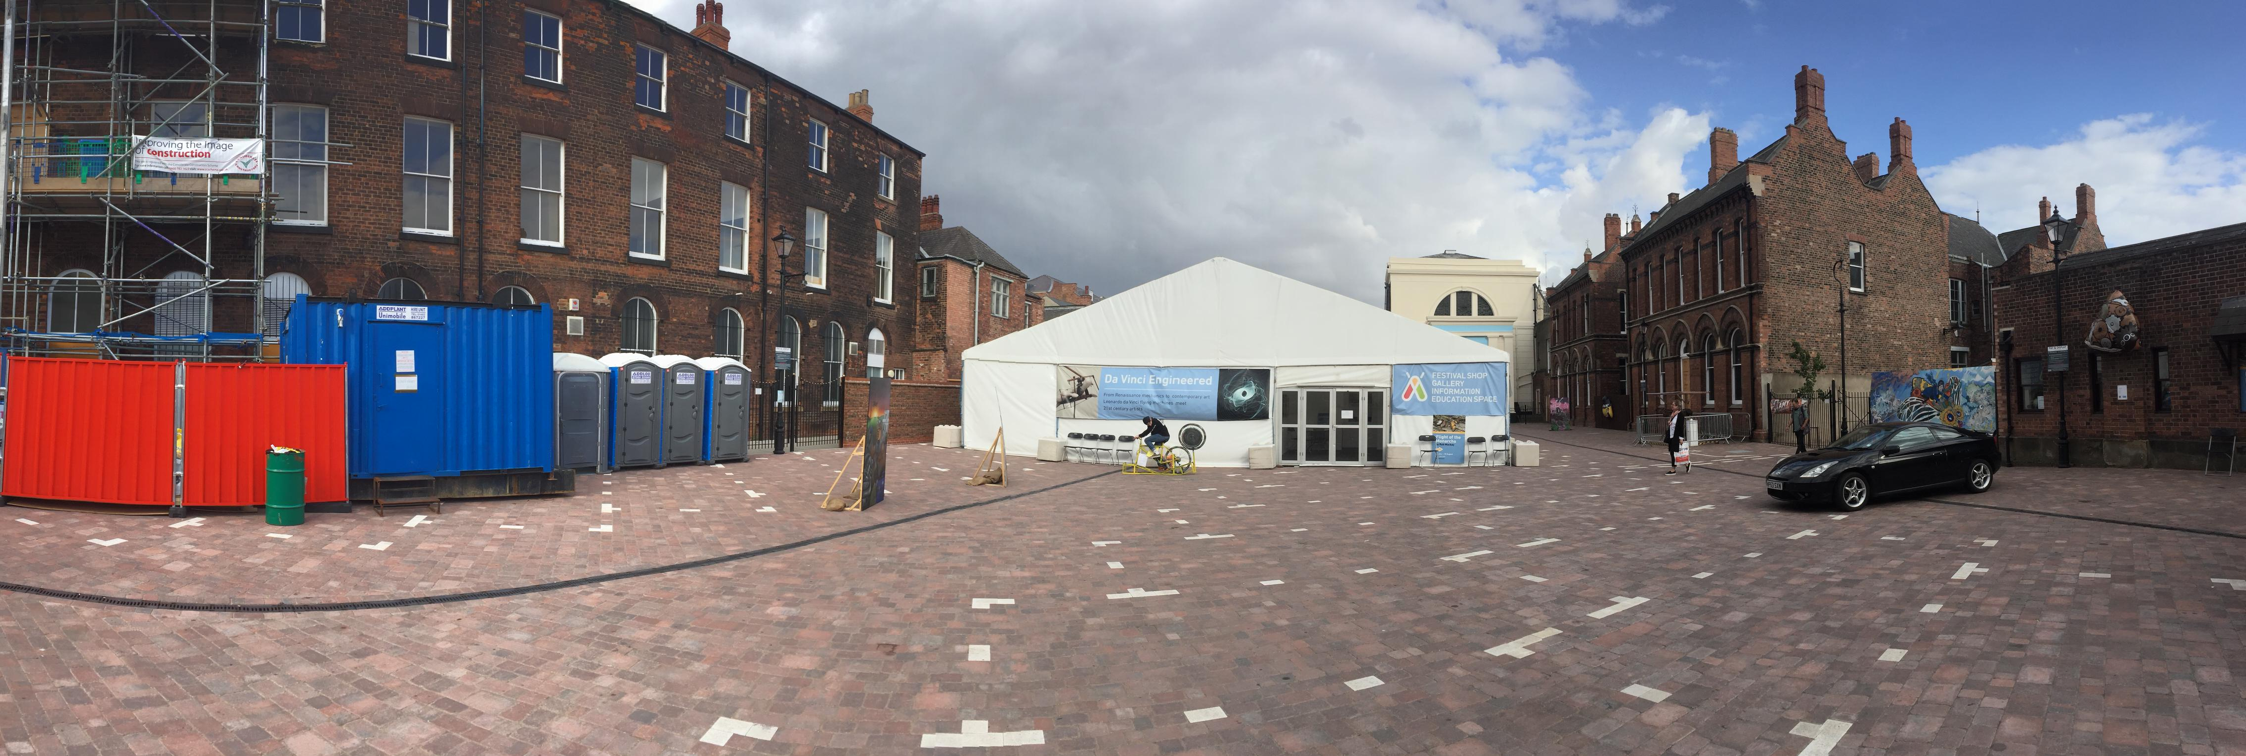
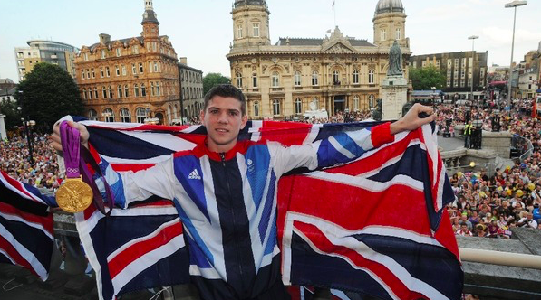
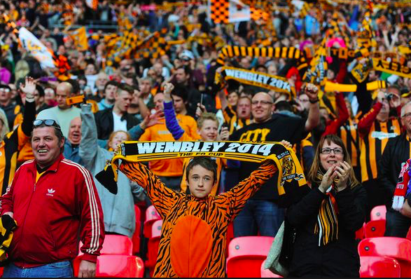
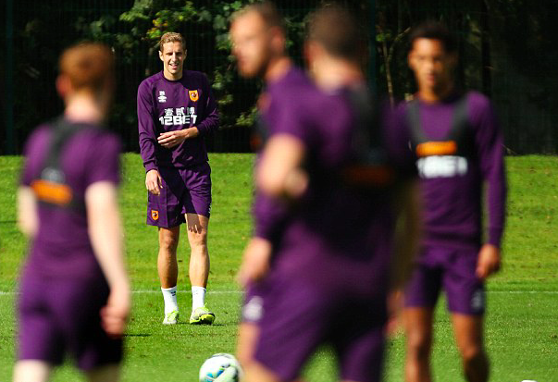
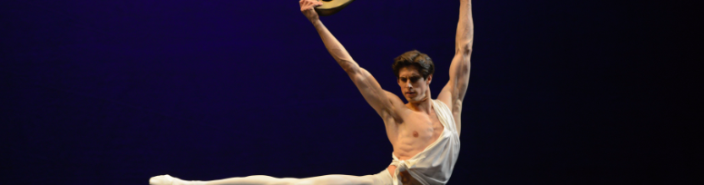
Location six: Zebedee’s Yard.
PHYSICAL HULL- Hull’s Sporting Achievements & the cultural interplay with Dance
Film animation & soundscapes portraying Hull’s shakers and movers in team & solo sports, the tribal allegiances of local fans, and the physical & cultural interplay between sport and dance. Where the playing field is the stage, and the human body is the vehicle, celebrating strength, stamina and the beauty of movement- from the corps de ballet & principal dancer, to the boxer in the ring, to the team on the pitch.

Slide 21
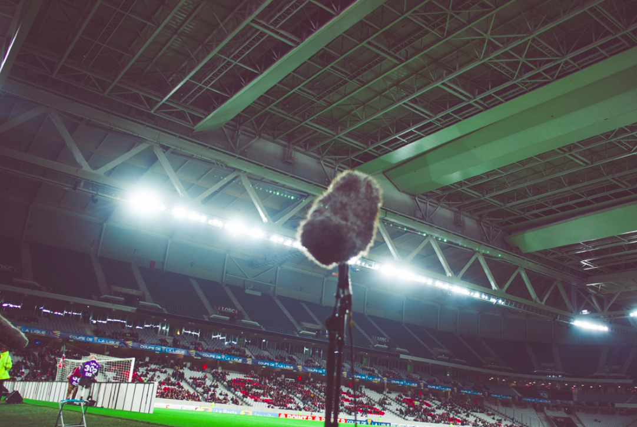
INVISABLE FLOCK
Invisible Flock are an interactive arts organisation based in Leeds, formed in 2009 by three lead artists Ben Eaton, Victoria Pratt and Richard Warburton.
Described by the Guardian as “real innovators” of digital and interactive art we are renowned for creating ground breaking hybrid work across forms. We create artworks that invite people to re-imagine the world they live in and how they participate in it, using technology to incite meaningful encounters.
Creative Community programming funded project.

Slide 22
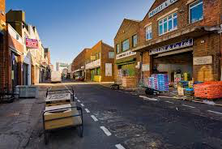
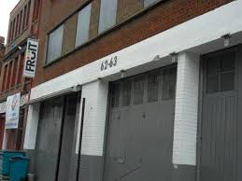

Location seven: Roaming & Fruit Humber Street.
Pot Luck at Fruit
A 2 week programme of nightly events at Fruit including music- stand-ups- films- guest performers each night- celebs from Hull (the thing I remember about Hull) – bands from Hull.
Prescott, Lucy Beaumont, Jarvis Cocker, Alan Johnson, Pinky, Bud Sugar
Other activity on Humber street
Street roaming activity through artists looking at the modern Hull with festivals and the spoken word, music & film.
New art exhibition space with an exhibition of Alec Gills a photographers work.

Slide 23


URBAN PRODUCTIONS &
QUENTIN BUDWORTH
Urban Productions has been creating media for all kinds of audiences since 2013.
They started off working with just video but now we work with almost all forms of media. They work with Audio, Video, Photography, Animation and Graphic Design. Their bike unit is designed to travel the streets and set up gorilla style to animate a city scape and effect otherwise untouched surfaces.
Quentin Budworth s a local artist looking at placing Hull charactures within Hollywood film settings and having a mobile unti to project his work in the Hull City centre and surrounding neighbourhood

Slide 24
Next steps
Contract artists and start to create a media and marketing plan
Construct a series of story strands across the event pieces.
Develop a web and marketing campaign promoting the team and artists.
Develop live content to compliment the artists commissions in certain locations

Slide 25


