Slide 1

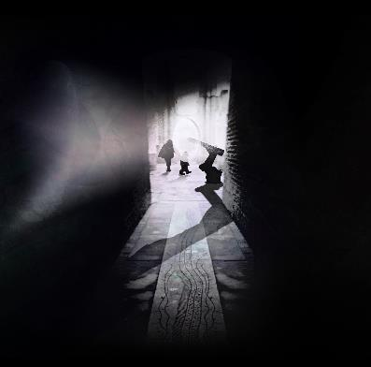
WHERE DO WE GO FROM HERE?
1 Dec – 7 Jan (5 – 9pm)
FREE Outdoor installation
By Jason Bruges Studio.

Slide 2

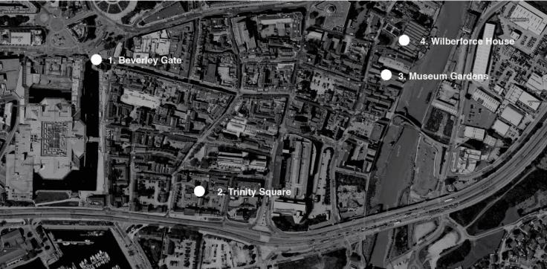
INSTALLATION SITES

Slide 3
OBJECTIVES
Encourage residents of Hull to explore Hull in new ways and to provoke conversation and thought about the future of their city
Engage visitors to the city in conversations to shape the future of Hull
Encourage new audiences to explore Hull’s history whilst at the same time looking to the future – drawing 2017 to a close in a forward looking way rather than a nostalgic outlook
Use wayfinding and city dressing as a dual purpose: to help people navigate around the four key installation sites, and to prompt answers to the question Where Do We Go From Here?
To encourage people to leave responses to the question in key sites across the route (a ‘post box’ on Whitefriargate, labels around the railings of Museum Gardens or writing on a window on High Street)
To shine light on the Old Town, an area less frequented by residents
Ensure that all residents feel able to participate in the conversation and explore unforgotten areas of their city for the final installation of the 2017 programme

Slide 4
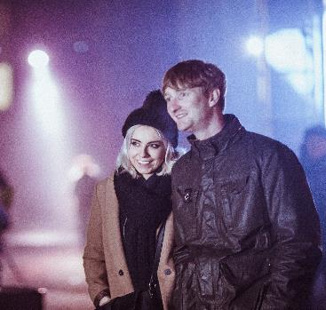
AUDIENCES
Residents of Hull
Residents living in East Riding and wider regional areas
Cultural and technology intrested young persons
Key stakeholders (creative and funding partners)
Media (local and technology, architecture and arts media)

Slide 5
KEY MEDIA TARGETS
Local and Regional Press
Specialist Press i.e. online and broadcast press for technology, performing arts, visual arts, design, film and broader arts and culture for previews and features
Reviews i.e. Corridor 8 / HDM / Yorkshire Post
TV Shows i.e. ITV Calendar/ Look North/ BBC Breakfast/ BBC Radio Humberside

Slide 6
ACTIVITY OVERVIEW
DIGITAL
Editorial input on website – up to X pieces of editorial across X weeks of activity: e.g. xxxxx
Social media – Posting and building online audiences with content. Release and promotion of promo film by Jason Bruges Studio. Release of captured responses in post box / tags / Vox pops.
Digital advertising – Targeted social media ads across Twitter, Facebook and Instagram promoting the event and the wider questions about the future of the city.
Email marketing – Event and editorial information in December edition of the monthly newsletter

Slide 7

PRINT AND ADVERTISING
Wayfinding Map - The map will be a DL print in the same format as MiH.
50,000 copies would be printed.
Residential Door drop of wayfinding map – Reaching 15,000 homes in Hull in lesser engaged regions: Orchard Park, Preston Road, Bransholme, to encourage them to visit the City Centre and engage with the installation and overarching question.
Media plan – Local/regional push using press ads: HDM/ Yorkshire Post/ Metro. Radio – 2 x weeks radio air-time on Capital (local only). Some OOH regional activity in Leeds, Sheffield, York. Pre-promotion end of Nov/ early Dec with a 2nd burst of activity at the end of Dec as a reminder for people looking to do something during the Xmas break.

Slide 8
WAYFINDING OVERVIEW
Interpretation – To take the form of 2m high pillars with CNC cut ‘Where Do We Go From Here’ up one side. The other 3 sides will be used as follows: general info about the project, specific information about the robot, partner information. These would be lit from the inside or would feature a light at the top to act as a beacon/location marker for each site. Three of the sites would feature these pillars, to be displayed alongside each of the installations. The fourth site at Wilberforce House would feature an interpretation board. £15k to be put aside from Marketing pot to cover interpretation (budgets TBC).
Wayfinding map – Volunteers stationed at each installation to provide the public with wayfinding maps to help navigate their way around the city centre. The maps would also indicate the ways in which people can get involved in the conversation
Questions added on routes to draw the crowds to the next locations – 2 routes available with interesting interactive elements along the main route.

Slide 9
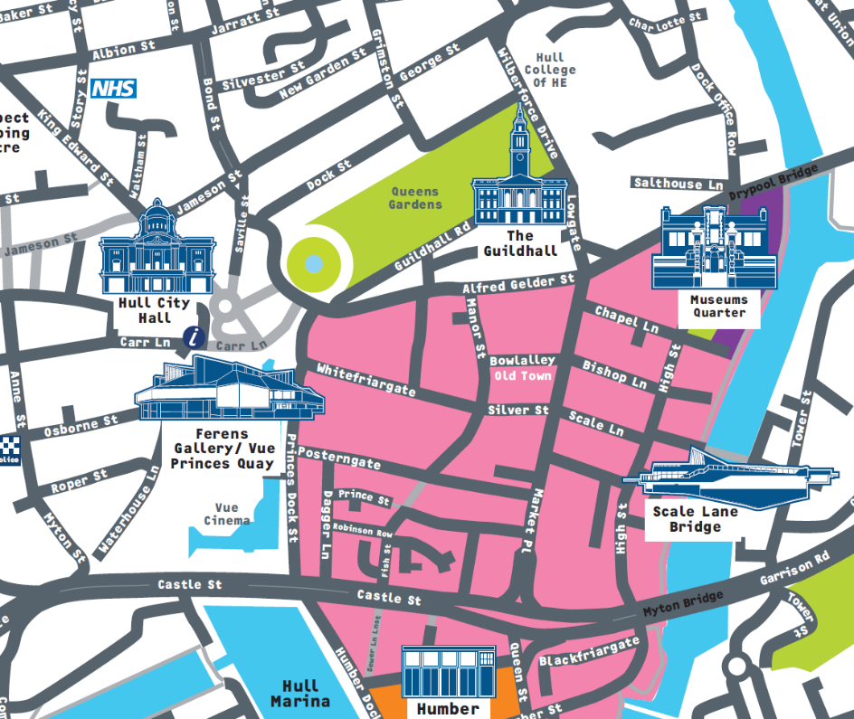

Slide 10
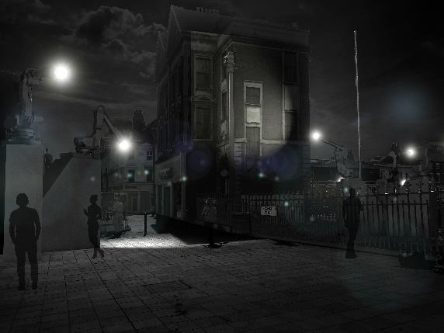
BEVERLEY GATE
The Gatekeeper Key themes: Morse Code (Maritime associations) Communication,
Entrance to Old Town

Slide 11
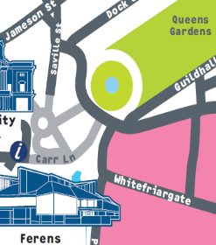
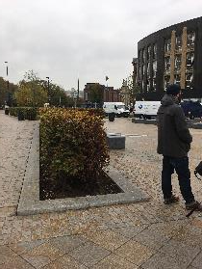
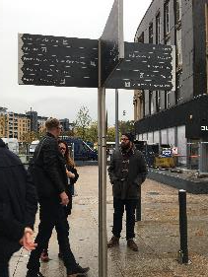
BEVERLEY GATE
Where do we go from here?
Pillar for interpretation Navigational arrows on signpost

Slide 12
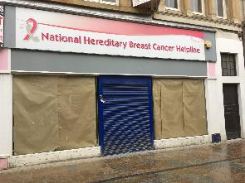
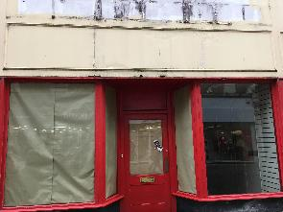
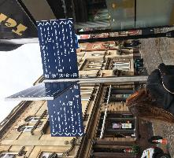
WHITEFRIARGATE
Left side of street
Full vinyl window covering
Right side of street: Lit fret cut vinyl and ‘post box’ through letterbox
Vinyl covering the windows with question cut out. Unit lit inside.
Sign above shop ‘Where Do We Go From Here?’
Door vinyl to encourage people to post their responses
Navigational arrows on signpost. 3 x arrows, pointing towards:
Whitefriargate, Land of Green Ginger and Trinity House Lane

Slide 13
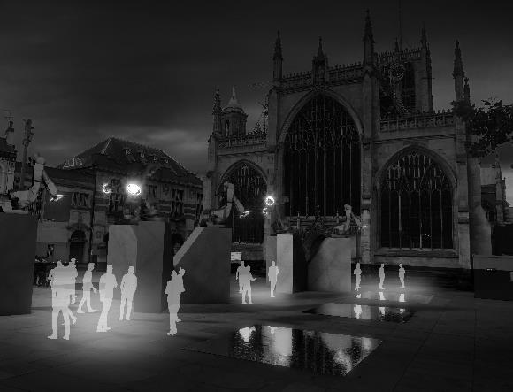
TRINITY SQUARE
Meeting Point Key themes: Response to movement
Man meets machine

Slide 14
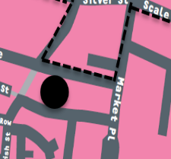
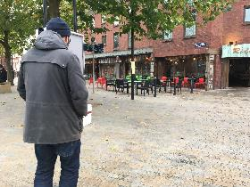
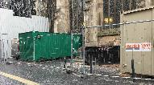

TRINITY SQUARE
Pillar for interpretation
Heras fencing banners covering Hull Minster building works
(UV?) Letter vinyls in windows of Trinity Market – 20 windows, 20 characters

Slide 15
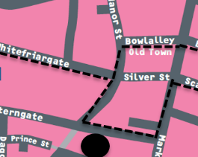
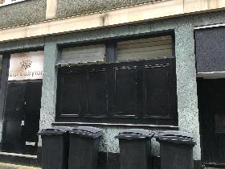
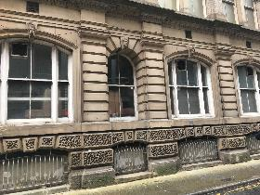
BOWLALLEY LANE
Window vinyl on Bar Babylon or on old Baracuda building
Light through alleyway?

Slide 16

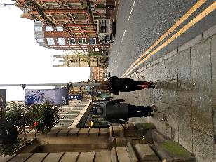
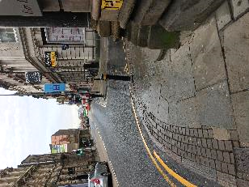
MARKETPLACE/LOWGATE
Basic signage as Lampost banners too expensive.

Slide 17
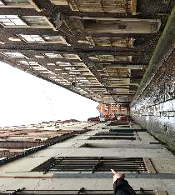
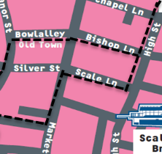
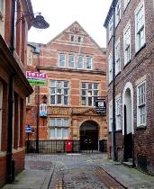
BISHOP LANE
PX lights from boardroom and staircase
Top windows to be multi-coloured to reference ‘We Wish To Communicate With You’
Ground floor window to have semi-transparent robot arm vinyl

Slide 18
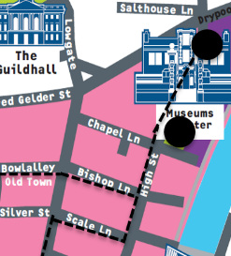
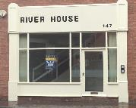
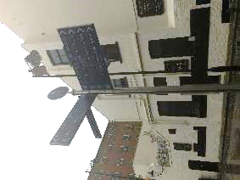
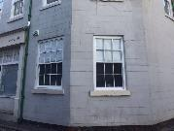
HIGH STREET
Map vinyl on River House windows (opp Lion & Key)
Arrows on Signpost: towards Museum Quarter and up Scale Lane
Window for writing responses on

Slide 19
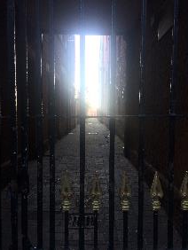
HIGH STREET - Ally
Non function Robot with a bright light back ligting it (as the advertising suggests.

Slide 20
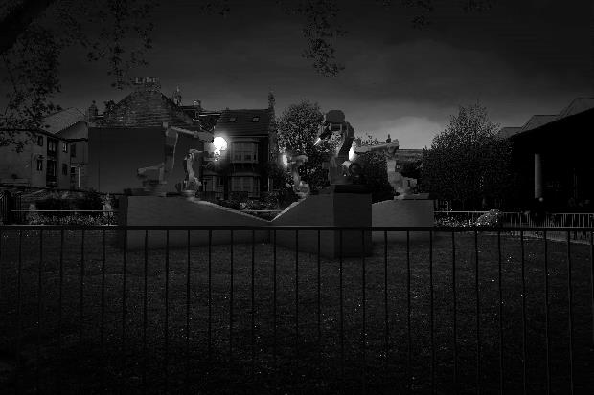
MUSEUM GARDENS
Collaboration Key themes: Movement,
Passing of light

Slide 21
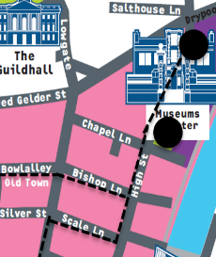
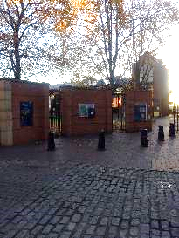
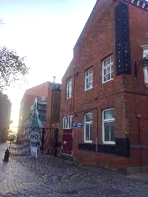
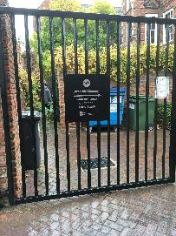
MUSEUM GARDENS
Interp Pillar – entrance to Museum Quarter
Entrance / Exit system
Entrance
Exit

Slide 22

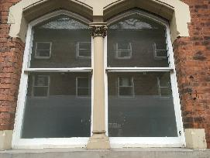
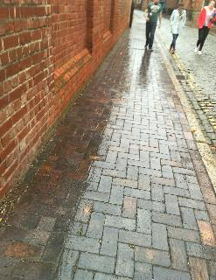
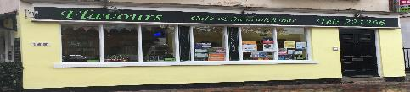
HIGH STREET
Flavours – vinyl with cut out question
Ecowash on floor leading from start of Museum Quarter to Wilberforce House
Vinyl on Commercial Museum side window

Slide 23
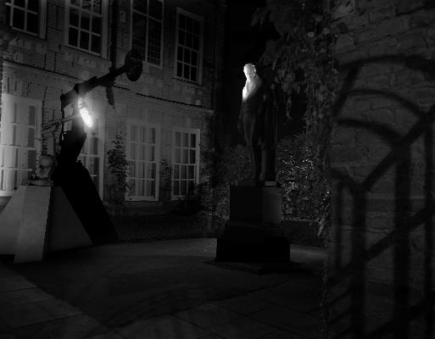
WILBERFORCE HOUSE
Man meets machine Key themes: Shadow play
Conversation between man (Wilberforce) and robot
Behind bars/hidden from view

Slide 24
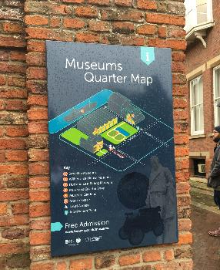
WILBERFORCE HOUSE
Wilberforce House Interp –
Cover MQ map with interp information specific to Robot 4

Slide 25
Media plan – To be approved and booked in
Creative development – interpretation boards/ map/ press advertising/ direction of radio ad
Interpretation and Wayfinding plans and costings to be firmed up, pillars to be spec’d, permission to be sought where relevant
NEXT STEPS

Slide 26
Media plan for above-the line advertising approved: w/c 31 Oct
Style-setter for look and feel of WDWGFH agreed: w/c 31 Oct
Print advertising concepts vis’d up and approved: w/c 6 Nov
Wayfinding map design vis’d up and approved for print: 17 Nov
Interp boards design vis’d up and approved for print: 17 Nov
Wayfinding map delivered to 15,000 households in Hull: 1 Dec
Interp boards finished and printed: 27 Nov
Installation of interp boards (including lighting): 29/30 Nov
Delivery of any additional wayfinding maps (if required) ahead of Xmas break: 18 Dec
KEY DEADLINES

