Slide 1

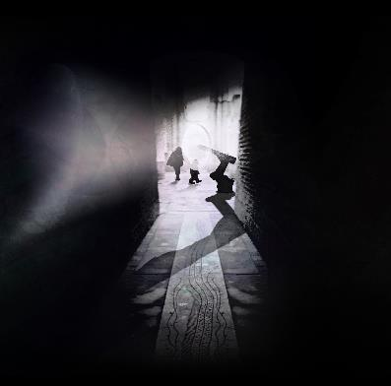
WHERE DO WE GO FROM HERE?
Visual Look and Feel
Interpretation and Wayfinding

Slide 2

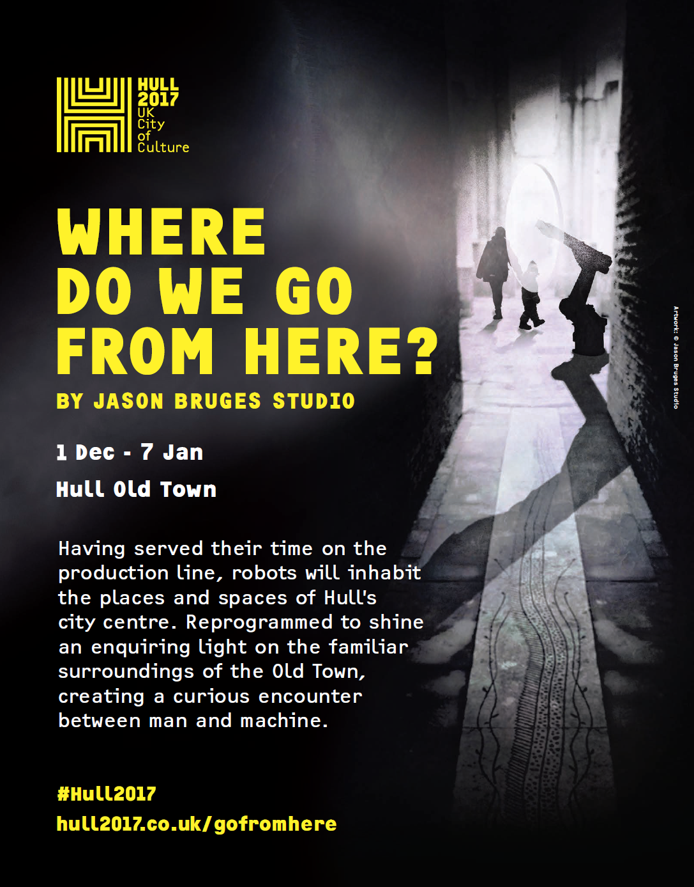
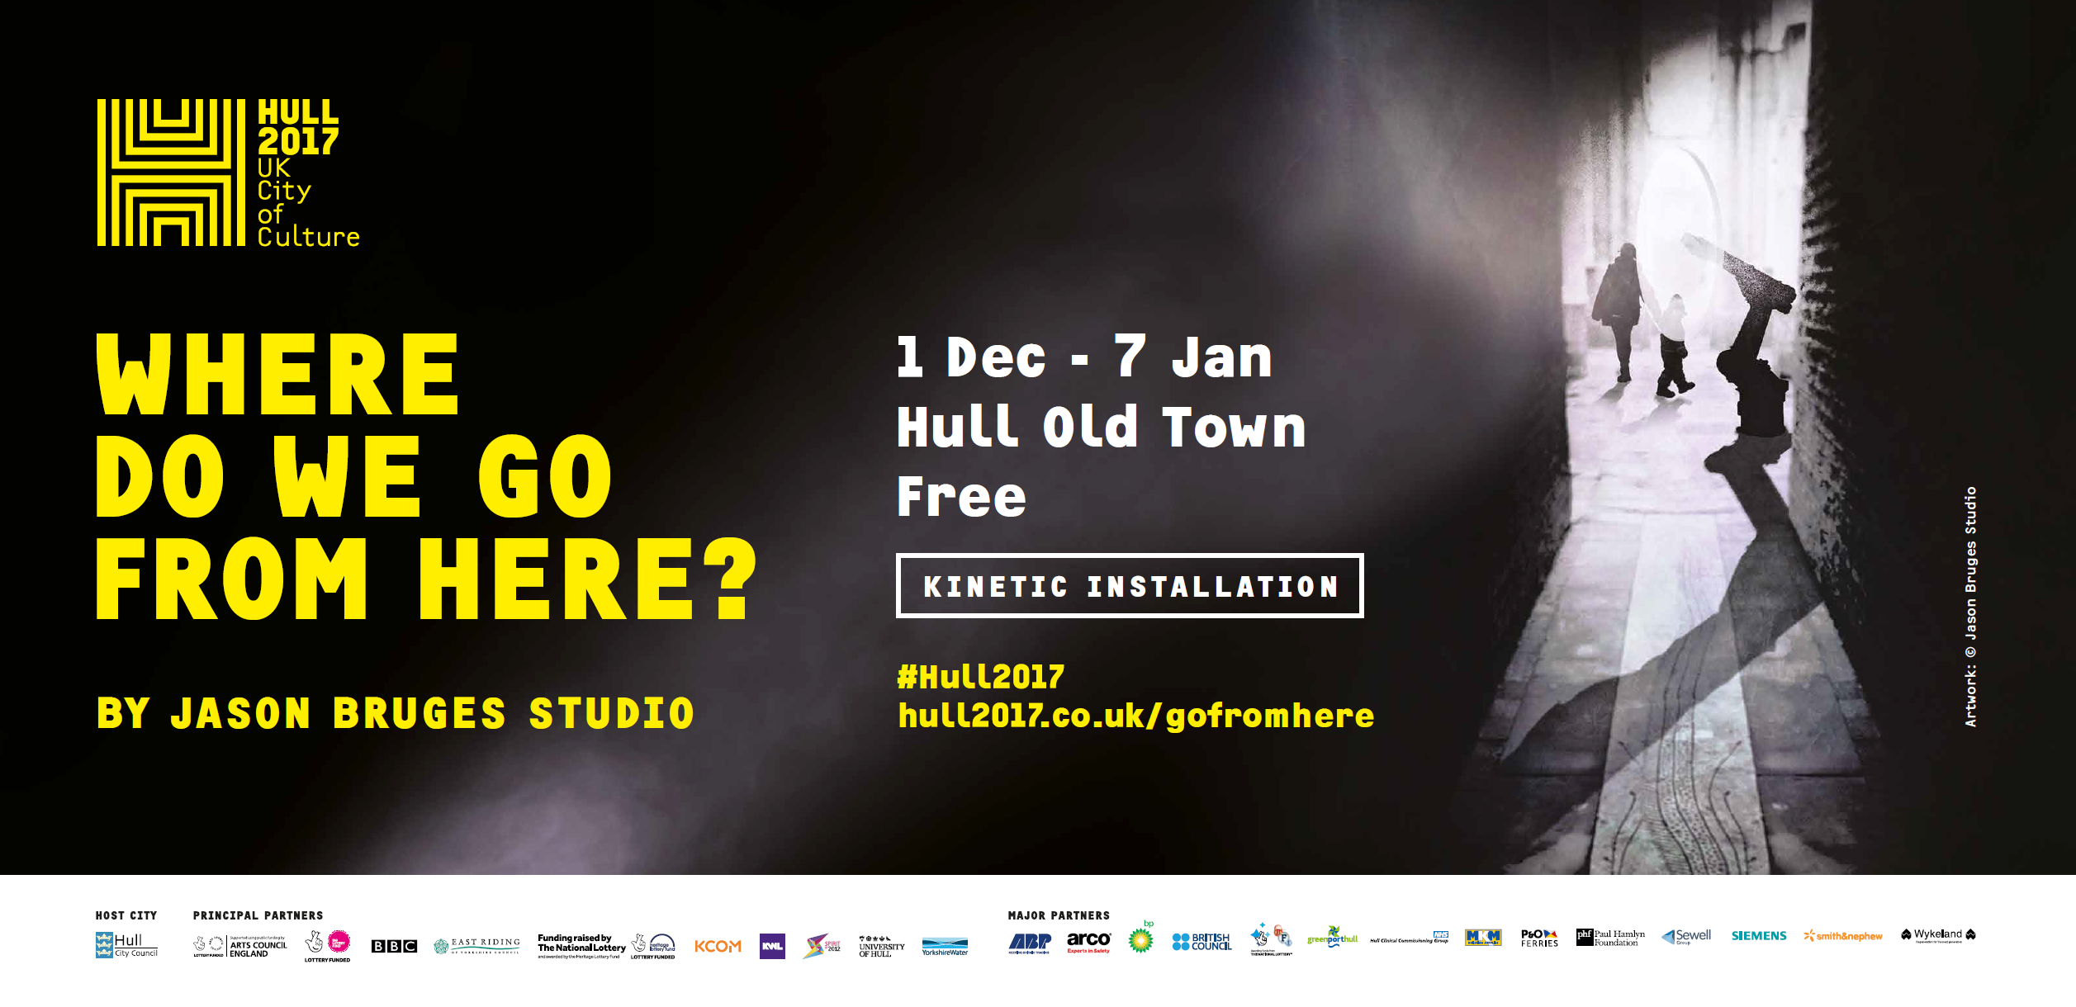
VISUAL LOOK AND FEEL – SEASON LAUNCH
BEFORE
Transition from the season launch designs to the new look and feel

Slide 3
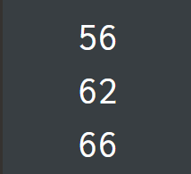
COLOUR SCHEME
Colour scheme going forwards will reflect the artwork itself (orange and dark grey),
combined with black and white
The Grey is matching the base colour of the plinths on the art work and the organge is a compost of the
orange on the robots and that from the yellow on the original artwork
RAL 7016
CMYK 60, 30, 20, 80
The colour of the bases
White
Hull 2017 Brand Colour:
Deep Energetic Yellow
CMYK 0, 58, 100, 0
The colour of the robots
Black

Slide 4
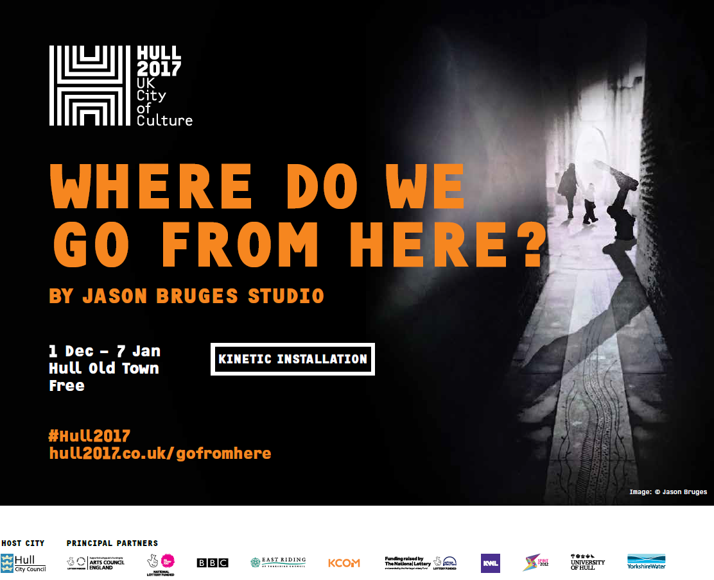
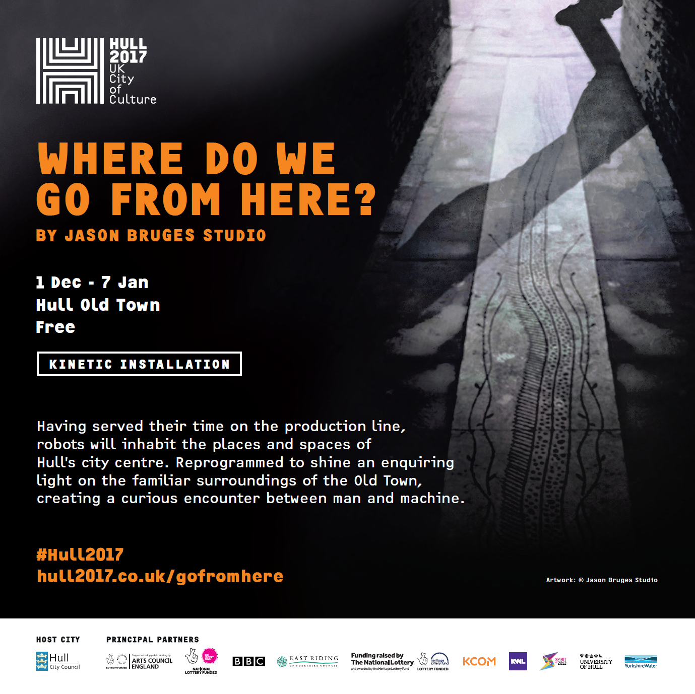
VISUAL LOOK AND FEEL - LOCAL
Local media campaign – question and artwork equal weighting
Some with blurb, some without, always question and promotional image
Incorporating the orange from the robots within the design

Slide 5
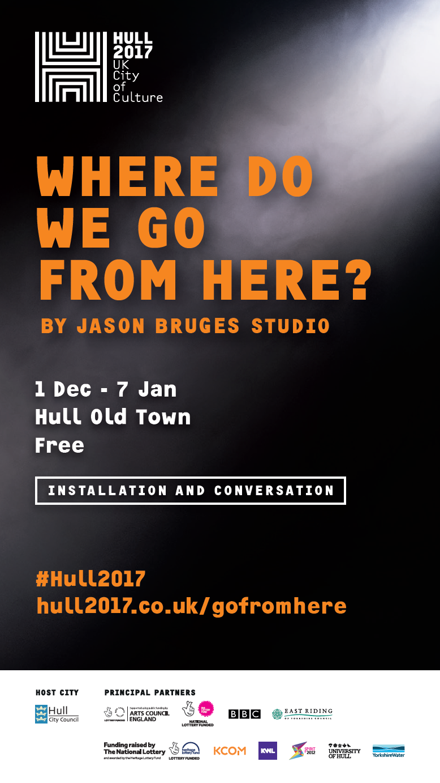
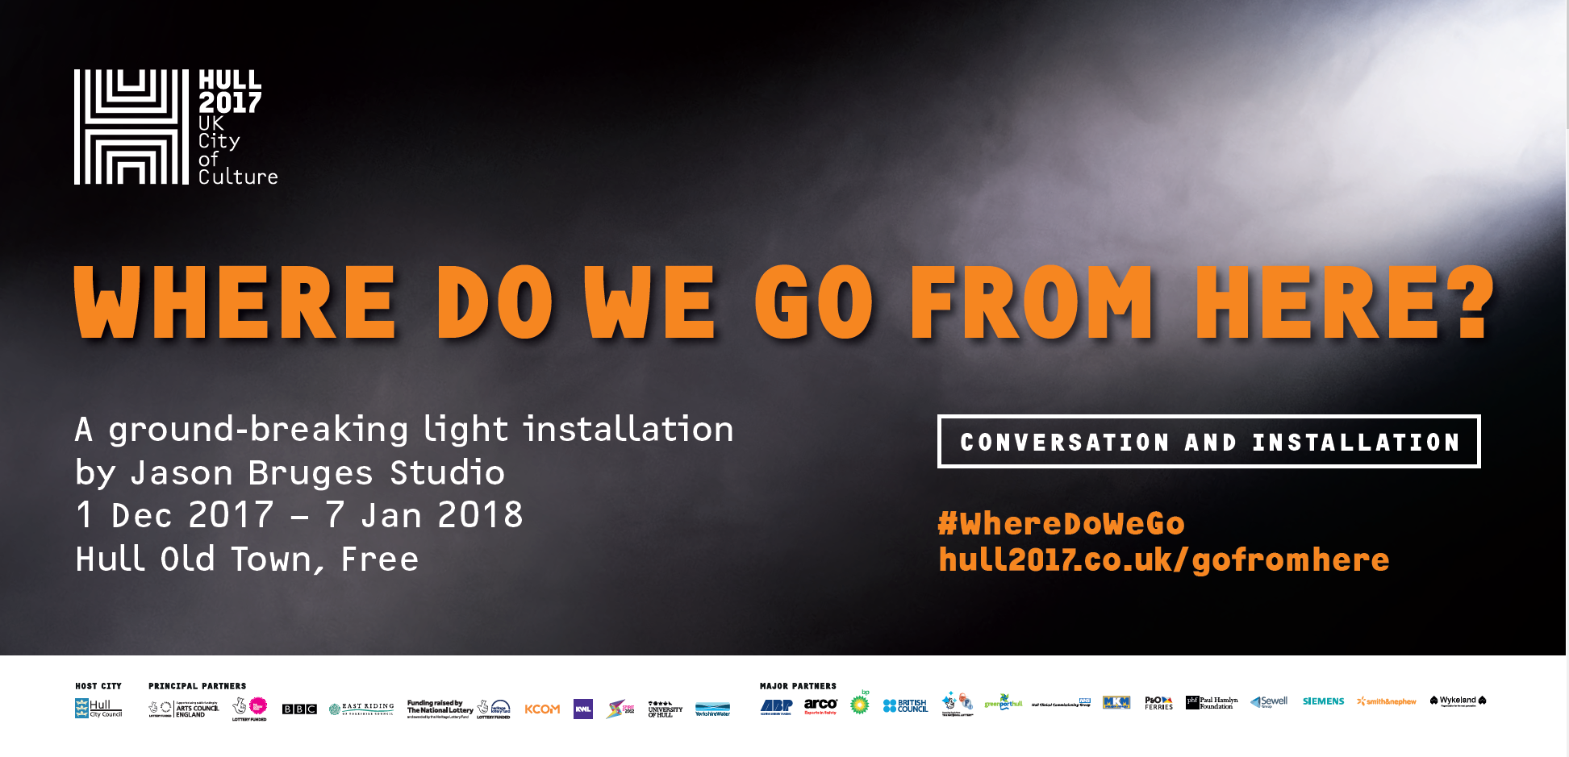
VISUAL LOOK AND FEEL - REGIONAL
Regional media campaign – question given prominence
Artwork always mentioned, with focus given to installation and conversation – dual purpose to
raise awareness and engage those unable to physically visit

Slide 6
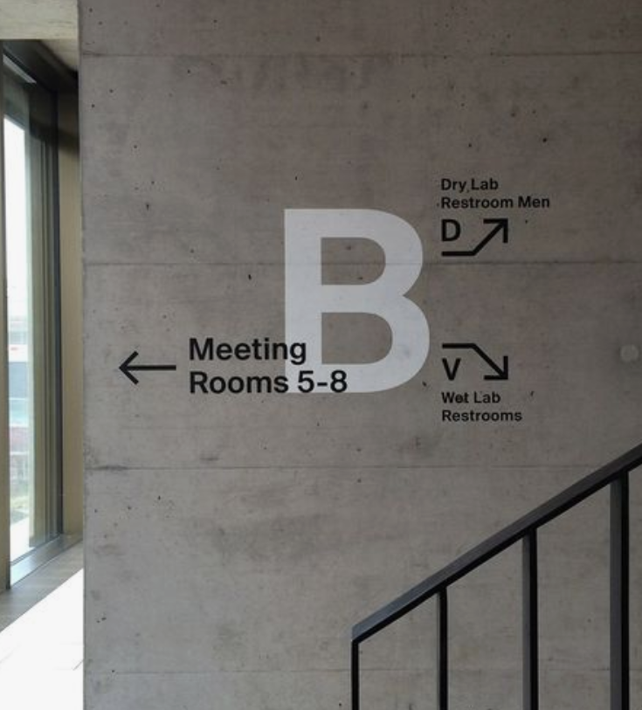
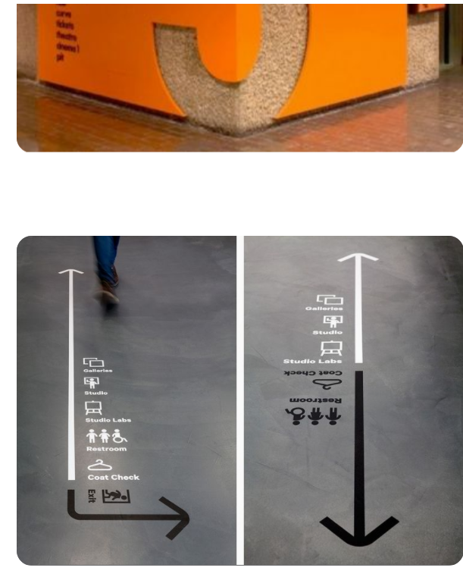
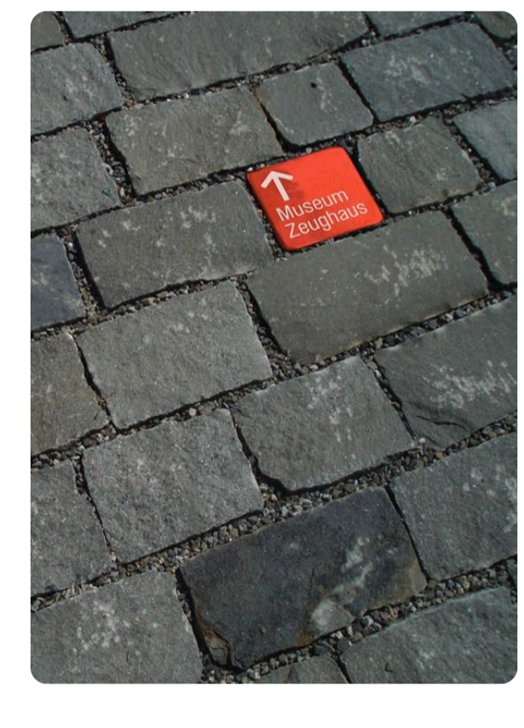
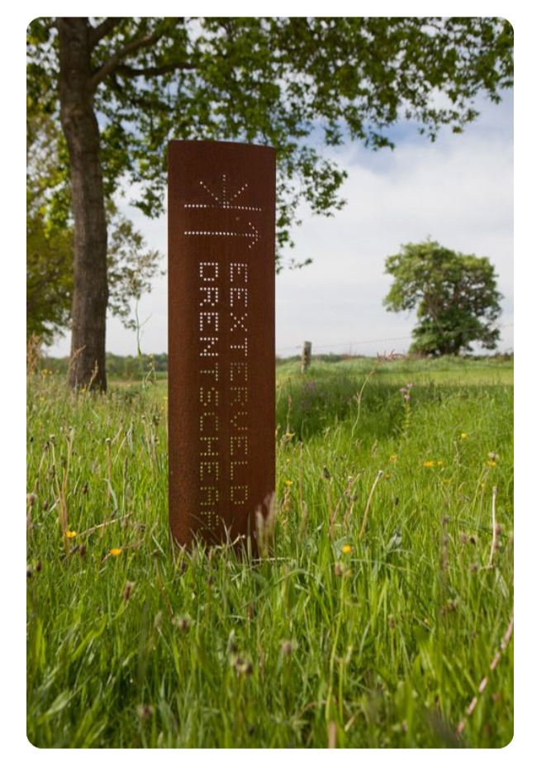
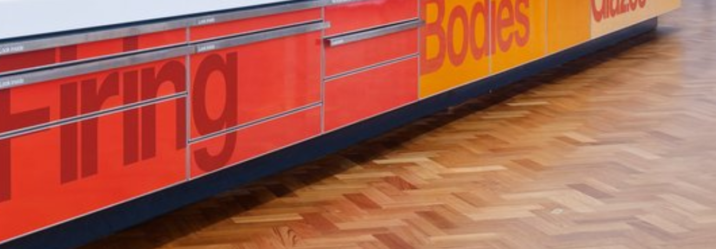
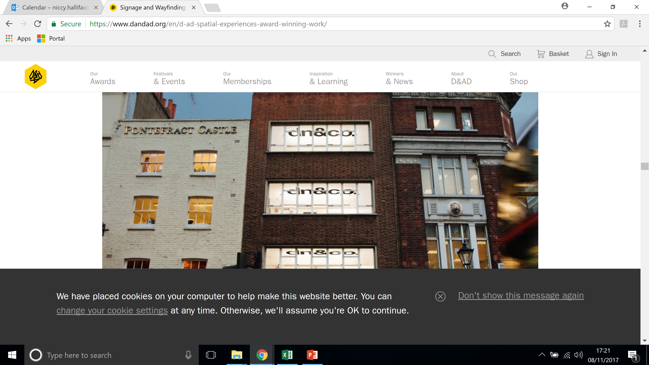
WAYFINDING INSPIRATION

Slide 7
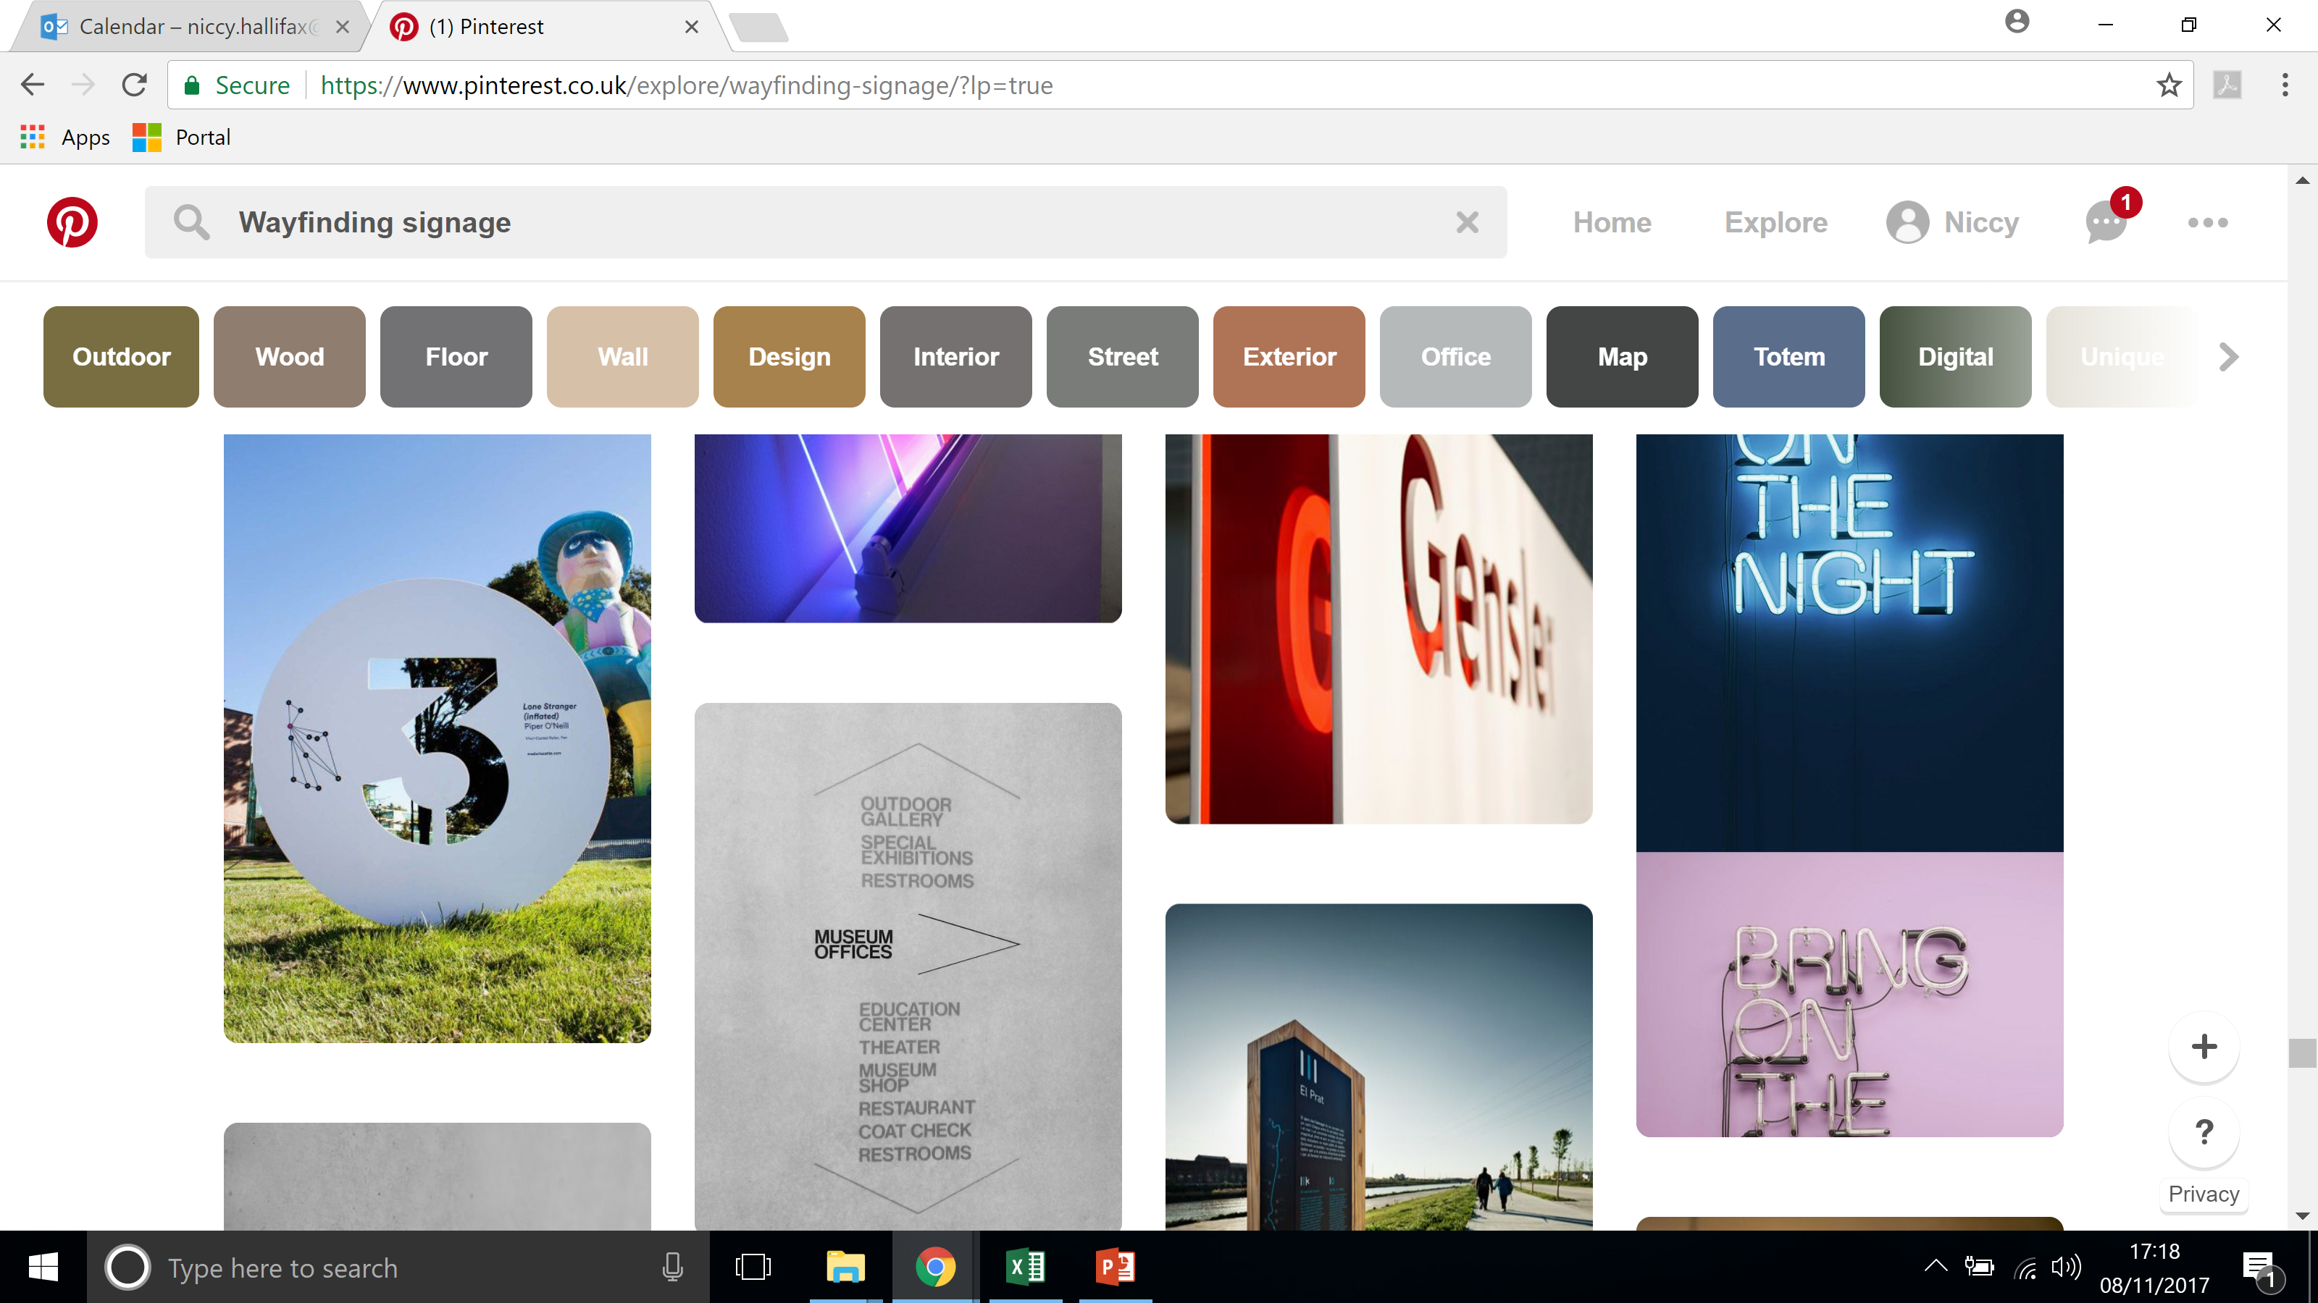
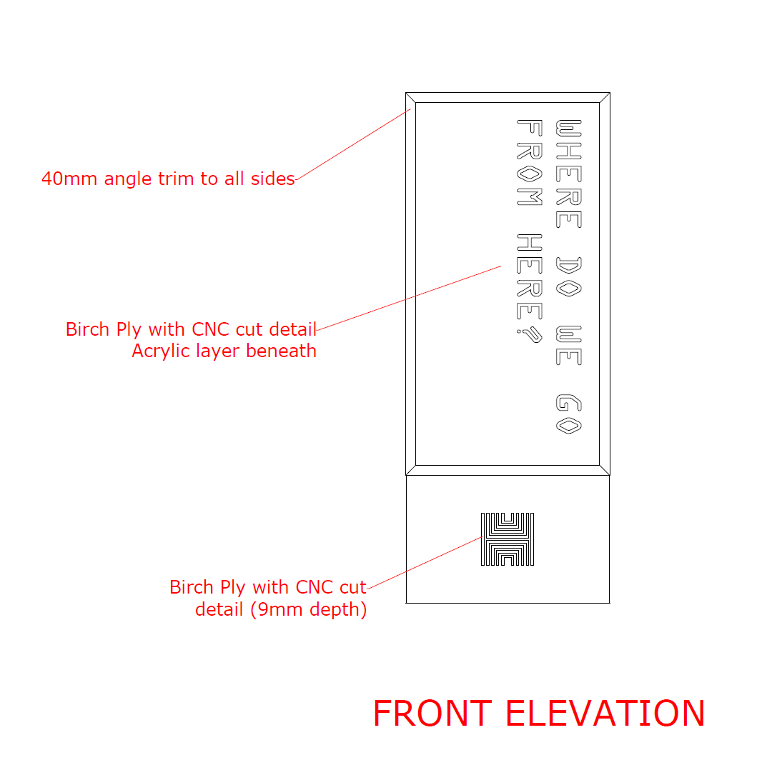
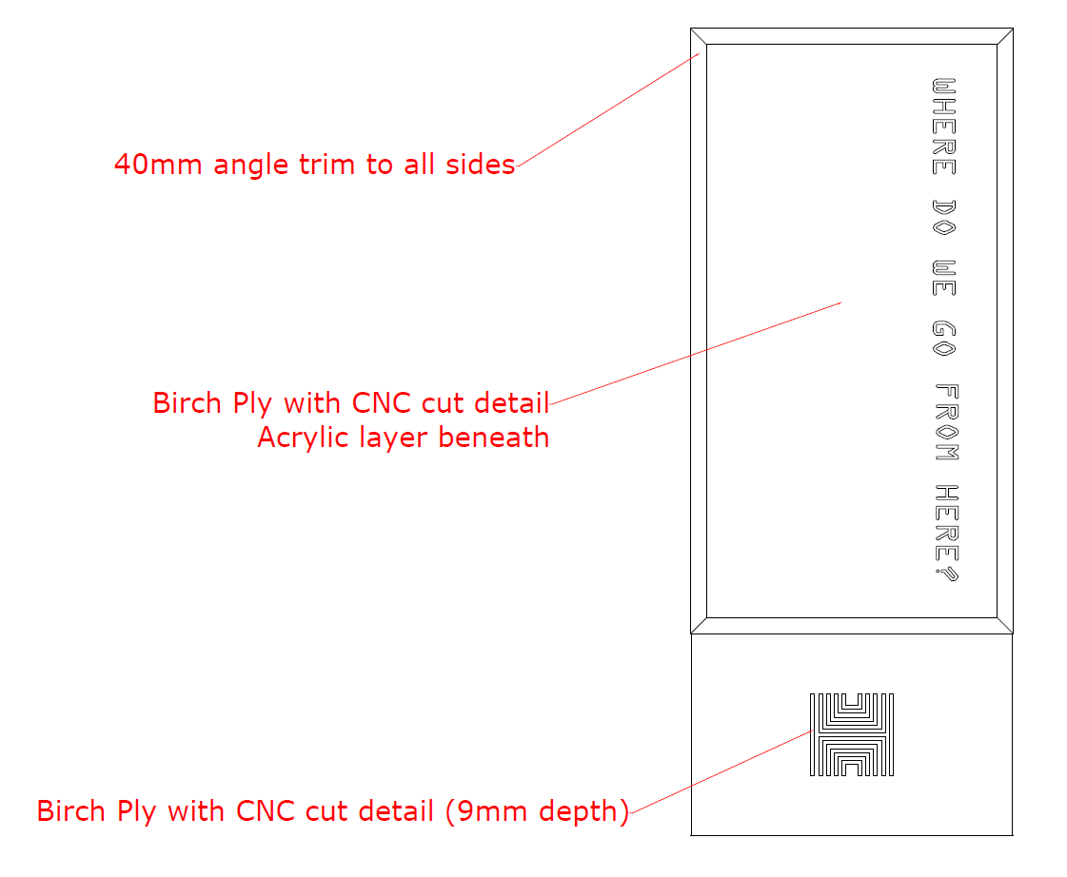
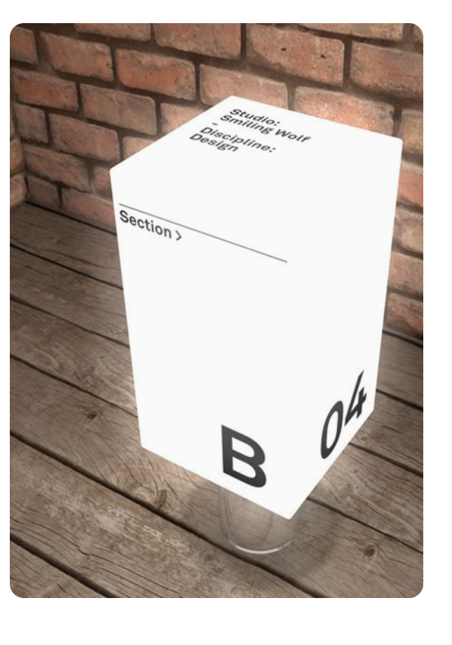
INTERPRETATION EXAMPLES
Working mock ups below of interpretation lightbox pillars to feature at 3 key sites
Museum Gardens, Beverley Gate, Trinity Square

Slide 8
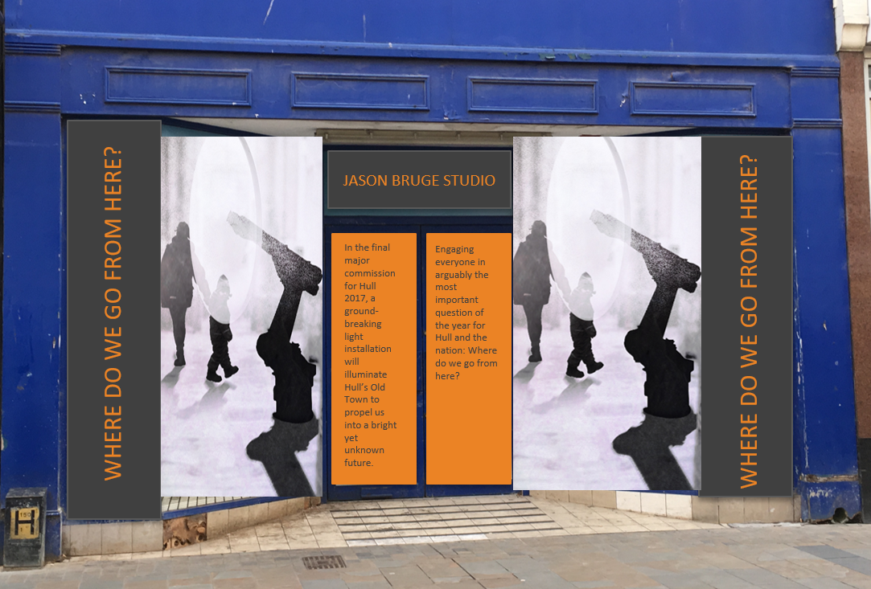
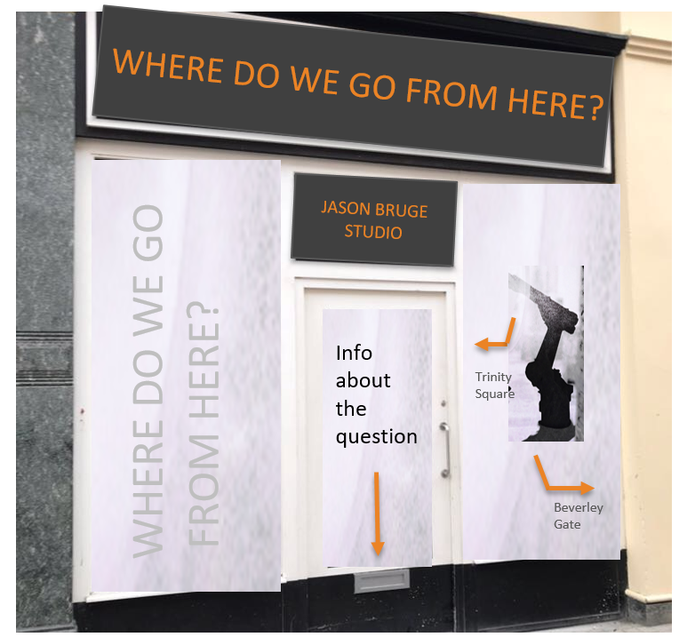
INTERPRETATION EXAMPLES
Working mock ups of window vinyl visuals
Where possible some vinyls will have the WDWGFH qn/title fret cut to allow light inside shop units
to shine through, in-keeping with the artwork and lightbox pillars

