Slide 1
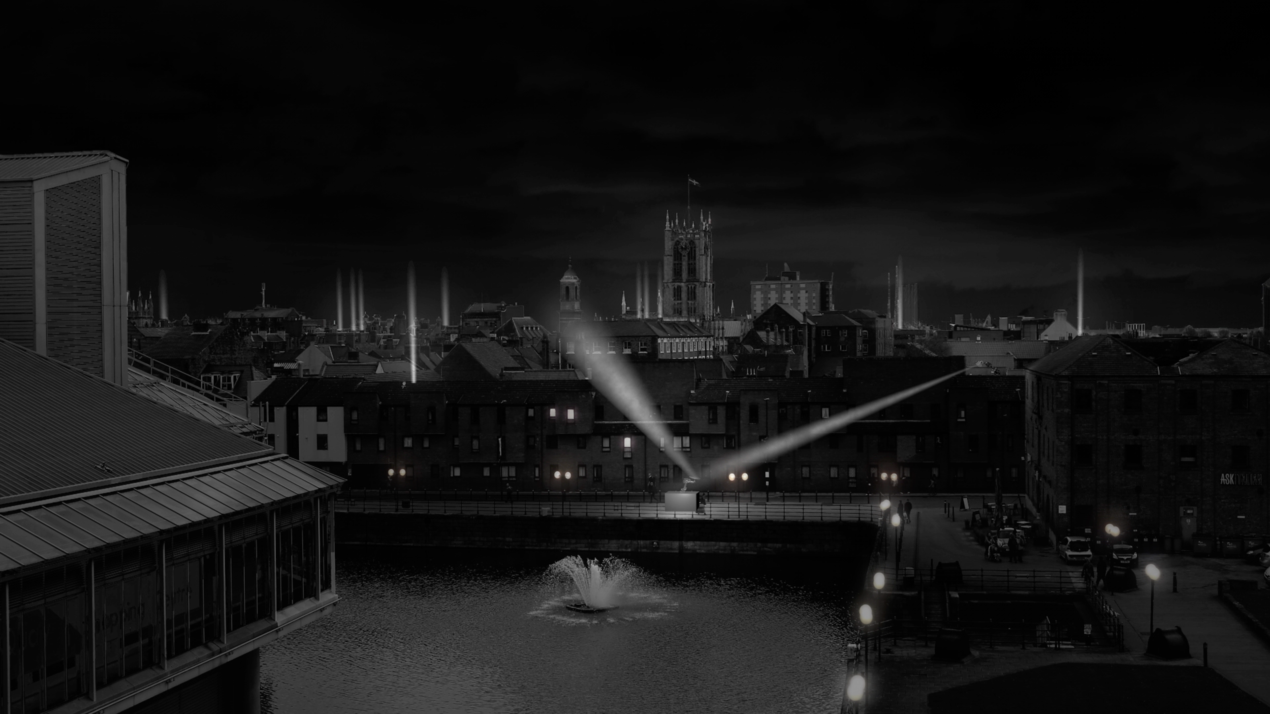

Where do we go from here?
Interim Scheme Presentation / Hull 2017

Slide 2
WHERE DO WE GO FROM HERE?
In our last major commission for , and as a challenging companion piece to Made in Hull, Jason Bruges Studio will shine an enquiring light through Hull’s old town. This ambitious intervention will produce a playful manipulation of light, responding to the city’s unique geometries and architecture revealing unseen spaces and pin pointing unconsidered details. The work, accompanied by new soundscapes seeks to propel us into a bright and yet unknown future, engaging everyone in arguably the most important question of the year for Hull and the nation; what kind of place do we wish to live in? What role should culture play? Where do we go from here? Jason Bruges Studio is critically acclaimed for producing innovative light installations in site specific environments across the globr in a way never experienced in Hull before.
A one of a kind light intervention which will allow the people of Hull and it’s many visitors to witness a playful manipulation of light, responding to the city’s unique geometries, architecture and imbedded history.
The robots will communicate through connected networks and act as light guides creating seamless pathways and kinetic animations resulting in an inquisitive acquaintance with the city.
Beyond the Stars will signal not only the end of a great year for the city, but the beginning of a brighter, more confident future.

Slide 3
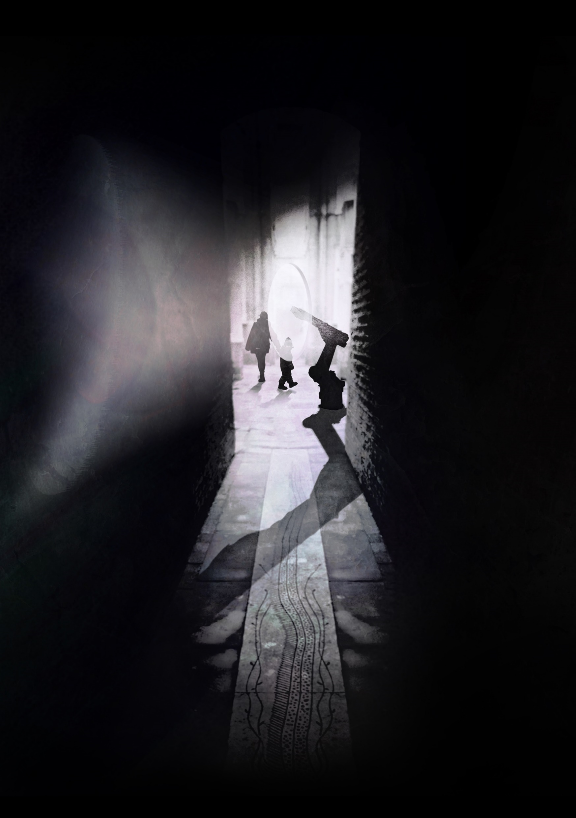
December & January proposal working with Lighting Designer and Installation artist Jason Bruges.
Programming : Niccy Hallifax & Sam Hunt.

Slide 4
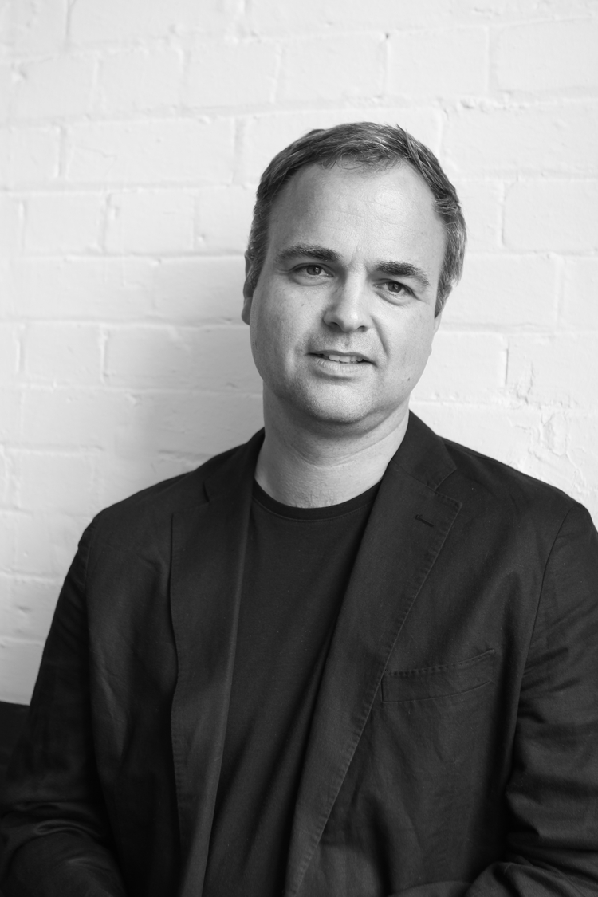
Jason Bruges Studio has become internationally renowned for producing innovative installations, interventions and ground breaking works. This practice involves creating interactive spaces and surfaces that sit between the world of architecture, site specific installation art and interaction design. Considered a pioneer of this hybrid in-between space, Jason has subsequently paved the way for a new genre of design studios, artists and designer-makers.
Jason Bruges is a multi-disciplinary artist and designer based in London. Jason’s work blends architecture with interaction design and uses a high-tech, mixed media palette to explore spectacle, time-based interventions and dynamic spatial experiences. He is passionate about creating site-specific pieces that engage people with their environments.

Slide 5
CONCEPT & VISION
The piece will focus on the ‘street’ as the site – its length and breadth, with an approach which is expected to reveal some of the less well used streets in the Hull Old Town. The work will be experienced as a promenade, accessible to all and free to enjoy. As people move through the city after the sun sets they will pass through a series of connected ‘lightscapes’ as a visual and social experience of time, space and place.
The project will be:
Presented within the context of Hull 2017’s season ‘Tell the World’
Created as a contemporary light intervention to occupy and animate the spaces and places of the ‘Hull Old Town’
Experienced as an immersive and interactive transformation of the streets
Orchestrated - the presence and absence of light, spotlight and shadow, colour and texture, spectacle and contemplative – to excite emotional and physical responses
Focused on engaging with the audience as active participants, rather than passive observers, transforming the look and feel of city and its future.

Slide 6
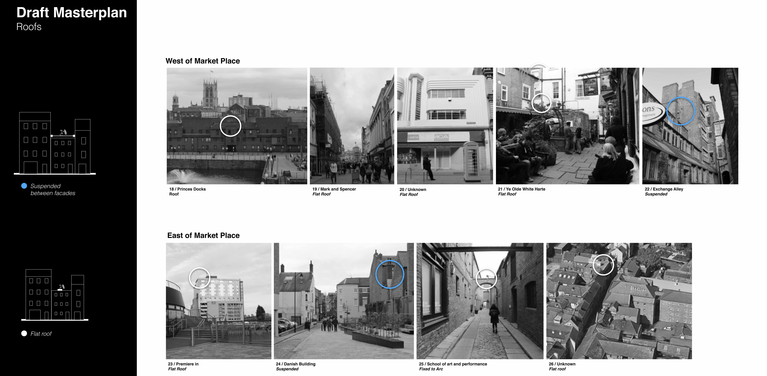

Slide 7
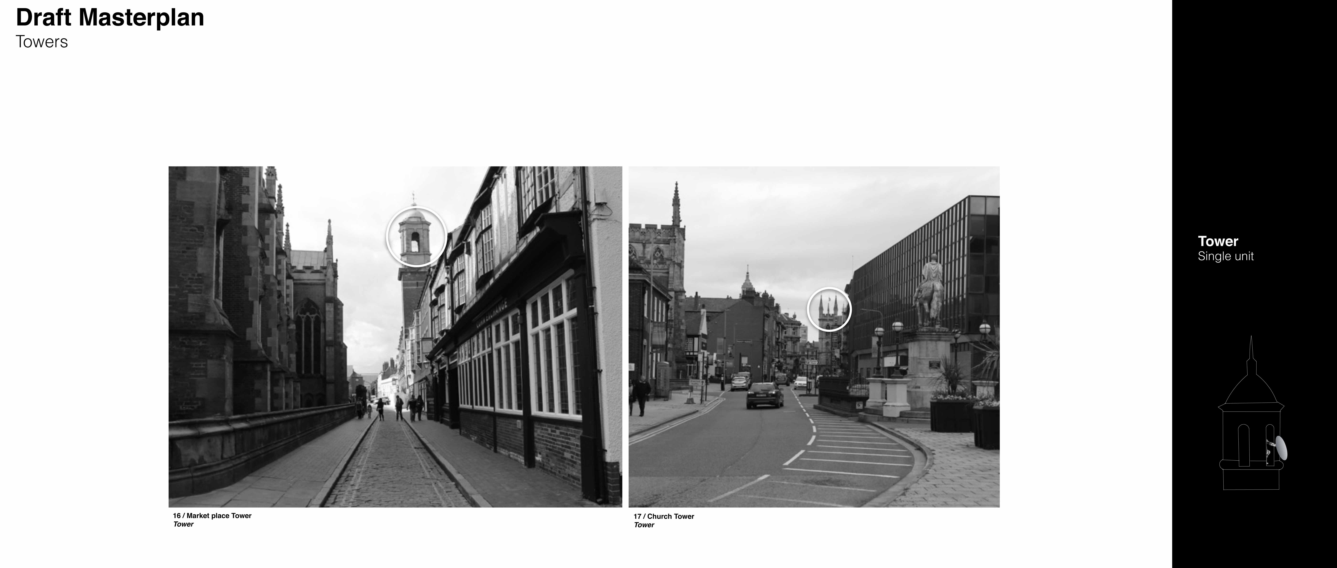

Slide 8
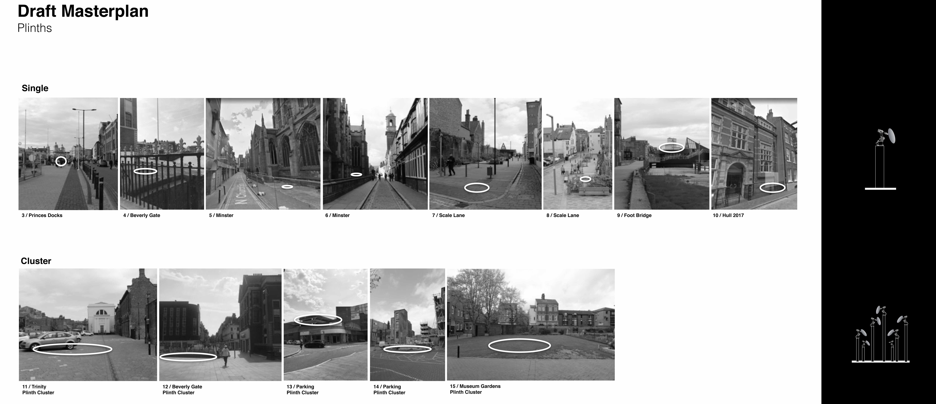

Slide 9
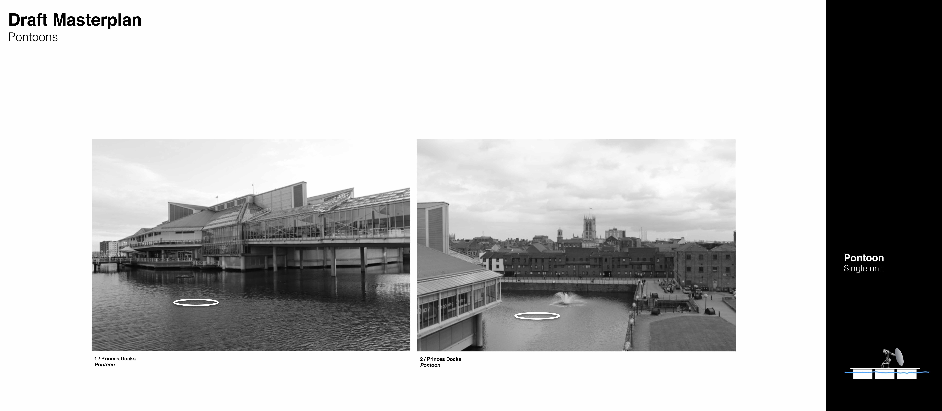

Slide 10
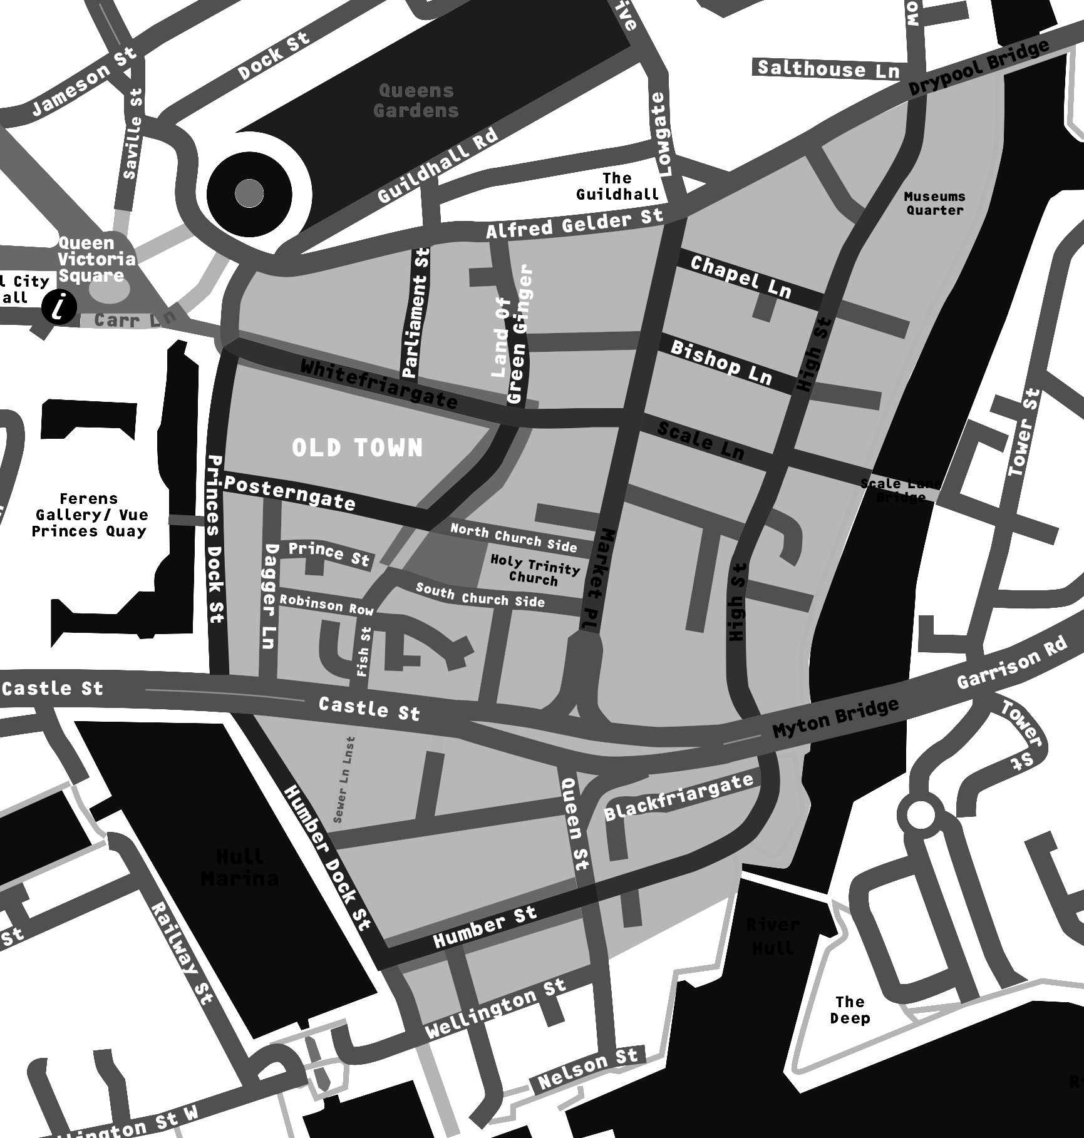

Artist Brief
‘Beyond the Stars’ will
Offer different ways to experience the city, in an impactful and visually arresting way
Be a contemporary light installation rooted in the historical heart of the city
Challenge people’s perceptions of Hull
Key Design Considerations
Celebrating the city through the creative energy and spectacle of light
Transform the city’s streets into places of colour, light and wonder
Engage audiences with playful and accessible spaces
Forward looking, encouraging exploration and social interaction
Promenading as the means to enjoy a holistic approach to the city landscape
Project Aims and Aspirations
Provide a focus across the winter months for for cultural and tourism programming
Build on the momentum of Hull 2017 going forward into 2018
Pragmatics
Be live from December 2017 to January 2018
Complement “The Golden Hour” and retail focussed seasonal lighting
Launched with a celebratory moment, conclude with a mass participatory event
Have a total project budget of £1m.

Slide 11
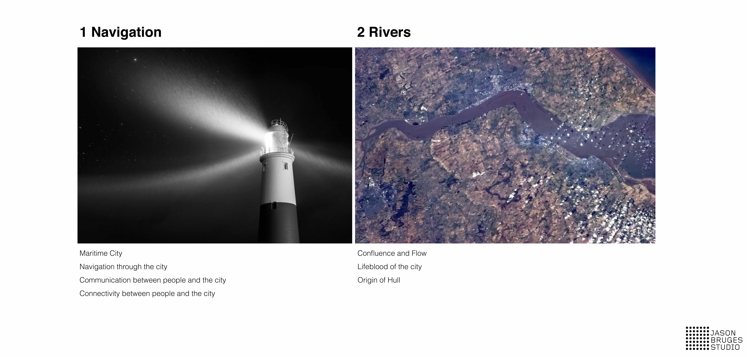
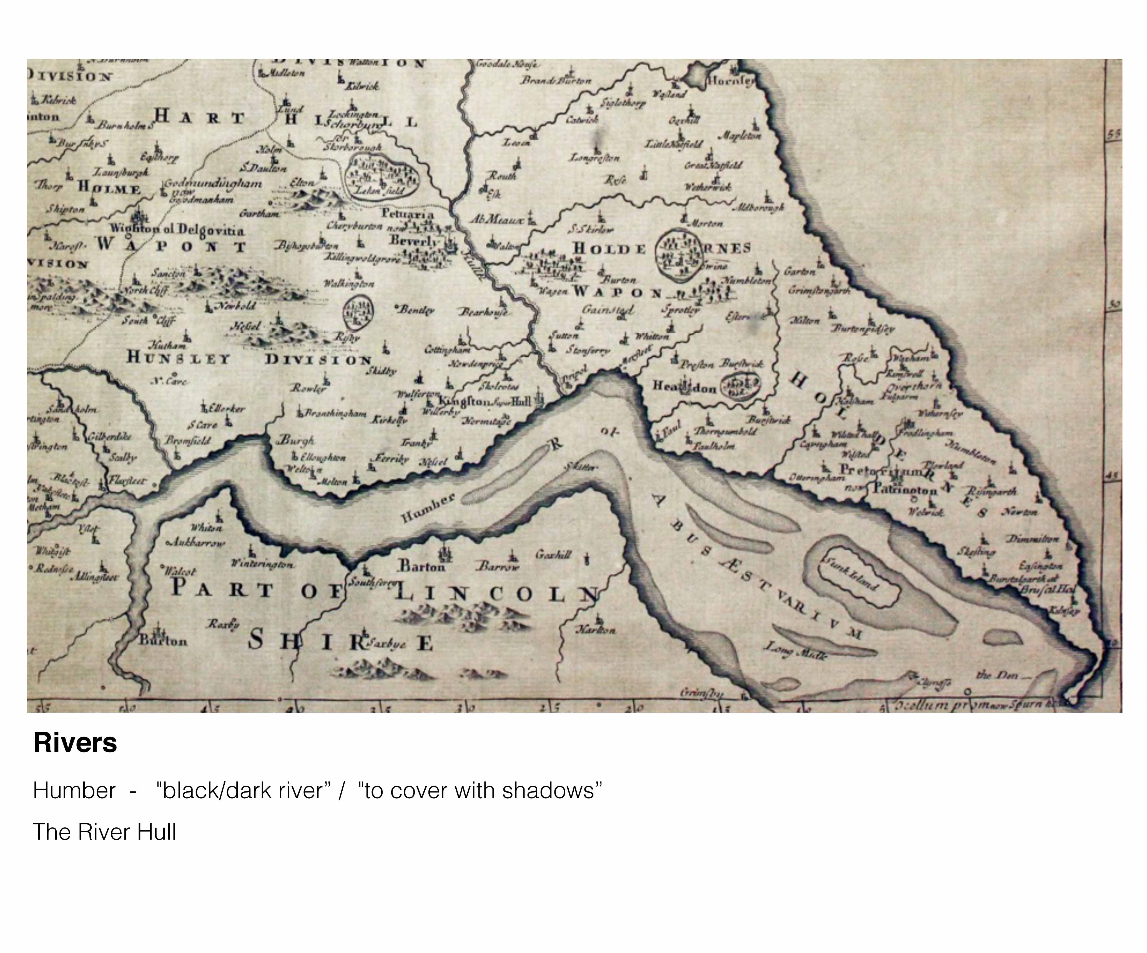

Slide 12
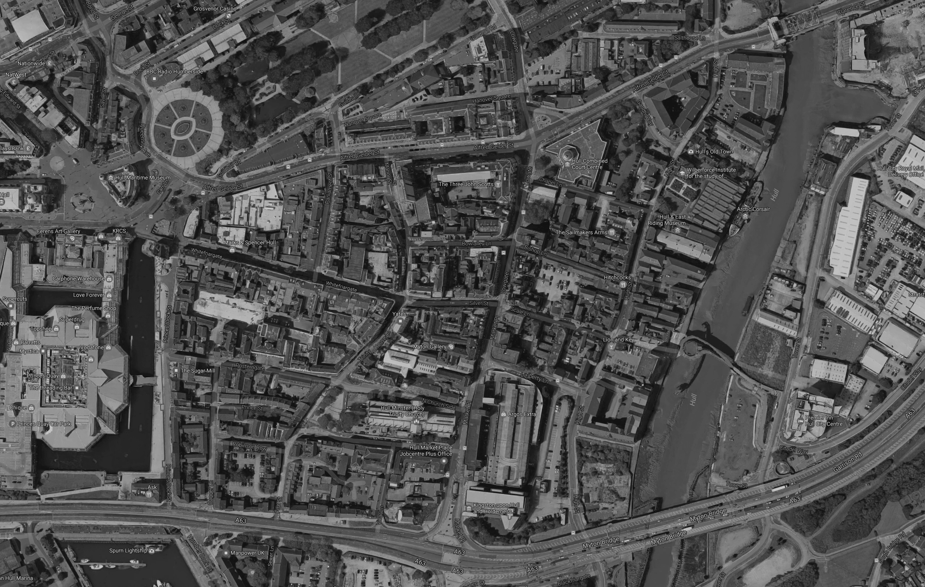
Possible Sites
Typology
Site examples
Open Space
Alley Ways
Streets
Museum Quarters
Historical sites
Beverly Gate
High Street
Old Docks
Scale Lane
Pedestrian entry point
New Docks
Princes Quay
Shopping
Trinity Square
Prince Street

Slide 13
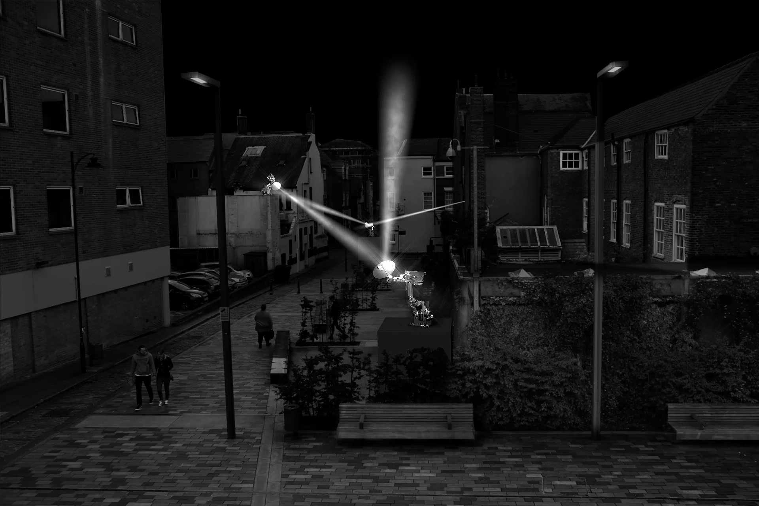
Light Guides
Artist Impression
Scale Lane

