Slide 1



Slide 2
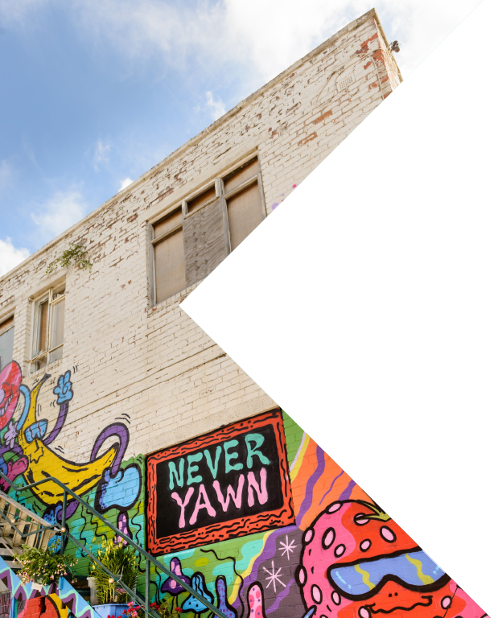
We will cover:
A Bus Back To Ours
Contracts
Technical Staff
Programme:
Theatre
Circus
TODAY’S MEETING

Slide 3
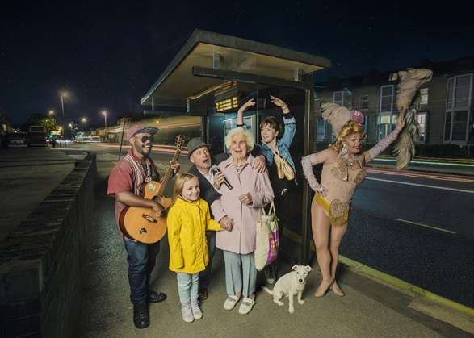

Slide 4
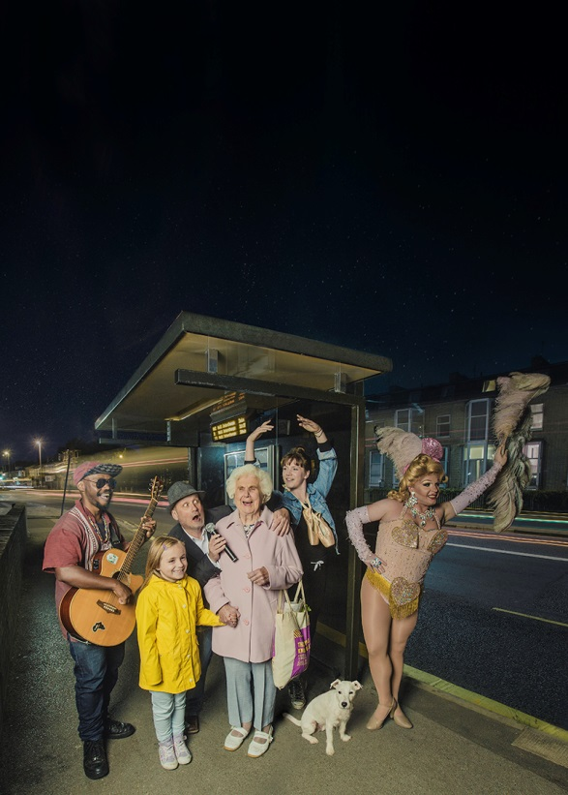



Slide 5
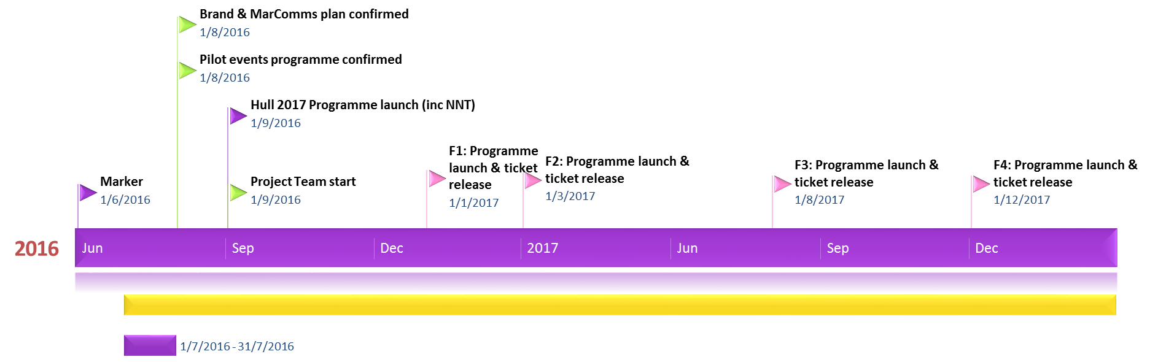
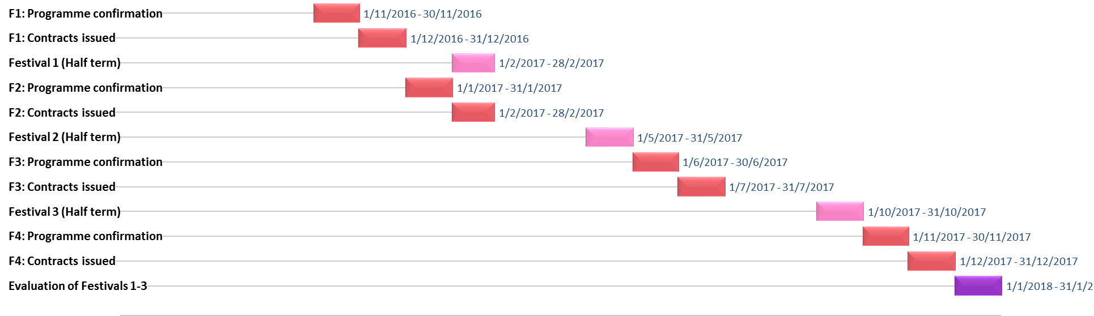

Slide 6

KINGS-WOOD
HYMERS
WINIFRED HOLTBY
North Point Shopping Centre
ARCH-BISHOP SENTAMU
PER VENUE:
◆ Venue Manager & Programming Lead
◆ Venue Technical Liaison
◆ Performing Arts Lead Teacher (schools)
SIRIUS WEST ACADEMY
WILLIAM GEMMELL
FREEDOM CENTRE
PUBS
(X3)
MALET LAMBERT
PER AREA:
◆ Local Technical Manager
◆ Local Technicians (x2)
◆ Technical Apprentice
◆ Local Marketing & Engagement Manager
◆ Box Office Team (x2)
◆ Marketing & Engagement Apprentice
◆ FOH Manager & Volunteer Co-ordinator
◆ Hull 2017 Volunteers (x10)
WALTON
ST
NORTH
WESTERN LIBRARY
East Park
WEST
EAST
◆ Hull Dance
◆ Hull Independent Cinema
◆ Humber Mouth
◆ Hull Truck
◆ Programme Director
◆ Project Administrator (p/t)
◆ Programme Consultants/
Local partners & promoters
◆ Technical Co-ordinator (p/t)
◆ Artists
◆ Booking Agent
◆ Technical Manager
◆ Technicians
◆ Marketing Agency
◆ PR Agency
PROGRAMMING
PARTNERS
PROJECT TEAM
TOURING PRODUCTIONS
◆ Programme Consultant
◆ Exec Producer
◆ Technical & Ops Team
◆ Artist Liaison
◆ MarComms Team
◆ Head of Education
◆ Volunteering Team
◆ Finance Team
◆ Monitoring & Evaluation
(University of Hull)
PROGRAMME
CONSULTANT
HULL 2017
CORE TEAM

Slide 7
Back To Ours
We want to develop a programme that will:
Bring high quality shows right to people’s doorsteps
There will be something for everyone
Create new performance spaces in your venues
It will be new and interesting
People will be able to connect with the work in some way
Great days and nights out that will create memories for families
Put Hull’s neighbourhoods on the touring map

Slide 8
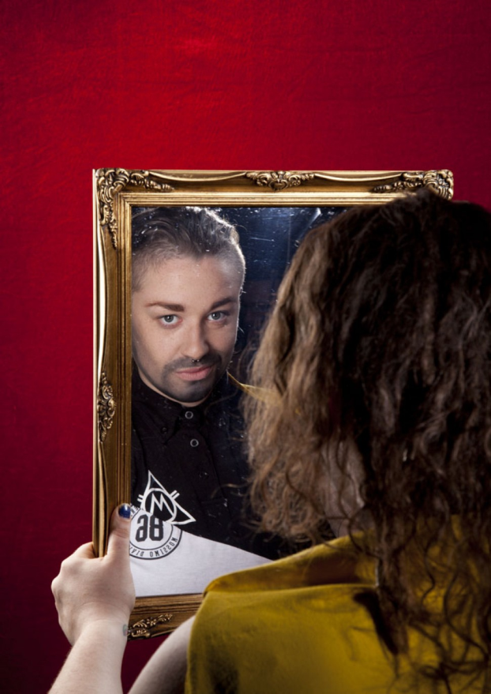
Milk Presents - JOAN
Put your drinks down and your hands together, all the way from Domremy in France (via Soho and 600 years) it’s JOAN!
An earthy story of courage, conviction and hope, this is Joan of Arc - quite possibly the world's first drag king. Packed with guts, heart and some well placed couscous, JOAN fuses lyrical new writing with quick wit and cabaret prowess.
Performed by drag king champion Lucy Jane Parkinson, aka LoUis CYfer ('a marvel to behold' Broadway Baby), and brought together by the ever-probing and playfully anarchic Milk Presents ('Every minute spent with Milk Presents is a gift' British Theatre Guide)
So pull up a pew, or indeed a bar stool, for this fearless new play about what it means to stand out, stand up and stand alone.

Slide 9

Red Ladder
Playing The Joker is about Eddie Waring’s attempt to give rugby league a national profile.
Through song, jokes and gripping drama, Playing The Joker examines the People’s Game through the eyes of its voice – Eddie Waring – and its fans and asks whether Eddie was good for the game or not. This moving, funny and critically acclaimed portrayal of a slice of 1970s northern life kicks off at the world-famous Headingley Stadium, pops in to the Queens Hotel – where it is set – and then takes in 20-odd venues from Hull to Hunslet, Whitehaven to Wigan.

Slide 10
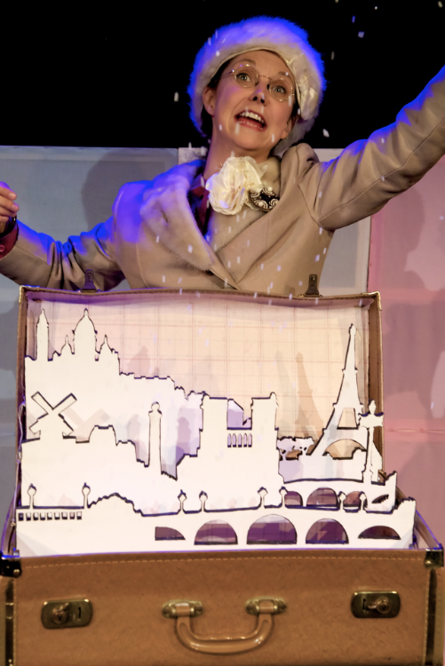
Caroline Horton’s - You’re Not Like The Other Girls Chrissy
January 1945, Paris is liberated. Christiane, an eccentric and acutely myopic Parisian waits at Gare Du Nord for a ticket to England to be reunited with her fiancé. Whilst she waits, this gloriously irrepressible Mademoiselle recounts the extraordinary story of her love affair with Cyril, a tongue-tied teacher from Staffordshire. From a chance encounter at Cheadle tennis club, their story takes us on to cosmopolitan 1930s Paris before war interrupts their unlikely romance. A fond, tender, comical and ultimately poignant portrait of one woman's experience of love and war.

Slide 11

Middle Child
Ten Storey Love Song follows Bobby the Artist's rise to stardom and horrific drug psychosis, Johnnie's attempts to stop thieving and start pleasing Ellen in bed, and Alan Blunt, a forty-year-old truck driver who spends a worrying amount of time patrolling the grounds of the local primary school.
Richard Milward's relentless prose is brought to life in spectacular form with live electronic music from James Orvis (Paris XY), vocals by Anna Wilson and projections by video artist Euan Baker.
Ten Storey Love Song: part play, part house party and a truly good night out.

Slide 12
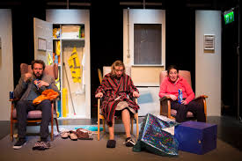
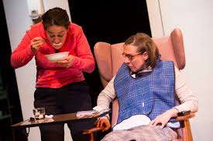
Inspector Sands and China Plate - THE LOUNGE
97 years go by in a flash.
An afternoon lasts an eternity
In a care home lounge somewhere off the A1, 97 year old Marsha Hewitt begins the last day of her life. But she cannot go quietly. As the radiators burn and Jeremy Kyle blares, rivalries, relatives and murderous impulses jostle for space on the Axminster carpet.
By teatime, a riot is brewing.
The award-winning Inspector Sands (A High Street Odyssey, If That’s All There Is, Hysteria) shine a spotlight on how we cope, or fail to cope, with ageing.

Slide 13
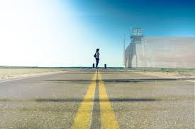
Stephanie Ridings – The Road To Huntsville
“I’m trying to understand why British women fall in love with men on death row. I’m corresponding with Jonny, incarcerated in Texas. I’m trying to understand the death penalty and how that fits into our 21st Century world. I’m trying not to be judgemental."
The Road to Huntsville is an exploration into unconventional love, state homicide and challenging preconceptions.

Slide 14
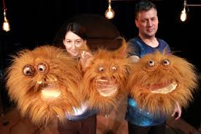
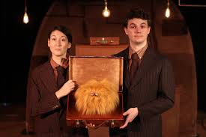
Ailie Cohen and Lewis Hetherington –
The Secret Life of Suitcases
Larry works in an office and he likes it very much. He likes sorting and tidying and generally putting things in order. Everything in its place, a place for everything.
But one day, a suitcase suddenly appears at his door. A suitcase with a tiny label. A tiny label with Larry’s name on it. And this suitcase has a mission...
Join Larry in ‘The Secret Life of Suitcases’ as his world gets turned upside down by a fantastical flying suitcase taking him further than he ever thought possible. Follow Larry’s journey as he discovers the thrill of adventure and the joy of coming home again. 4+

Slide 15
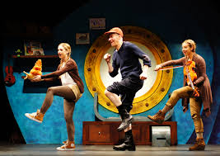
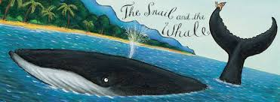
Tall Stories – The Snail and The Whale
Join a tiny snail on her trip round the world in Tall Stories’ magical, musical adaptation of the fantastic picture book by Julia Donaldson and Axel Scheffler.
Longing to see the world, a tiny snail hitches a lift on the tail of a humpback whale. Together they go on an amazing adventure - but when the whale gets beached, how will the snail save him? Follow the tiny snail’s exciting journey, as seen through the eyes of an adventurous young girl and her seafaring father...
Storytelling, live music and lots of laughs, in a show for everyone aged 4 and up.

Slide 16
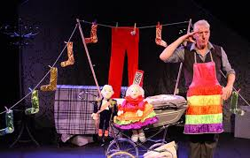
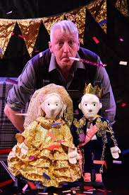
Krazy Kat – Cinder Ella
“Stuck in a tower, hour after hour” she sings to herself. What would you do? Join us for a tall tale of princes and pigtails, of potions and pizzas, as Rapunzel begins to find out there is more to life than just the visits from her Witch…
Multi award-winning Artistic Director Kinny Gardner creates a whole new take on this classic tale, with beautiful puppets, magical transformations, and fully integrated Sign Language. Showcasing Krazy Kat’s mastery of visual storytelling, and bristling with creativity and humour, this is an ingenious and imaginative theatre show with big laughs!
For 3-7 years and their families, the show lasts 50 minutes and is suitable for both deaf and hearing audiences.

Slide 17
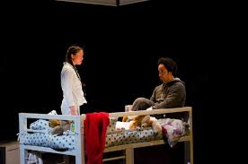
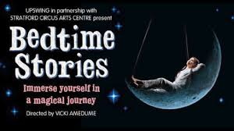
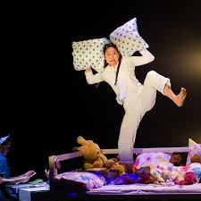
Upswing
Bedtime Stories encourages us to take time out from our busy lives and explore the importance of the connection between carers and children, achieving a work-life balance and managing priorities within the family. Suitable for everyone ages 3+, the show is a transporting and highly immersive experience, that combines awe-inspiring aerial feats with storytelling, physical theatre, dance and stunning projections. Upon entering the theatre space, audiences are invited to relax and feel at home in the environment of a child's bedroom and view the show from the comfort of family beds, tucked up and surrounded by cushions, teddies and blankets.

Slide 18
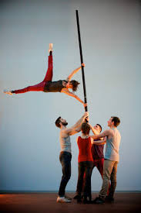
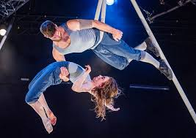
Okhams Razor – Tipping Point
Ockham’s Razor return with their new full length show. Tipping Point is set in the round; the audience drawn in close, as the action veers from catastrophe to mastery. The five performers, enclosed within the circle of the stage, transform simple 5 metre metal poles into a rich landscape of images.
Poles are balanced on fingertips, hung from the roof, lashed, climbed, swung from and walked along, they become forests, cross roads and pendulums. The performers balance, climb and cling to this teetering world, supporting each other as they wrestle with the moment when things begin to shift. They must decide whether to rail against the chaos, struggling to exert order on a disordered world, or ride it out, allowing life to tilt towards the tipping point. 6+

Slide 19


22nd September
&
Next Meeting

