Slide 1
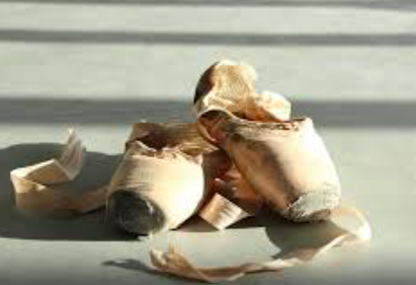



Royal Ballet & the opening of the New Theatre.
16th September 2017
Niccy Hallifax

Slide 2
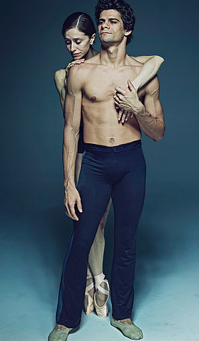
The Royal Ballet’s visit will celebrate Hull’s extraordinary contribution to dance and ballet, while showcasing the city’s next generation of dancers. Reaching out to dance enthusiasts of all ages and levels of experience, Opening The New will offer a range of opportunities during 2017, including pop-up performances
and the Royal Opera House National Nutcracker project with local schools.
Culminating in a day of free public events across the city, The Royal Ballet visit will bring dance schools, participants and the public together to dance, enjoy and recognize Hull New Theatre as a premier stage and venue for audiences from the city, the region and beyond.

Slide 3
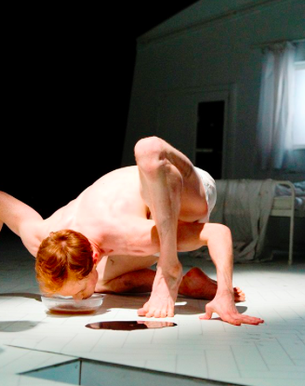
This is a three-way partnership with the Royal Ballet, Hull City Council and Hull 2017.
The three separate conjoined events are:
The RB celebration Performance on the 16th September in the New Theatre
The Screening of the Performance
The community and engagement piece culminating in a performance with the opportunity to participate

Slide 4
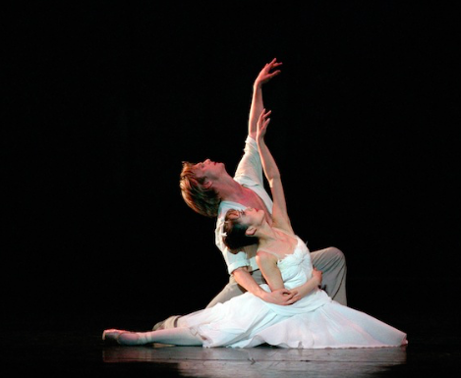
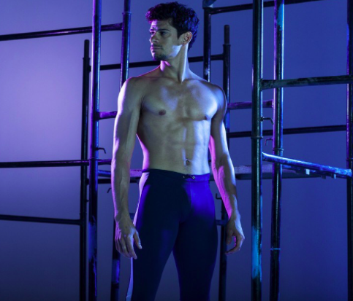
The New Theatre:
Doors open: 18:30
Performance starts: 19:30

Slide 5
Marking The Royal Ballet's first performance in Hull for 30 years, the evening will feature performances by some of the finest dancers in the world. Royal Ballet Principal dancers Francesca Hayward, Sarah Lamb, Marianela Nuñez, Thiago Soares, Steven McRae and Edward Watson will be joined by Xander Parish, who was born in North Ferriby, first learned to dance in Hull and was the first British dancer to be employed by the Mariinsky Ballet in St Petersburg. Xander's sister Demelza Parish, a First Artist of The Royal Ballet will also feature in the performance, as well Royal Ballet Soloist Elizabeth Harrod, another dancer who trained in Hull. Hull-born Joseph Caley, who was recently announced as joining English National Ballet from Birmingham Royal Ballet where he began his career, rising through the ranks to Principal, will also perform.
The programme will include excerpts from Swan Lake and Romeo and Juliet and works by The Royal Ballet's associated choreographers, the internationally renowned Wayne McGregor and Christopher Wheeldon.

Slide 6
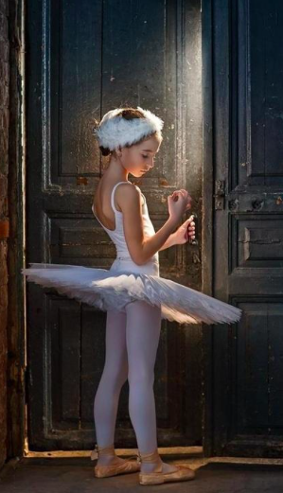
Skelton Hooper and NAPA- the next generation.
The 2 dance schools will perform a piece each as part of the
New Theatre presentation.
Skelton Hooper school of Dance and Theatre, taught dancers
Xander and Demelza Parish to name but 2 and Vanessa
Hooper has choreographed a piece called xxx
NAPA was the college that Liam Mower now dancing with
Matthew Bourne is from and Julie Lovewell has created a 5
Minute contemporary piece utilising the poem created
by Shane Rhodes.

Slide 7
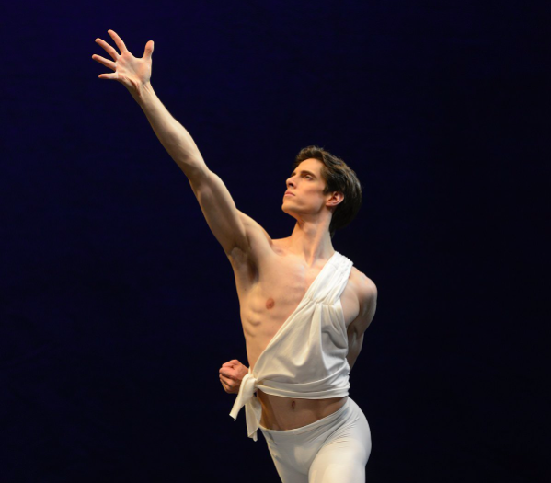
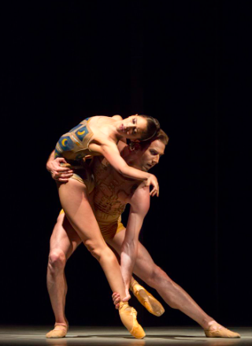
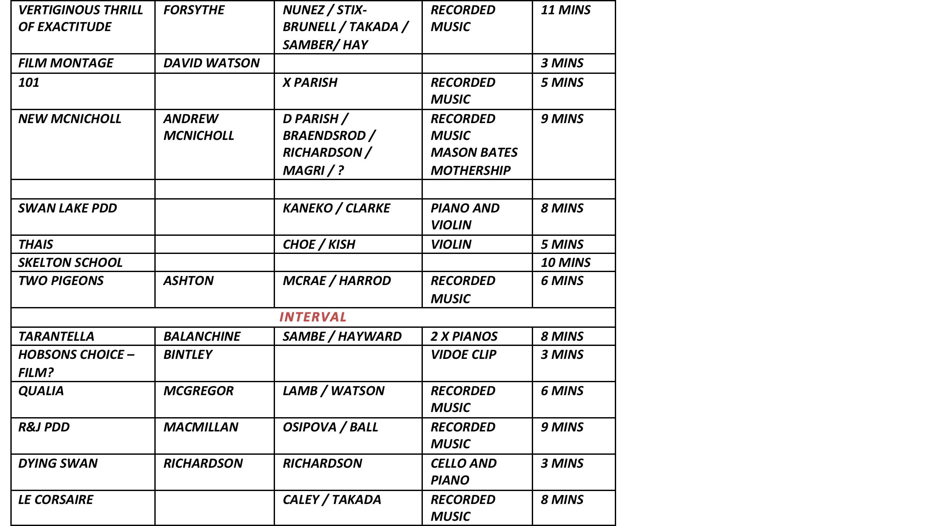

Slide 8
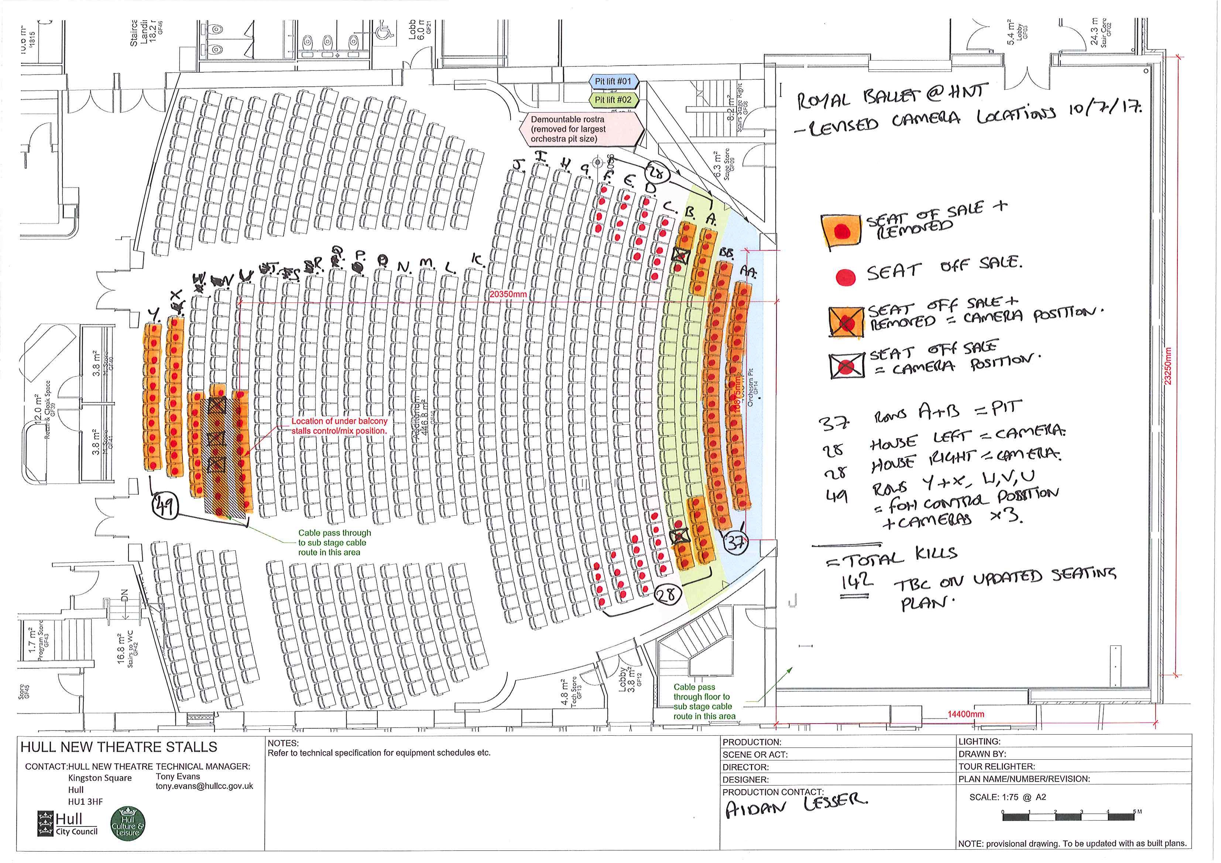
Seats & camera Locations

Slide 9
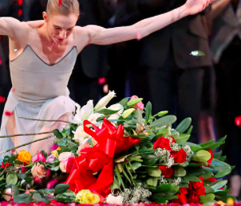
Flower Presentations
The idea is to have the next generation giving flowers to this
Generation of dancers.
The proposal is:
Two each from NAPA and Skelton Hooper giving the flowers in the Theatre
Two from LWHS and MacKowen giving them in the Gardens.

Slide 10
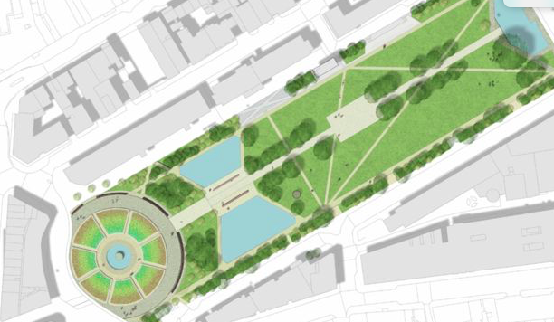
Queens Gardens
Doors open: 18:30
Performance starts: 19:50

Slide 11
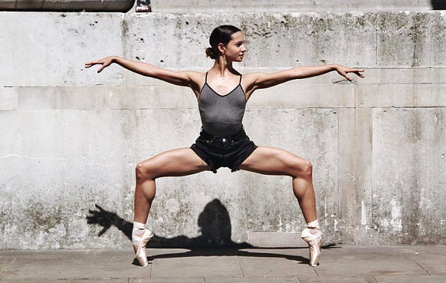
The Queens Garden Screening: The screening will be a ticketed event for 5000 people, these tickets will be £6.00 and will give the audience an opportunity to see the one off piece and experience a performance that is unique and never to be repeated with some of the world’s best dancers on show.
The screening itself will be on a short delay of 20 minutes and this is to enable the dancers and the Artistic director the opportunity to get to the gardens and take a bow. There will be a bar and possible concessions as well as an opportunity just to bring a picnic and blanket and watch the show.

Slide 13
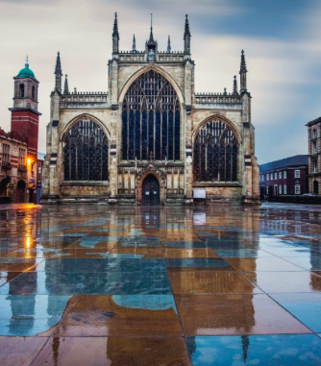
Trinity Square:
Performances: TBC

Slide 14
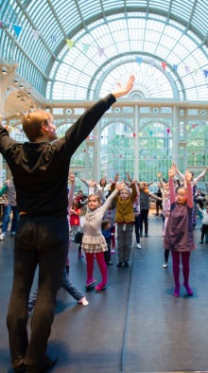
On Saturday 16th September, the City of Hull will be animated with performances and activities inspired by The Royal Ballet’s Swan Lake.
Take Flight will be an outdoor installation performance featuring performers from the city’s dance groups, Hull locals and dancers from The Royal Ballet, accompanied by a specially commissioned musical score. Taking movements from the swans in the iconic corps de ballet moments of Swan Lake, Take Flight will create a visual and sonic spectacle for the audience, surrounding them with the beauty, precision and impact of ballet up close.
The performance will be complimented by a series of participatory dance and craft workshops and displays across the city.

