Slide 1
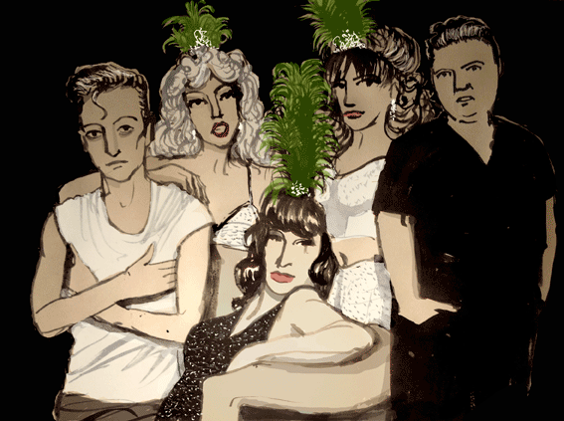
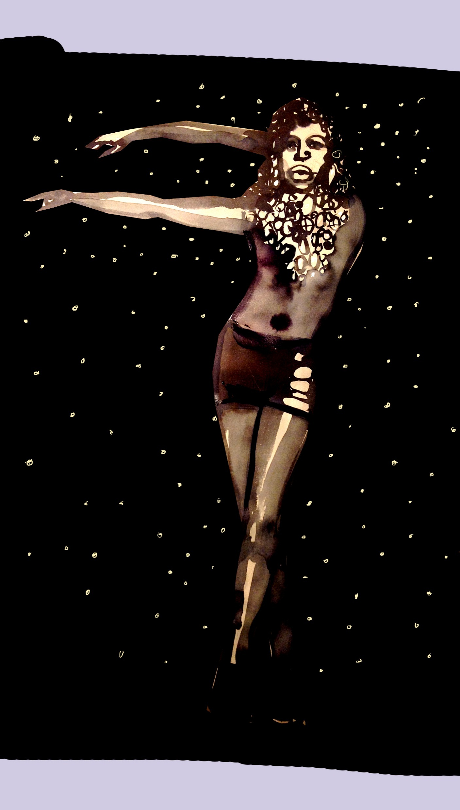
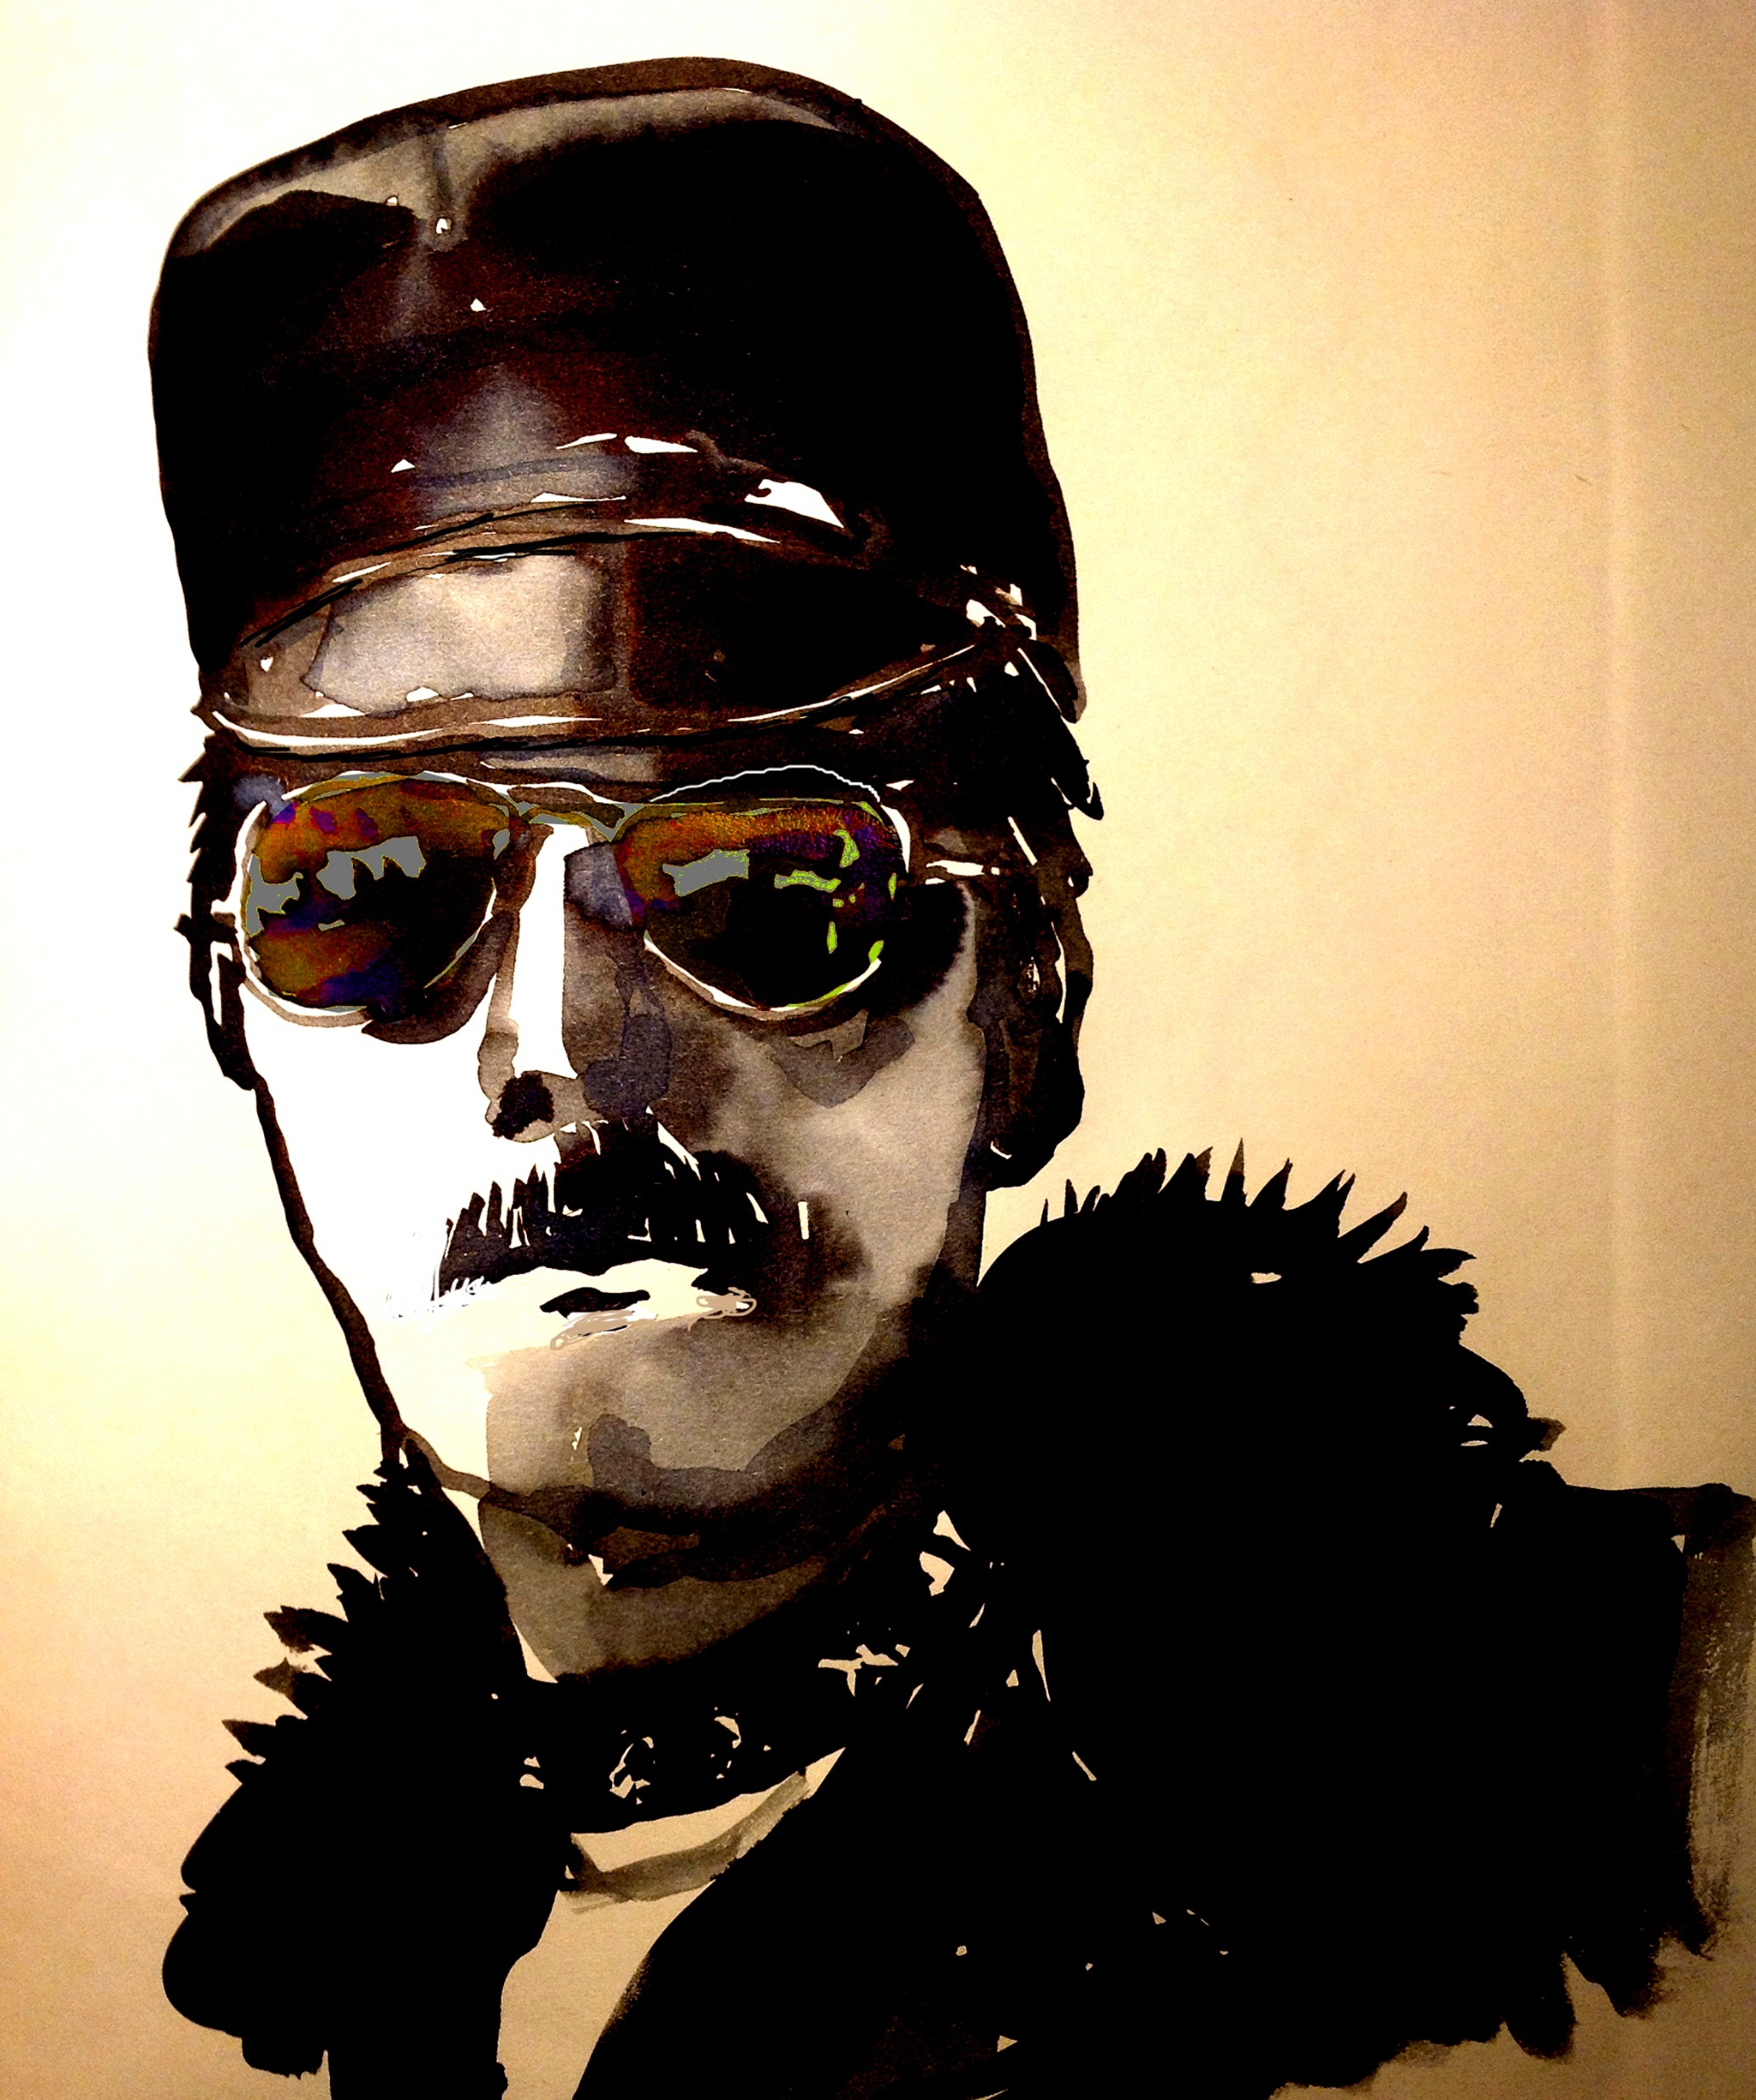
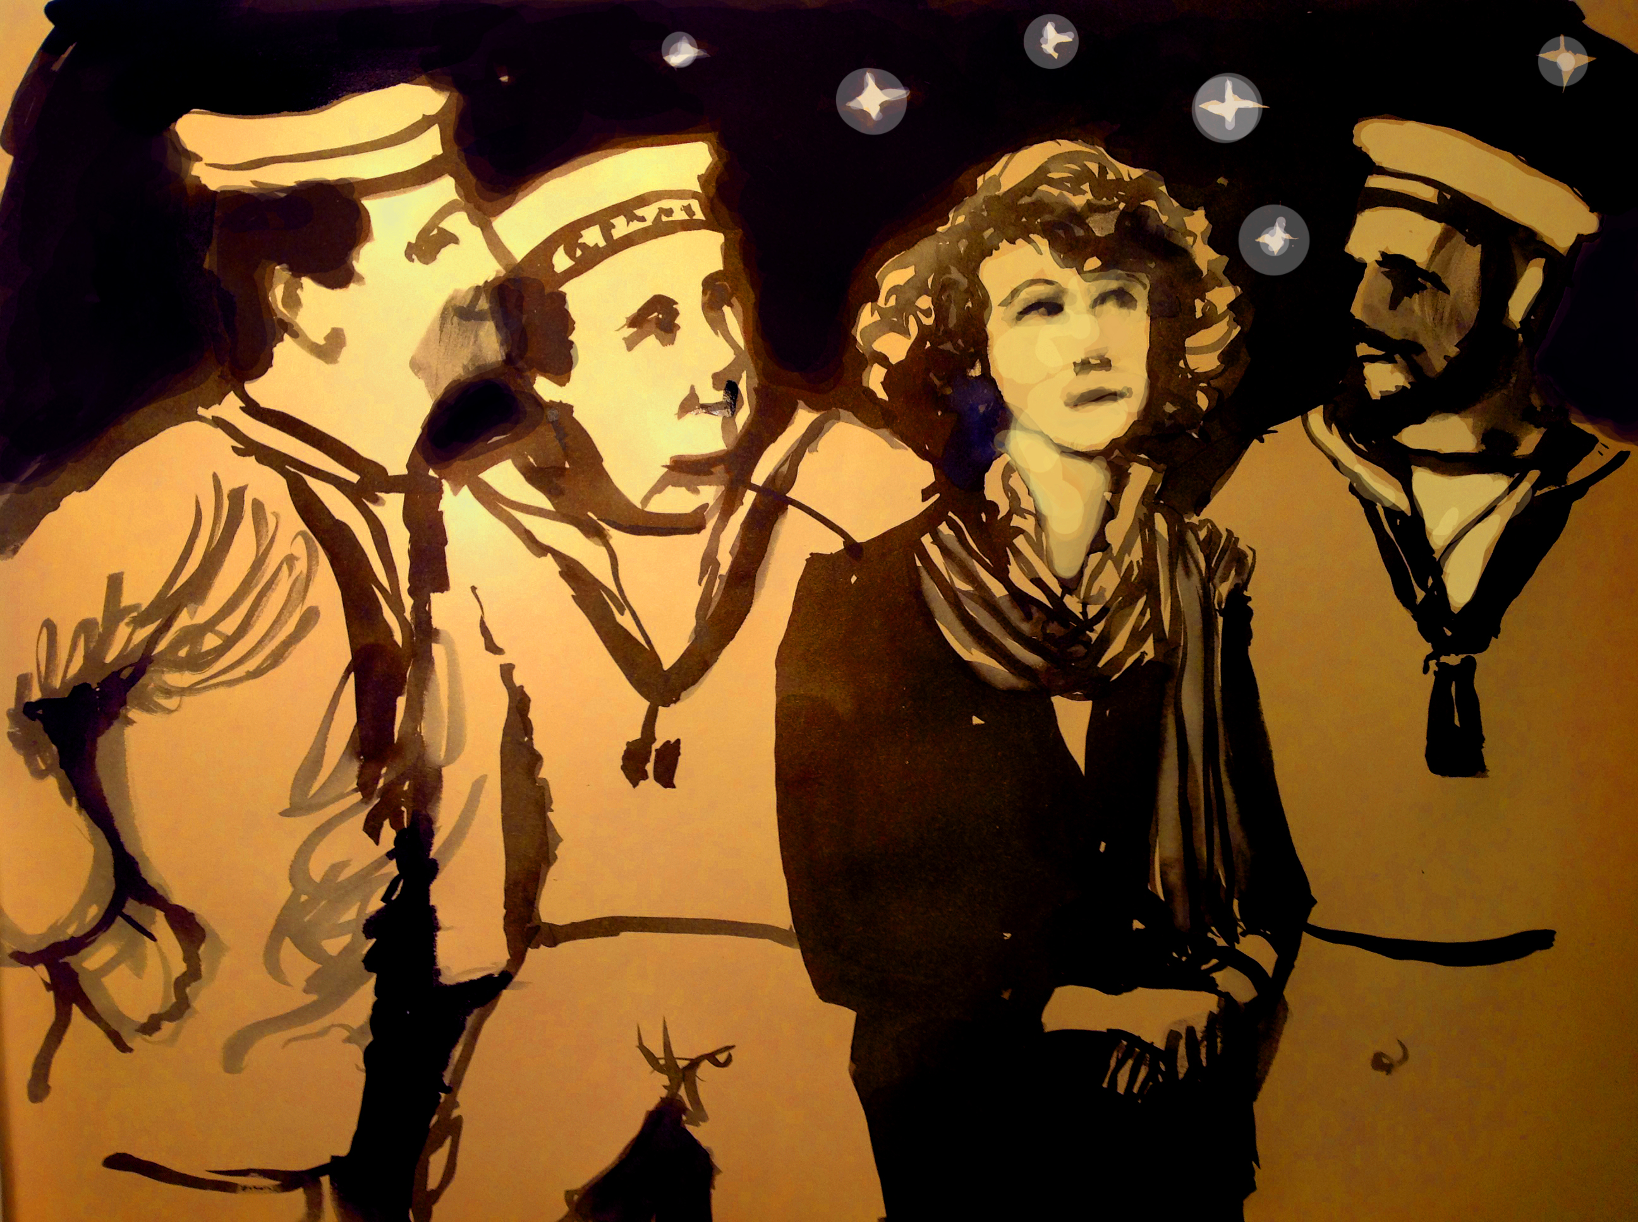
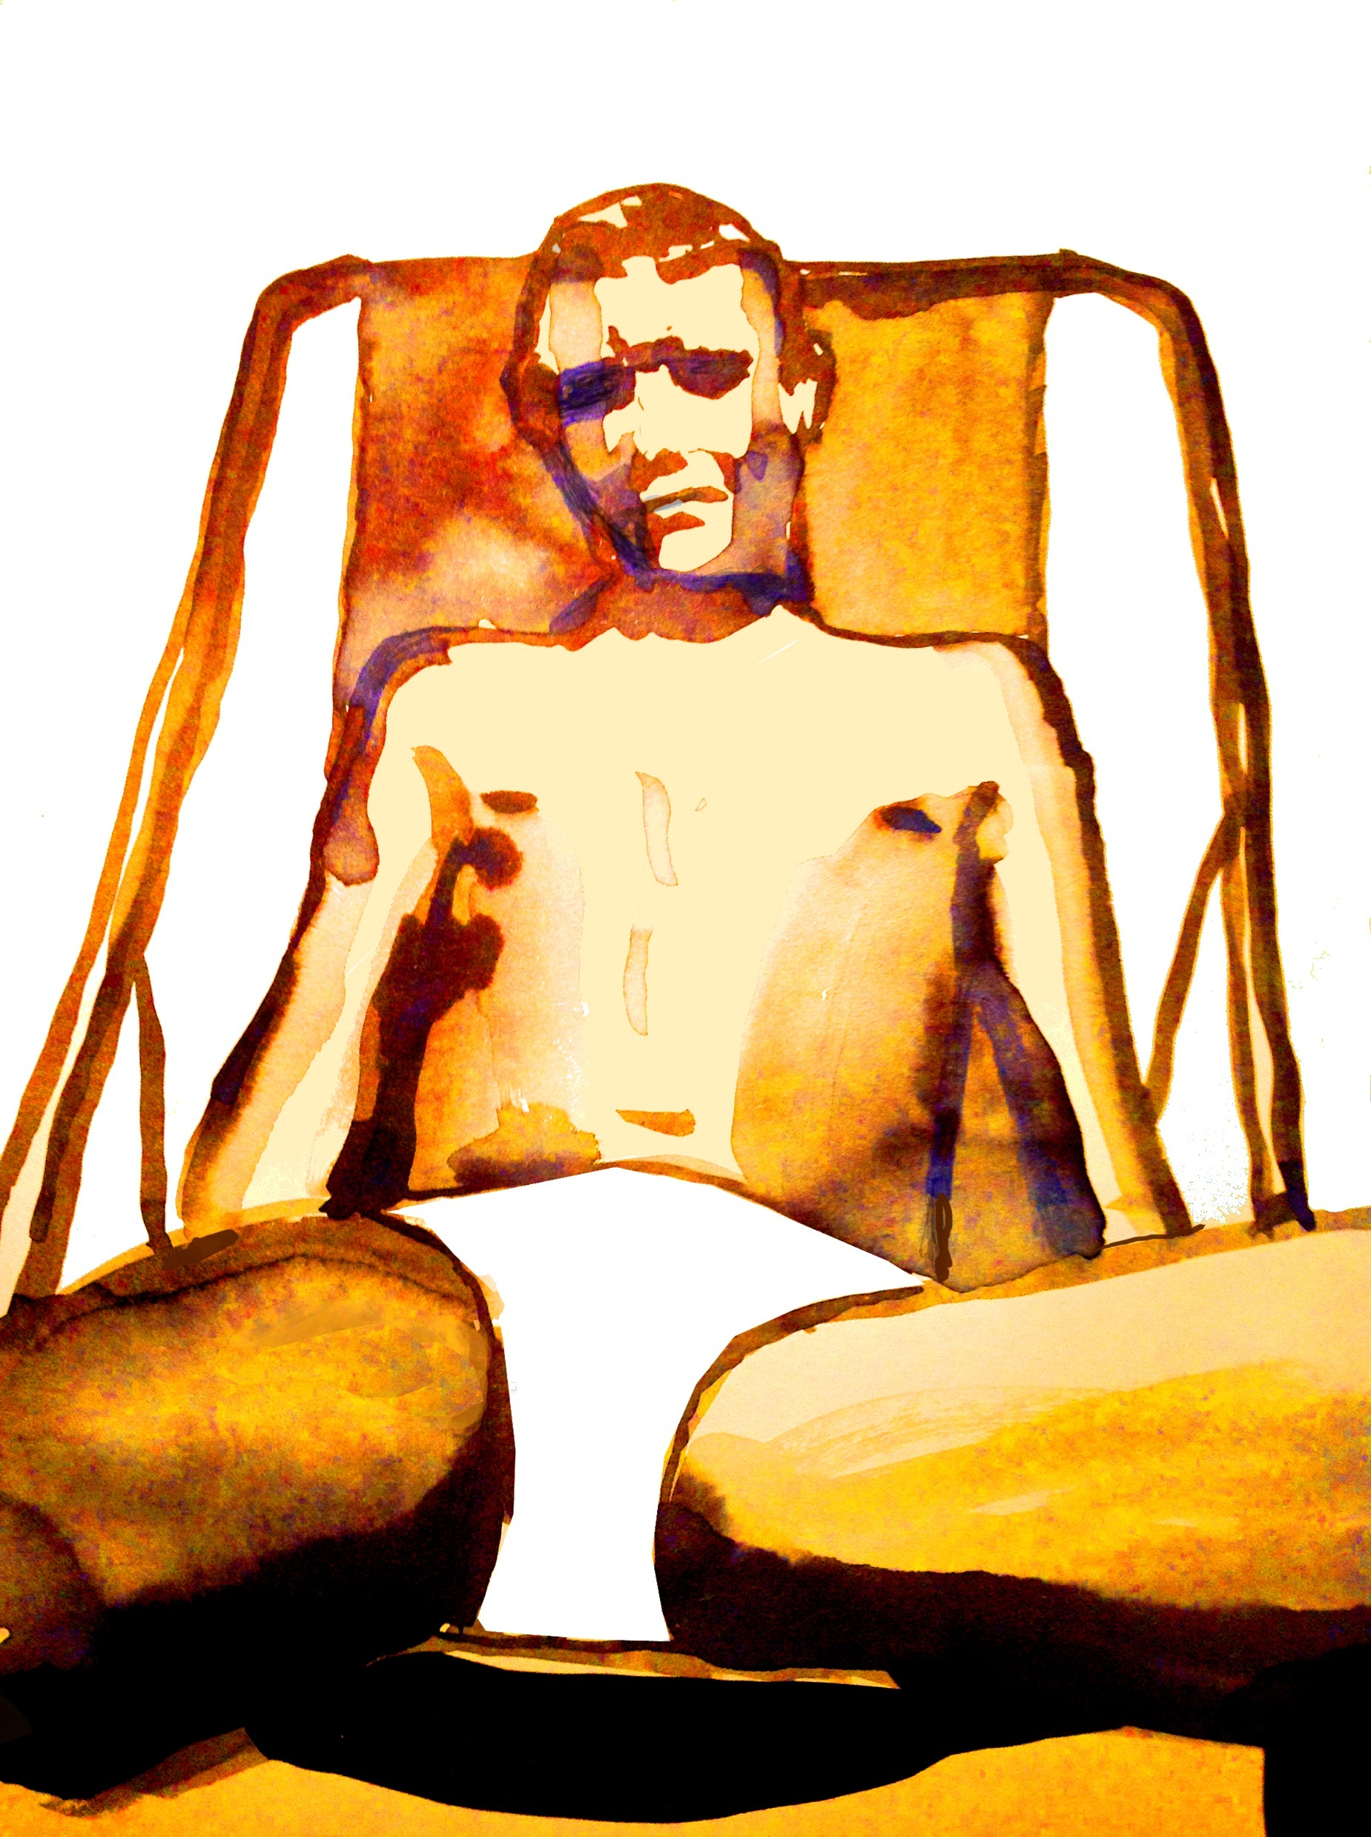
LGBT 50

Slide 2
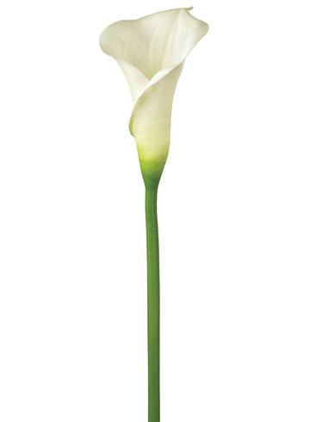
22 July – 29 July 2017
Pride in Hull present 1st UK Pride
Duckie
Gary Clark Dance Project
LGBTQ at Humber Street
BBC

Slide 3
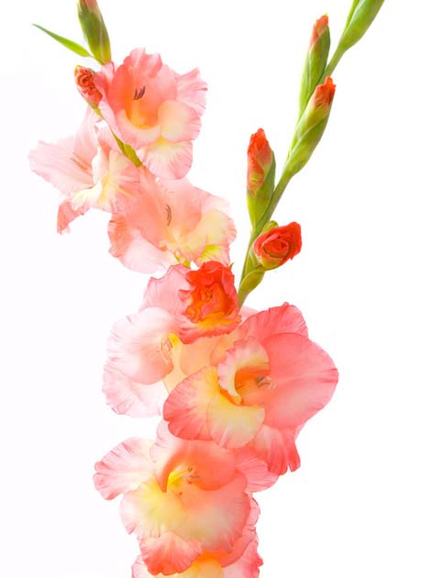
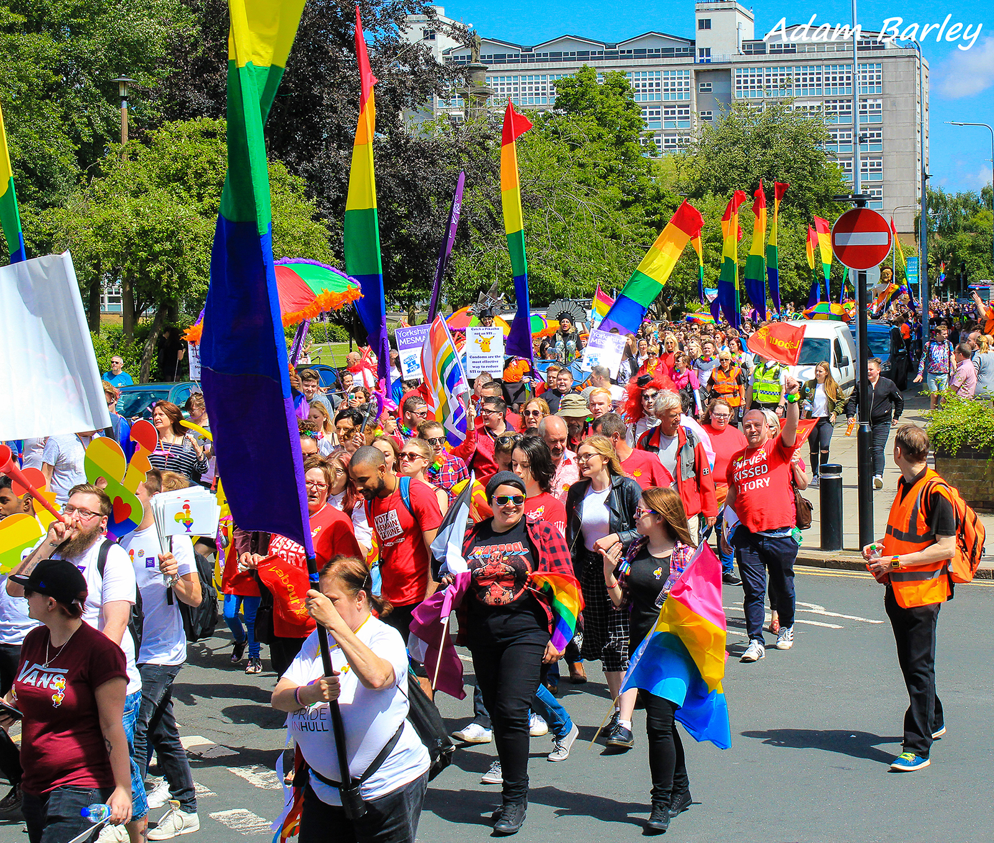
Pride in Hull present UK Pride
22 July 2017
Hull will present the first UK Pride in 2017
New parade route
Partnership with Duckie
Queen’s Gardens

Slide 4
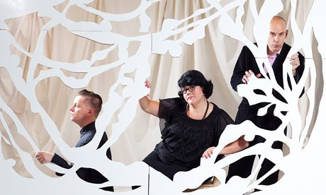
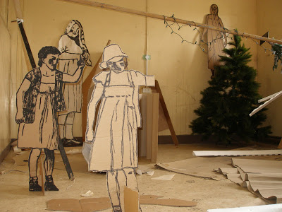
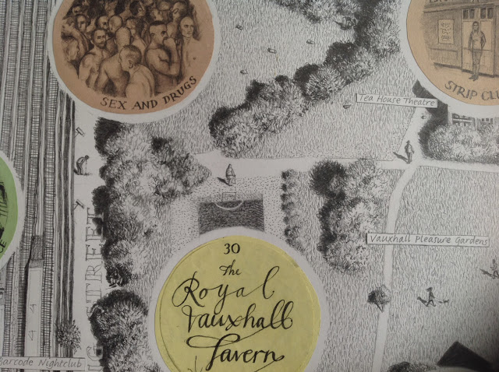
DUCKIE
Pride in Hull Parade
Robin Whitmore Studio in Hull
50 Queers for 50 Years Parade

Slide 5
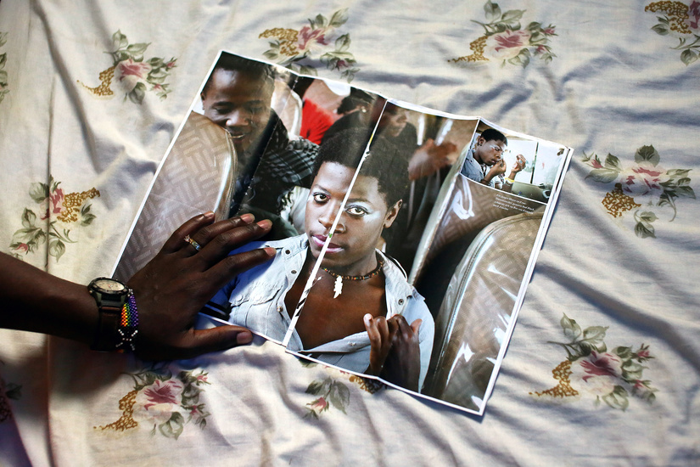
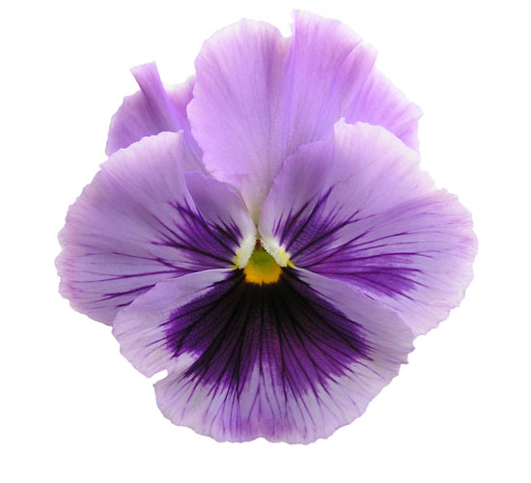
Freetown
27th July – 23rd September 2017
Humber Street Gallery
A new exhibition by Lee Price
Freetown, Sierra Leone

Slide 6
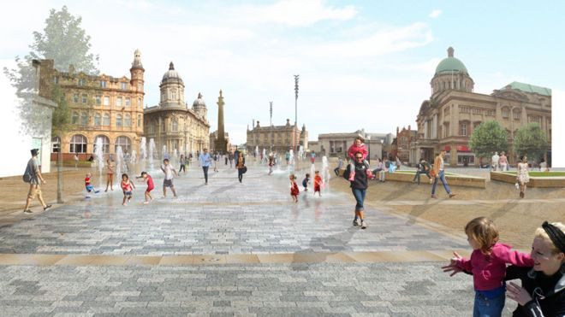
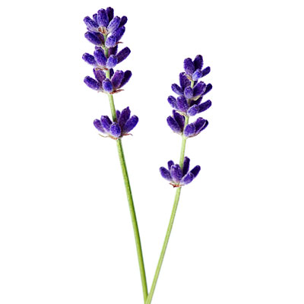
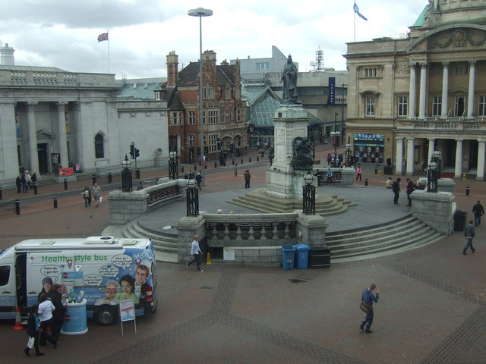
DUCKIE
Fur Coat No Knickers: A Duckie Summer Tea Party
Victoria Square 5pm – 8pm 29th July 2017
A Summer Tea Party inviting everyone to dance
Festoons and Bunting
Parisian Café style tables and seating
Live music from Balcony of City Hall
Family friendly LGBT cabaret

Slide 7
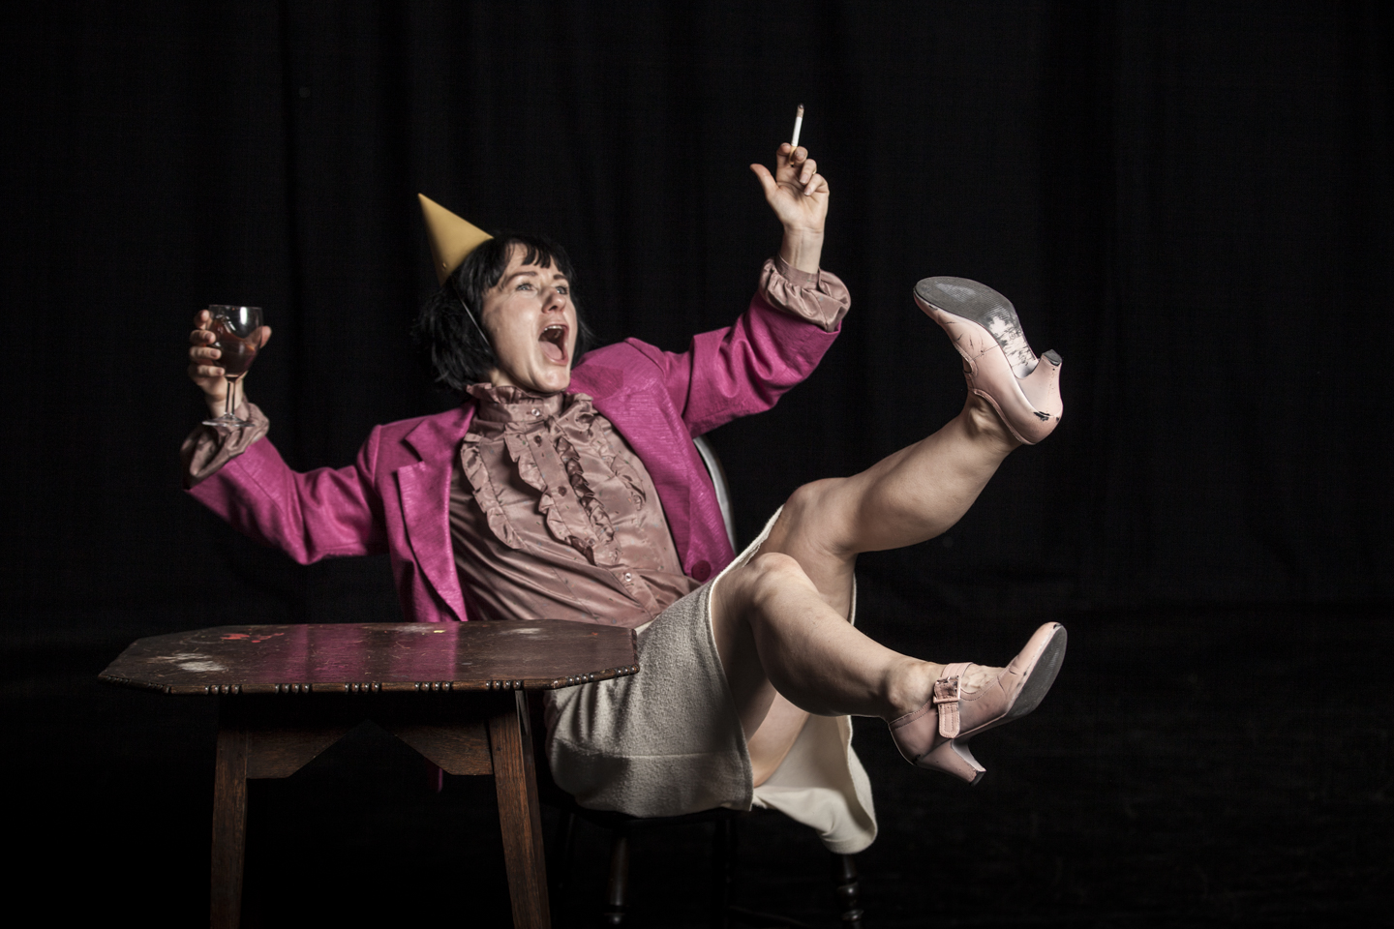
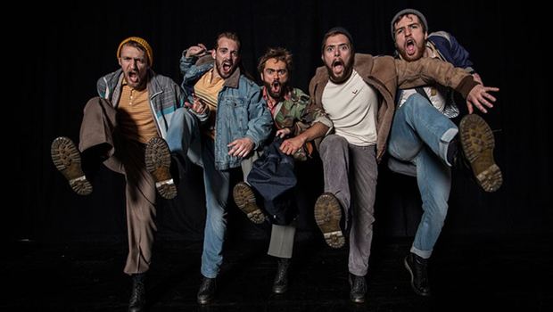
Gary Clark Dance Project
Victoria Square 29th July 2017
Yorkshire Dance and Duckie present:
A new work by Gary Clark
Involving participants from Hull LGBT community and friends
Intergenerational theme

Slide 8
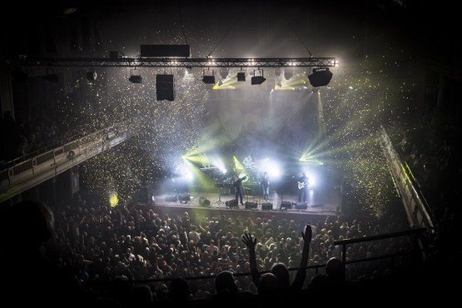
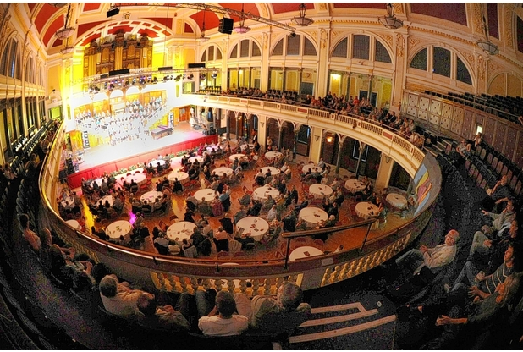
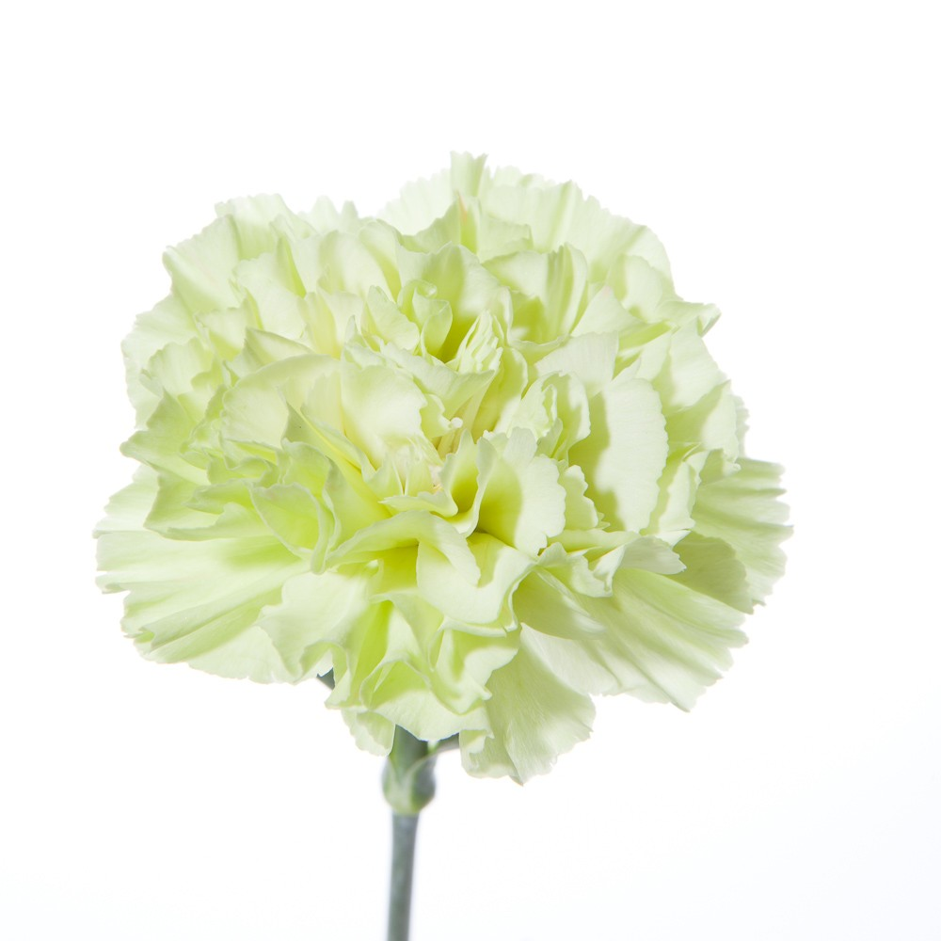
LGBT 50 Live on BBC 2
City Hall 29th July 2017
A Frootenanny!
Fur Coat No Knickers
Duckie Warm-Up
Duckie After-Party

