Slide 1


Slide 2
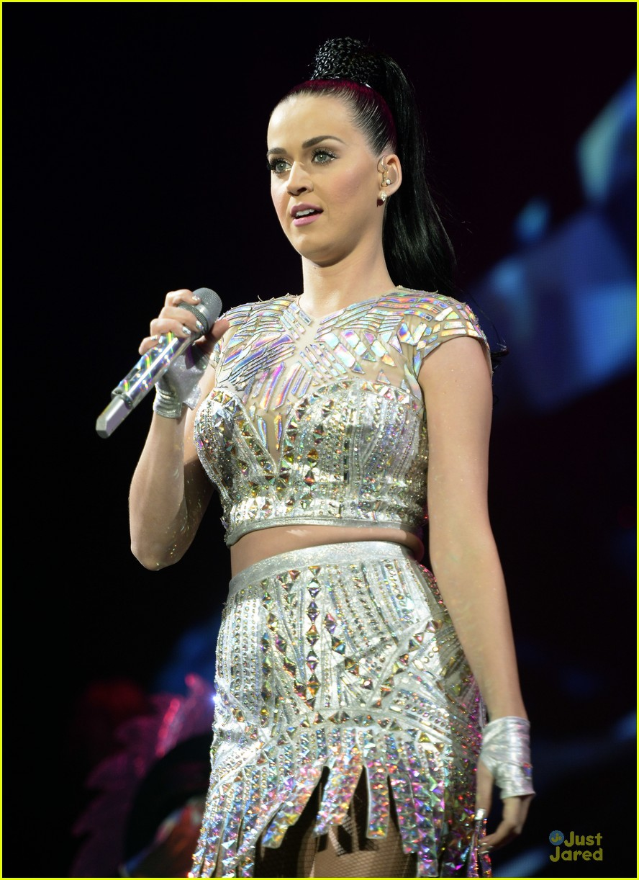
Radio 1’s Big Weekend is the stations’ flagship event each year Hull is the 16th Big Weekend, previous host cities include Glasgow, Derry Londonderry, Bangor, Norwich & Exeter Artists performing this year include Katy Parry, Little Mix, Kings of Leon and Stormzy Radio 1 reaches 42% of all 15-24 year olds in the UK Radio 1’s Big Weekend Hull will be a major part of Hull UK City of Culture 2017 The event is covered on BBC Radio 1, BBC Radio 1 Extra, BBC iPlayer and BBC Red Button.

Slide 3
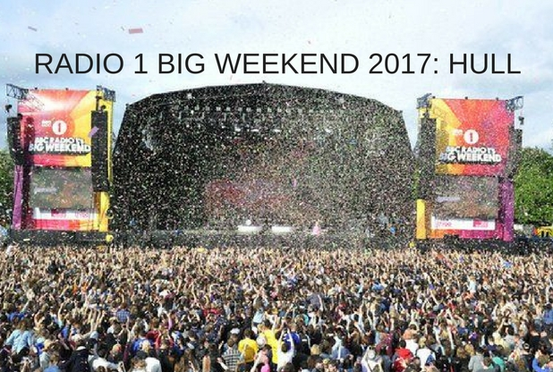
ECONOMIC BENEFITS Radio 1 Big Weekend brought over £3.5m to the local economy in Exeter and Teignbridge An average spend of £58 per person (off site) Exeter recorded 100% hotel occupancy across Big Weekend Glasgow estimated a Press and Marketing value of £10.2m

Slide 4
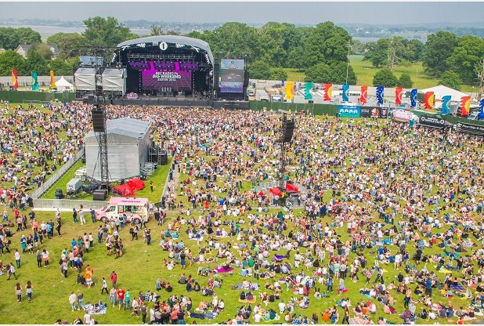
Exeter & Teignbridge “That was outstanding – the experience of a lifetime for me and much of Devon. Thanks from the bottom of my heart” – Earl of Devon “It’s been a memorable weekend for the people of Teignbridge and one which has truly put our wonderful region on the the national and world stage. In years to come, this will still be the talk of Teignbridge and it’s a proud chapter in our local history. Such a huge event would not have been possible without the support of our residents” – Cllr Jeremy Christophers, Leader, Teignbrdige Council.

Slide 5
WHO IS DELIVERING RADIO 1’S BIG WEEKEND
Delivering an event like Radio 1’s Big Weekend requires co-operation between many organisations and agencies, these include:
Radio 1 Hull UK City of Culture 2017 East Riding of Yorkshire Council Hull City Council Humberside Police Yorkshire Ambulance Service | Burton Constable Foundation Burton Constable Estate Natural England Historic England Humberside Fire & Rescue

Slide 6
The
Site

Slide 7
The
Arena

Slide 8
THE SITE
Burton Constable is an historic site, why has the event been allowed to go ahead here?
Burton Constable is an historic location and was originally landscaped by Capability Brown. All the plans for the event have been drawn up with this in mind. It is a unique opportunity to introduce this beautiful house and grounds to a new audience both live and on television.
All the plans for the event have been approved by the Burton Constable Foundation, Natural England and Historic England.

Slide 9
TRAFFIC MANAGEMENT
How will the local area cope with all the visitors and traffic?
Ticket holders are being brought to and from the site in a fleet of shuttle buses, which dramatically reduces the environmental impact.
An extensive traffic management plan has been developed to deal with the additional traffic, this will be operated by a company who have extensive experience of this type of event.
How will you stop people dropping off ticket holders in Sproatley for the local shuttle bus?
The local shuttle bus is not being advertised publicly and is by invitation only. Special wristbands will be issued to local residents on proof of address and event tickets.

Slide 10
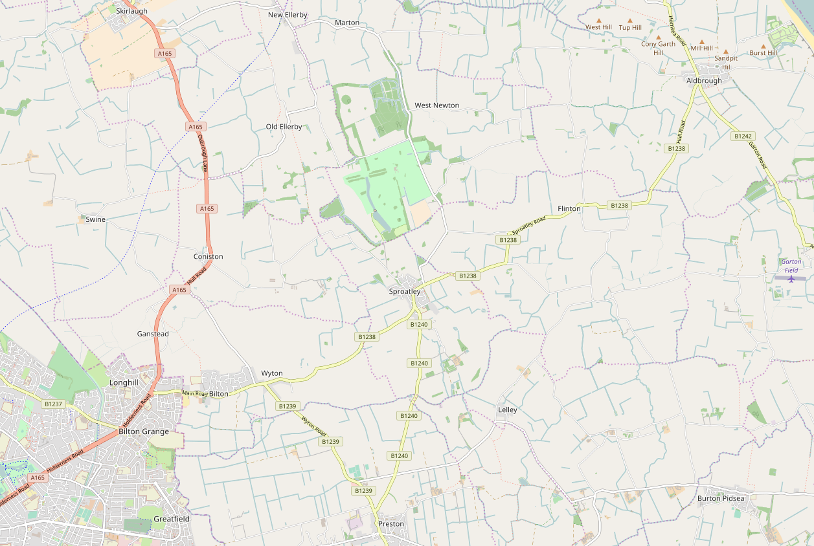

Figure 6: Burton Constable Local Area Traffic Management Plan : General Arrangement
Vehicle check area
SITE ENTRY
(A165 Skirlaugh)
Source Imagery: Copyright Google Earth Pro (License Key-JCPMR5M58LXF2GE)
N
DRAFT
Temporary Bus Station and Taxi/PHV area
Coniston
Event
Blue Badge/Special Guest Parking
SITE EXIT
(B1238 east of Sproatley)
Authorised vehicles route (Bus, Taxi, PHV, Operations, Production, Artistes, Local Residents)
Unauthorised vehicles exit route
Production Route (Event)
Blue Badge/Special Guest route
Local resident route
One-Way Traffic
Two Way Traffic
Control point

Slide 11
Figure 7: Burton Constable Local Area Traffic Management Plan : Exit Phase
Authorised Vehicle Route operates South to North during Exit Phase on both days of event (14:30 to 00:00)
SITE EXIT
(A165 Skirlaugh)
Source Imagery: Copyright Google Earth Pro (License Key-JCPMR5M58LXF2GE)
N
DRAFT
Temporary Bus Station and Taxi/PHV area
Coniston
Event
Blue Badge/Special Guest Parking
SITE ENTRY
(B1238 east of Sproatley)
Authorised vehicles route (Bus, Taxi, PHV, Operations, Production, Artistes, Local Residents)
Production Route (Event)
Blue Badge/Special Guest route
Local resident route
One-Way Traffic
Two Way Traffic
Control point

Slide 12
Figure 8: LATMP : Extents of proposed temporary Clearway order
Source Imagery: Copyright Google Earth Pro (License Key-JCPMR5M58LXF2GE)
N
DRAFT
Parking limited to 1 hour no return within hour adjacent to Post Office, local shops and Public Houses
KEY
No Stopping At Any Time

Slide 13
Source Imagery: Copyright Google Earth Pro (License Key-JCPMR5M58LXF2GE)
Figure 9: LATMP : Proposed temporary road closures except for authorised vehicles
N
KEY
Proposed temporary road closures

Slide 14
TRAVEL TO SITE
Drop-offs and Pick ups
It is not possible to drop off or pick up concert goers at Burton Constable. Vehicles attempting to drop off or pick up passengers will not be allowed into the road closure and will be redirected to Leconfield Park & Ride
Walking & Cycling
For public safety reasons it will not be possible to walk or cycle to the event.
Taxis/PHVs
A taxi/PHV area will be provided at the site to facilitate drop-offs and pick-ups. The facility will not operate as a hackney carriage rank and will be available for both taxi and PHV usage.

Slide 15
LOCAL TICKET HOLDERS
As a local resident do I need to use the shuttle bus services?
Residents who live directly on the road closure route will be offered a shuttle service. Other local residents will need to use other services.
As a local resident will a walking path be available?
Owing to volume of traffic on narrow rural roads, it will not be safe to walk to the site
As a local resident will I be able to leave and return to site?
No, there is no readmission for any ticket holders

Slide 16
RESIDENT INFORMATION
NOISE MANAGEMENT
What measures will be in place to minimise noise pollution?
Noise levels at the concert will be monitored at all times and will not breach regulated levels. A resident hotline number will be distributed in case of complaints.
How much traffic is anticipated in the lead up to the event?
The onside build starts on May 11th and production vehicles will be arriving at the site throughout the following 2 weeks. The break down will take 1 week.

Slide 17
RESIDENT INFORMATION
NOISE MANAGEMENT
How late will busses run after the event?
The last buses are scheduled to leave the site at 23:59
What time does the event end – can you guarantee this will finish as scheduled and there will be no late night noise issues?
The last performances finish at 22:00. This is a condition of the event licence, so performances cannot continue after then.

Slide 18
RESIDENT INFORMATION
SECURITY AND WASTE MANAGEMENT
How is security at the event site being managed?
Event security is being provided by a specialist company who have decades of experience of managing crowds at large music events.
Will audience attending the event be able to access local properties?
The event site is surrounded by a 3 metre high ‘steel shield’ fence. It will not be possible for concert goers to leave the site other than via the main entrance/exit and shuttle buses.

Slide 19
RESIDENT INFORMATION
SECURITY AND WASTE MANAGEMENT
What measures are in place to minimise waste coming out of the site area and into the local area?
A specialist waste management company have been engaged keep the site clean. They are onsite from the start of the build to the end of the break down. Although sites are always left clean, extra care will be taken at Burton Constable because of the historic nature of the land.

Slide 20
RESIDENT INFORMATION
AUDIENCE PROFILE & WELFARE
What is the anticipated age range of the event?
Radio 1’s target demographic is 15-24 year olds, however Big Weekend is a family friendly event that attracts a wide age range of attendees.
Are unaccompanied minors allowed on site?
No. Anyone under 16 must be accompanied by an adult. ID checks are carried out at the ticket gates.
What is the provision for the sale of alcohol on site?
There are several bars onsite. All operate a Challenge 25 policy. The family nature of this event means that large volumes of alcohol are not consumed.

Slide 21
RESIDENT INFORMATION
AUDIENCE PROFILE & WELFARE
Will the event put a strain on local medical resources?
No, the event has it own private medical team with doctors, paramedics, nurses and first aiders onsite. There are onsite treatment facilities and three ambulances should anyone require transport to hospital.
What welfare provisions are there onsite?
A welfare team are onsite to reunite lost children with their families and to deal with any issues such as dehydration or over exposure to the sun.

Slide 22
RESIDENT INFORMATION
AUDIENCE PROFILE & WELFARE
How do you intend to prevent audience attending becoming a nuisance to local residents?
The audience will arrive on shuttle buses and from that moment they are in an enclosed event site until they leave.
What measures will be in place for nuisance audience members and the welfare of local residents?
Along with the security personnel, Humberside Police will have a presence at the event. If necessary troublesome audience members will be ejected and removed from site. This is a rare occurrence at Radio 1’s Big Weekend

Slide 23


