Slide 1


MADE IN HULL
Niccy Hallifax, Opening Lead Producer
Chris Clay – Director of Technical and Operations, City of culture, 2017
Lindsey Hammond – Assistant Producer
Kate Doyle – Event manager, Ground Control
Charlotte Denton- Operations coordinator, Ground Control.
Shaun Crummy – Head of Volunteering
Harriet Johnson – Volunteer Manager

Slide 2
The first and opening event of our year as UK City of culture, and the first of the season Made in Hull will be a large scale multi site event inspired by the heritage and culture of the city, and a statement of intent of the way we intend to (re)position the city & to engage in meaningful ways with its communities.

Slide 3
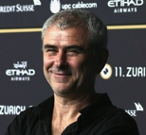
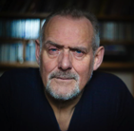
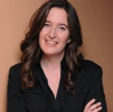
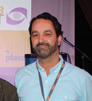
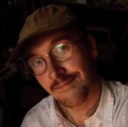
CREATIVE TEAM
Sean McAllister
Creative Director
Rupert Creed
Writer
Ala Lloyd
3D & Environmental Designer
Durham Marenghi
Lighting Designer
Dan Jones
Composer & Sound Designer
Sean McAllister a documentary director and the creative team have been brought onto the project which is a 7 day event to help create a spectacular start to 2017. The event captures Hull's history in the last 70 years, culture and residents in a dramatic and thematic way by using some of the heritage buildings and structures as a canvas to hold the conversation about Hull and its psyche.
The core creative team are experts in their fields and as well as being part of the process of commissioning several local and national artists to create a responses to briefs, they are also looking at the project in its whole form and ensuring there is a coherence and cohesion between sites.

Slide 4
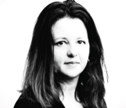
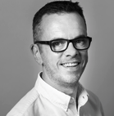
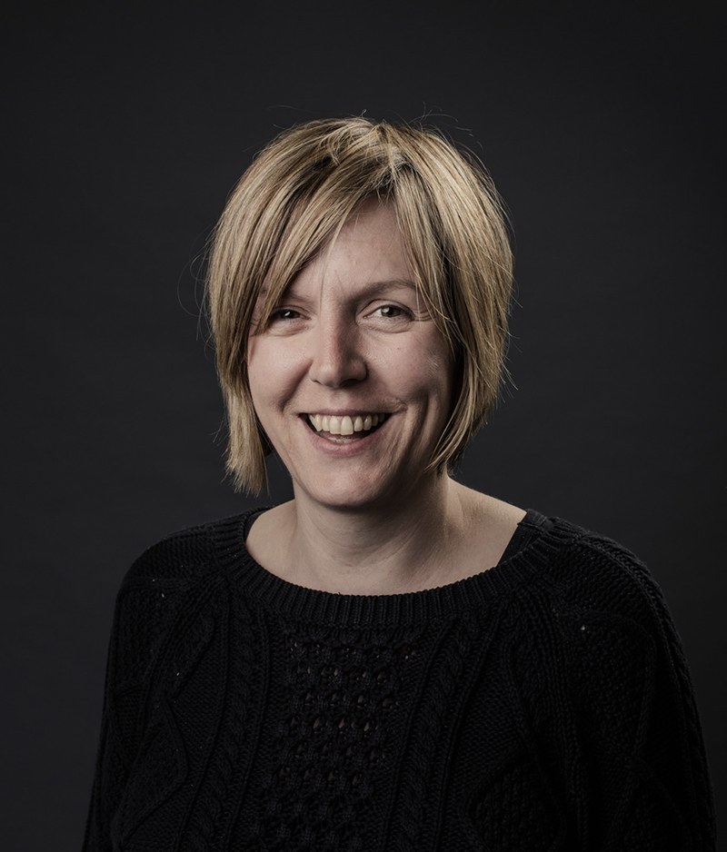
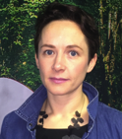
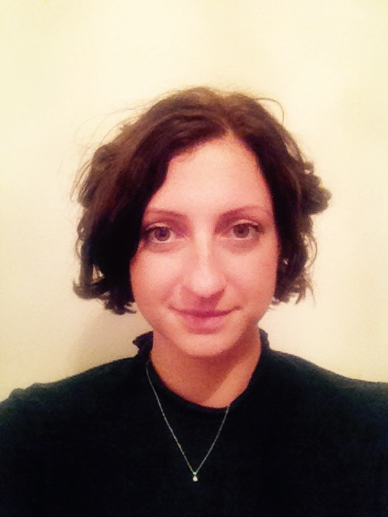
PRODUCTION TEAM
Niccy Hallifax
Creative Producer
Chris Clay
Technical Director
Lindsey Hammond
Assistant producer
Kate Doyle
Ground Control
Charlotte Denton
Ground Control
Working with Niccy Hallifax (Freelance Creative Producer) and Chris Clay (technical and operations director) the production and technical teams will be working with Ground Control an independent events company. GC have been brought in to manage the technical and operations aspects of the overall project for the Opening and will be key contacts for you. Kate is the Event Manager and Charlotte is the Coordinator for GC.

Slide 5

to kick off a year long programme that really does showcase the City as the national cultural centre for 2017 with the Volunteers being present and integrated into the wider team.
to unlock Hulls volunteer potential and to give real experience to people involved.
to ensure all the visitors who come to the vent have fun.
to ensure you have fun.
to ensure the public are well informed

Slide 6
Who to speak to
If you are in the following locations this is who to talk to if you have a problem or need help:
Customer service point: Shaun Crummy
Welfare centre: Ground control Accreditation person. (TBC)
Visitor Hosts and ushers: Per venue you will be allocated a person or find a team member or a crew member with a radio (this will be told to you who has one each day)
Runners: Charlotte Denton
If it is an HR or welfare query:
Speak to either Harriett Johnson or Shaun Crummy.
If you need to escalate problems: ask for Kate Doyle or Niccy Hallifax.

Slide 7
Volunteers
The different Roles and every role matters.
Ushers (FOH)and BOH roles:
Visitor Hosting at each site.
Runners: Technical and Event management.
Leaders – Ushers. (FOH)
  A personal journey for all.
  Values & attitudes- you are the face of the city and the project
  Smile you are on camera….. the face of Made in Hull
  Integrated into our team as we operate a one team approach.

Slide 8
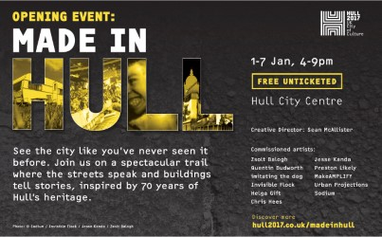

Slide 9
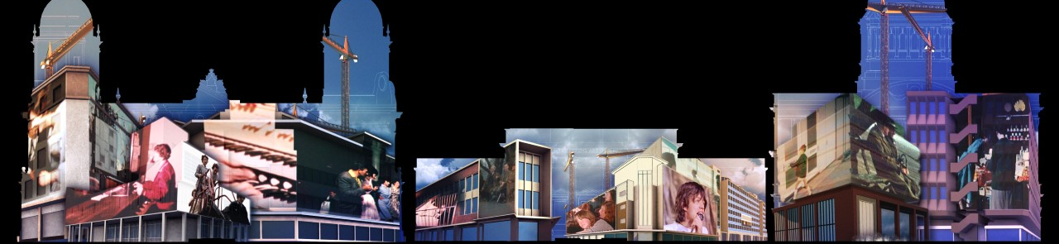
Location One: Queen Victoria Square.
We Are Hull
Created by Zsolt Balogh with original soundtrack by Dan Jones
We Are Hull is a spectacular panoramic 15-minute film sequence projected onto the Maritime Museum, the Ferens Art Gallery and City Hall. The show takes you on a moving and exhilarating journey through the last 100 years of Hull’s history, transporting you into the sky, underwater, and through time. It tells a story of constant change, destruction and recovery, re-invention and resilience, culminating in Hull’s win as the UK City of Culture 2017. We Are Hull mixes archive footage with cutting-edge CGI animation and special visual effects, to a soundtrack that includes some of Hull’s famous musicians and bands, as well as a montage of photographs submitted by local people.

Slide 10
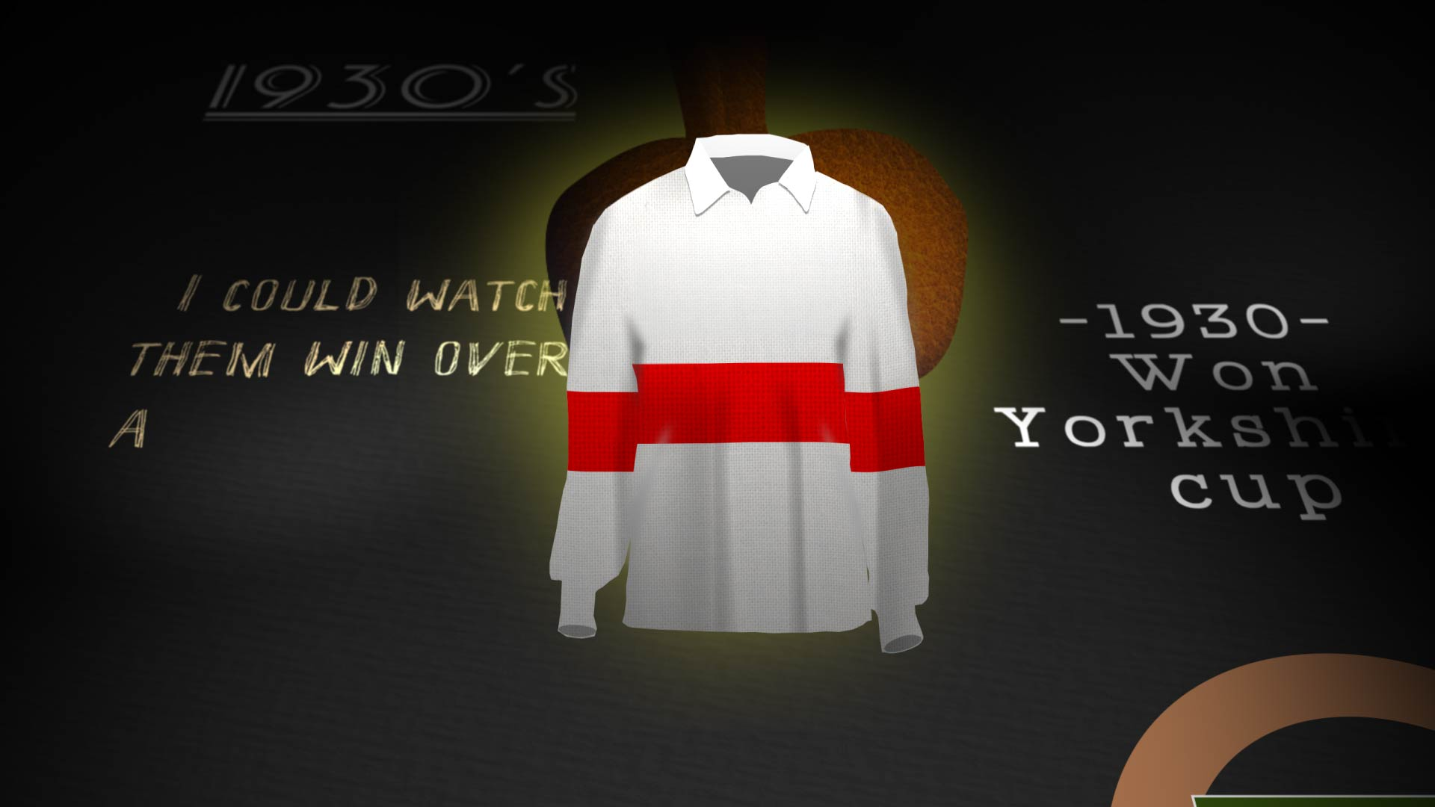
Location Two: Whitefriargate Street.
The Heart of Rugby
Produced by Chris Hees and animated by Alex Twiston-Davies
The Heart of Rugby invites you to feel the burning passion for the game that courses through the city. One side is red and white, the other black and white, Hull KR and Hull FC. As the city grows and changes, decades pass, they face years of success, years of hurt, and years of intense rivalry. The one thing ever present is the beating hearts of the die-hard supporters.
This was missing a word. Is thing the right word?

Slide 11
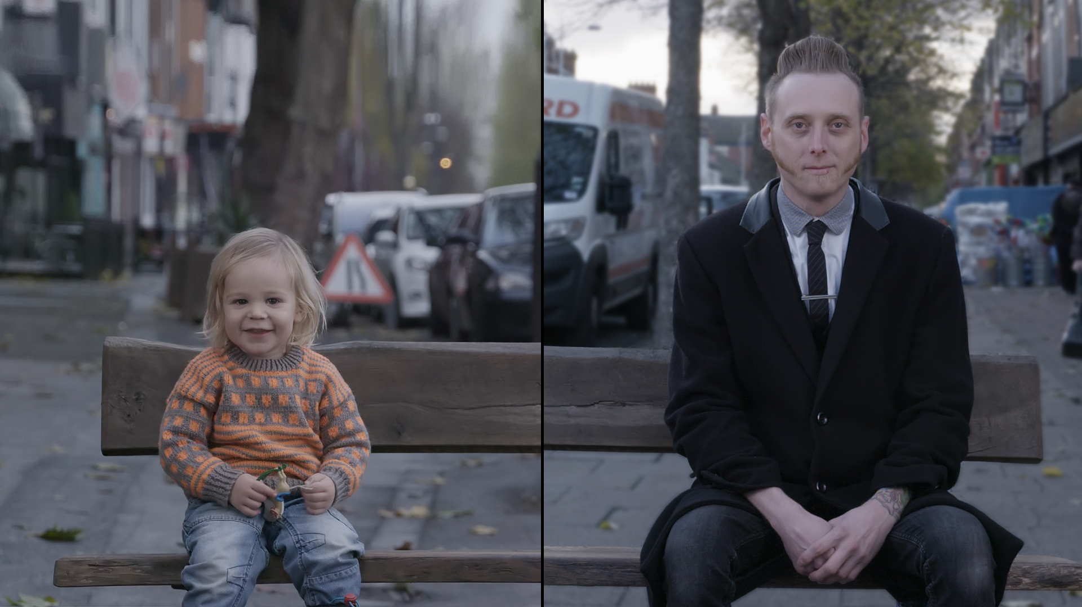
Reflections
Created by Invisible Flock
Three windows + three perspectives
Two roads + two individuals sharing a bench
One minute + one life in the here and now
Reflections follows and captures the daily lives of those who live on two streets in two parts of town. A celebration of who we are and where we live, of our intrinsic relationship to those around us, strangers and friends, passersby and family, near and far.
Reflections is a momentary encounter and a momentary reveal of personal memory and daily routine, a portrait of two people sharing a bench across geographies and an invitation to meet the gaze of another.

Slide 12

We’re all going on a Summer Holiday
Created by Sodium
The caravan. A home from home and a castle on a clifftop. The caravan has been a staple of the UK’s holiday experience from the early 60s and a key industry in Hull, this is where caravans are made. We hear first-hand reports about the early days of production on the factory floor, as well as some taller tales about what happened after clocking off. We also see and hear misadventures from a young couple of Hull holiday makers.
Split over two vacated shops you are invited to take a look at the real people that built the industry over 50 years ago and witness a new breed of people that are hitched to an adventurous way of spending their holiday. The Factory: We see and hear what it was like to be working in a growing company and thriving industry in the 60s and 70s, enjoying a real job and a real life. Stories and anecdotes of after work with teammates and a social life in Hull. Positive, upbeat accounts and fond memories with a familiar cheeky and honest Hull tone.
The Holiday: Stories and capers from a young couple from Hull living and holidaying for the first time on the east coast. They don’t have to leave the UK to find the best way to spend their summer but they do have to try and fit their knees under the table

Slide 13
Amuse Agents – Hull's Premier Inconvenience Store.
Created by Preston Likely
Stop and check out the small ads. They might just offer the one thing that could change your life for the better. For ever. Look close and you might find the object of your desire, the event you really don’t want to miss, or that special service your lifestyle has been lacking. No time wasters.
Pauline’s Gift Shop Emporium
Created by Helga Gift
Hull artist Helga Gift works autobiographically exploring emotions through materials and found objects. Her mother Pauline used to run Pauline’s Gift Shop on Princes Avenue. This installation reflects on her mother’s later years spent in this 8ft square space after a very active lifestyle. Reminiscing about her days filled with hunting and gathering. It’s about growing old, her body slowing down, letting her down, while her mind remained sharp and active. It’s about her interaction with those she met, the people who bought from her shops, with a tale or nugget of advice thrown in for free.

Slide 14
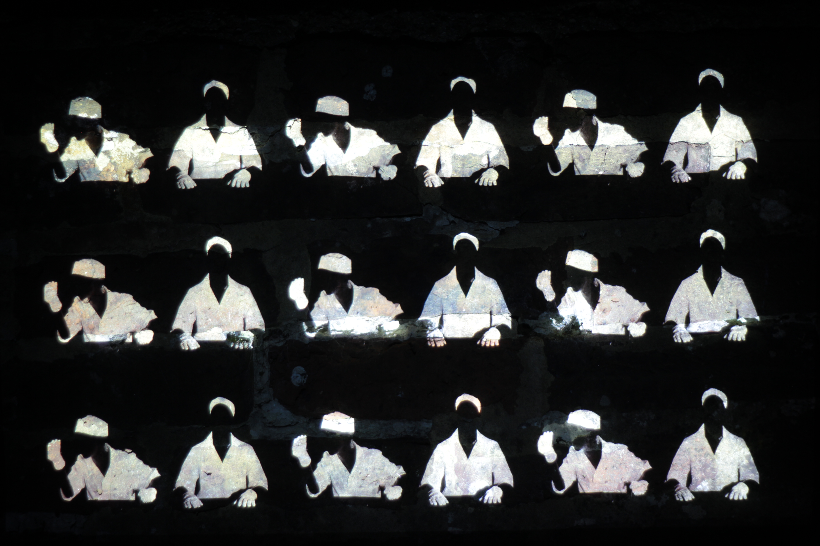
Location three: Scale Lane Staith.
(in) Dignity of Labour
Created by artistic directors Jennifer Irons and Zach Walker makeAMPLIFY, with original score by Dan Gale and featuring Jody McKenna
(in) Dignity of Labour examines the worlds of employment, unemployment and the benefits system through the real-life experiences of Hull’s young people. Based on interviews and combining movement, archive footage, and video mapping, their stories of struggle, dehumanisation and hope have been set against the boom and bust of Hull’s industrial past. This multi-sensory installation connects the past and present, the city to its people and each other. It animates the lost and forgotten spaces of the city, offers an intimate portrait of the ambitions of its young people, and ultimately gives a voice to those who are voiceless.

Slide 15
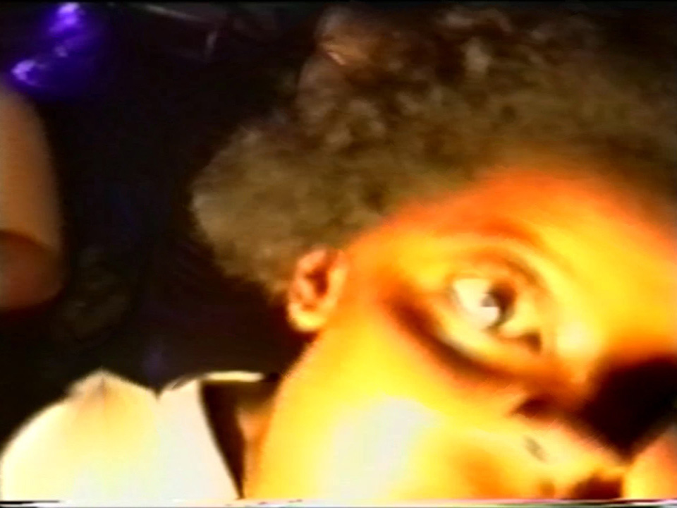
Location four: The Underpass.
Embers
Created by Jesse Kanda
A multi-screen and sound installation that recreates an echo of the club scene in 90s Yorkshire. With visuals drawn from archive footage of raves, it portrays the human impulse for freedom of movement, self-expression, and the collective release of shared emotions. ‘Beyond the restraints of social norms and conventions we can be who we want to be – be our truer selves, be more human together, experience and find ourselves.’
While the 90s evokes nostalgia for an era when Yorkshire clubs were inclusive places of playful identity, it is their historic setting that has inspired this installation. In the sound for this piece, the artist and composer are influenced by the hits of club and rave culture, all mid to high frequencies are cut out, so we feel the pulse of the music like a distant memory. A tribute to the innocence and importance of self-expression in the protective womb of the club space.

Slide 16
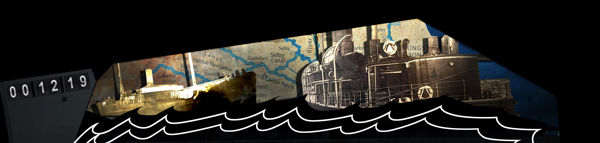
Location five: The Deep.
Arrivals and Departures
Created by imitating the dog and designed and storyboarded by Simon Wainwright with the Soundtrack created by Terry Dunn
“This place is built on working hands washed here by the sea…”
Arrivals and Departures explores the journeys of people into and through Hull, who moulded the city’s population and shaped its distinctive physical and cultural landscape. From the 18th and 19th century workforce of Irish navvies who built the city’s docks, the south coast seamen who developed our fishing industry, and the millions of trans-migrants from Scandinavia and Europe who sailed to Hull and on to the New World. From the post-WW2 Chinese and Polish communities, to the 21st-Century European Union, Kosovan and Kurdish incomers, Hull’s character, creativity and innovations have been built on the mosaic of people from many shores.
While these layers of history are depicted through archive photography, the broader story of what migration and movement mean in our contemporary society are told through a more playful language of animation. With the Deep as a canvas, the building is transported into the future as the architecture ripples and shifts to depict a ship, a train, a barge and a plane. At the same time layers of maps and plans change into migratory animals reminding us that our travels in ever more sophisticated forms of transport are only a mirror of the natural world.
Hull as a port city is connected through trade, travel and time to people from many other places and cultures. A city whose story past and present, is built on a history of integration and culture. A city built on working hands.

Slide 17
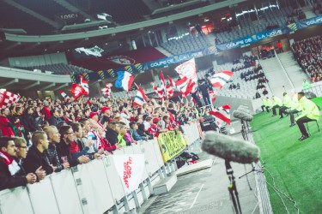
Location six: Zebedee’s Yard.
105+dB
Created by Invisible Flock :
Victoria Pratt, Richard Warburton, Ben Eaton and Catherine Baxendale
In an increasingly uniform world how do we articulate and retain our identity? For many, football provides the perfect arena to congregate and express passion, unity and pride, and a shared sense of tribal togetherness; 105+dB is the volume at which our individual voices are lost in the crowd.
Produced for Hull UK City of Culture 2017 as part of the Creative Communities Programme, this new, large-scale sound installation transplants the awesome wall of noise and energy found in Hull City’s football crowds during matches recorded on 28 November to Zebedee’s Yard, where it can now be explored and appreciated. It is designed as a mass piece of public art, using a total of 36 speakers and creating a truly unique piece of sonic architecture. Immerse yourself in the sound and stillness, hear the roar of the crowd, the tensions as the match is played out, and experience the beautiful game as never before.

Slide 18
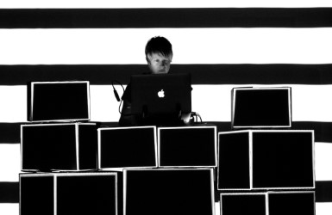
Location seven: Humber Street.
Vantage Point
Created by Rebecca Smith - Urban Projections
Asking the viewer to step inside and ‘become’ the artwork, Vantage Point captures and reflects the fun and vibrancy of Hull and its people, transforming street locations into a living canvas of light and movement.
By day, the city and its unique landscape is used as an urban canvas for the creation of a site-specific piece of art. As dusk falls and daylight retreats, digital projections burst from the Light Cycle, a mobile projection device designed for portable projections, illuminating and bringing the artwork to life.
Members of the public are invited to explore and interact with the piece, capturing their selfies in a digital selfie booth as they are immersed in the installation. The moments of interaction become an integral part of the piece, as their photograph is beamed back onto surrounding architecture and shared with all.

Slide 19
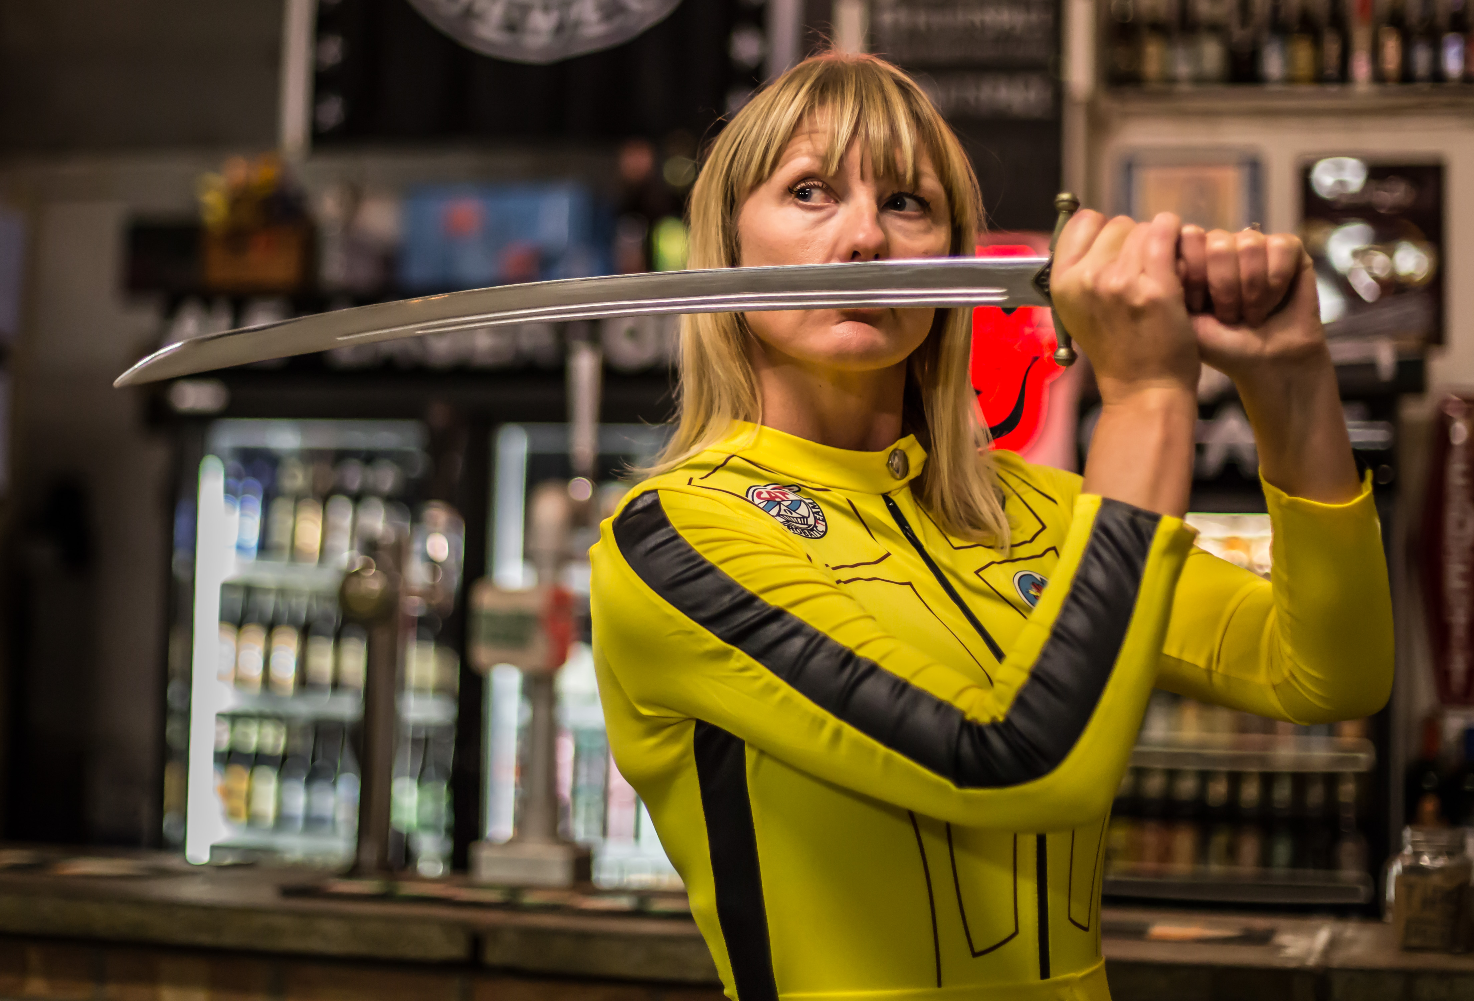
Location eight: Silver street.
Hullywood Icons
Created by Quentin Budworth
For Hullywood Icons, local people have taken up the challenge of re-creating and starring in a scene from a classic movie. From Brief Encounter to Castaway these still photographs capture the spirit of the original and reveal the character, enthusiasm and passions of those taking part. Projected onto buildings Hullywood Icons puts the people of Hull and East Yorkshire on the big screen with some playful twists.
By using Hull as a movie set, a playground for creative work and as an exhibiting space Quentin has created a body of work that has involved the people of Hull as participants and collaborators in a playful way whilst creating a series of photographs that celebrate the city's unique character and spirit.

Slide 20
MADE IN HULL
Break outs:
Crowd management - completed
Visitor Hosting – with Niccy Hallifax & Charlotte Denton
Leaders, Production and Events runners – Chris Clay & Kate Doyle

