Slide 1
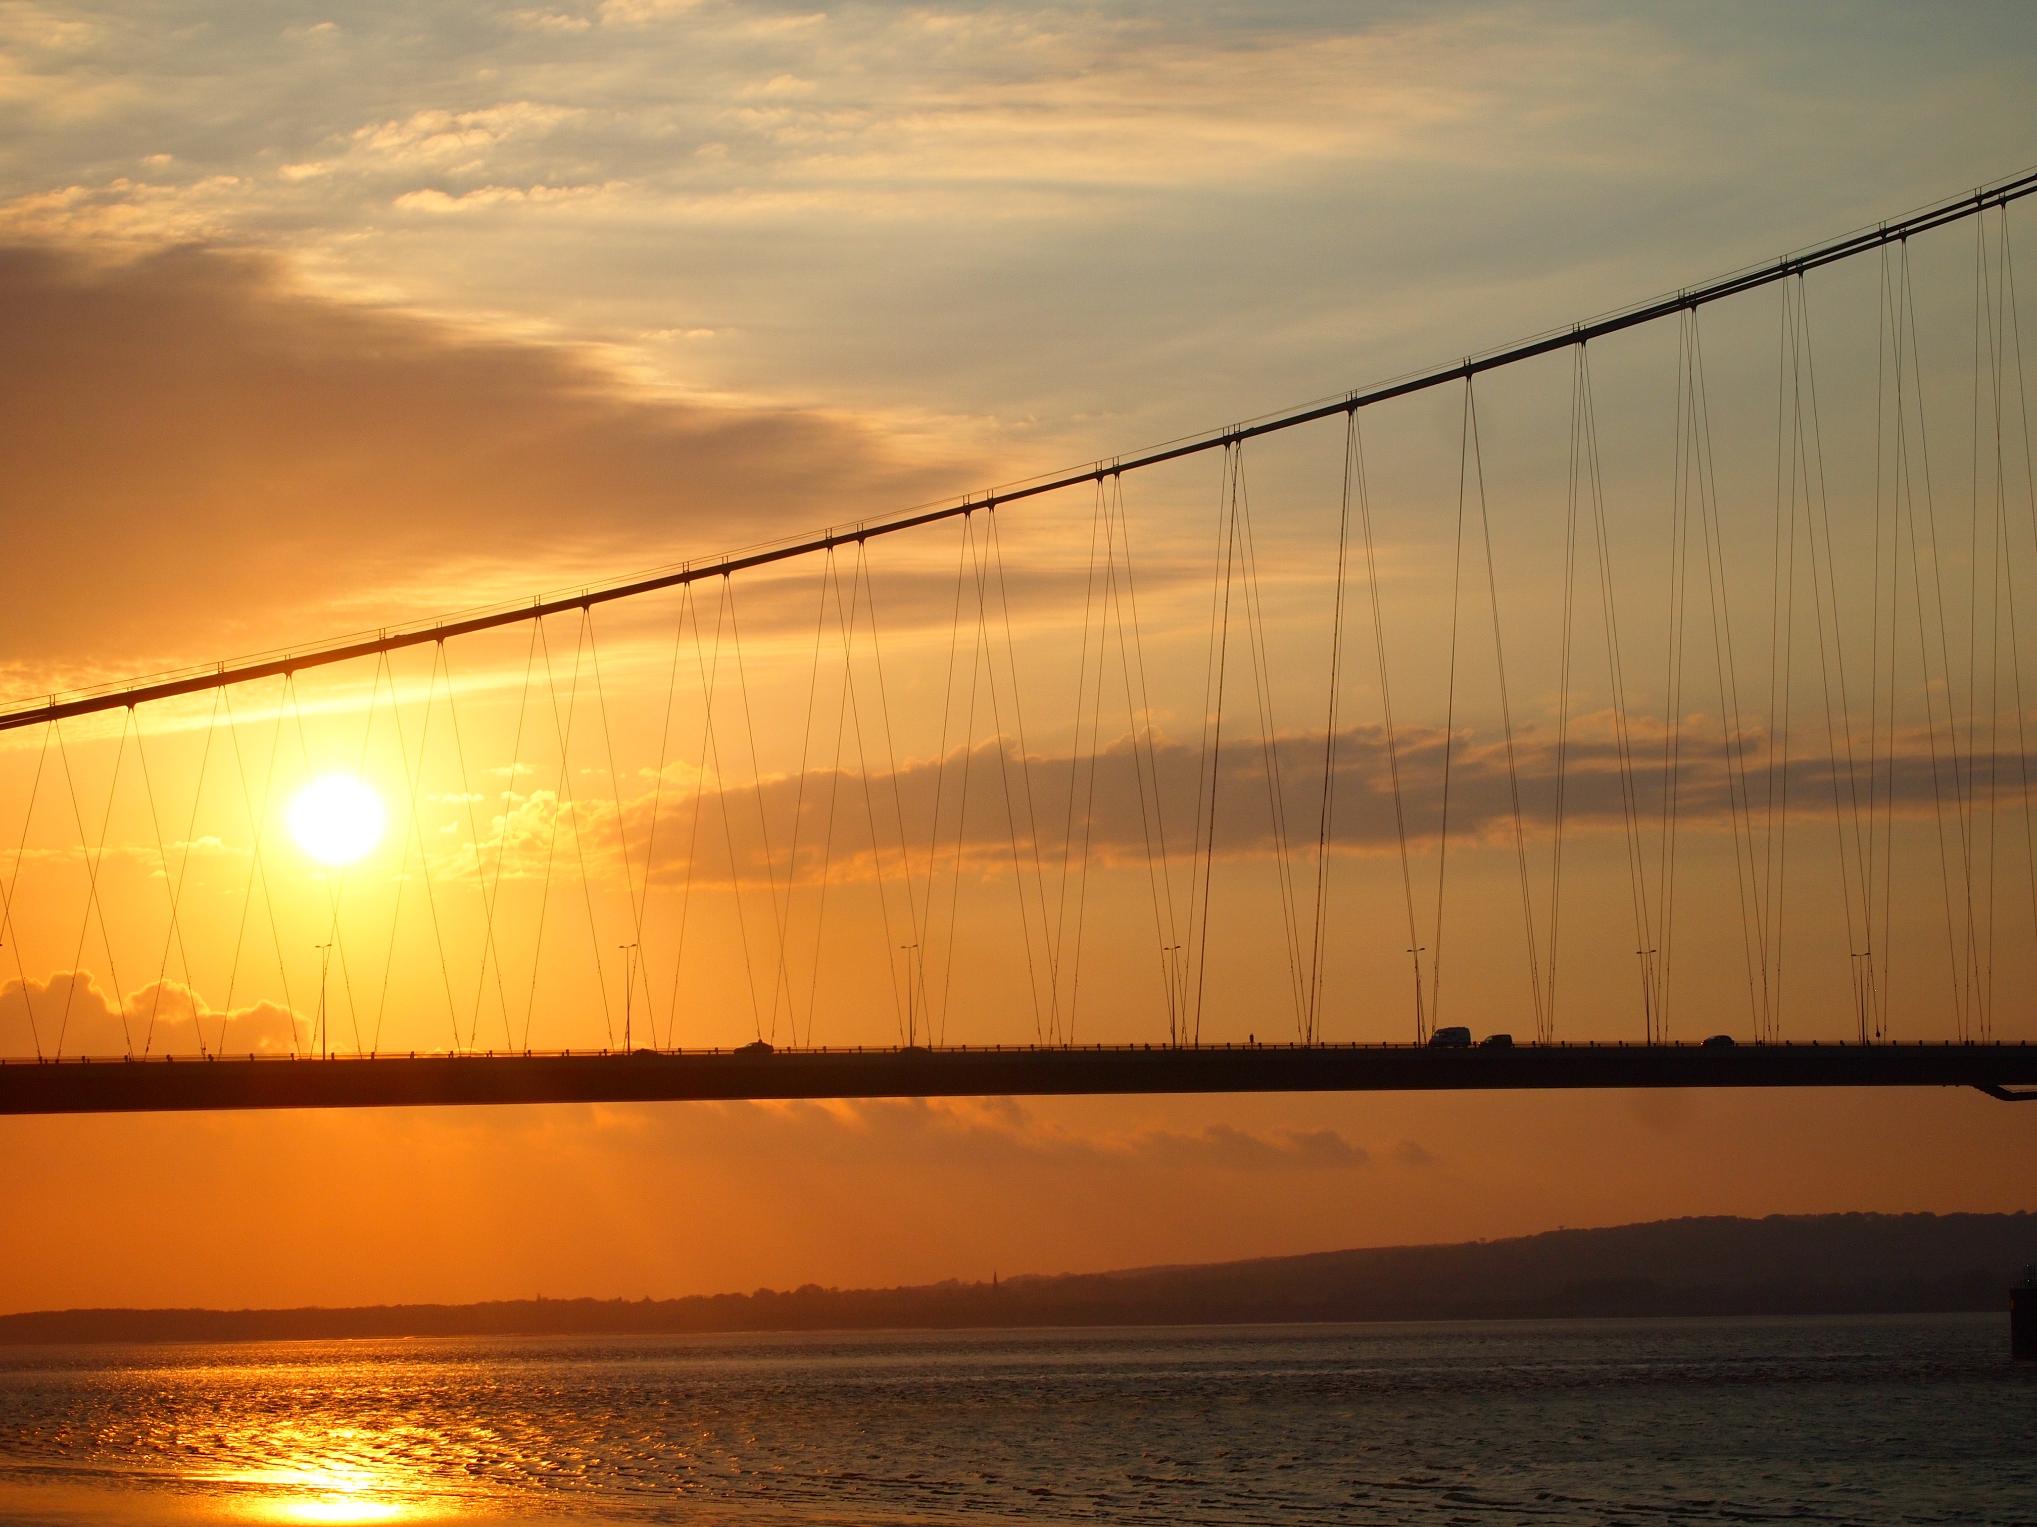
the humber lights
The world’s largest interactive artwork
coming as part of hull2017

Slide 2
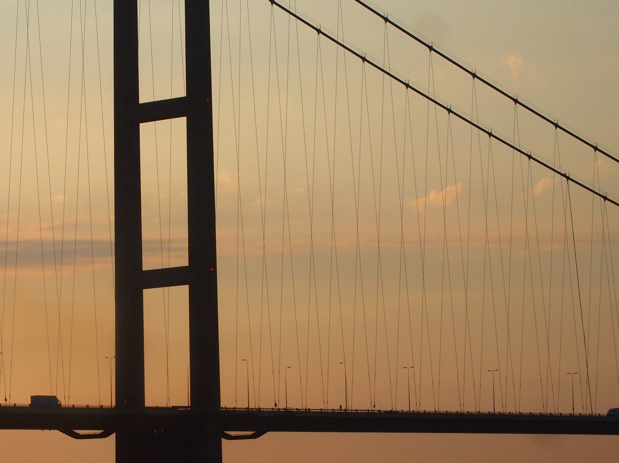

Slide 3
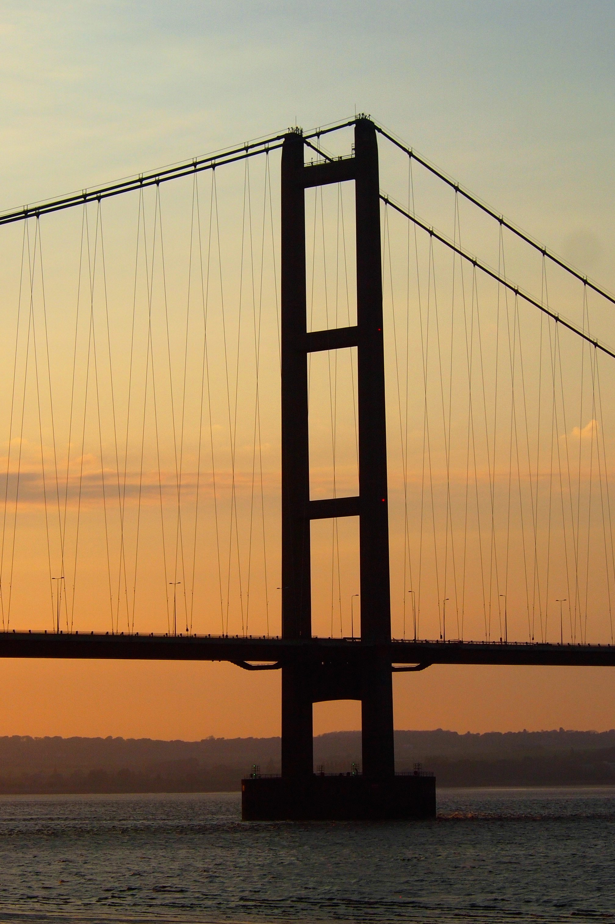
the humber
lights
THE LARGEST INTERACTIVE ARTWORK IN THE WORLD
A NATIONAL VISITOR ATTRACTION
A GLOBAL MEDIA AND ONLINE DESTINATION
SHOWCASING REGIONAL INNOVATION AND AMBITION
WITH POTENTIAL FOR SIGNIFICANT POSITIVE ECONOMIC IMPACT

Slide 4
ambition, scale and ambition
OVER 20KM OF STATE-OF-THE-ART LED LIGHTS
IN EXCESS OF 70,000 LIGHT NODES
CONNECTED TO THE INTERNET
DESIGNED AND CONTROLLED USING LEADING-EDGE TECHNOLOGY
MAKING THE MOST OF ONE OF THE REGION’S GREATEST ASSETS
CHANGING THE WAY IN WHICH PEOPLE SEE THE REGION FOREVER

Slide 5

A VISITOR ATTRACTION, MEDIA DESTINATION AND UNIQUE LEGACY
WILL INCREASE PHYSICAL VISTS WITH POTENTIAL TO DRIVE EVENING ECONOMY
WILL PROVIDE A MEDIA FOCUS AND ONGOING GLOBAL ATTENTION
CREATED AS A LASTING LEGACY OF HULL CITY OF CULTURE 2017
INITIAL PLANNING FOR ONE YEAR WITH INTENDED LONG-TERM EXTENSION

Slide 6
ARTISTIC PROGRAMME
UNIQUE, FLEXIBLE CREATIVE TOOLS TO DESIGN DISPLAYS
  BY WELL-KNOWN AND EMERGING ARTISTS
  GAMES AND DATA VISUALISATION DESIGNERS
VIA DESIGN COMPETITIONS, PUBLIC VOTE AND COMMISSIONS
LOCAL CODING CHALLENGE SUPPORTED BY MAJOR TECH PLAYER

Slide 7
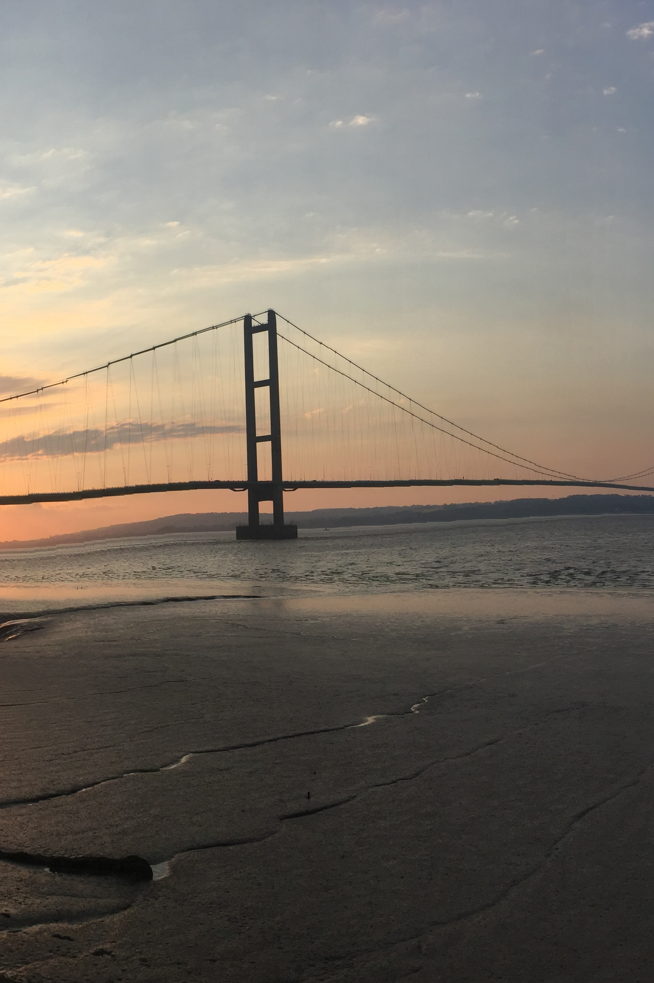
LOGISTICS
BUDGET £4.3M
£XXX SECURED
DECISION TO PROCEED BY DECEMBER 2016
PROJECT GREENLIGHT JANUARY 2017. EQUIPMENT INSTALLATION SUMMER 2017
LAUNCH OCTOBER 2017
HANDED OVER TO THE LOCAL COMMUNITY EASTER 2018

