Slide 1
Turner Prize Masterclass
#TurnerPrize2017
#TurnerPrize
26/06/2017
Notes:
Logo should be in the same colour as the copy – so here it should be the deep purple. It also needs to be bigger.
Apply to all header slides – making sure the logo matches the copy colour.

Slide 2
Turner Prize 2017 Curators
George Vasey and Sacha Craddock
Welcome, thank you for coming.
We hope you enjoy our presentation about the Turner Prize.
We want to;
tell you a little of the history
show some pictures
we hope, interest you enough that you want to be involved with the Turner Prize here in Hull.

Slide 3
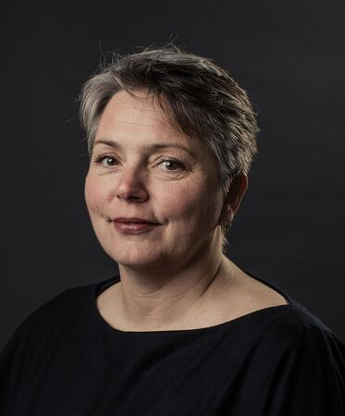
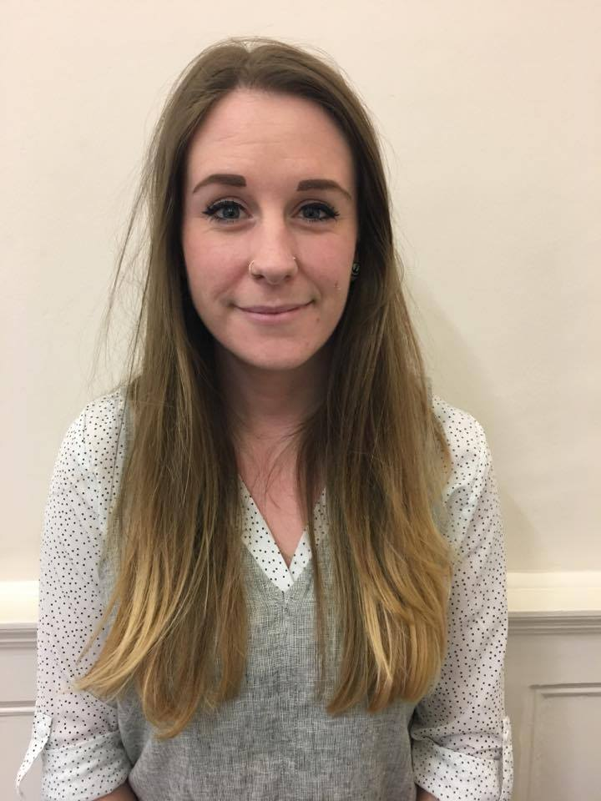

Hull 2017 Turner Prize Team
Sara Black
Project Manager
Lily Mellor
Assistant Producer
Learning
Marketing
Communications and Digital
Volunteering
Finance
Hull Culture and Leisure
Heritage Learning

Slide 4
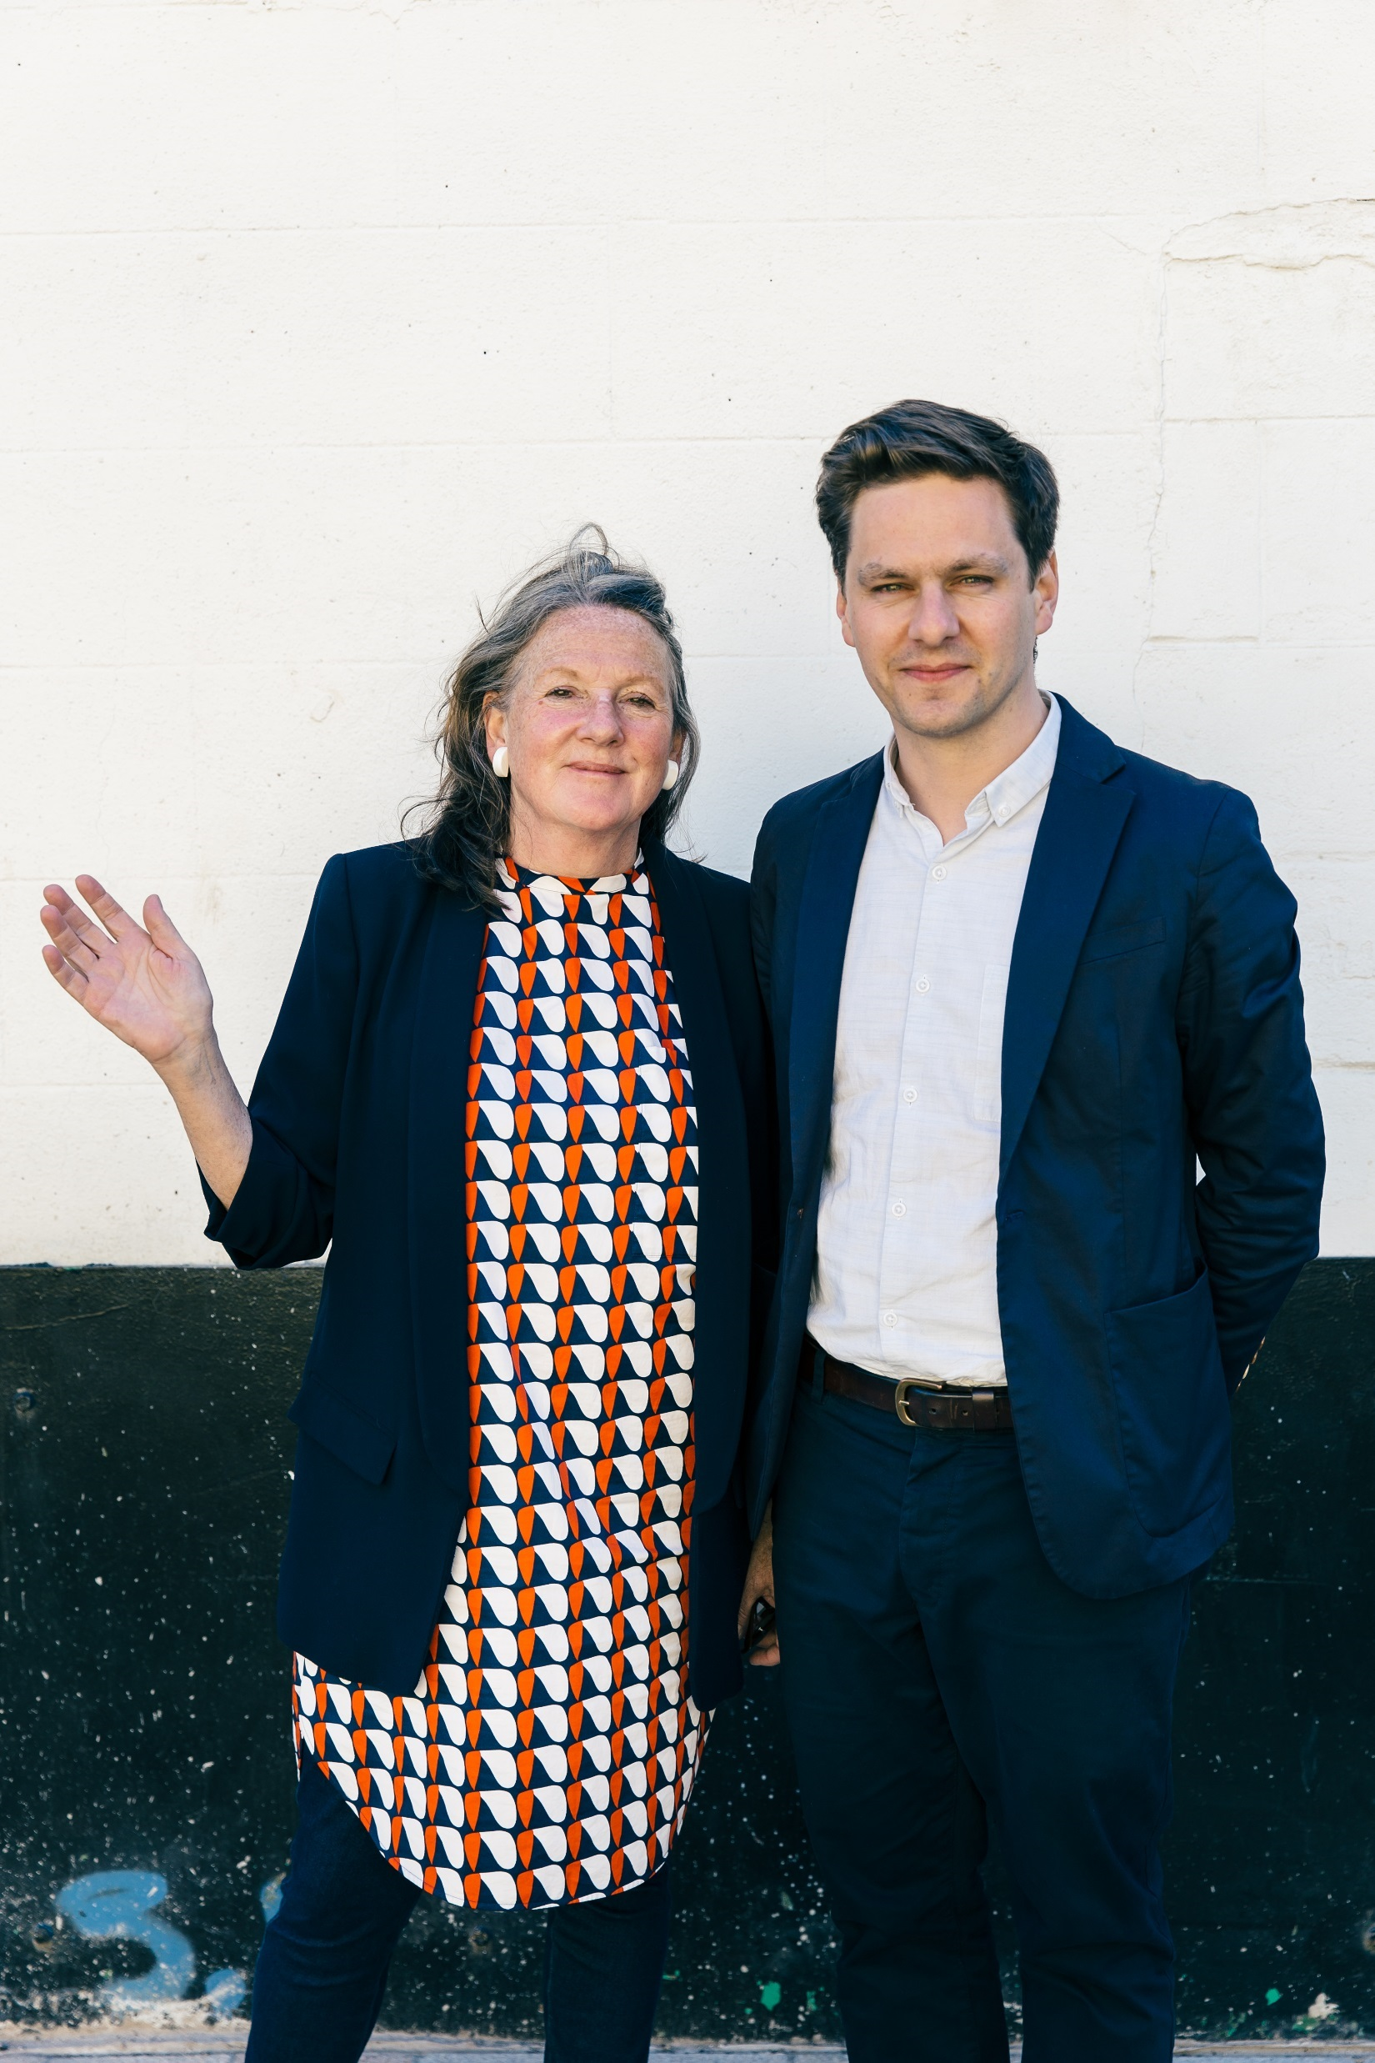
Turner Prize 2017 Curators
George Vasey and Sacha Craddock
We are responsible for making the exhibition and making sure it serves the interests of the artists, public and the Ferens Gallery itself.

Slide 5
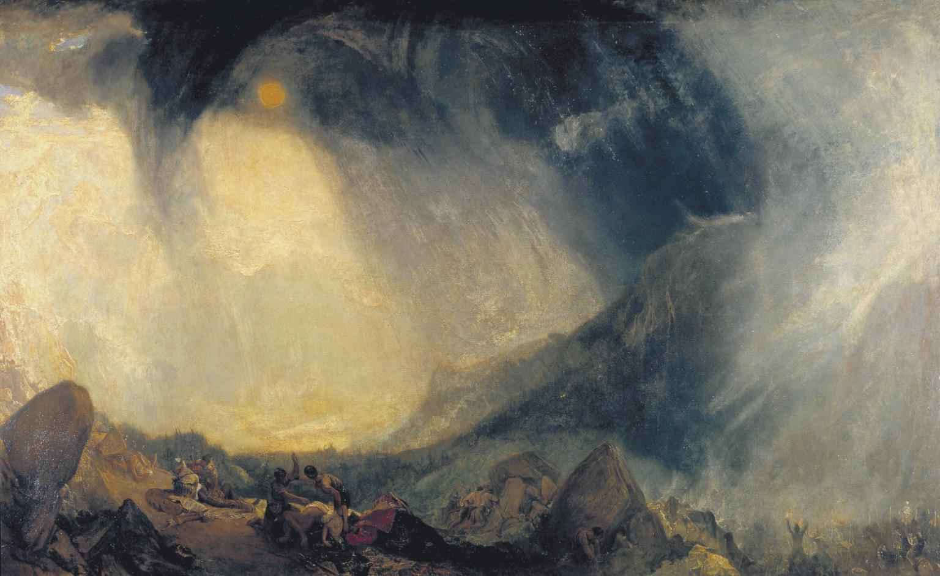
What is the Turner Prize?
An exhibition of work by four finalists, The Turner Prize has existed since it was started by the Tate during the 1980s
Named after JMW Turner, the nineteenth century artist who was seen as innovative and controversial in his own day, but went on to be seen as one of the greatest British artists
Taking place every year, it always used to be held at what was the Tate Gallery, now called Tate Britain
Since 2007, The Turner Prize is hosted in a city outside London every other year, including Liverpool, Gateshead, Glasgow, and Derry. It comes to Hull this year as a major component of Hull City of Culture 2017 celebrations
J.M.W Turner, Snow Storm: Hannibal and his Army Crossing the Alps (1812) Photo: Tate

Slide 6
What is the Turner Prize?
Awarded every year to an artist born, living or working in Britain
Based on an outstanding exhibition of their work anywhere in the world in the previous year
Four artists are shortlisted and produce an exhibition
An independent panel of judges choose the shortlist and the winner
The winner receives £25,000 and each runner up gets £5,000

Slide 7
MYTH: It matters most who wins.
False - The prize money is useful, but inclusion on the shortlist can be just as important for artists.
Here is a brief introduction to some of the past nominees…

Slide 8
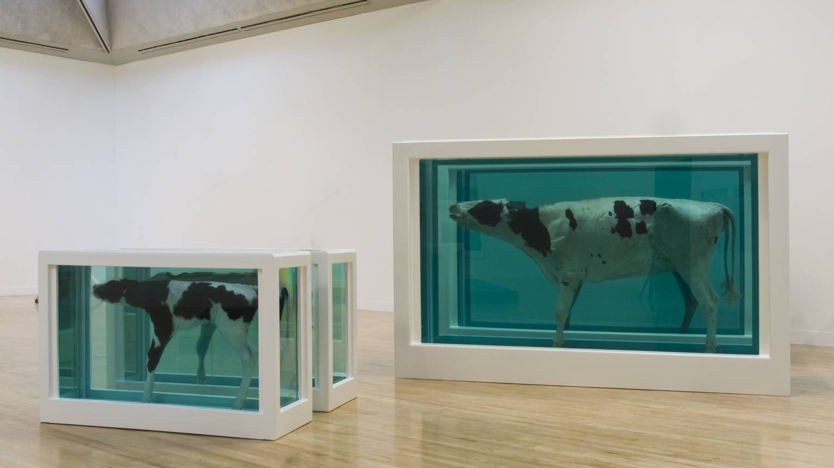
1995
Damien Hirst, Mother and Child (Divided) (1993) Photo courtesy Tate and the artist.

Slide 9
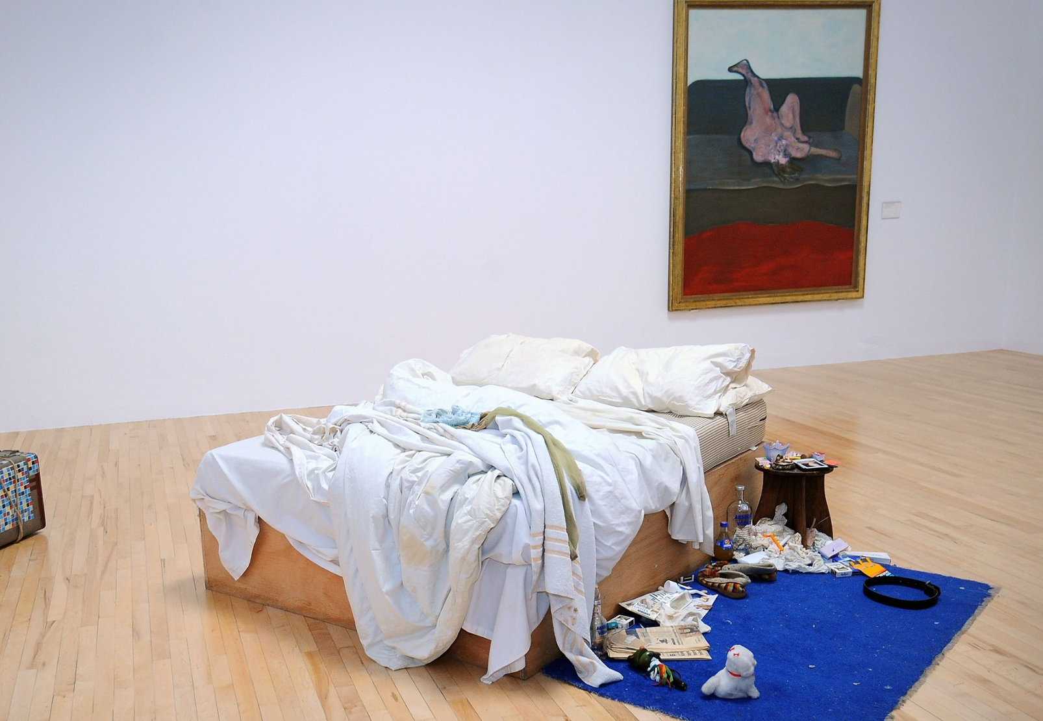
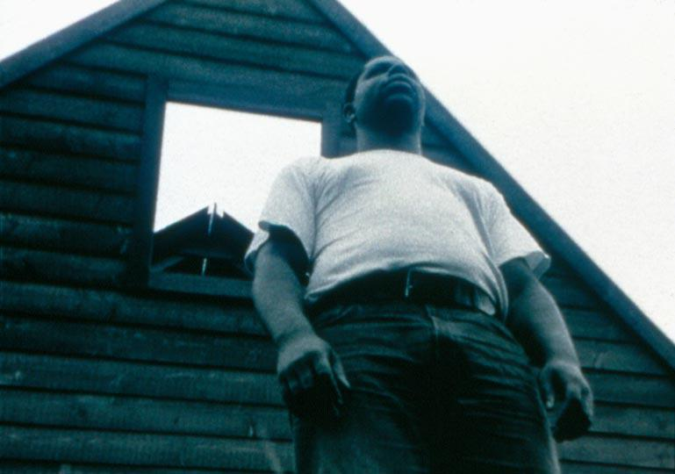
1999
Sacha was a selector this year!
Tracey Emin, My Bed (1998) Photo courtesy Tate and the artist.
Steve McQueen, Deadpan (1997) Photo courtesy thisistomorrow and the artist.

Slide 10
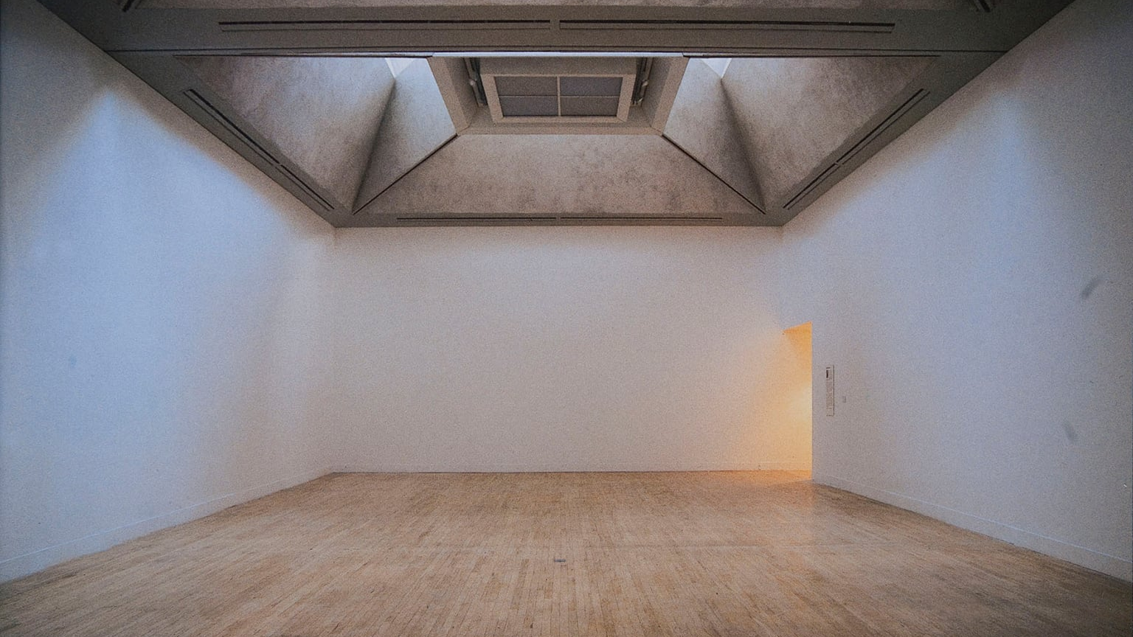
2001
Martin Creed, Work No. 227: The lights going on and off (2001) Photo courtesy Tate and the artist.

Slide 11
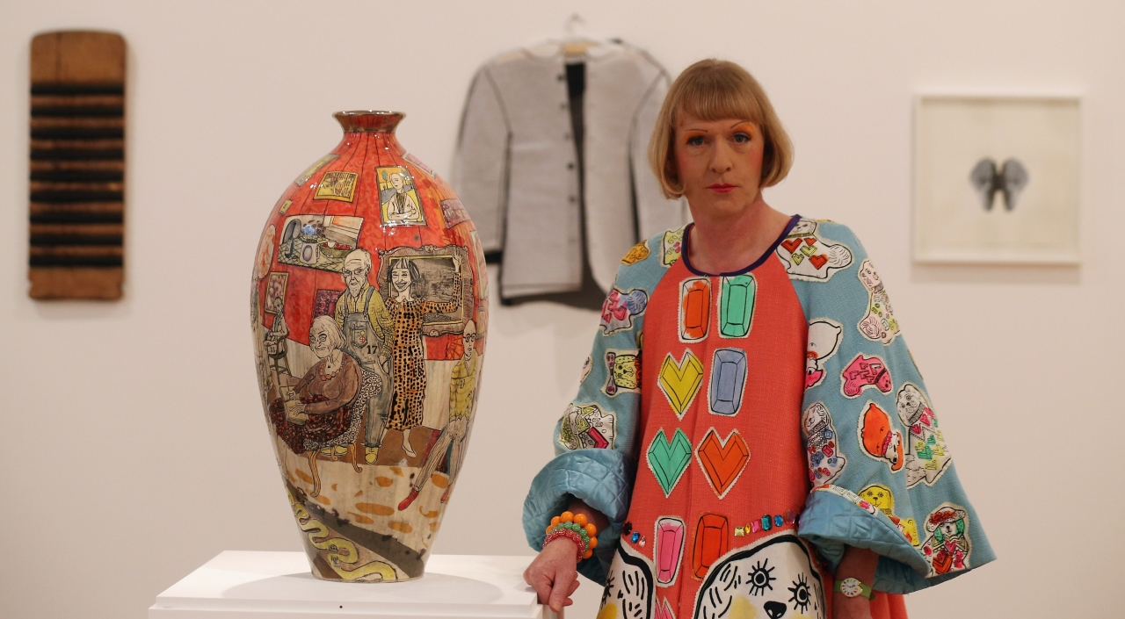
2003
Grayson Perry. Photo courtesy Tate and the artist.

Slide 12
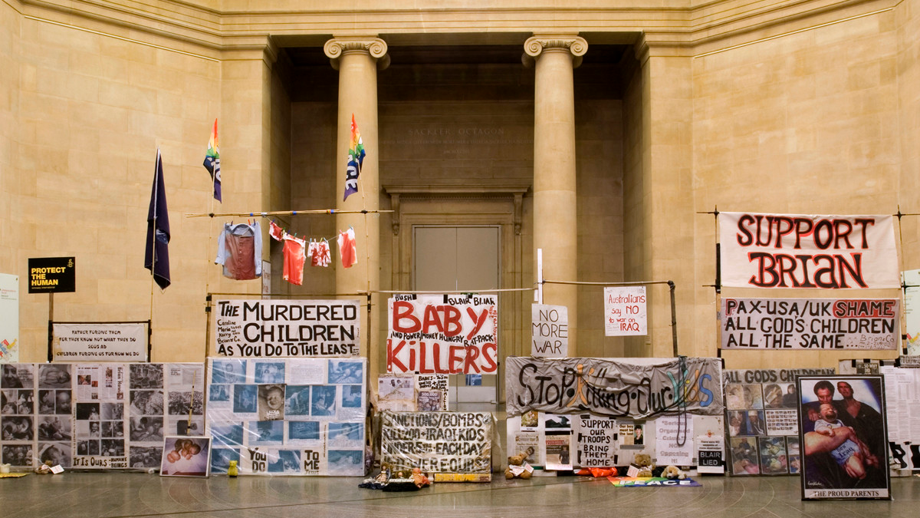
2007
Mark Wallinger, State Britain (2007) Photo courtesy Tate and the artist.

Slide 13
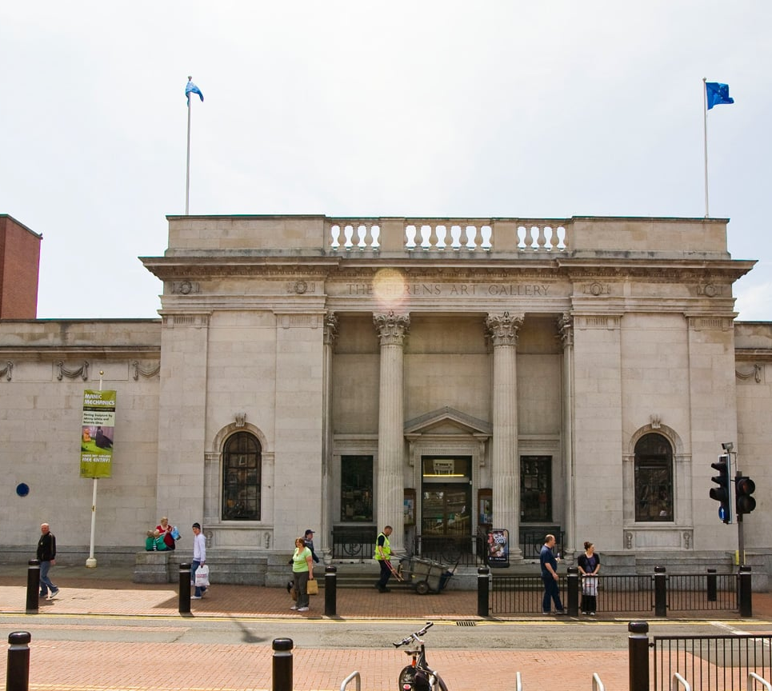
Turner Prize 2017
26 September 2017 – 7 January 2018
Ferens Art Gallery, Kingston upon Hull

Slide 14
MYTH: The Turner Prize has nothing to do with people outside London
False - Artists come from all over the country and the world.
Everywhere, in some way, is involved in discussing, teaching, making, exhibiting and influencing work surrounding the Prize.

Slide 15
This year’s Turner Prize is different because…
First time held actively within a gallery with a historical collection.
The familiar Ferens Art Gallery layout will be re-organised and re-configured to show work by the four artists alongside much loved paintings and sculpture from the permanent collection.
We aim to show the art work as if normal and ordinary, rather than separate and different to everything else around it.
No upper age limit

Slide 16
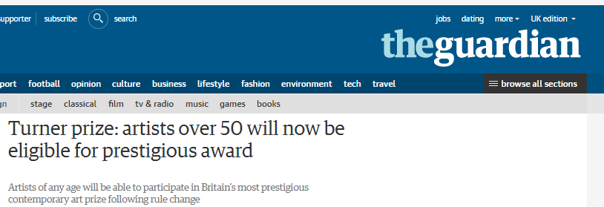
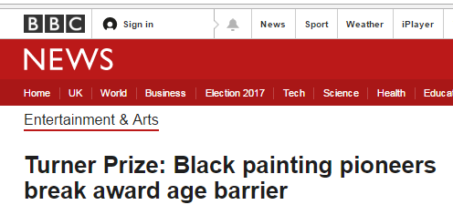
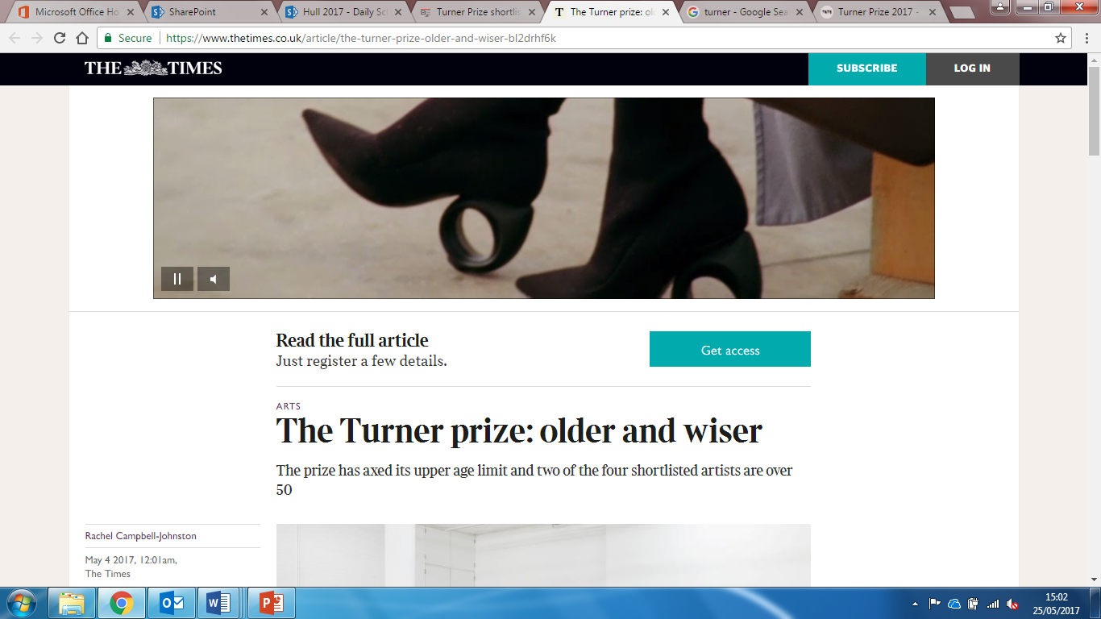
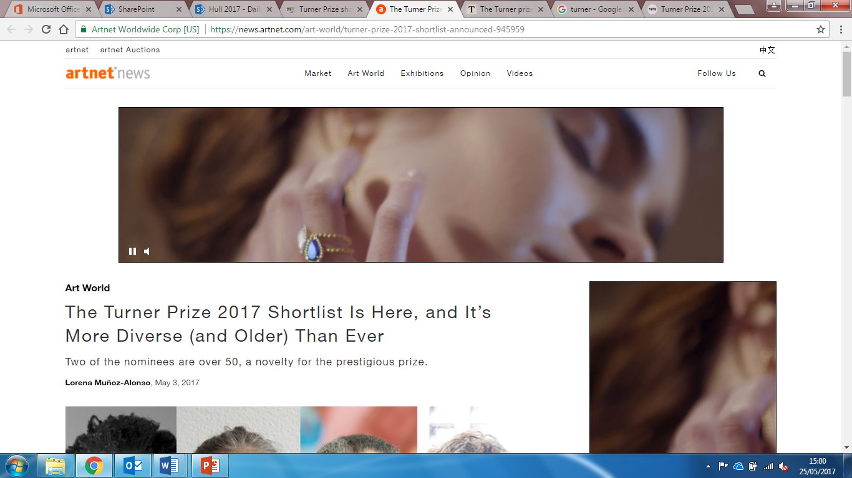
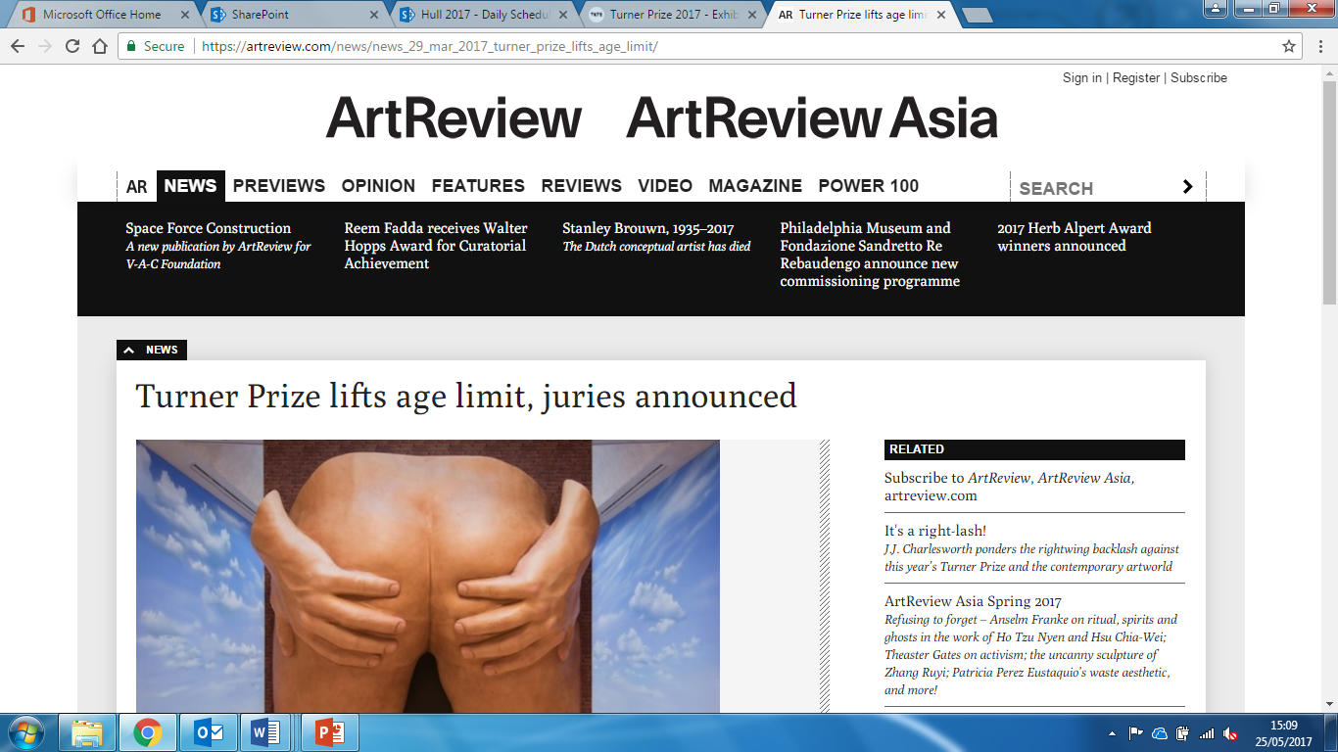
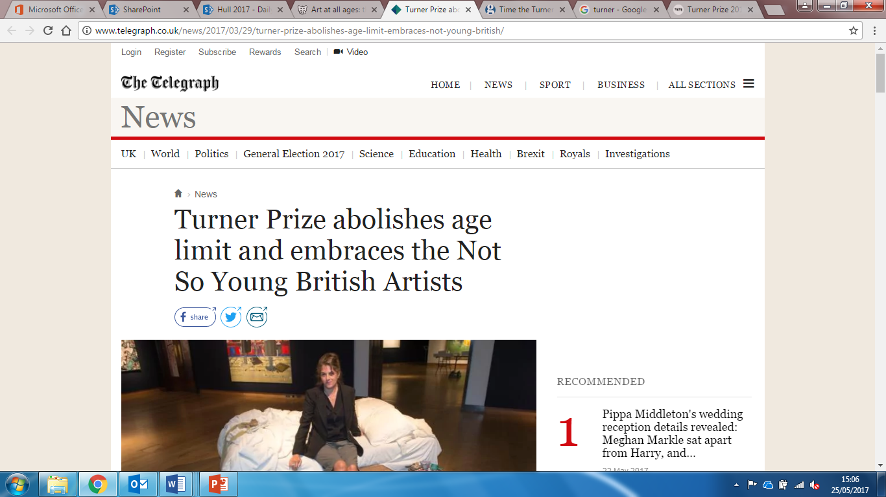

Slide 17
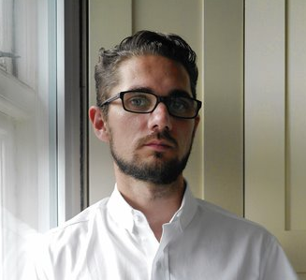
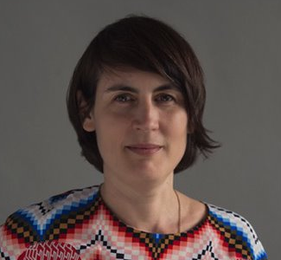
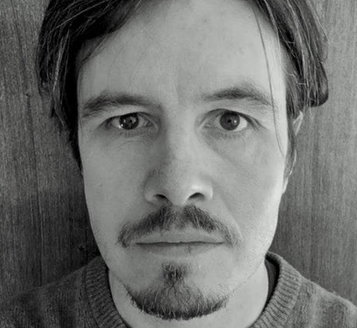
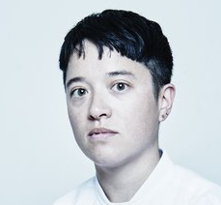
2017 Turner Prize Jury
Dan Fox
Co-Editor at Frieze
Emily Pethick
Director of Showroom, London
Martin Herbert
Art Critic
Mason Leaver-Yap
Walker Art Center’s Bentson Scholar of Moving Image in Minneapolis, and Associate Curator at KW Institute for Contemporary Art in Berlin

Slide 18
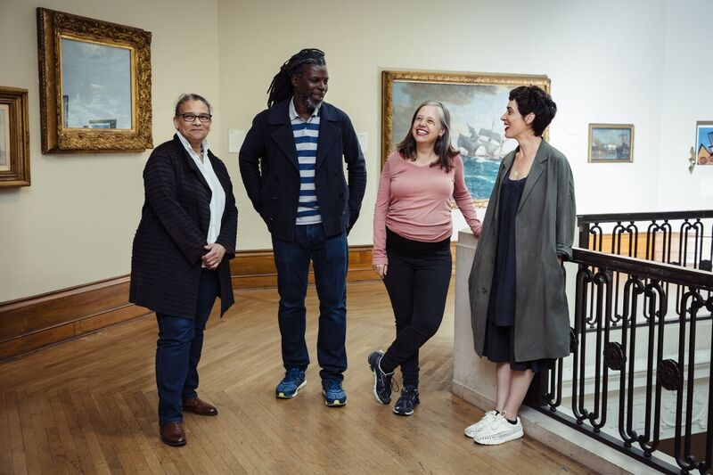
2017 Shortlisted Artists
(Left to Right) Lubaina Himid, Hurvin Anderson, Andrea Büttner, Rosalind Nashashibi. Image: James Mulkeen and Hull City of Culture 2017

Slide 19
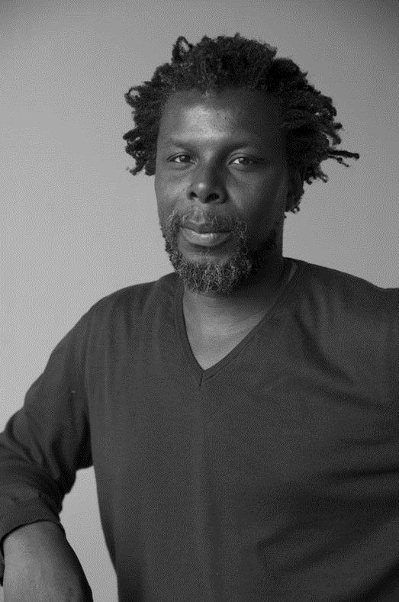
Hurvin Anderson
b.1965 in Birmingham, UK. Lives and works in London.
Nominated for;
Hurvin Anderson: Dub Versions at New Art Exchange in Nottingham
Hurvin Anderson: Backdrop at the Art Gallery of Ontario in Canada

Slide 20
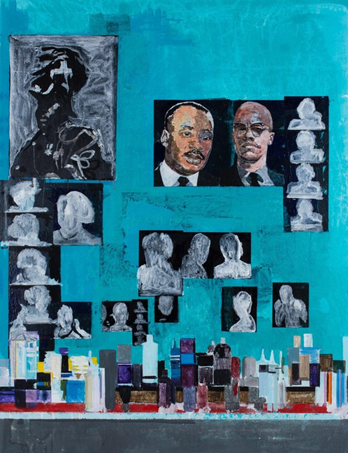
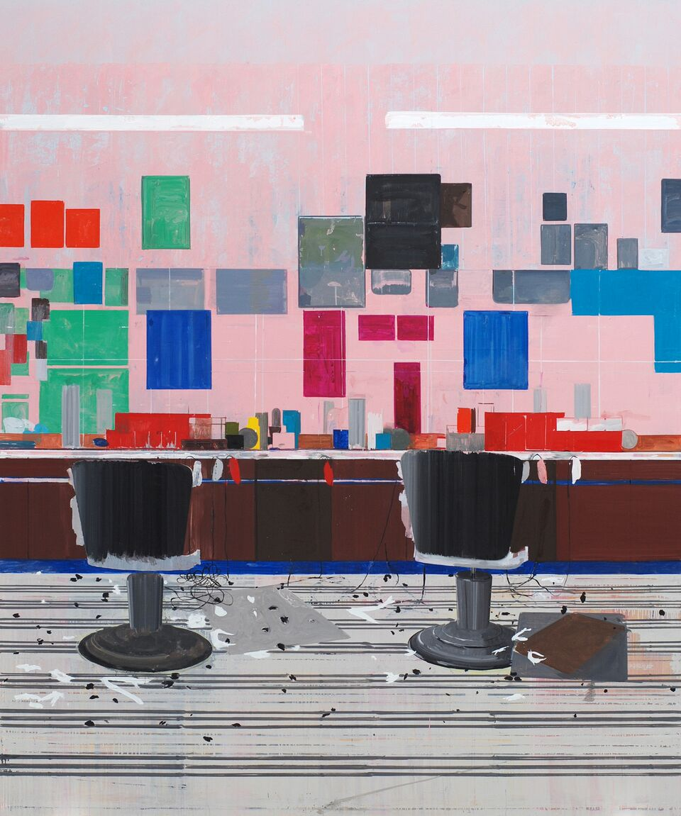
Hurvin Anderson, Is It OK To Be Black? (2016). Photo courtesy the artist.
Hurvin Anderson, Flat Top (2008). Photo courtesy the artist.

Slide 21
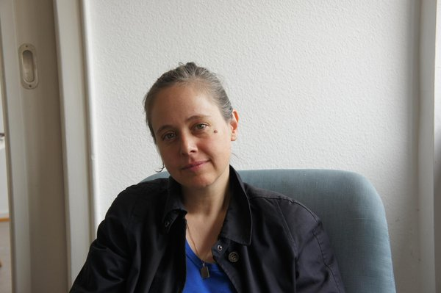
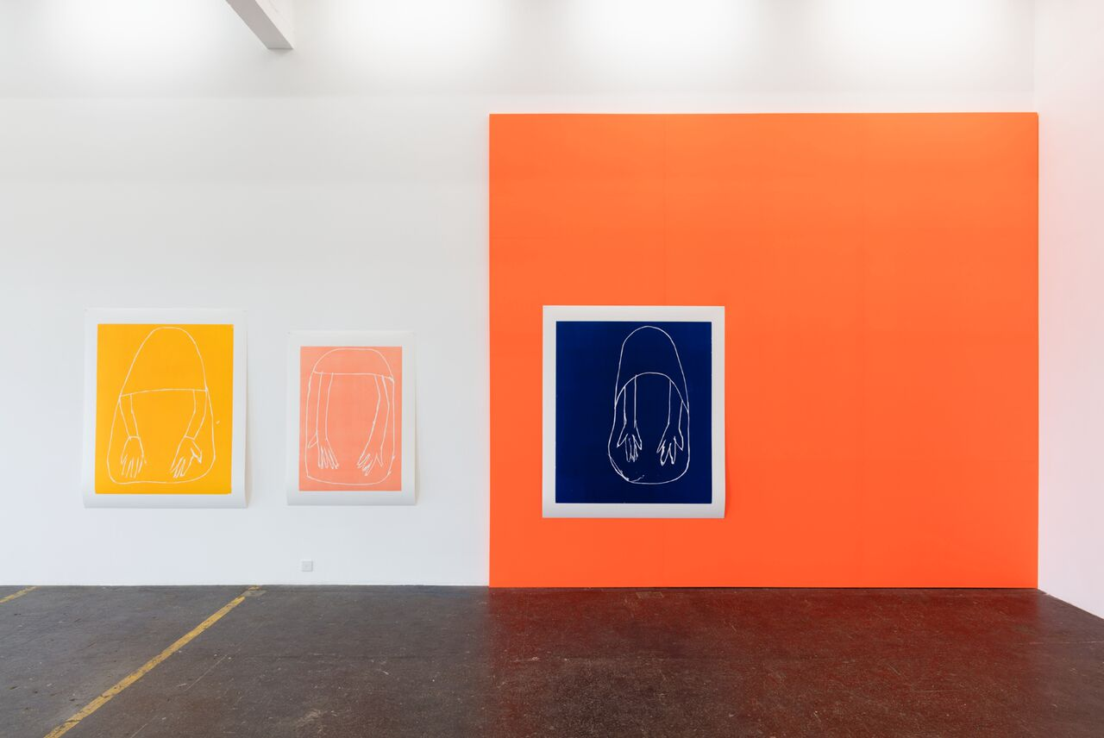
Andrea Büttner b.1972 in Stuttgart, Germany. Lives and works in London and Berlin.
Nominated for;
Andrea Büttner: Gesamtzusammenhang at Kunsthalle Sankt Gallen in Switzerland
Andrea Büttner at David Kordansky in Los Angeles
(L) Andrea Büttner. (R) Installation View of Andrea Büttner: Gesamtzusammenhang, Kunst Halle Sankt Gallen, Switzerland, 2017 Photo: Kunst Halle Sankt Gallen, Gunnar Meier

Slide 22
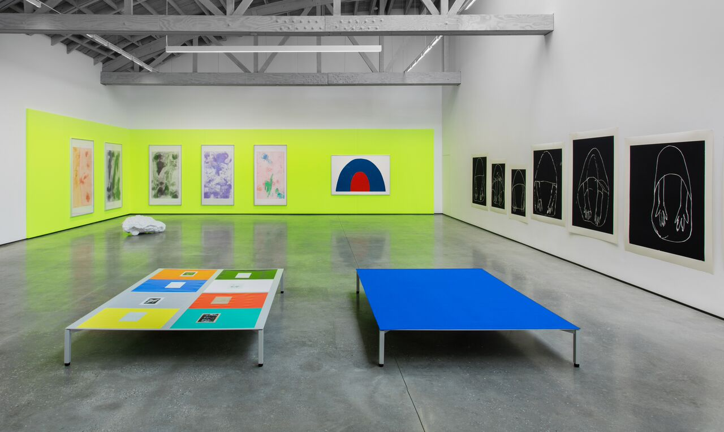
Installation View of Andrea Büttner, David Kordansky Gallery, Los Angeles 2016. Photo: Brian Forrest

Slide 23
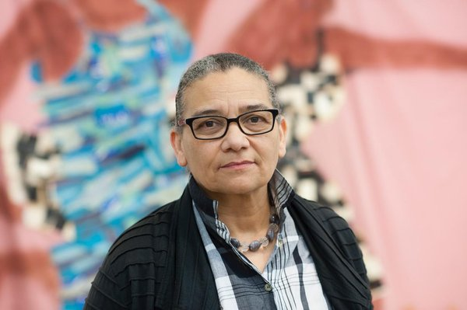
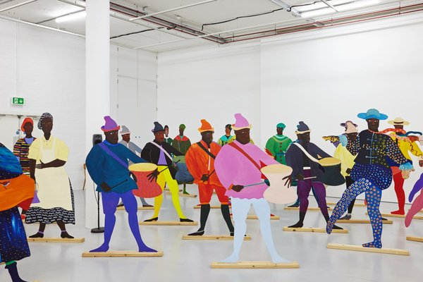
Lubaina Himid b.1954 in Zanzibar, Tanzania. Lives and works in Preston.
Nominated for;
Lubaina Himid: Invisible Strategies at Modern Art Oxford
Navigation Charts at Spike Island in Bristol
The Place is Here at Nottingham Contemporary (Group Show)
(L) Lubaina Himid 2017. Photo courtest the artist and Hollybush Gardens. Photo: Edmund Blok for Modern Art Oxford (R) Lubaina Himid, Naming The Money (2004). Courtesy the artist, Hollybush Gardens and National Museums Liverpool. Photo: Stuart Whipps

Slide 24
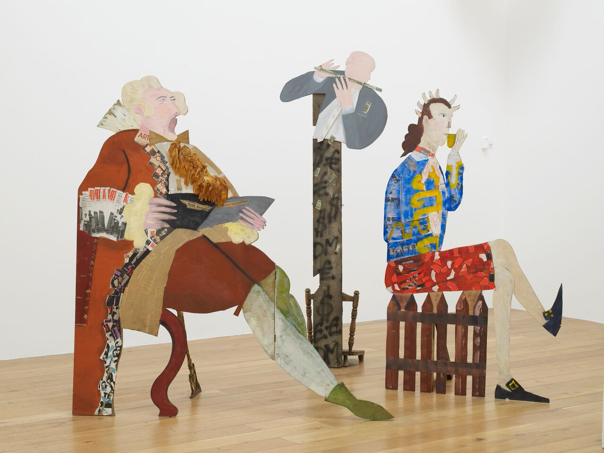
Lubaina Himid, A Fashionable Marriage (1986). Photo courtesy the artist and Hollybush Gardens. Photo: Andy Keate

Slide 25
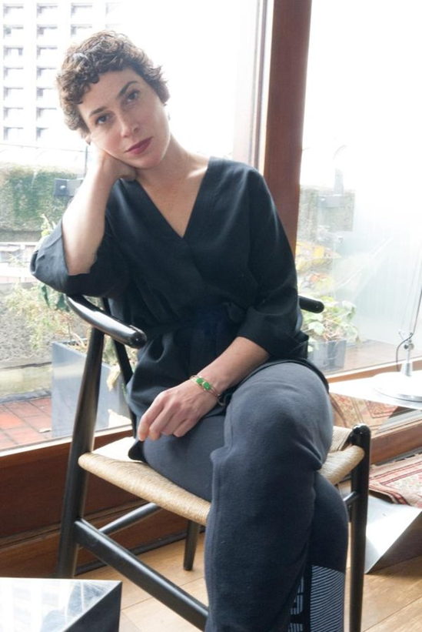
Rosalind Nashashibi
b.1973 in Croydon, London. Lives and works in London.
Nominated for;
On This Island at The University Art Galleries at UC Irvine’s Claire Trevor School of the Arts in California
Her participation in Documenta 14

Slide 26
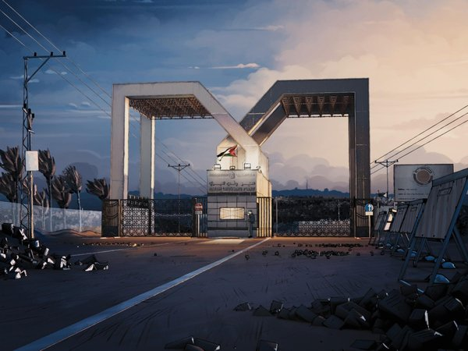
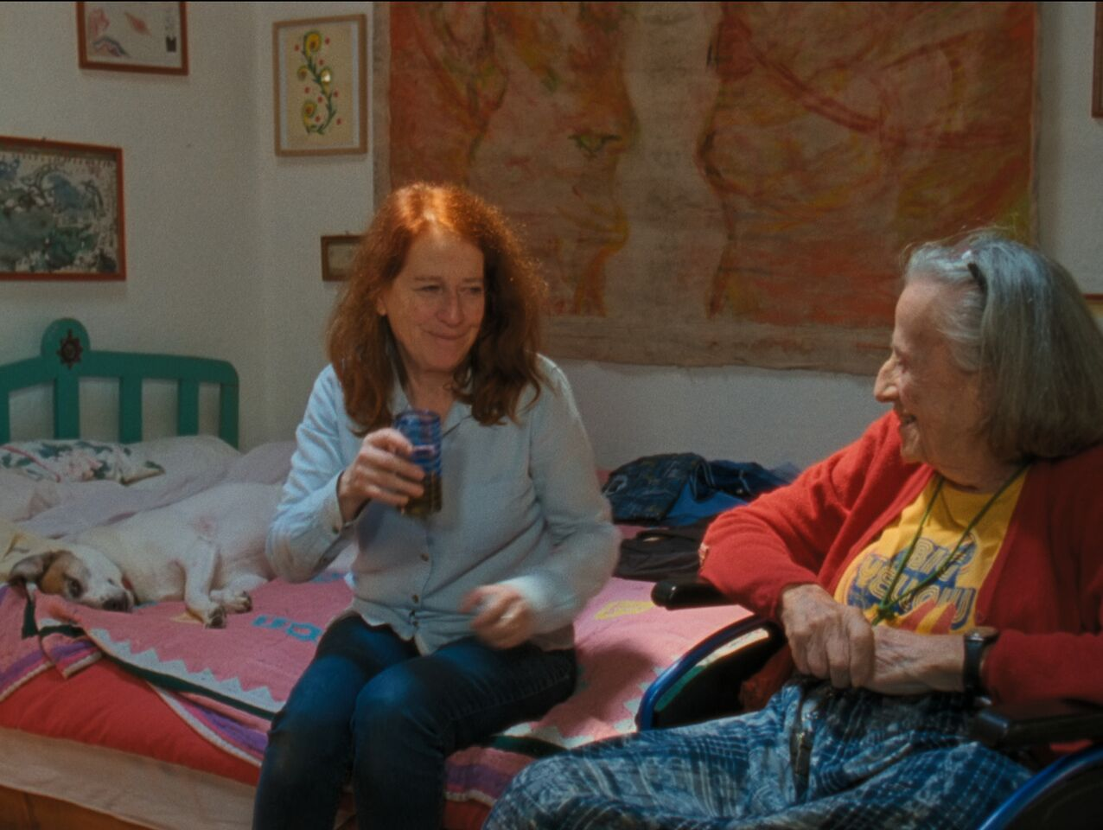
Rosalind Nashashibi, Electrical Gaza (2015). Courtesy the artist.
Rosalind Nashashibi, Vivian’s Garden (2017). Courtesy the artist.

Slide 27
What is the Turner Prize for?
From the beginning it was there to encourage discussion and involvement in contemporary art
The role and position of contemporary art has changed over three decades and is now much more discussed and familiar than it used to be
The press has played a good and bad part in this

Slide 28
Our Public Learning Programme
We have an extensive programme of different opportunities for learning for all ages (from babies to the elderly) and all abilities.
We want to reach as many people from different backgrounds and interests as possible and get them talking about and learning from the Turner Prize!
These opportunities include;
Hands-on workshops and masterclasses
Online Education resources with information, tasks and games
A conference
A magazine that goes to 22,500 children in Hull and 7,500 in East Riding
Tuner Prize themed ‘Explore Art’ space in Ferens
A range of accessible, bespoke and language tours
…and much more!

Slide 29
How you can get involved…
Do further research online (there are some links on your handouts!)
Ask questions and talk to others about it
Spend time with the work once the exhibition is open
Be part of the discussion - we all have something to say.
We want to help people to understand, enjoy and be inspired by contemporary art.

Slide 30
How you can get involved…
There will be many exciting opportunities for you to get involved, learn and have fun; from spreading the word, being the face of the Turner Prize and helping behind-the-scenes…
We are still working out how many Volunteers we will need on a day to day basis to help with the Turner Prize. Volunteer shifts will be released in the usual way and all Turner Prize Volunteers will receive Ferens training.
We will then hold 2x compulsory training sessions for Volunteers. These will focus specifically on this year’s Turner Prize.

Slide 31
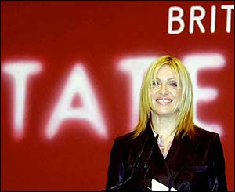
Important Dates
TBC: Intensive training sessions for Turner Prize Volunteers at Ferens
25 September 2017: Press preview of the Turner Prize 2017 and VIP opening party at Ferens
26 September 2017: Turner Prize 2017 opens to the public
5 December 2017: Awards ceremony, presented by a celebrity host and covered by the BBC
Madonna presenting the Turner Prize in 2001. Image Courtesy BBC

Slide 32
THANK YOU for coming!
Any questions?

